Slide 1
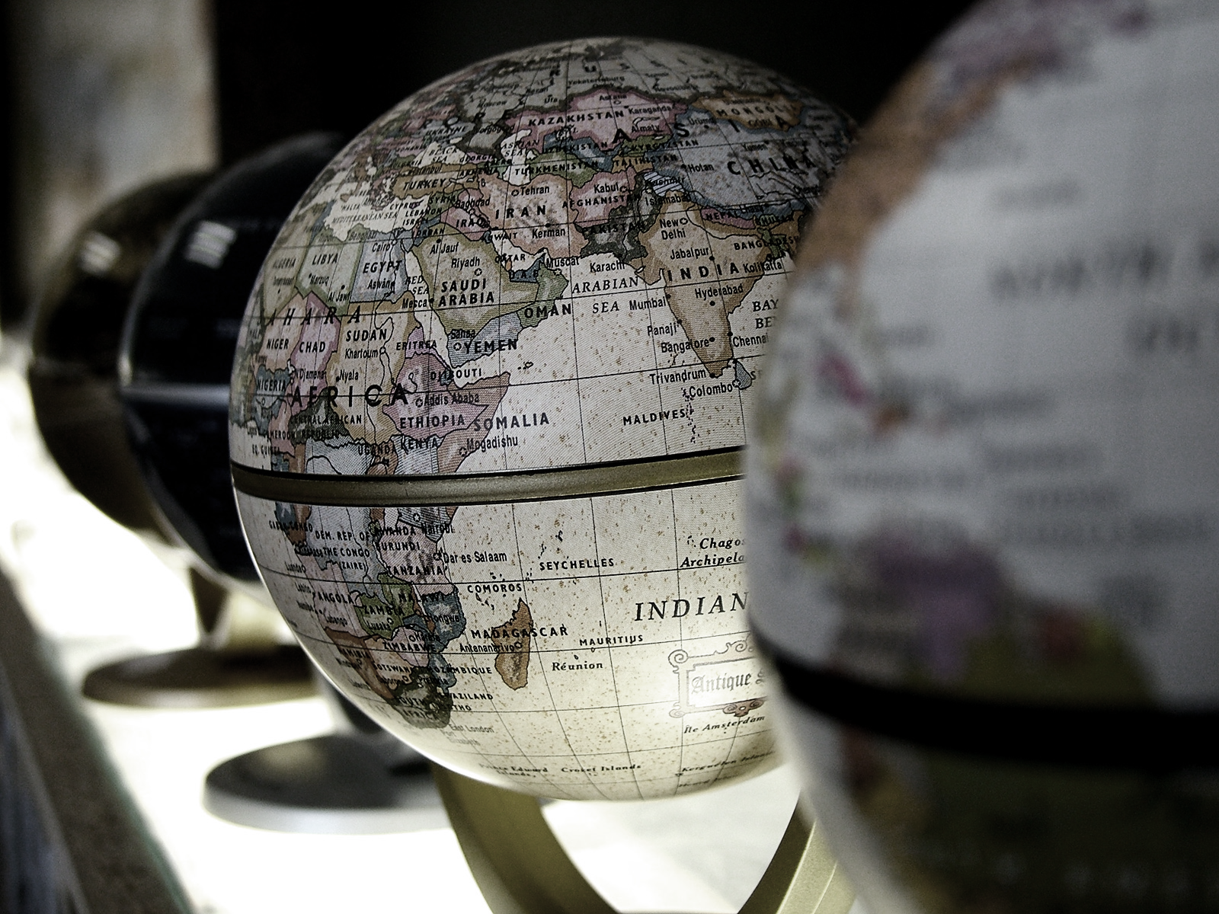
Political Geography
Asst. Prof. Merve ALTUNDAL ÖNCÜ

Slide 2
Criteria for Boundaries
1. Ethnic:
Some political geographers have felt that ethnic criteria may be the most appropriate for the definition of international boundaries.
In other words, boundaries should be drawn so as to separate peoples who are culturally uniform so that a minimum of stress will be placed on them.
The nation state aims to establish boundaries that include, within the territory of each, all people of corresponding nation, and, conversely, to exclude all others.
E.g. the states of India, Pakistan and Burma were established on the bases that may loosely be called “ethnic”.
Rather than risk losing valuable industrial and other resources through a change of boundary, governments have expelled the minority people from their territory.

Slide 3
2. Language:
It might also be proposed as a basis for boundary definition.
But the map of the world’s languages shows a patchwork of great complexity that would immeasurably compound the boundary framework existing today.
Many states are multilingual and would be fragmented in such effort. In this case then a boundary will inevitably be a barrier between adjacent states.
If a boundary separates peoples who speak different languages, they are not likely to understand each other well, with the result that relations may remain hostile across their international boundary.
On the other hand, a boundary running through a region of linguistic homogeneity would ensure that people on either side would at least have a language in common, and as a result could communicate more easily.
This common language across the border would then act as a bond between the two states involved.

Slide 4
3. Religion:
Like language, it is important component of ethnicity an even nationhood.
Peoples of widely varied races and tongues have accepted the same faith, and peoples speaking the same language have adopted different religions.
Nevertheless, in areas where religion has been a strong source of internal friction, it has been a major basis for boundary definition.
A good example is the partition of the Indian subcontinent into (mainly Hindu) India and (mainly Muslim) Pakistan.
The latter, as a result, became a fragmented state and has demonstrated the weakness of religion as a centripetal force.

Slide 5
4. Physical features:
Many political boundaries of the world lie along prominent physical features in the landscape.
Such boundaries have become known as “physiographic political boundaries,” a term not to be confused with the physiographic boundary used in physical geography.
In political geography a physiographic boundary refers to any prominent physical feature paralleled by a political boundary: a river, mountain range, or escarpment.
These would seem to be especially acceptable criteria, since pronounced physical features often also separate culturally different areas.

