Slide 1
iPS Cells
Applications

Slide 2
What do iPS cells offer?
iPS Cells
Somatic Cells
Patient
Neurons
Cardiomyocytes
Hepatocytes
Regenerative medicine
Disease modelling
Drug-screening

Slide 3
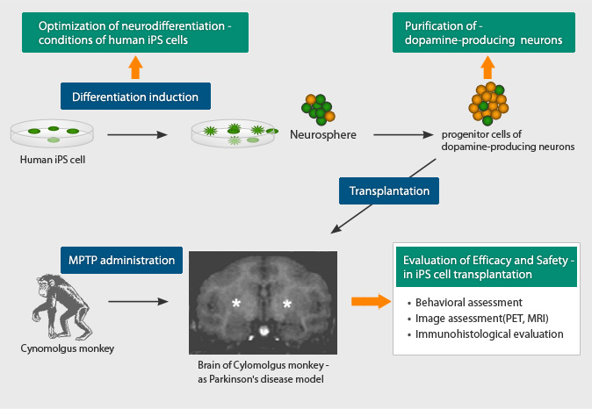
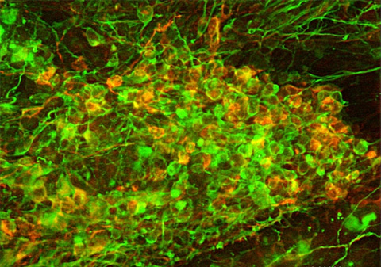
An example from regenerative medicine…
Dopaminergic neurons from hiPSCs
Dr. Jun Takahashi (CiRA): Using Dopaminergic neurons differentiatedfrom hiPSCs for the treatment of Parkinson’s disese.
Primate models
Expected clinical traisl
www. .cira.kyoto-u.ac.jp/e/research/takahashi_summary.html

Slide 4
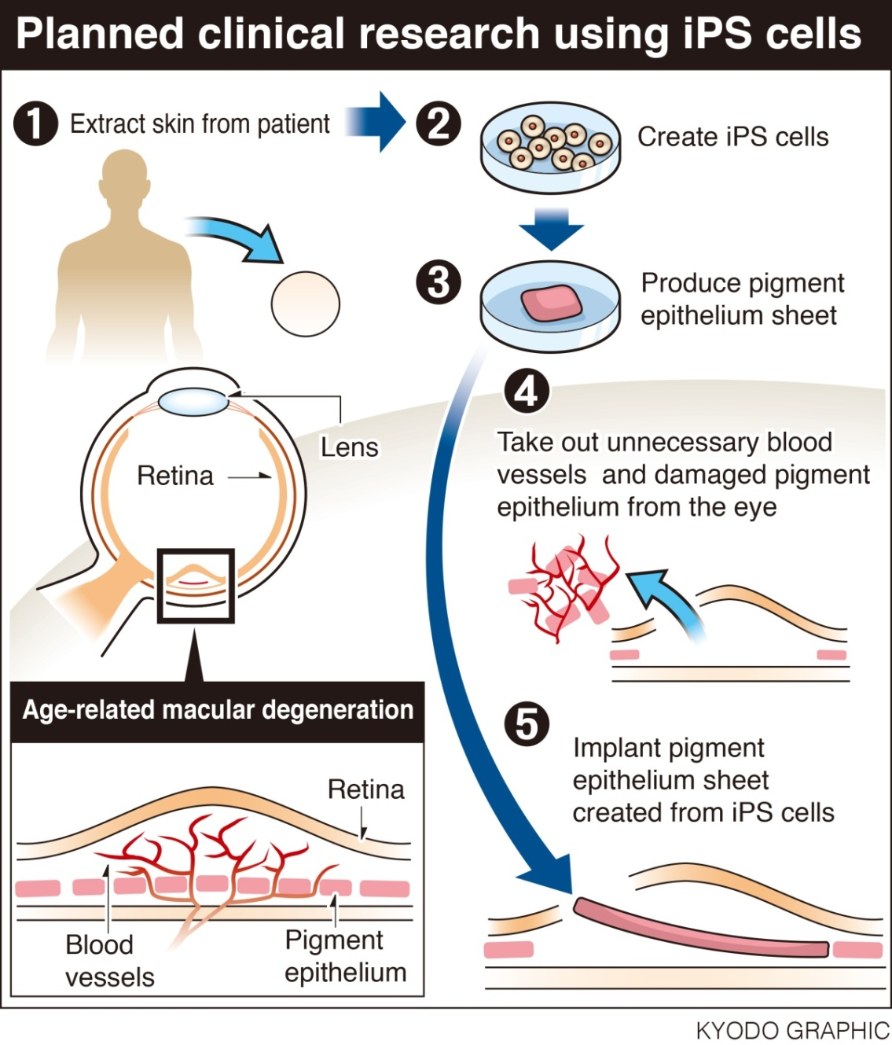
An example from the clinical applciation…
Dr. Masayo Takahashi
(RIKEN Institute, Japon)
First clinical trial in 2013
Treating age-related macular degeneration with retinal pigment cells derived from autologous iPS cells
Trial suspended in 2015 – (genomic instability problems)
Second trial started in 2017
5 patient received treatment
1 Adverse event reported in Jan. 2018 (retinal edema, could be due to the cells or injection protocol)
http://www.japantimes.co.jp/

Slide 5
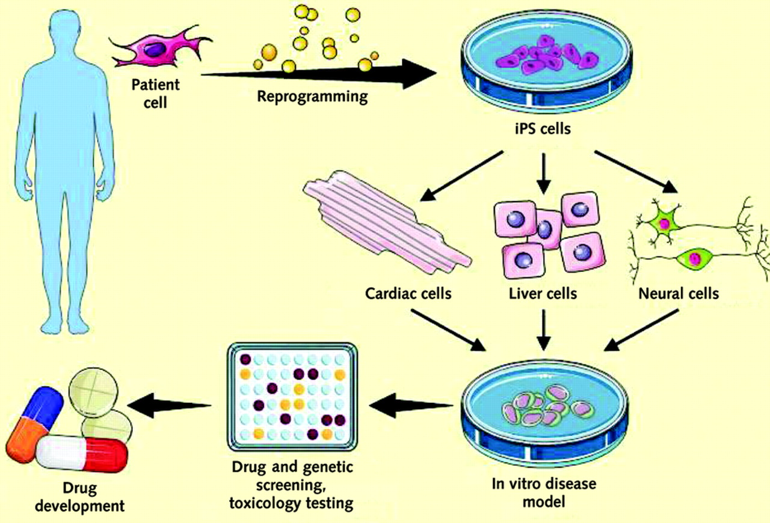
Disease modelling and drug screening
Patient somatic cells

Slide 6
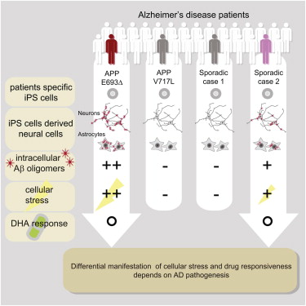
An example for disease modelling and drug screening
Alzheimer Hastalığı: amyloid plaques (Aβ oligomers) induces stress on neural cells
docosahexaenoic acid (DHA) therapy shows various outcomes
Kondo et al., Cell Stem Cell, 2013.
Notes:
Hücresel stres ve ilaca verdikleri cevap hastalığın patojenitesine göre değişiklik gösterdi
Farklı hastalardan dermal fibroblastları
Epizomal vektörler
Astrosit: Merkezî sinir sisteminde bulunan, sinir hücrelerinin, oligodendrositlerin ve damarların çevresinde yerleşen, kan ve sinir hücreleri arasında su ve mineral madde alışverişini sağlayan, ektodermal kökenli bir çeşit nörogliya hücresi, astrogliya.
Alzheimer’s disease. Alzheimer’s disease (AD) is charac- terized by the degeneration of cortical neurons and the presence of amyloid plaques, which are primarily com- posed of Aβ
amyloid beta Reaktif oksijen türlerinin oluşumuna neden olduğu için hücresel stressin oluşmasına neden olur.

Slide 7
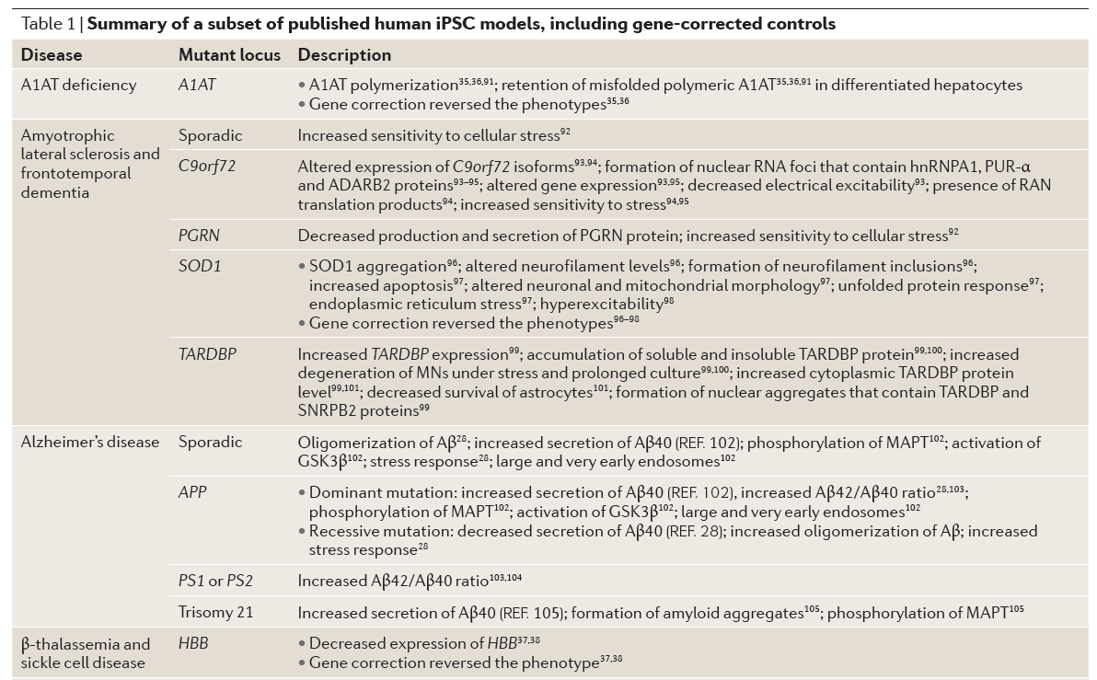
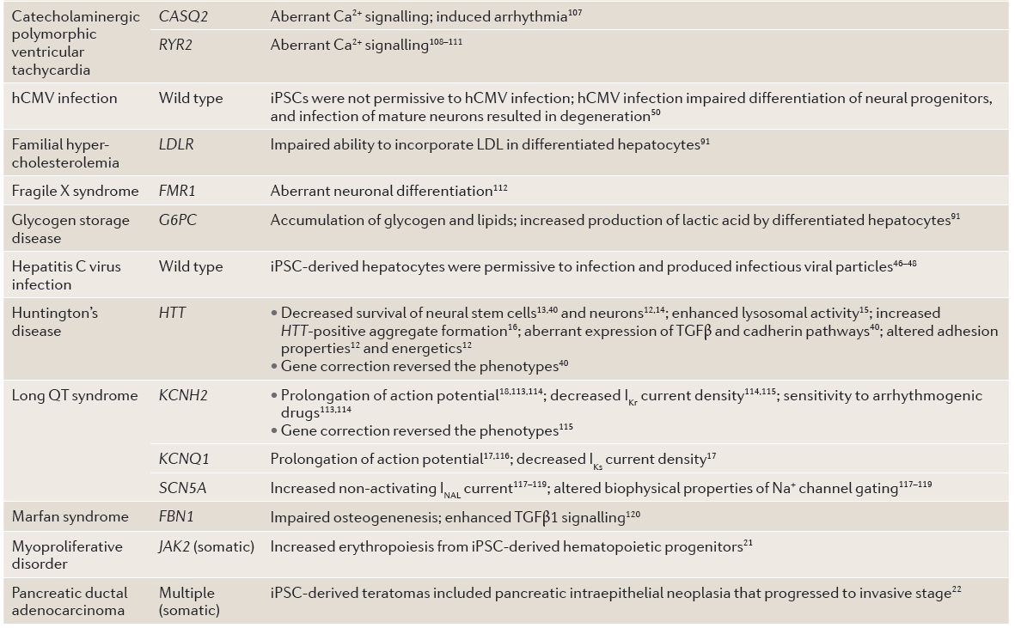
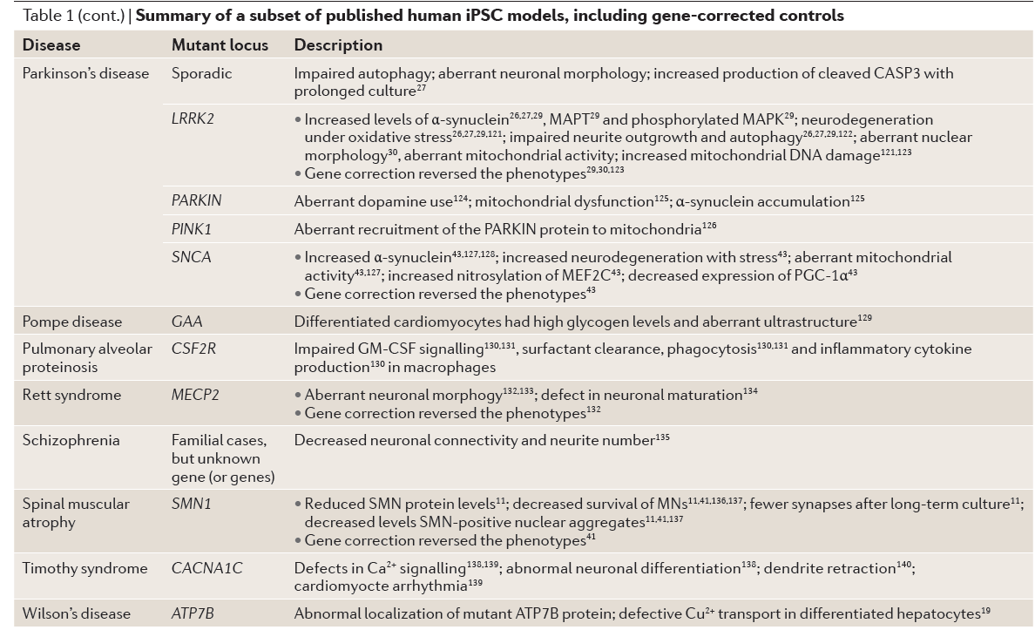
Sterneckert et al, 2014 ,NATURE REVIEWS | GENETICS

Slide 8
Treatment of Sickle Cell Anemia Mouse Model with iPSCs Generated from Autologous Skin
Notes:
The team then engineered the induced pluripotent stem cells to become healthy blood-producing cells, by replacing the defective globin gene with a normal copy. The stem cells were then transplanted back into three genetically identical sick mice, which had been irradiated to destroy their faulty blood-producing cells.
Twelve weeks after the procedure, mice treated with the engineered stem cells had more normal blood, including higher red-blood-cell counts and hemoglobin content, than untreated sickle-cell mice.

Slide 9
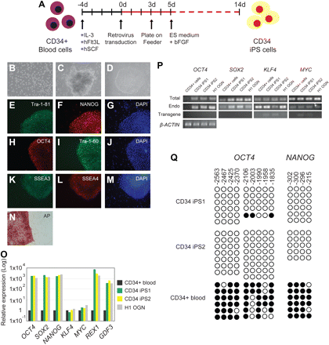
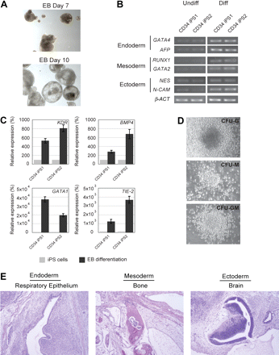
Generation of iPSCs from Human Blood
Loh, et al., Blood 2009

Slide 10
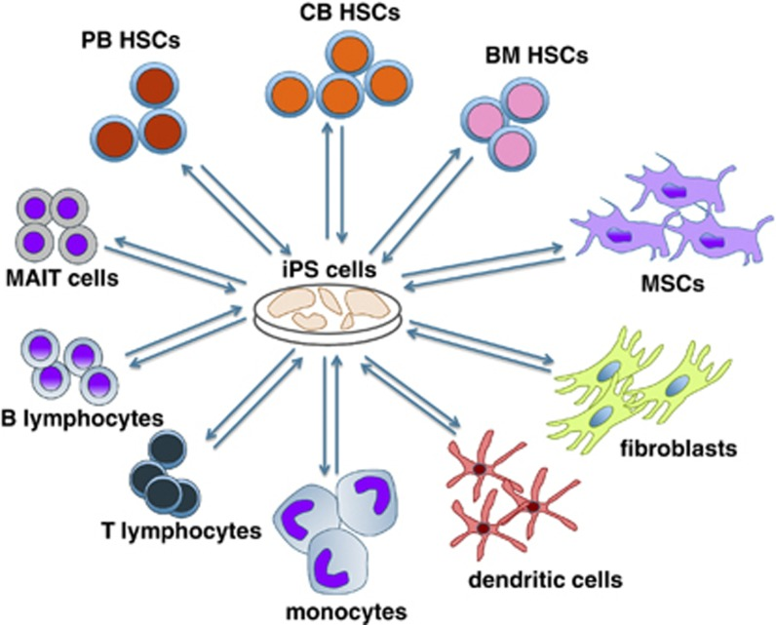
iPS Cells ⬄ Blood Cells
Focosi et al., 2014 Blood Cancer J.

Slide 11
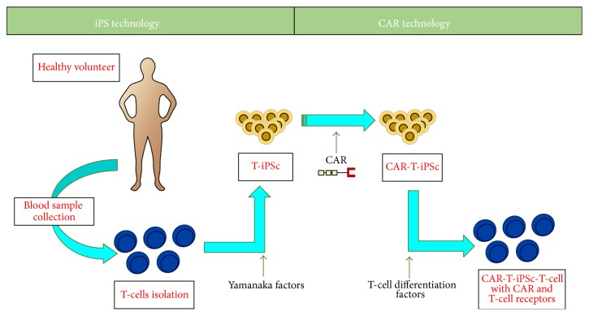
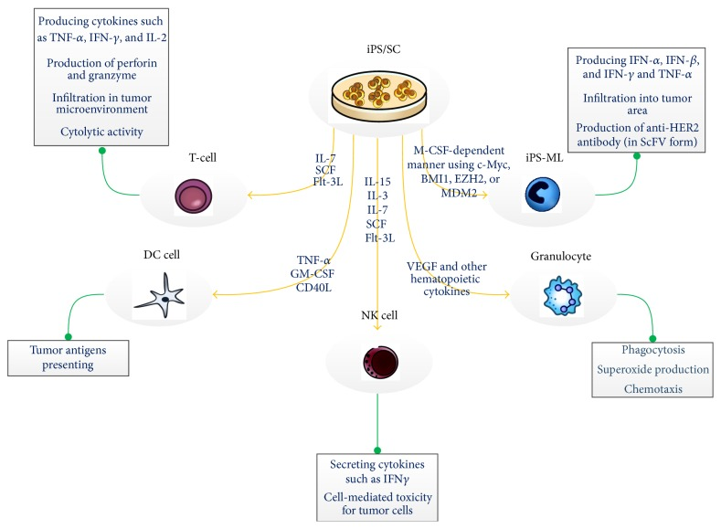
iPS Cells ⬄ Immunotherapy
Notes:
Cost and risk (insertional mutagenesis)

Slide 12
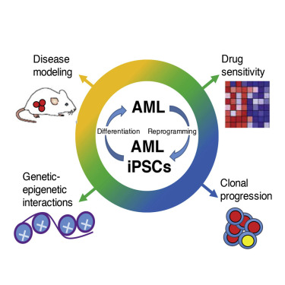
Modelling AML with iPSCs
AML-iPSCs can be generated!
Reprogramming resets epigenetic status but retains cytogenetic and mutational abnormalities.
Leukemic behavior and methylation are reacquired upon hematopoietic differentiation
AML iPSCs enable investigation of genetic subclones and clonal relapse patterns
Chao, et al., 2017 Cell Stem Cell
Notes:
leukemic blasts are reprogrammed

Slide 14
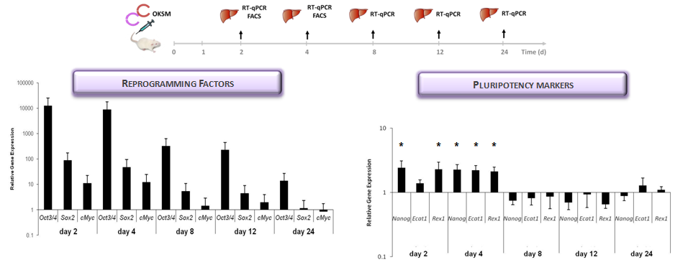
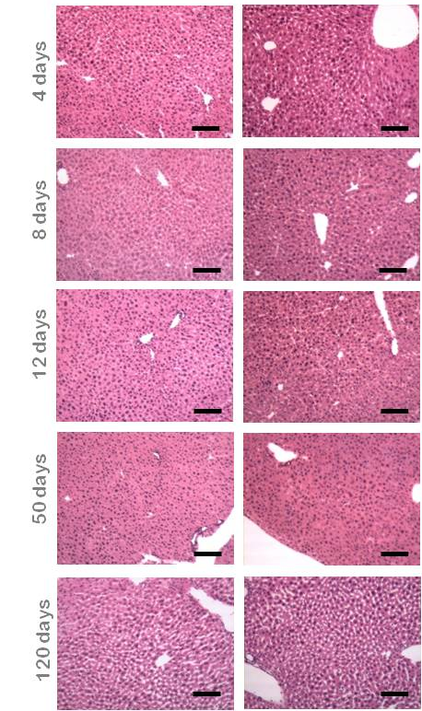
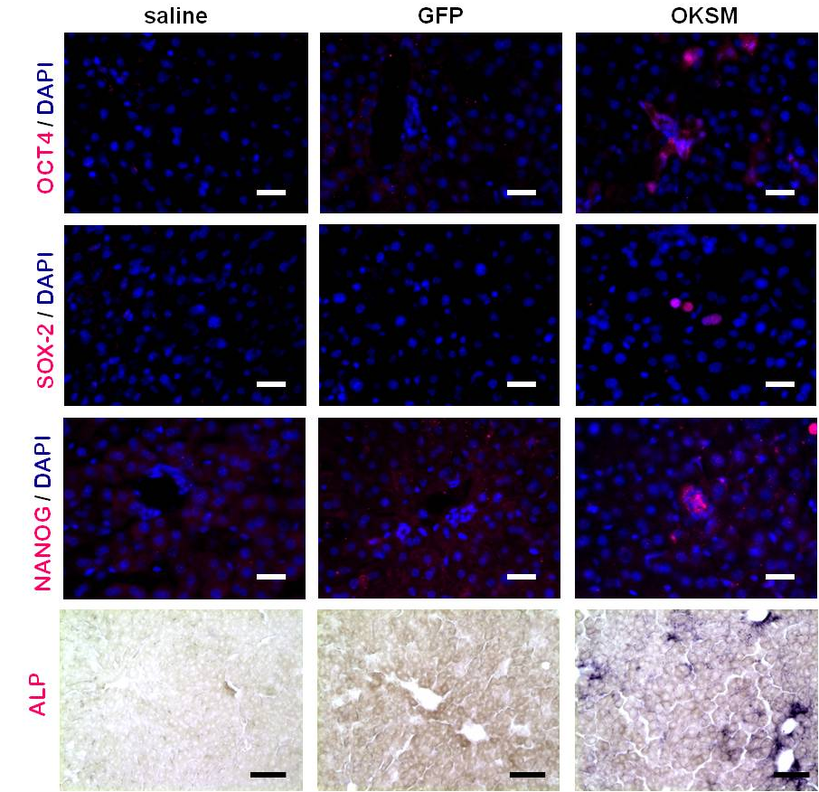
Project from my lab: In Vivo Cell Reprogramming
Yilmazer et al, PLoS One, 2013.
Yilmazer et al, JoVE, 2013
de Lazaro et al. Biomaterials 2014
de Lazaro, Yilmazer et al. Nature Biotech. Submitted.

Slide 15
