Slide 1
Inspiration from Birds
https://www.aerotime.aero/24830-top-5-airbus-plane-designs-inspired-by-animals
Dr. Arzu GÜRSOY ERGEN
6

Slide 2
Designs Inspired by Birds
Jet engine evolution inspired by the Peregrine Falcon
Shielding airplane black boxes,
The Woodpecker Electrical Hammer
American football players helmet
A better ice axes for mountain climbers designed after the woodpecker.
The Bullet Train in Japan
Swimming Fins

Slide 3
Is it a bird? Is it a plane? Biomimicry in airplanes

Slide 4
Is it a bird? Is it a plane? Biomimicry in airplanes
Airplanes eradicated the problem of accessibility and made it faster and more convenient to do business.
Birds fly so effortlessly because of the adaptations that they have.
Birds have streamlined shapes so that when they are in flight the air can flow on their surface smoothly.
Engineers used the shape of the birds as inspiration to model the planes.

Slide 5
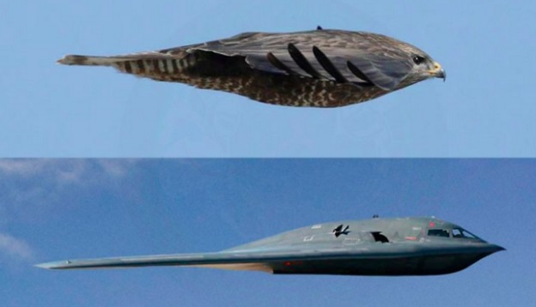
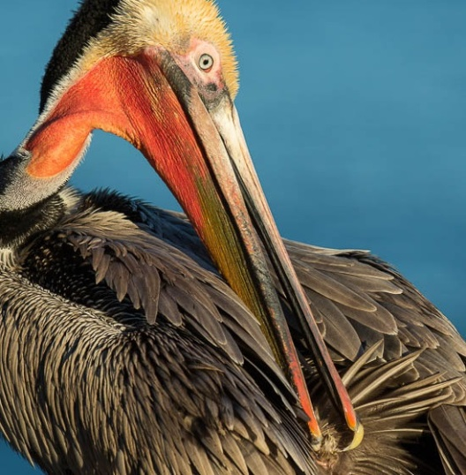
Is it a bird? Is it a plane? Biomimicry in airplanes
Engineers;
Teardrops = streamlined shape
Wings= Wings
Tail=Tail
Feet= Landing gear
Fast metabolism= Aircraft fuels
Strong flying muscles=Strong engines
Feathers= Aerodinamik vücut şekilleri nedeniyle sürtünmeyi azaltırlar.
Preen on feathers= Polished paints
Preen on feathers = Applying oil to mechanical parts
Concave wings= Flap
Weight-reducing adaptations

Slide 6
The concept of biomimicry has inspired the airplane wings.
When birds want to take off, they raise their wings thereby creating a low pressure, and the body goes up through the process of ‘lift’.
Airplanes use the same notion while taking off and landing.
The scientists mimic the movements of the birds while modeling the wings.
Airplane wings have taken the same shape as the birds’ wing and the taper outside.

Slide 7
Biomimicry
Designer:
What is the product made from?
How has the product been ‘inspired by nature’?
Level 1
Level 2
Level 3
How is the product designed for the whole cycle (product in a system)?
Image/s

