Slide 1
miRNA-related databases

Slide 2
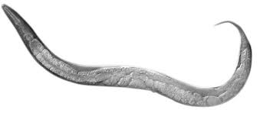
Discoverey of miRNAs
microRNAs were discovered in 1993 by Victor Ambros, Rosalind Lee and Rhonda Feinbaum during a study of the gene lin-14 in C. elegans development.
They found that LIN-14 protein abundance was regulated by a short RNA product encoded by the lin-4 gene.

Slide 3
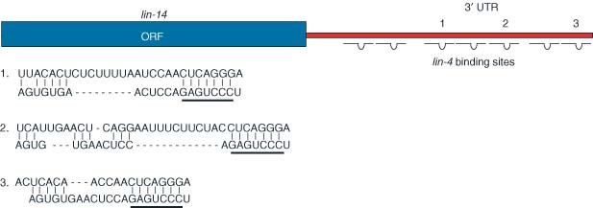
lin-4 & lin-14
“MicroRNA targeting in mammalian genomes: genes and mechanisms”
S. A. Muljo, C. Kanellopoulou, L. Aravind
DOI: 10.1002/wsbm.53
lin-14 geninin 3’ UTR bölgesinde lin-4 RNA’ları ile komplementer bir kaç bölge olduğu farkedilmiştir.
Ruvkun ve ark. bu komplementarite nedeniyle lin-14 mRNA seviyesinde farkedilir bir değişim olmaksızın LİN-14 protein miktarının azaldığını göstermiştir.

Slide 4
let-7 & lin-41

Slide 5
miRNA Biogenesis
Bushati N, M. Cohen S,2007, Annu.Rev. Cell. Biol. 23:175-205

Slide 6
miRNA Etki Mekanizması
1. mRNA degradation
2. Translational repression
* Komplementarite derecesi belirleyici rol oynar.
Sun W, J. Li Y, Huang H. Da, Shyy John Y-J, Chien Shu. “microRNA: A Master Regulator of Cellular Processes for Bioengineering Systems”. The Ann. Rev. Cell Dev. Biol. 2010; 12:1-27

Slide 7
1. mRNA degradation
M.R.Fabian,N.Sonenberg, W.Filipowicz. “Regulation of mRNA Translation and Stability by microRNAs”
Annu. Rev. Biochem. 2010, 79: 351-379

Slide 8
2. Translational repression
M.R.Fabian,N.Sonenberg, W.Filipowicz. “Regulation of mRNA Translation and Stability by microRNAs”
Annu. Rev. Biochem. 2010, 79: 351-379

Slide 9
Hedef Tanıma Mekanizması
3’UTR
mRNA
Bushati N, M. Cohen S,2007, Annu.Rev. Cell. Biol. 23:175-205

Slide 10
miRNA And miRNA Sequence Information
miRBASE
The miRBase database is a searchable database of published miRNA sequences and annotation.
Each entry in the miRBase Sequence database represents a predicted hairpin portion of a miRNA transcript (termed mir in the database)
information on the location and sequence of the mature miRNA sequence (termed miR)

Slide 11
http://www.mirbase.org/

Slide 12
http://www.mirbase.org/

Slide 13
http://www.mirbase.org/

Slide 14
http://www.mirbase.org/

Slide 16
http://www.mirbase.org/

Slide 17
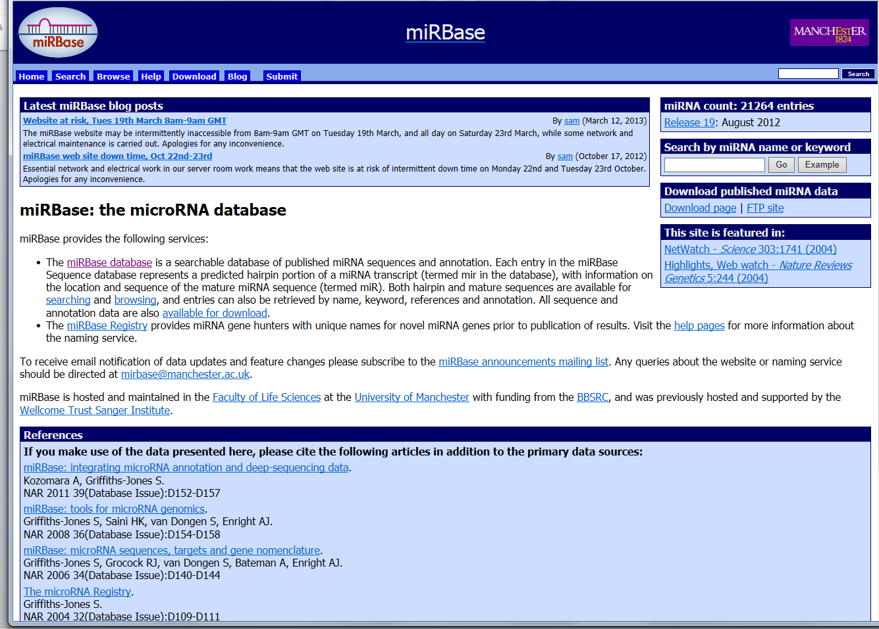
Release Issue

Slide 18
Searching And Browsing
Both hairpin and mature sequences are available for searching and browsing, and entries can also be retrieved by name, keyword, references and annotation.

