Slide 1
ANKARA UNIVERSITY Department of Energy Engineering HydroelectrIc Energy
INSTRUCTOR
DR. ÖZGÜR SELİMOĞLU

Slide 2
CONTENTS
a. Hydroelectric Power Plants
Run-of-River Plants
Storage Type Hydroelectric Plants
Pumped Storage Hydroelectricity
b. Power Generation
c. Transmitting Power

Slide 3
HYDROELECTRIC POWER PLANTS
Hydroelectric power plants are generally classified according to their operative mode, such as
Run-of-River Plant,
Storage Plant, and
Pumped-Storage Plant.

Slide 4
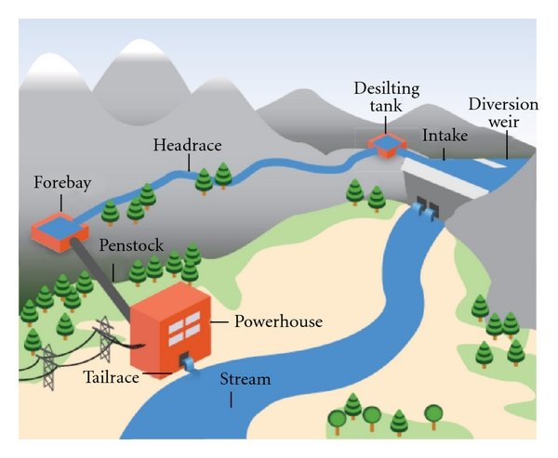
Run-of-River Plants
Run-of-the-river hydroelectricity is a type of hydroelectric generation whereby the natural flow and elevation drop of a river are used to generate electricity. Power stations of this type are built on rivers with a consistent and steady flow, either natural or through the use of a large reservoir at the head of the river which then can provide a regulated steady flow for stations down-river.

Slide 5
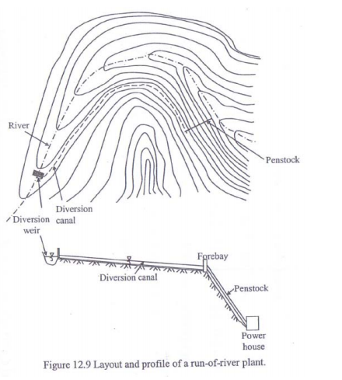
Run-of-River Plants
Uses river flow with no storage
Productivity depends on the river regime.
Considered as base load plants
The flow is diverted from the river to the
lined canal
Forebay facilitates daily or weekly storage to meet intermediate or peaking loads.

Slide 6
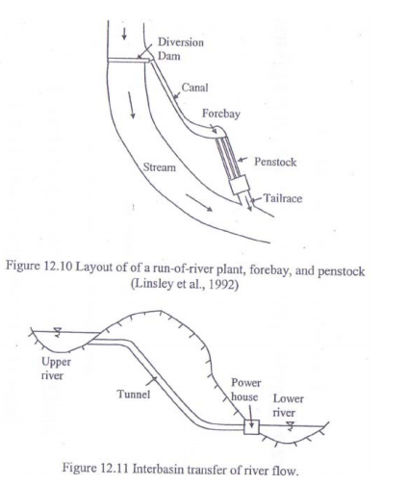
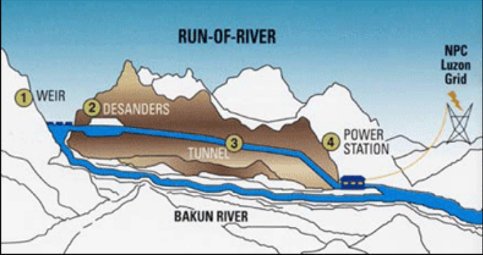
A penstock transmits the flow to the power house.

Slide 7
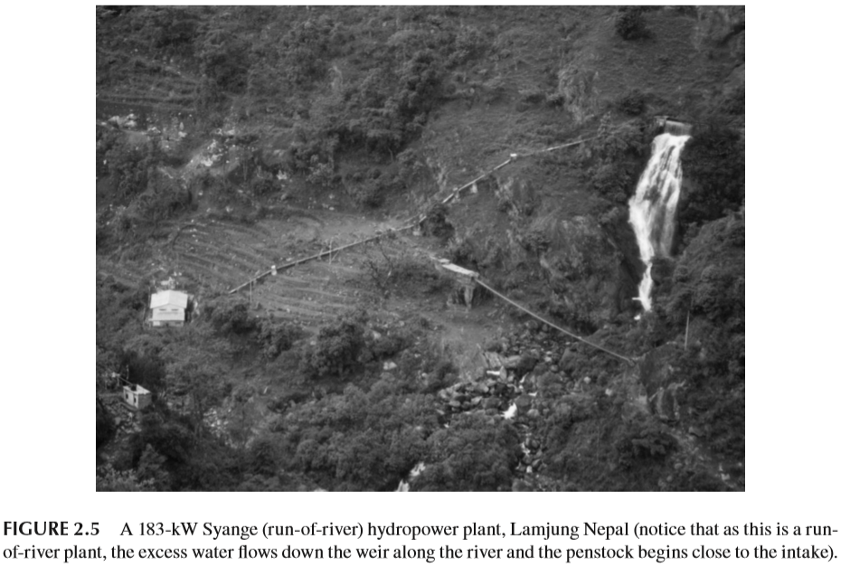
Water flow in the river depends on precipitation, groundwater flow and runoff: these parameters may have substantial daily, monthly, or seasonal variations.

Slide 8
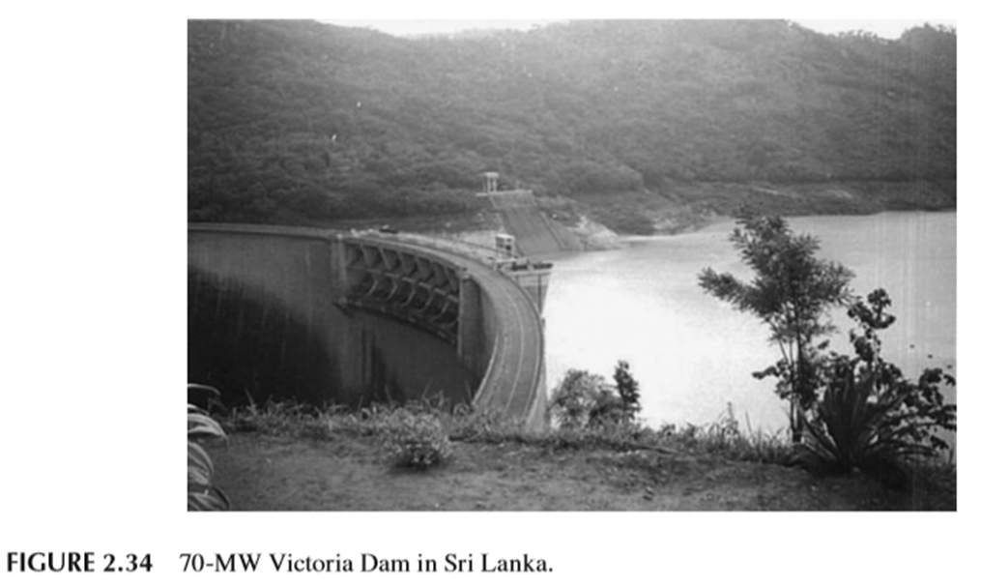
Storage Type Hydroelectric Plants
Storage type hydroelectric power plants comprise a dam built across the river to impound large volumes of water. Some dams create reservoirs extending tens of kilometers upstream. Hydroelectric power plants associated with large dams do not usually have long waterways as in the case of run ­of ­river plants. The intake is located at the upstream face of the dam whereas the powerhouse is placed at the foot of the dam.

Slide 9
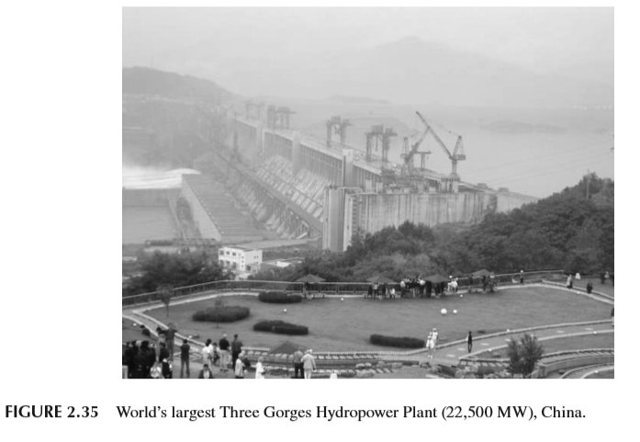
Some large dams are designed to store flows larger than the annual river water volume. In such large storage projects, the crest of the dam sometimes serves as a multiple lane highway. Smaller dams are designed to store seasonal river flows, such as the volume available during the high ­flow season.

Slide 10
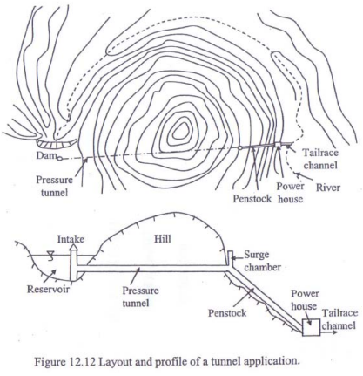
Water is withdrawn from the reservoir by means of penstocks to the turbines for electricity generation.
To obtain high head sometimes a power house is to be constructed at a sufficiently lower elevation on the other side of a hill.
In this case water is diverted to the penstocks by pressure tunnels.

Slide 11
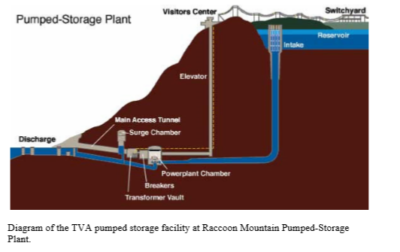
Pumped Storage Hydroelectricity
Pumped-storage hydroelectricity is a type of hydroelectric power generation used by some power plants for load balancing. The method stores energy in the form of water, pumped from a lower elevation reservoir to a higher elevation. Low-cost off-peak electric power is used to run the pumps. During periods of high electrical demand, the stored water is released through turbines.

Slide 12
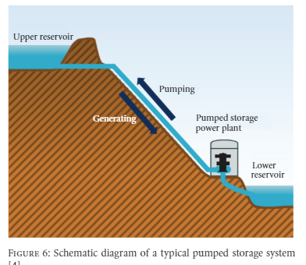
Typically, the round-trip energy efficiency of Pumped Storage Hydroelectricity varies in practice between 70% and 80%, with some claiming up to 87.
The main disadvantage of PHS is the specialist nature of the site required, needing both geographical height and water availability.

Slide 13
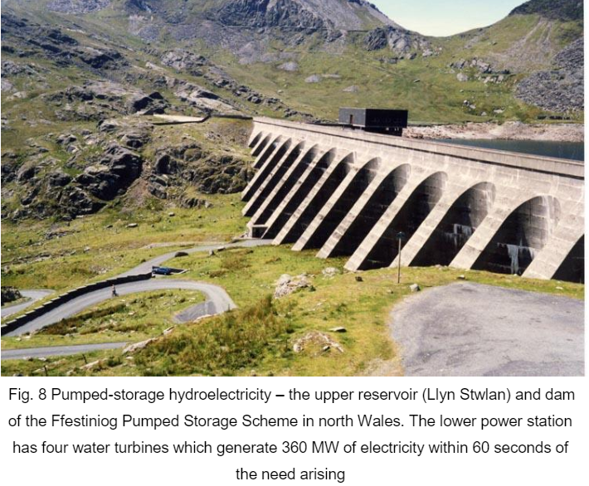
At times of low electrical demand, excess generation capacity is used to pump water into the higher reservoir. When there is higher demand, water is released back into the lower reservoir through a turbine, generating electricity.

Slide 14
Selection of Dam Type
As far as technical feasibility is concerned, often more than one type of dam is adequate for a selected dam site location. The final selection, then, is either based on economic considerations, on preferences of the designer or owner, or on the decision of a consulting board. Following is a list factors which the dam designer must consider in selecting the most appropriate structure for a site:
Topography
Flood hazard
Climate
Construction time
Govermantal regulation
Available resources

Slide 15
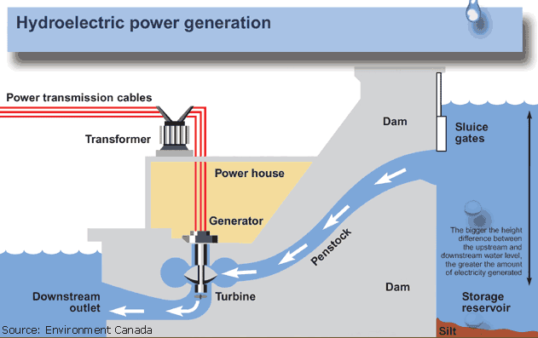
POWER GENERATION
The turbine turns the generator rotor which then converts this mechanical energy into another energy form electricity. Since water is the initial source of energy, we call this hydroelectric power or hydropower for short.

Slide 16
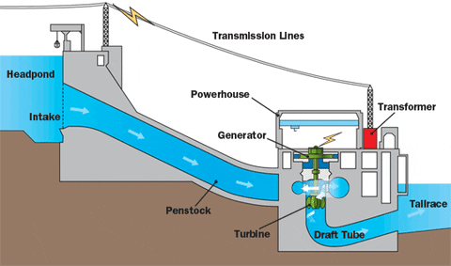
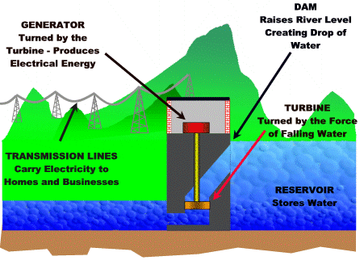

Slide 17
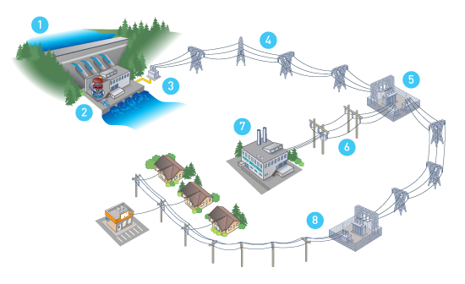
TRANSMITTING POWER
Once the electricity is produced, it must be delivered to where it is needed our homes, schools, offices, factories, etc. Dams are often in remote locations and power must be transmitted over some distance to its users.

Slide 18
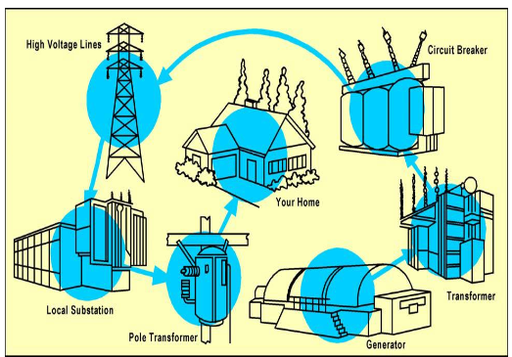
Vast networks of transmission lines and facilities are used to bring electricity to us in a form we can use. All the electricity made at a power plant comes first through transformers which raise the voltage so it can travel long distances through power lines. (Voltage is the pressure that forces an electric current through a wire.) At local substations, transformers reduce the voltage so electricity can be divided up and directed throughout an area.

Slide 19
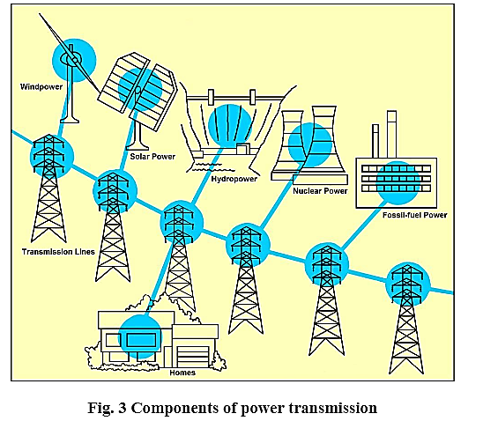
Transmission lines, when interconnected with each other, become transmission network. The combined transmission and distrubition network is known as the ‘‘power grid’’.
Transformers on poles (or buried underground, in some neighborhoods) further reduce the electric power to the right voltage for appliances and use in the home. When electricity gets to our homes, we buy it by the kilowatt-hour, and a meter measures how much we use.

Slide 20
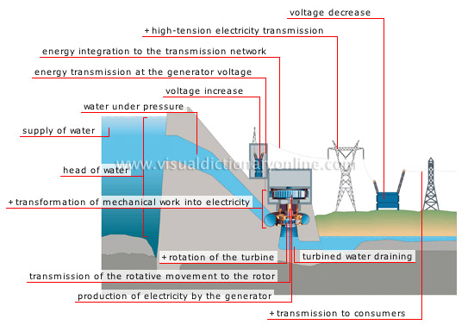

Slide 21
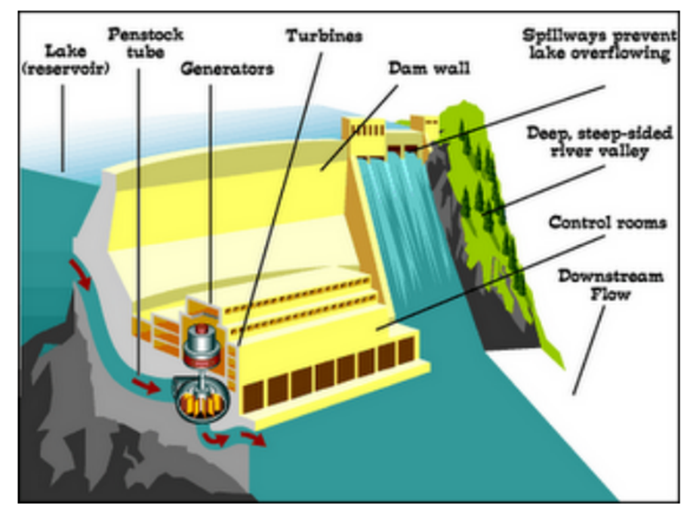
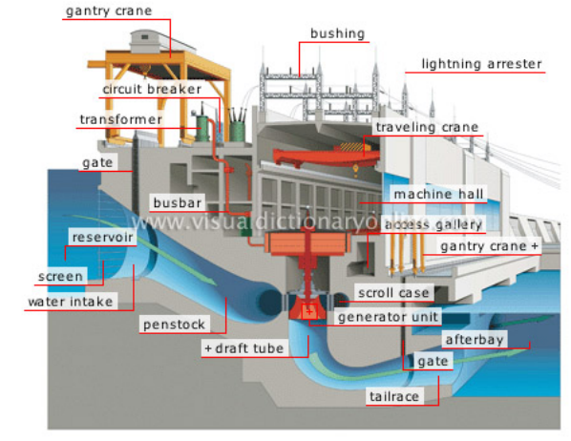

Slide 22
In the hydropower nomenclature, the volumetric flow of water is referred to as “flow,” and the units in SI are m³/s. Similarly, the vertical height is referred to as the “head,” and the SI unit is m. The relationship between power output, flow, and head, which is referred to as the “power equation,” is computed as follows.
The potential energy of a body of mass M, falling from a certain height h is expressed as
E = M g h [Joules]
Potential Energy
where g is the acceleration due to gravity. At sea level, the value of g is 9.81 m/s².

Slide 23
The mass of water is its density (ρ) times its volume (V), or M = ρV.
Thus E = (ρV) g h [Joules]
Now divide both sides of the equation by time (t):
$$\frac{E}{t}=\left(\frac{ρxV}{t}\right)xgxh [Watt]$$
Power
Volume over time (V/t) is the volumetric flow of water (Q) or flow in m³/s.

Slide 24
Thus, replacing E/t by P and V/t by Q, the power equation becomes
$$P=ρxQxgxh \left[W\right]$$
Power
Note that ρg = γ, which is the unit weight of water = 9.81 kN/m³.
According to principles of thermodynamics, when energy is changed from one form to another, there will be some losses based on the efficiency of the conversion process or equipment. Hydropower is generated when the potential energy of falling water is first converted into mechanical energy as it rotates the turbine. The turbine shaft, in turn, drives the generator shaft, and the rotating generator converts the mechanical energy into electrical energy.

Slide 25
The overall efficiency of the power plant depends on the efficiency of the penstock pipe, turbine, and generator.
Replacing ρg with γ and taking into account the overall efficiency, the power equation becomes
$$P=γxQxhxe_{0} \left[W\right]$$
ρg = γ
e₀ efficiency
The overall efficiency (penstock pipe, turbine, and generator) of the power plant and is “unitless.” Note that because the unit for γ is kN/m³, the unit for P is also kW.

Slide 26
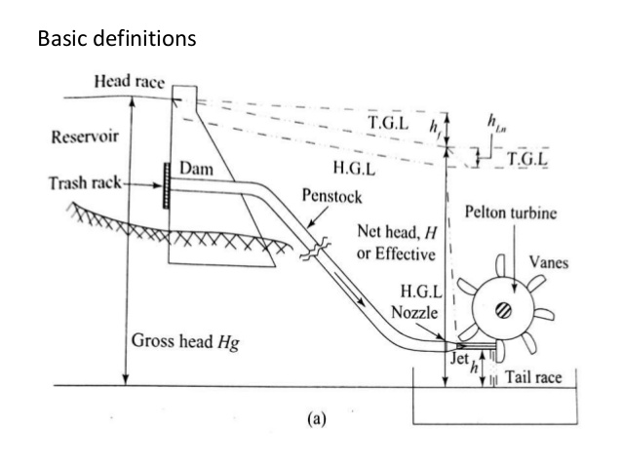
Q=V/t
$$P=Qxgx{hxe}_{0} \left[kW\right]$$
(Power)
Gross head (h_{g}) is the difference in elevation from the forebay for a run ­of­ river plant or the water level behind the dam for a storage project to the centerline of the turbine at the powerhouse for impulse turbines.

Slide 27
The overall power output efficiency, e_{o}, is the product of different efficiencies for several components of the hydroelectric system as follows:
e_{o} = e_{penstock} x e_{turbine}x e_{generator} x e_{transformer}
e_{penstock} is the efficiency of the penstock. For micro hydroelectric power plants, the efficiency of the penstock is generally in the range of 90%–95%—that is, 0.90–0.95. For larger power plants, the penstock diameter is sized such that the efficiency is optimum, given the plant size and cost–benefit analysis.

Slide 28
e_{turbine} is the efficiency of the turbine. For medium and large hydropower plants, the turbine efficiency can be over 90%, depending on the type of turbine installed. For micro hydroelectric power plants with turbines manufactured at local workshops, the efficiency may be as low as 60%.
e_{generator} is the efficiency of the generator. For medium and large hydropower plants, the generator efficiency can be over 95% whereas for micro hydroelectric power plants the efficiency could be lower, for example, 70%–90%.
e_{transformer} is the efficiency of the transformer. Based on size of the transformer, the efficiency can vary between 95% and 98%.

Slide 30
REFERENCES
Assmann, D., Laumanns, U., & Uh, D. (Eds.). (2006). Renewable energy: a global review of technologies, policies and markets. Routledge.
Carrasco, F. (2011). Introduction to hydropower. The English Press.
Ehrlich, R., & Geller, H. A. (2017). Renewable energy: a first course. CRC Press.
Pandey, B., & Karki, A. (2016). Hydroelectric energy: renewable energy and the environment. CRC Press.
Twidell, J., & Weir, T. (2015). Renewable energy resources. Routledge.
https://www.hydropower.org/
https://www.sciencedirect.com
https://www.slideshare.net
https://www.researchgate.net/publication/334415702_Hydroelectric_Power_Generation

