Slide 1
Protein Chemistry
Chemical structure are the vocabulary of biochemistry.
Prof. Dr. Zeliha Büyükbingöl

Slide 2
PROTEIN CHEMISTRY
AMİNO ACIDS
About 500 amino acids are known (though only 20 appear in the genetic code) and can be classified in many ways.

Slide 3
PROTEINS
Proteins are among the most abundant organic molecules in living systems and are way more diverse in structure and function than other classes of macromolecules. A single cell can contain thousands of proteins, each with a unique function. Although their structures, like their functions, vary greatly, all proteins are made up of one or more chains of amino acids.

Slide 4
Protein types and functions
Role | Examples | Functions
Digestive enzyme | Amylase, lipase, pepsin | Break down nutrients in food into small pieces that can be readily absorbed
Transport | Hemoglobin | Carry substances throughout the body in blood or lymph
Structure | Actin, tubulin, keratin | Build different structures, like the cytoskeleton
Hormone signaling | Insulin, glucagon | Coordinate the activity of different body systems
Defense | Antibodies (immunoglobulins, interferon) | Protect the body from foreign pathogens
Contraction | Myosin | Carry out muscle contraction
Storage | Legume storage proteins, egg white (albumin), ferritin | Provide food for the early development of the embryo or the seedling

Slide 5
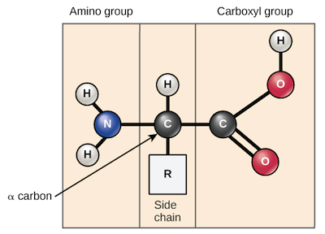
Amino acids are the monomers that make up proteins.
Specifically, a protein is made up of one or more linear chains of amino acids, each of which is called a polypeptide. There are 20 types of amino acids commonly found in proteins.

Slide 6
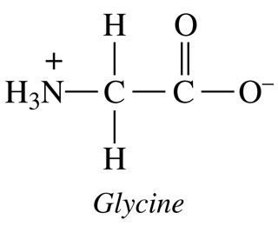
Chiral center
Except glycine the alpha-carbon is attached to four different groups.

Slide 7
20 amino acids
1- Aliphatic (nonpolar, monoamino-monocarboxylic, unsubstituted)
Glycine, Alanine, Valine, Leucine, İsoleucine
2- Aliphatic hydroxy (polar, uncharged, mono amino-monocarboxylic)
Serine, Threonine
3- Aromatic (monoamino-monocarboxylic)
Phenylalanine, Tyrosine, Tryptophan
4- Positive charged ( diamino-monocarboxylic):
Lysine, Arginine, Histidine
5- Negative charged (monoamino-dicarboxylic):
Aspartate, Glutamate
6- Amide group containing(polar, uncharged, carboxamide)
Asparagine, Glutamine
7- Sulfur containing Methionine, Cysteine
8- Imino group containing (Nonpolar, Heterocyclic)
Proline

Slide 8
Essential amino acids
The 8 essential amino acids are: isoleucine, leucine, lysine, methionine, phenylalanine, threonine, tryptophan and valine.
Conditional amino acids: histidine, arginine

Slide 9
All the standart amino acids found in proteins are alfa- amino acids
( the amino and carboxyl group are bonded to the same carbon atom). Two other substituents (H and R) are bound to the alfa- C.
Inside a cell, under normal physiological conditions, the amino group is protonated (-NH3+) because the pKa of this group is close to 9. The carboxyl group is ionized (-COO-) because the pKa of that group is below 3. Thus in the physiological pH range (6.8-7.4) amino acids are zwitteions, or dipolar ions, even though their net charge may be zero. However, some side chains can also ionize.

Slide 10
Amino acids as zwitterions
Zwitterions in simple amino acid solutions
An amino acid has both a basic amine group and an acidic carboxylic acid group.
There is an internal transfer of a hydrogen ion from the -COOH group to the -NH₂ group to leave an ion with both a negative charge and a positive charge.
-called a zwitterion.
A zwitterion is a compound with no overall electrical charge, but which contains separate parts which are positively and negatively charged.

Slide 11
Adding an alkali to an amino acid solution If you increase the pH of a solution of an amino acid by adding hydroxide ions, the hydrogen ion is removed from the -NH₃⁺ group.

Slide 12
Adding an acid to an amino acid solution If you decrease the pH by adding an acid to a solution of an amino acid, the -COO⁻ part of the zwitterion picks up a hydrogen ion.

Slide 13
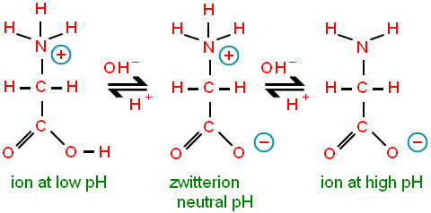

Slide 14
Isoelectronic point, pI
The isoelectronic point / isoionic point is the pH at which the amino acid does not migrate in an electric field.
Means it is the pH at which the amino acid is neutral, i.e. the zwitterion form is dominant.

Slide 15
Determination of amino acid composition of protein Techniques to determine amino acid sequence of a protein
Edman Degradation
This reaction for determining the sequences of peptides and proteins from their N-terminus was reported by Pehr Edman in the early 1950s. It now constitutes one of the oldest, molecular method that is still much in use. It uses a three-stage reaction cycle for step-wise removal of amino acid residues from the N-terminus of a polypeptide chain. The three stages of the Edman cycle are (i) coupling, (ii) cyclization, and (iii) conversion.
Sanger Reaction
Cyanogen bromide cleaves peptide bond on the COOH terminal side of methionine residues.
Carboxypeptidases cleaves peptide bond.

