Slide 1
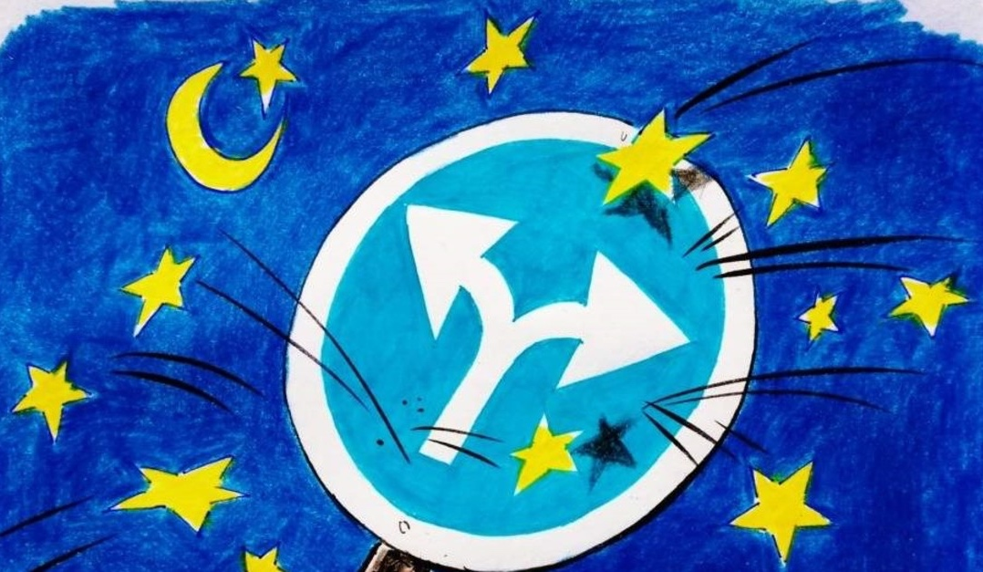
TR - EU Negotiation Process CHAPTER 11(Agricultural and Rural Development)
CHAPTER 9
Res. Assist. PhD. Arzu Gökdai

Slide 2
Content of Chapter 11
This chapter covers the principles of CAP and EU Rural Development Policy. In terms of CAP there are some subjects such as;
The subsidies for agricultural sector from EU budget
The systems which are used for the management and control of subsidies practices
Government investments for sector
Market precautions for the products exist in CMO
Marketing standards and commerce orders for those products
Protection precautions in the period of crisis
Quality policy
Organic production
Description of agricultural products
Agricultural and Rural Development Statistics

Slide 3
Chapter 11
Chapter 11 Agriculture and Rural Development has not yet been opened for negotiations due to political blockage. However, 2 of the 5 technical opening criteria determined to open the chapter for negotiation were met as a result of the studies. Legislative harmonization studies in this area are ongoing and necessary measures are taken to have the most of EU funds.

Slide 4
CURRENT SITUATION OF CHAPTER 11 IN NEGOTIATION PROCESS
The Screening Report of the Chapter 11 Agriculture and Rural Development was officially conveyed to us with the letter of the German Presidency dated January 24, 2007. Apart from the first criterion regarding the application of the Ankara Treaty Additional Protocol without any discrimination, 5 criteria were set for opening the chapter to negotiations:
1. The Agency- an accredited in accordance with EU requirements- IPARD (Instrument for Pre-Accession - Rural Development Component) should be established in Turkey.

Slide 5
CURRENT SITUATION OF CHAPTER 11 IN NEGOTIATION PROCESS
2. Turkey should provide of a strategy to the Commission which is related with direct support payments associated production and price support measures to reverse the trend of increasing importance in the agricultural budget in recent years.
3. In order to attain an adequate level for the start of negotiations, Turkey should present a detailed strategy report to Commission covers the agriculture and rural development in the accurate and reliable statistics and supplying the information cereals, sugar, milk, live animals, including sensitive products such as fruits and vegetables.

Slide 6
CURRENT SITUATION OF CHAPTER 11 IN NEGOTIATION PROCESS
4. Turkey should present a report on how to develop a strategy with land identification of the National Farmers Registry System to prepare for controls on agricultural land.
5. Turkey should remove restrictions on beef, cattle (bovine-buffalo) and imposed trade derivative .

Slide 7
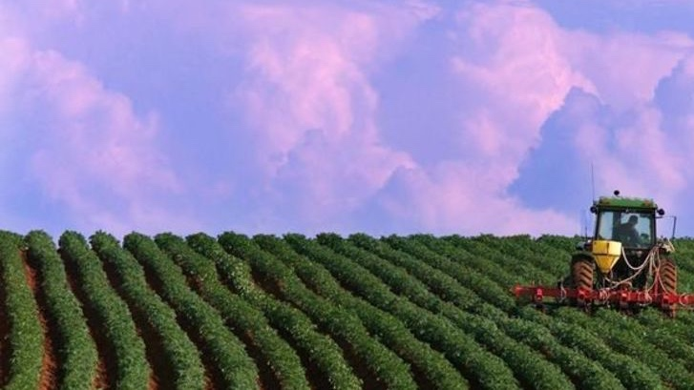
Main Policy Areas of Chapter 11
Agricultural Subsidies;
Content
Agricultural supports provided under the first column of the CAP are provided to farmers through direct payments detailed in Regulation (EU) No 1307/2013 published on 20 December 2013 after the CAP reform made in 2013. In the said regulation, the supports under the direct payments and the rules that the farmers are obliged to fulfill in order to benefit from these supports are included. In order to benefit from agricultural supports, farmers must comply with the definition of active farmers whose main source of income and activity is agriculture or real person.

Slide 8
Main Policy Areas of Chapter 11
A major part of the agricultural support budget in the EU is the Basic Payment Plan. These supports are in the form of income supports, independent of production. In other words, in the EU, producer-based support is adopted as the basic principle rather than product-based support. However, member states are associated with production in exceptional and limited circumstances.

Slide 9
Main Policy Areas of Chapter 11
Another support measure under direct payments is the Young Farmer Program. With the aim of preventing the aging of the agricultural population in the European Union, the 2013 reform provides additional support to young farmers under the age of 40 who operate or will operate in the agricultural sector. Within the framework of this support, 25% of the support they receive for five years is paid to the producers who apply and comply with the definition of the young farmer in Article 50 of the Regulation (EU) No 1307/2013.

Slide 10
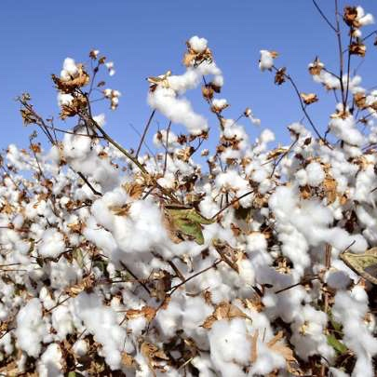
Main Policy Areas of Chapter 11
Apart from these support programs, member states also provide farmers with special support for cotton within the direct payments mechanism, a special support program for the Aegean Islands, a special support program for regions with natural constraints and POSEI (a definition developed for transoceanic islands connected to the European Union). Direct payments are provided from the European Union budget. Aid provided by member states from their national budgets is subject to state aid rules.

