Slide 1
Political Geography
Asst. Prof. Merve ALTUNDAL ÖNCÜ

Slide 2
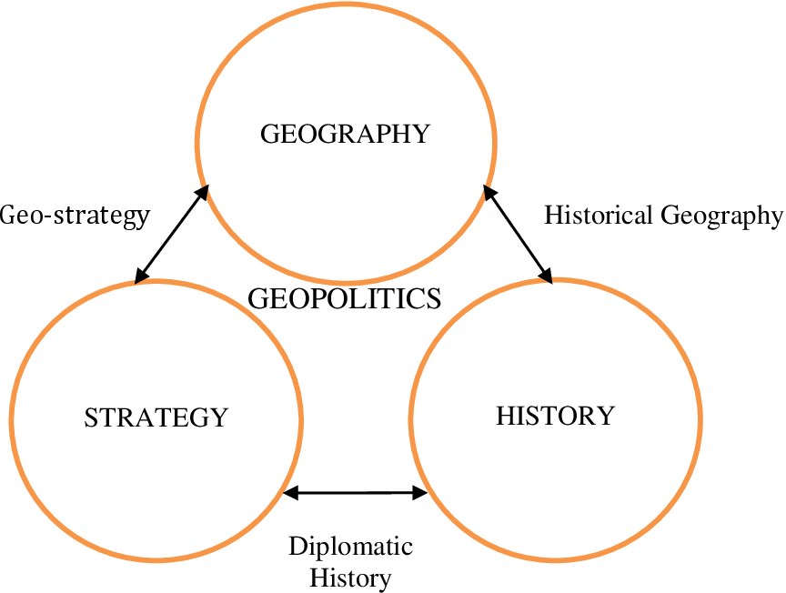
Conceptual framework:
Strategy
Geostrategy
Geopolitics
Political geography

Slide 3
Strategy
Although definitions of these concepts cannot be made in a precise manner, it can be said that their most important feature is their ability to provide projections for the future.
The origin of the word "strategy" is linked to the ancient Greek word "strategus," which means the art of generalship. In Greek, "strata-" means army, "ago-" means using, and "stratos ago-" means using the army. In ancient times, great statesmen and commanders emphasized that strategy was a "method of thinking."

Slide 4
Although the transition of strategy from military and political contexts to business and management began in the late 1960s, it was in the late 1980s that it became more prominent. For a long time, the term "strategy" was mostly used in a military sense. Especially when a war environment emerged, the use of strategy, which was considered the art of using military forces to achieve results by political power, outside the military domain; for example, in political, economic, cultural, and similar areas, expanded the known meaning of this term years ago.

Slide 5
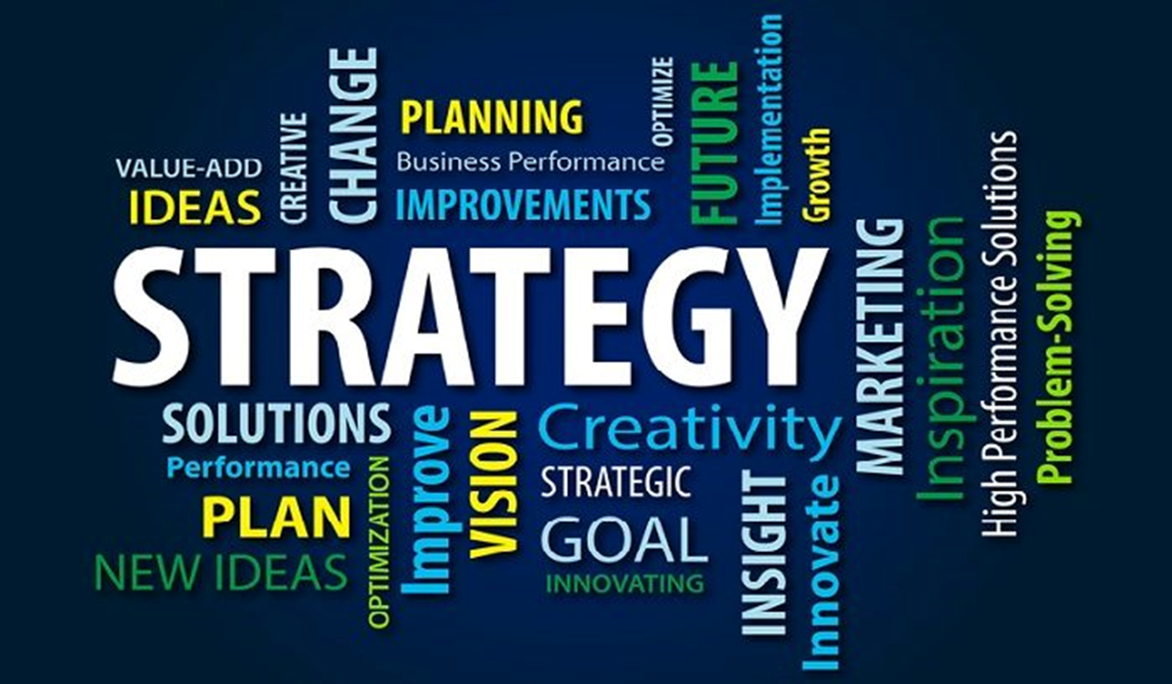
In military literature, classical strategy, in its classic sense, refers to the principles upon which military operations during a war are based in order to win the war.
In today's context, the concept of strategy can be considered synonymous with the concept of methodology. This term can be defined today as the fundamental management principles and the ways to be implemented.

Slide 6
According to Alger, strategy is "the collection of plans employed by a state's political group or military leader in a rational manner to coordinate diverse resources in order to achieve victory over an opponent." One of the founders of modern strategy, Carl von Clausewitz, defines strategy in his work "On War" as "the use of combat to serve the objectives of war."

Slide 7
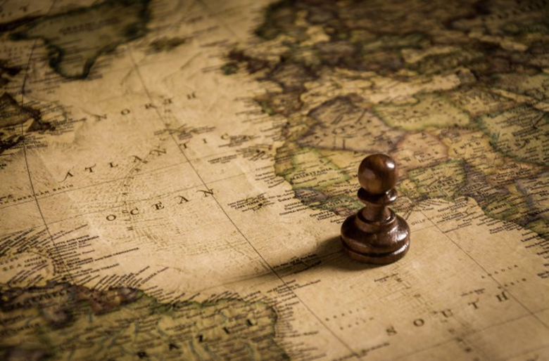
Geostrategy
Geostrategy examines the relationships between strategy and geographical elements. The subject of geostrategy consists of the examination of geographical elements from a strategic perspective and drawing strategic conclusions.

Slide 8
Geostrategy is the science of military command levels benefiting from the geographical, hydrographic, meteorological, and climatic characteristics of a state's country and its surroundings in military operations.
Geostrategy is the form of organizing where, how, and when large military forces will be used to achieve national political objectives.
Geostrategy is the science of analyzing geography for military purposes and planning and implementing military operations considering the conditions of geography.

Slide 9
In a narrow sense, geostrategy is the defense plan that a country's armed forces will implement against any enemy threat.
In a broader sense, geostrategy refers to a country's natural resources, human resources, population, industry, and the size of its military forces.

Slide 10
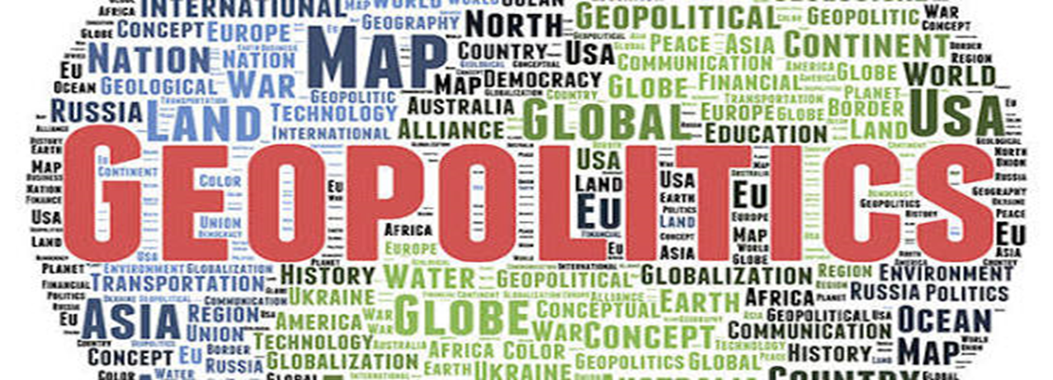
Geopolitics
Geopolitics, etymologically, arises from the combination of the terms "geo" and "politics." "Geo" means place, land, and earth. The term "politics" (politikos) is derived from the word "polis," which means city-state or city.

Slide 11
The concept of geopolitics emphasizes the special relationship between political action and the spatial environment where actions take place.
According to Nicholas Spykman, geopolitics is the planning of a country's security policy based on geographical events.
According to Keiffer, geopolitics is the application of the social, political, economic, and strategic elements of a state to determine and pursue its foreign policy.
According to Hartshorne, geopolitics is the adaptation of geography to politics. Its value and significance depend on the value assigned to the political purpose it serves and its alignment with political goals.

Slide 12
Geopolitics is a discipline that examines humanity in mutual relation with the spatial factor.
According to Suat İlhan, geopolitics examines the relationship between present and future political power and political goals based on geographical power. It determines the goals and the conditions and stages of achieving those goals. Geopolitics is the activation of all types and data of geography.

Slide 13
Rudolf Kjellen, who coined the term geopolitics, defined geopolitics as a science that examines states as geographical organisms or phenomena in space.
According to Kjellen, the state is a living organism. The body of this organism is its territory. The administrative center of the state (its brain) is the rivers and highways within the country. Railroads are the veins of the state.

Slide 14
The most important feature of these three concepts is their ability to provide projections for the future.
Just as humans must act according to the requirements of their physical structure, countries must also act according to the requirements of their geographical conditions.

Slide 15
Political Geography
Political geography is a branch of human geography.
It is concerned with humans and their activities, especially those activities that are political in nature.
The field of political geography grew from geographers’ interest in the spatial nature of the national state.
Political geography is the analysis of how political systems and structures from the local to international levels- influence and is influenced by the spatial distribution of resources, events, and groups and by interactions among sub-national, national and international political units across the globe.
It focuses on, in one hand, how groups interact- particularly the ways they manipulate each other: in pursuit of controlling resources and, on how these social, economic, and political activities determine the use of and thereby modify, the resource base. It is simply the relationship between spaces and political processes which is the focus of attention.
The political geography of international relations, then, often comes down to control over key resources and flows of commodity such as oil, a specific border crossing, or the “global commons”-and who is best connected in the global system in terms of communications, trade and ideal flows.

Slide 16
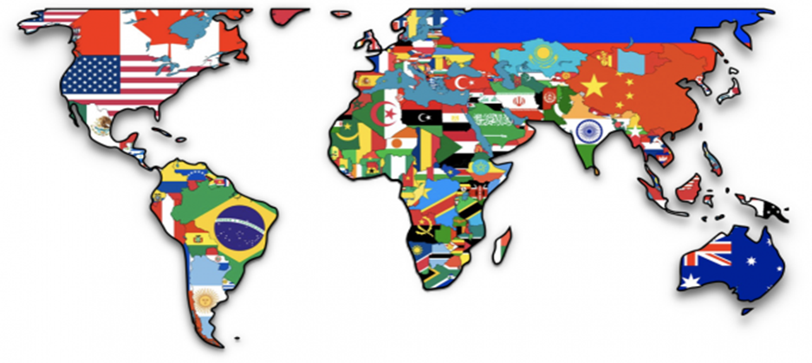
Political geography is a branch of social geography that investigates and examines the locations where political formations and activities occur on the earth's surface, the reasons and forms of their occurrence, and the effects they create in their locations and worldwide, while adhering to the fundamental principles of geography, and presents its findings in a synthesized form.

Slide 17
The difference between political geography and geopolitics:
Political geography examines the geographical location, shape, size, natural resources, boundaries, population structure, and administrative system of states objectively and descriptively. However, it does not deal with the policies that states need to implement. On the other hand, geopolitics is directly concerned with the national policies of states. It examines the role of geographical factors in determining and implementing foreign policies.
Political geography merely describes, while geopolitics is required to draw conclusions about the future.

