Slide 1
BIO 206 PLANT MORPHOLOGY
LECTURE NOTES
12th WEEK
DR. AYDAN ACAR ŞAHİN

Slide 2
Flower
reproductive organ of flowering plants (angiosperms)
= a modified, determinate shoot bearing sporophylls (stamens and/or carpels),
with or without outer modified leaves (the perianth)

Slide 3
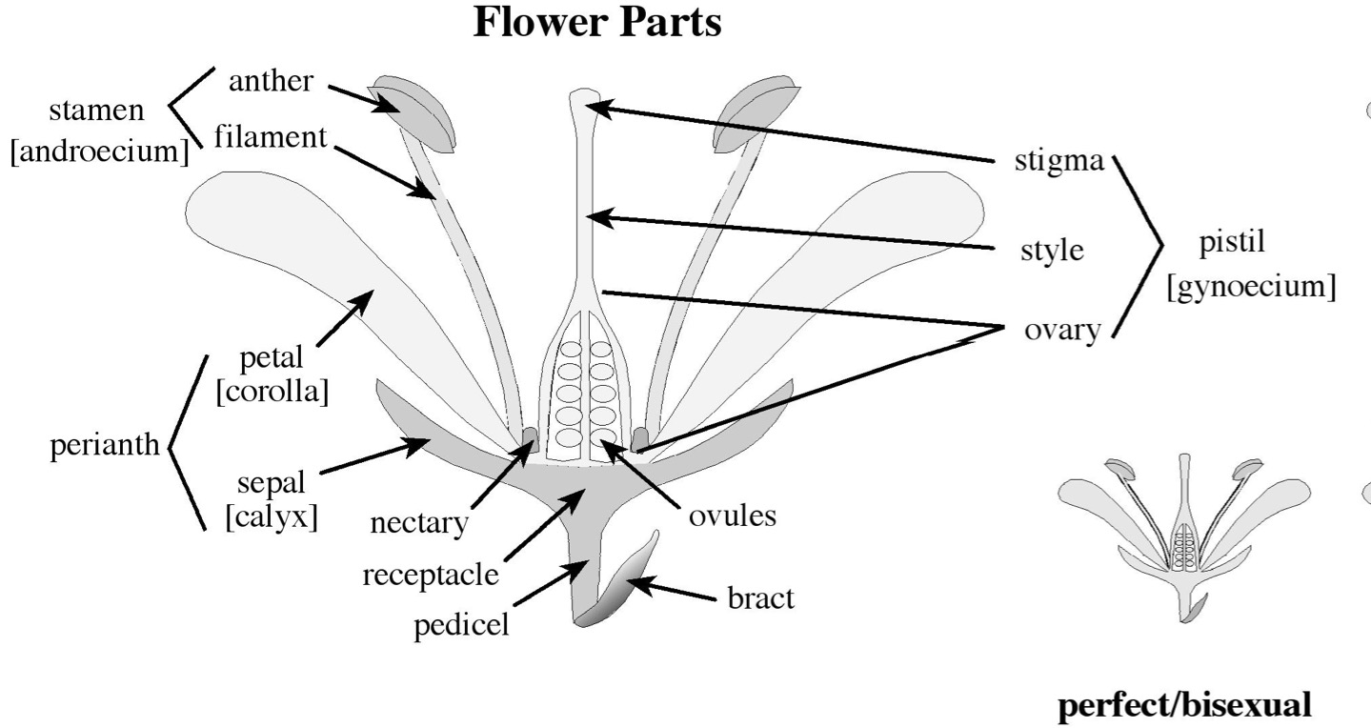

Slide 4
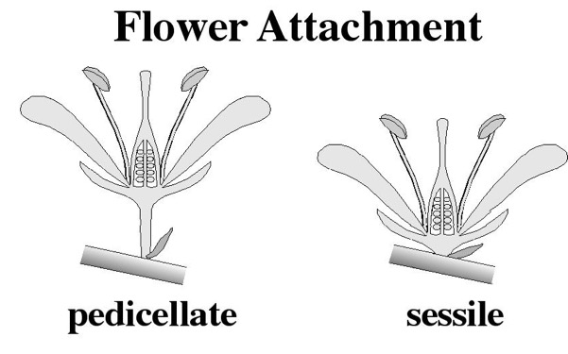
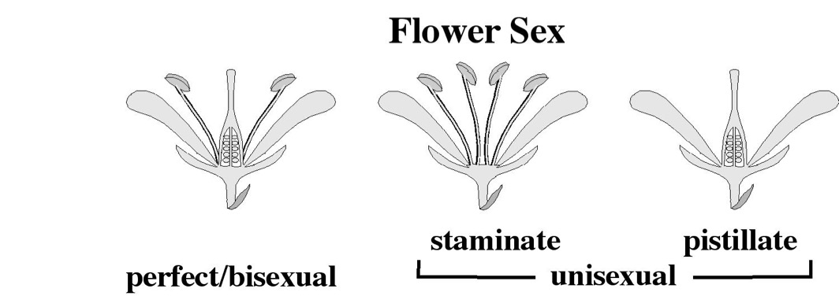
Plant sex:
if flowers bisexual: hermaphroditic
if flowers unisexual: monoecious - on same plant
dioecious - on different plants

Slide 5
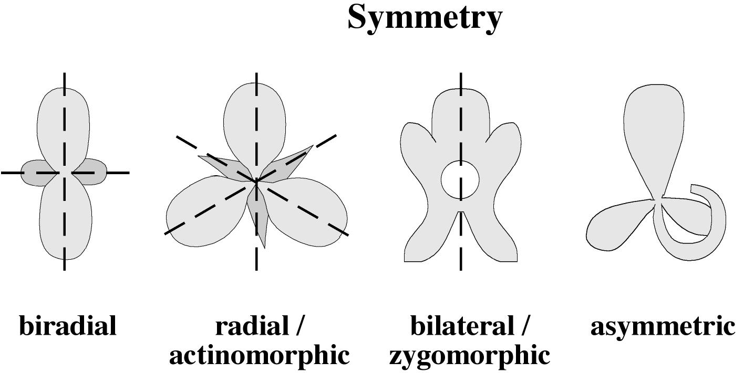

Slide 6
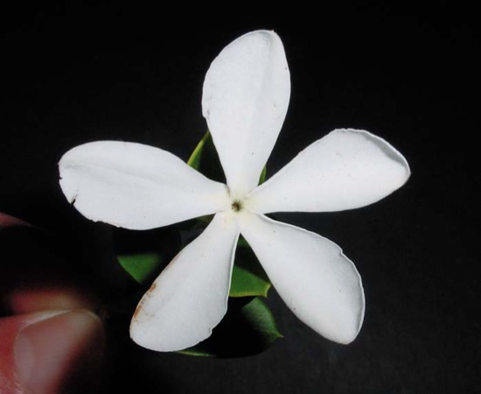
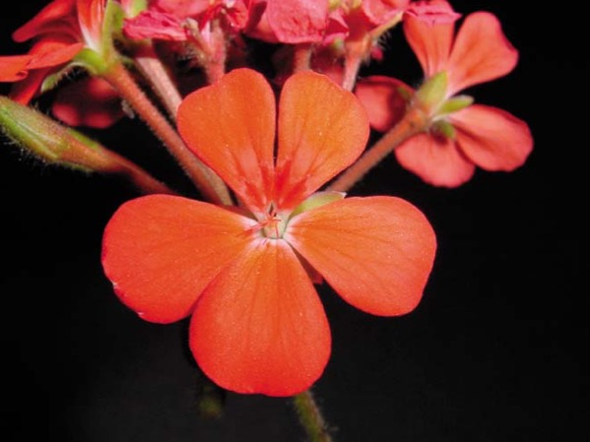
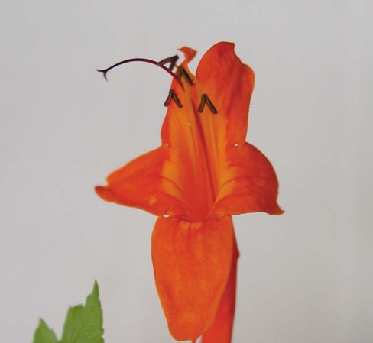
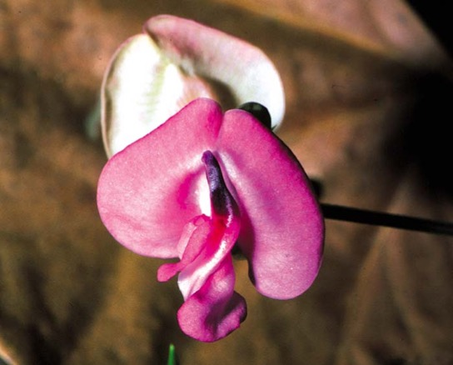
radial /
actinomorpic
bilateral /zygomorphic
bilateral /zygomorphic
asymmetric

Slide 7
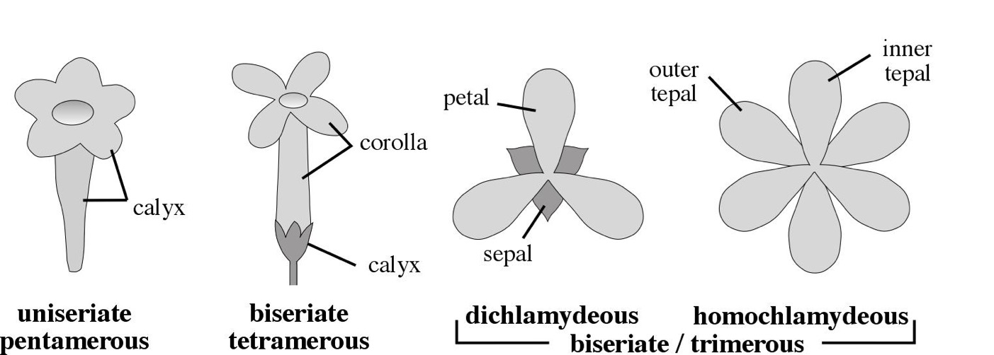
Perianth cycly = no. of whorls in perianth
Perianth merosity = no. of parts per whorl

Slide 8
Perianth cycly = no. of whorls in perianth
Perianth merosity = no. of parts per whorl

Slide 9
Perianth cycly = no. of whorls in perianth
Perianth merosity = no. of parts per whorl

Slide 10
Perianth cycly = no. of whorls in perianth
Perianth merosity = no. of parts per whorl

Slide 11
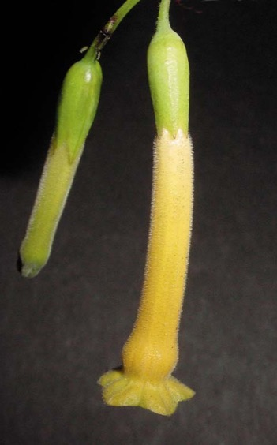
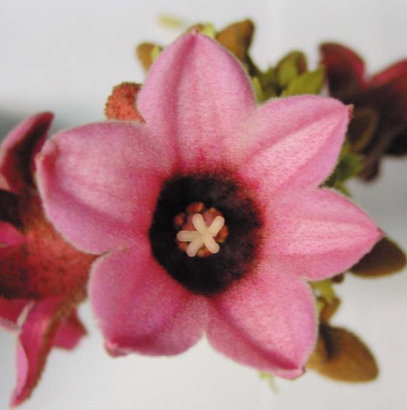
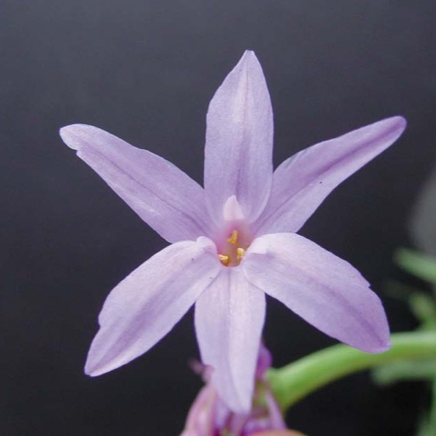
Perianth cycly
biseriate
dichlamydeous
uniseriate
biseriate
homochlamydeous

Slide 12
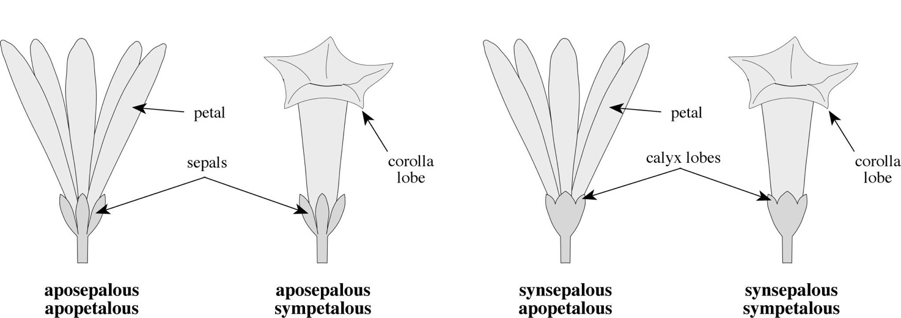
Perianth Fusion:

Slide 13
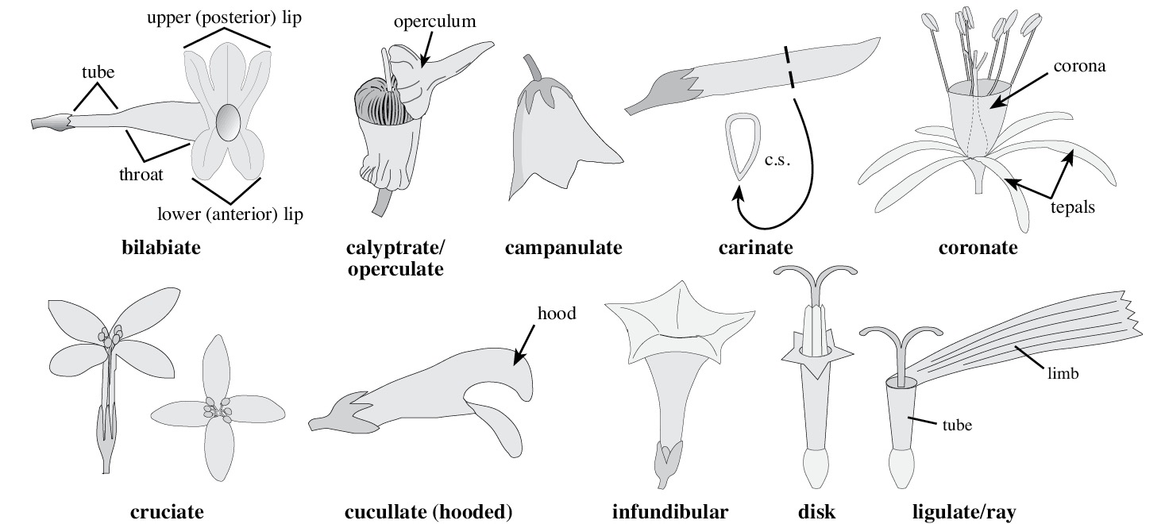
Perianth Types/Parts:

Slide 14
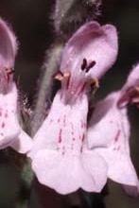
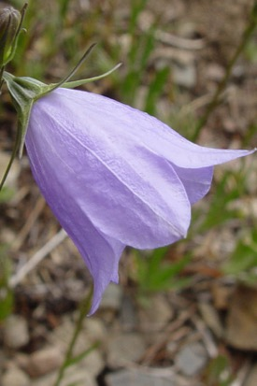
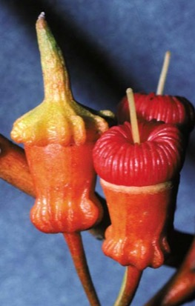
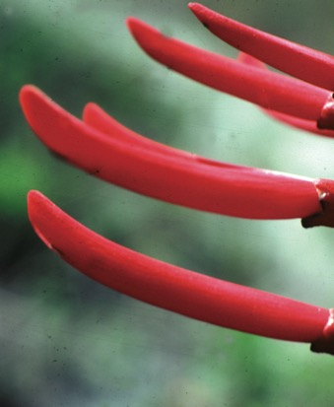
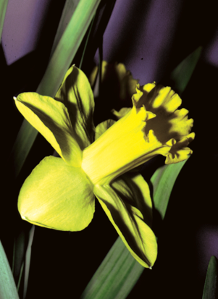
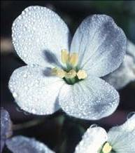
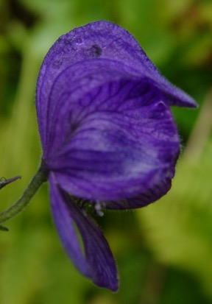
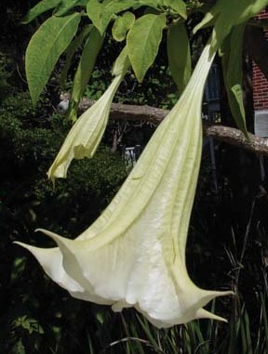
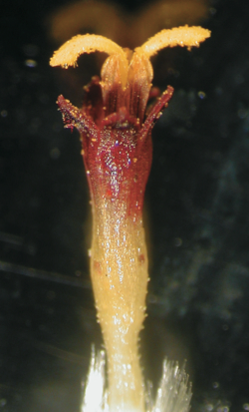
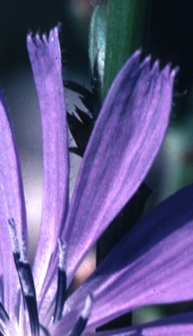
Perianth Types/Parts:
bilabiate
campanulate
calyptrate
carinate
coronate
cruciate
hooded
infundibular
disk
ray

Slide 15
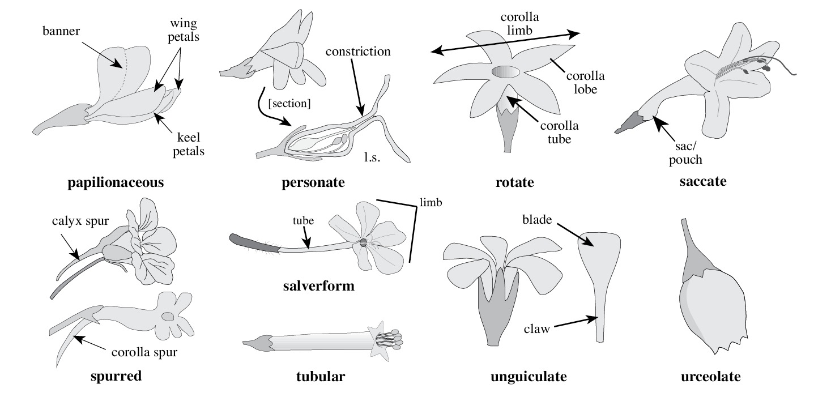
Perianth Types/Parts:

Slide 16
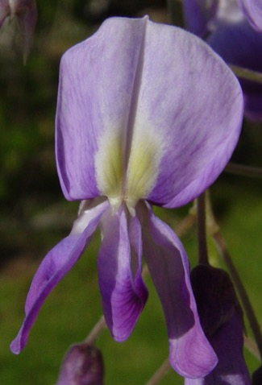
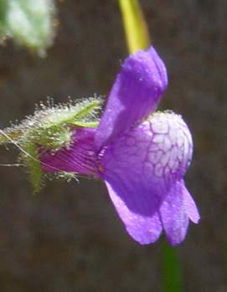
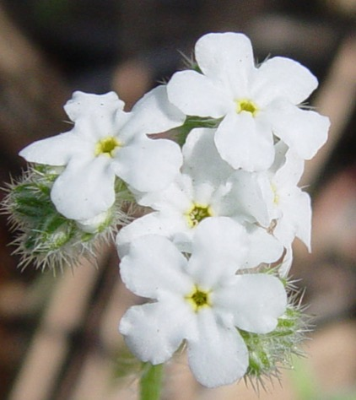
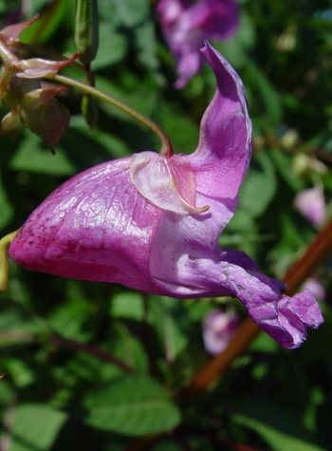
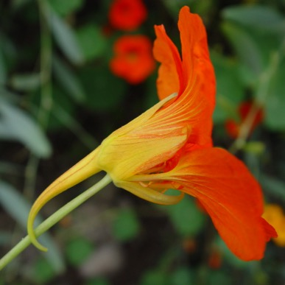
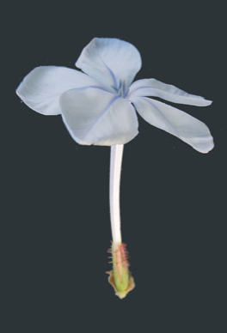
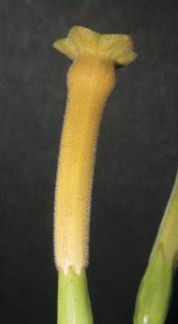
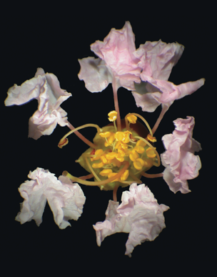
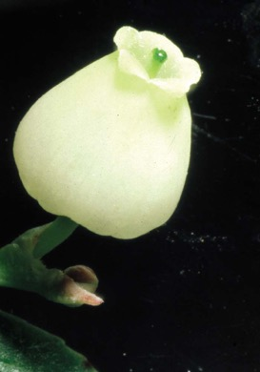
Perianth Types/Parts:
papilionaceous
personate
rotate
saccate
spurred
salverform
tubular
unguiculate
urceolate

Slide 17
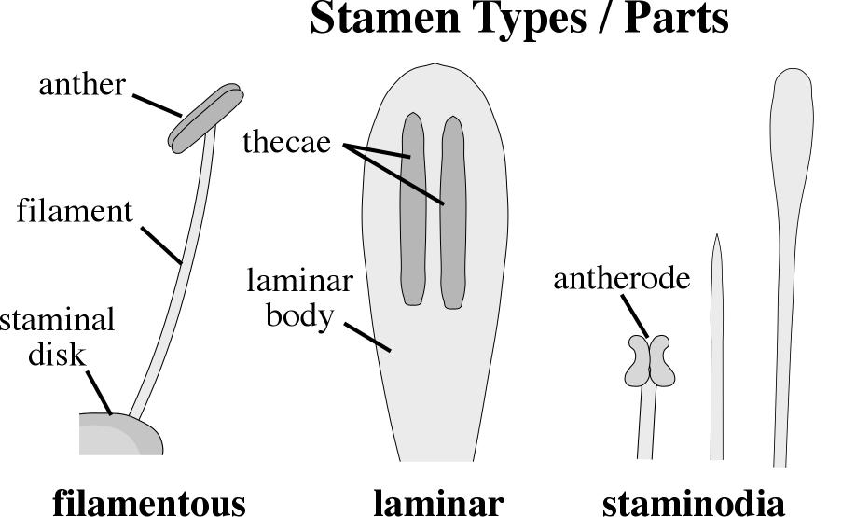
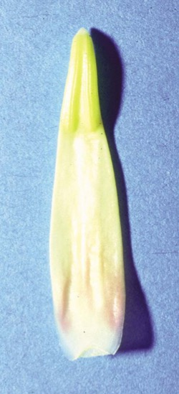
Androecium:

Slide 18
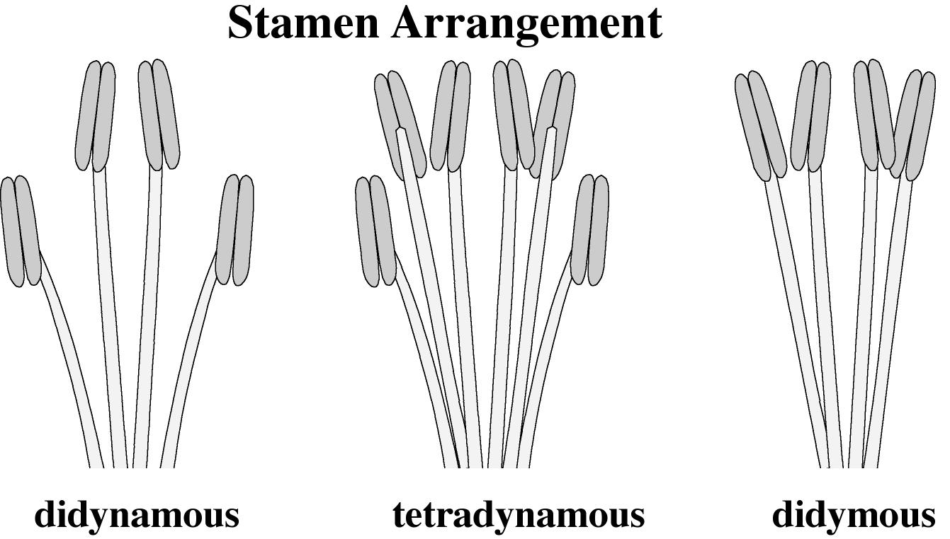

Slide 19
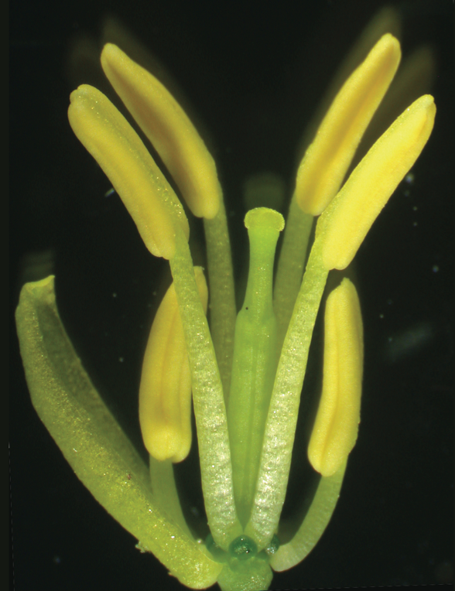
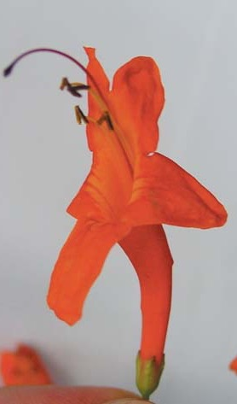
tetradynamous
didynamous

Slide 20
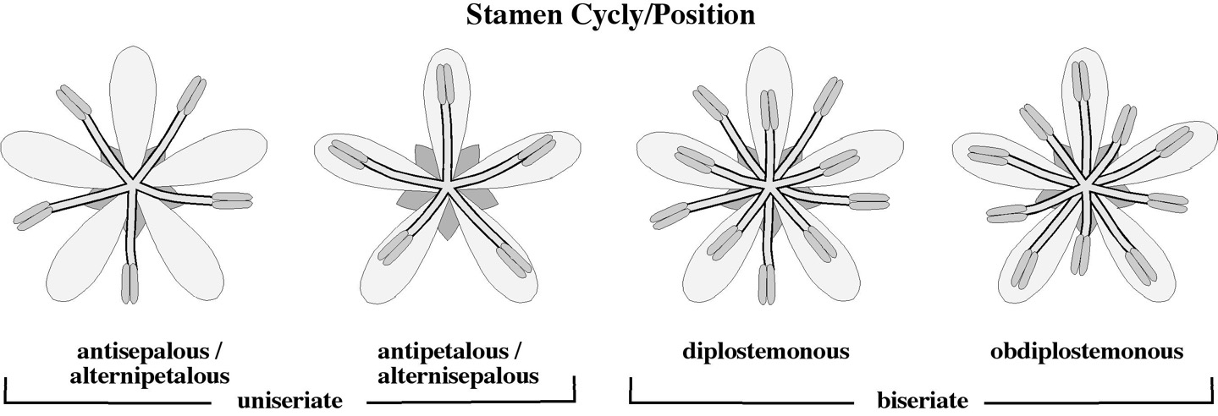
antisepalous
(alternipetalous)
antipetalous
(alternisepalous)
diplostemonous
obdiplostemonous
uniseriate
biseriate

Slide 21
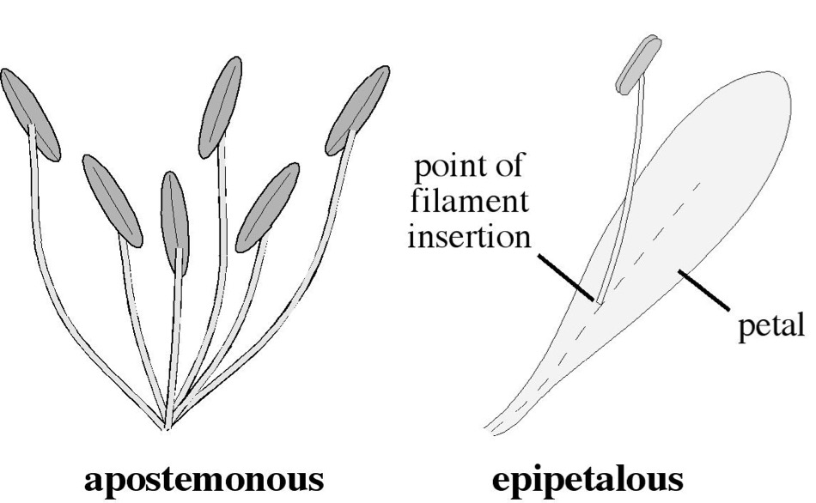
Androecial / Stamen Fusion
apostemonous
epipetalous

Slide 22
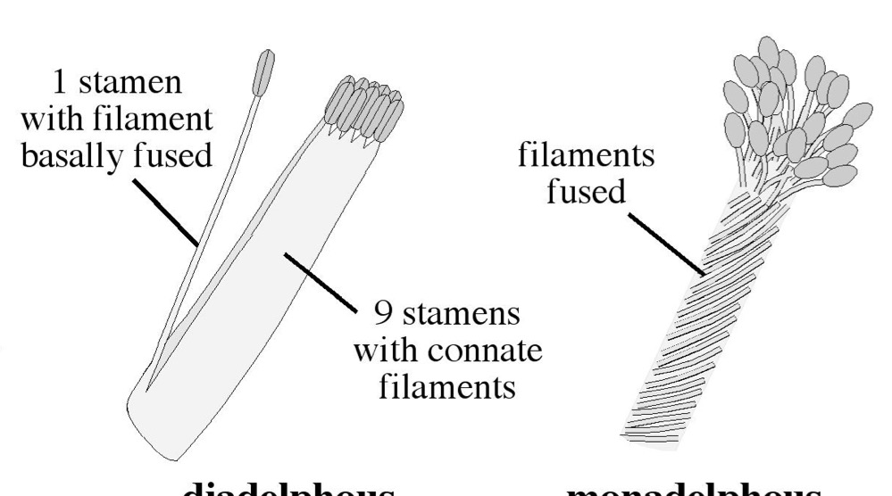
Androecial / Stamen Fusion
diadelphous
monadelphous

Slide 23
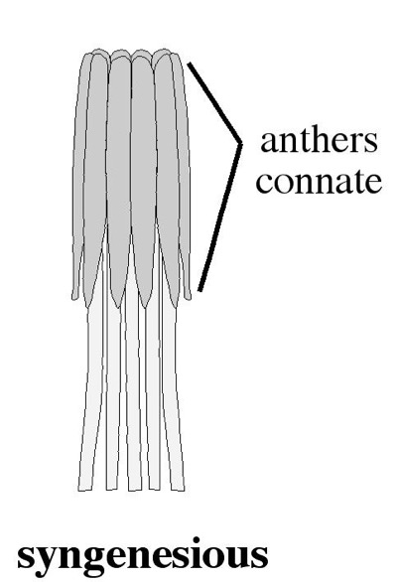
Androecial / Stamen Fusion
syngenesious

Slide 24
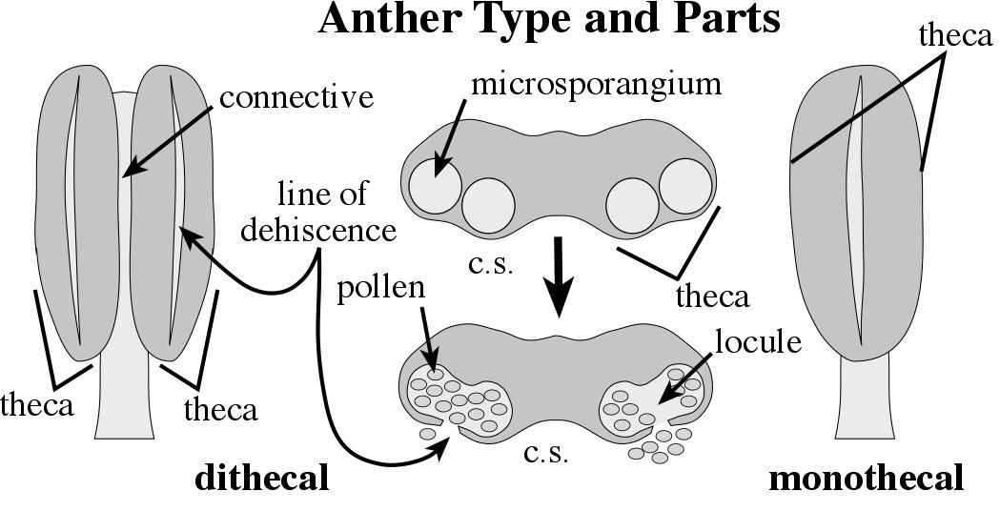

Slide 25
Gynoecium = all female parts of a flower
Pistil = structure consisting of ovary, style(s), and stigma(s)
Carpel = conduplicate megasporophyll
Carpel can be unit of pistil, if pistil compound (composed of >1 carpel)

Slide 26
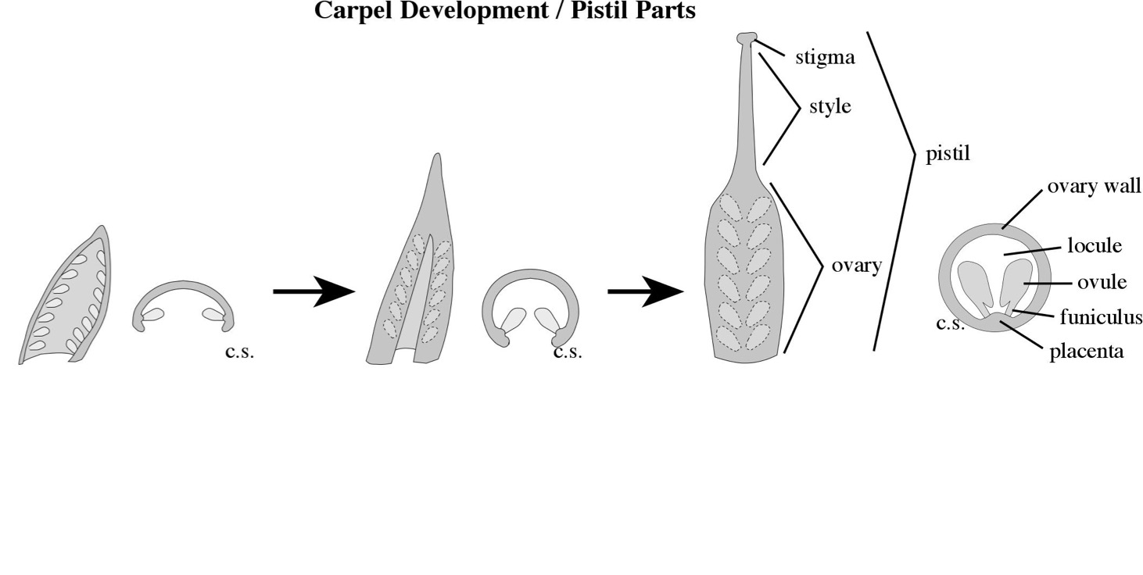
Gynoecium:

Slide 27
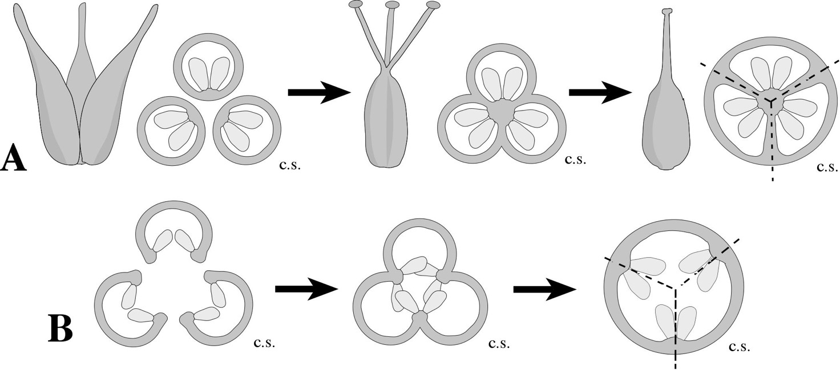
Gynoecial Development/Fusion:

Slide 28
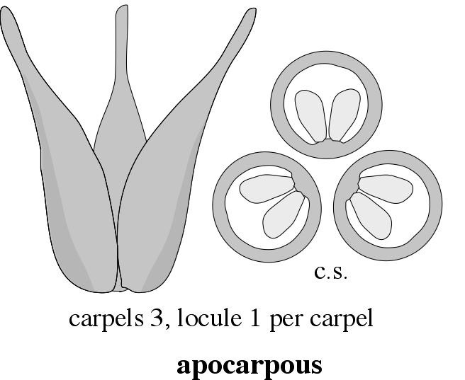
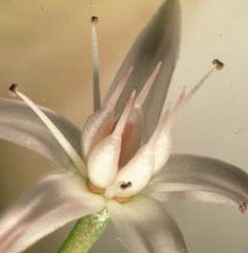
Gynoecial Fusion:
Crassula argentea Crassulaceae

Slide 29
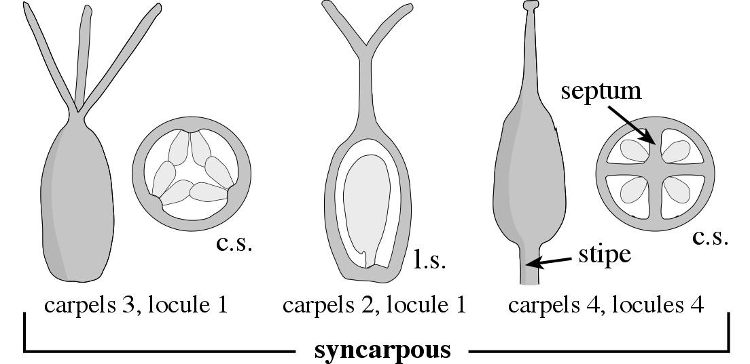
Gynoecial Fusion:

Slide 30
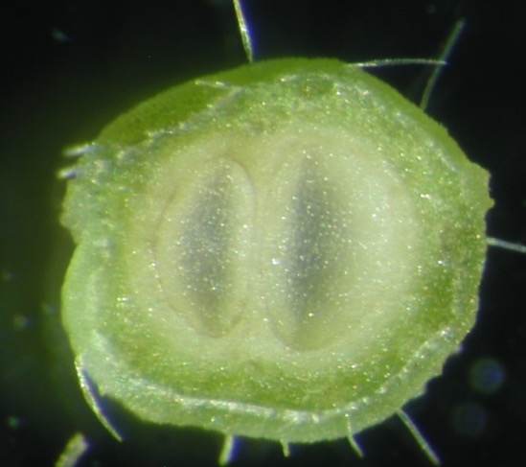
Gynoecial Fusion:

Slide 31
Gynoecial Fusion:
unicarpellous
Erythrina caffra Fabaceae

Slide 32
Placentation

Slide 33
Placentation

Slide 34
Placentation

Slide 35
Placentation

Slide 36
Placentation

Slide 37
Placentation

Slide 38
Placentation

Slide 39
Placentation

Slide 40
Placentation

Slide 41
Borago officinalis
Boraginaceae
Verbena rigida
Verbenaceae
Fragaria sp.
Rosaceae

Slide 43
Carpel number:
= number of pistils (if > 1 pistil)
Carpels 3 (pistils 3)

Slide 44
Carpel number:
(if 1 pistil) = number of styles (if > 1 style)
Carpels 3 (styles 3)

Slide 45
Carpel number:
(if 1 style) = number of locules (if > 1)
Carpels 5 (locules 5)
Carpels 2 (locules 2)

Slide 46
Carpel number:
(if 1 locule) = number of placentae
Carpels 2 (placentae 2)
Carpels 3 (placentae 3)
Carpel 1 (placenta 1)

Slide 47
FLORAL DIAGRAMS

Slide 49
Inflorescence:
A collection or aggregation of flowers
Boundaries defined by vegetative leaves below
(not always clear what the boundaries are)
Inflorescence position:
Terminal - develops from apical meristem of primary shoot or of an extended lateral branch, with vegetative leaves.
Axillary - develops from axillary bud of a vegetative leaf, does not develop into an extended branch system.

Slide 50
Inflorescence parts:
Peduncle - stalk of inflorescence
Inflorescence axes - branches of inflorescence

Slide 51
Inflorescence parts:
Bract
Flower bract - subtends individual flower
Inflorescence bract - subtends entire inflorescence or an inflorescence axis.

Slide 52
Inflorescence parts:
Involucre - group of inflorescence bracts subtending entire inflorescence, e.g., in compound umbel of Apiaceae, head of Asteraceae

Slide 53
Inflorescence parts:
Spathe - specialized single inflorescence bract that subtends entire inflor., e.g., spadix of Araceae

Slide 54
Inflorescence development:
Determinate - apical meristem of the primary inflorescence axis terminates in a flower; typically, the terminal flower matures first, with subsequent maturation occurring from apex to base
Indeterminate - apical meristem of the primary inflorescence axis does not develop into a flower; typically, the basal flower matures first, with maturation occurring from base to apex
Cyme:
General term for a determinate inflorescence

Slide 55
Dichasium:
simple dichasium -a 3-flowered cyme, with a single terminal flower and two, opposite lateral flowers, the pedicels of equal length; bracts typically subtend the two lateral flowers, although they may be absent
compound dichasium -a many flowered cyme of repeatedly branching, simple dichasia units, the branches typically decussately arranged, thus in multiple planes
compound cyme -a branched cyme, similar to a
compound dichasium but lacking a consistent dichasial branching pattern. Some have the same branching pattern as a compound dichasium but with certain internodal axes reduced or missing, appearing more congested

Slide 56
Monochasium
- a cyme that develops along one axis only
X
X
X
helicoid cyme (bostryx) -a monochasium in which the axes develop on only one side of each sequential axis, appearing coiled at least early in development

Slide 57
Monochasium
- a cyme that develops along one axis only
X
X
X
scorpioid cyme (cincinnus) -a monochasium in which the branches develop on alternating sides of each sequential axis, typically resulting in a geniculate (zig-zag) structure, which can also be coiled (circinate)

Slide 58
Monochasium
- a cyme that develops along one axis only
rhipidium -a monochasium in which the branches develop on alternating sides of each sequential axis; like scorpioid cymes, rhipidia typically have a geniculate (zig-zag) appearance.
(Rhipidia are treated as scorpioid cymes in some terminology.)
drepanium -a monochasium in which the axes develop on only one side of each sequential axis; like a helicoid cyme, drepania typically appear coiled at least early in development.
(Drepania are treated as helicoid cymes in some terminology.)

Slide 59
Indeterminate inflorescences - apical meristem of the primary inflorescence axis does not develop into a flower; typically, the basal flower matures first, with maturation occurring from base to apex
spike -an indeterminate inflorescence, consisting of a single axis bearing sessile flowers
raceme -an indeterminate inflorescence in which the single axis bears pedicellate flowers

Slide 60
Indeterminate inflorescences - apical meristem of the primary inflorescence axis does not develop into a flower; typically, the basal flower matures first, with maturation occurring from base to apex
corymb (simple) -an indeterminate
inflorescence consisting of a single axis bearing pedicels, the flowers collectively flat-topped or convex
corymb (compound) -an indeterminate
inflorescence consisting of a single axis bearing branched, lateral axes, the flowers collectively flat-topped or convex
panicle -a branched raceme, defined as an indeterminate inflorescence having several branched axes bearing pedicellate flowers

Slide 61
Indeterminate inflorescences:
Sambucus nigra L. subsp. caerulea (Raf.) Bolli

Slide 62
Indeterminate or Determinate inflorescences:
simple umbel (indeterminate) -a flat-topped or convex inflorescence with pedicels attached at one point to a peduncle; indeterminate if the flowers mature from outside to center
simple umbel (determinate) -
fascicle -a racemelike or paniclelike inflorescence with pedicellate flowers in which internodes between flowers are very short
glomerule -an inflorescence of sessile or subsessile flowers in which the internodes between flowers are very short
simple umbel (determinate) -a flat-topped or convex inflorescence with pedicels attached at one point to a peduncle; determinate if the flowers mature from center to outside

Slide 63
Secondary inflorescences:
thyrse -a raceme of cymes, in which the main axis is indeterminate but the opposite, lateral, unit inflorescences are pedicellate cymes, typically either simple dichasia, compound dichasia, or compound cymes, occasionally monochasial cymes.
verticillaster -a “spike of
opposite cymes,” similar to a thyrse in having an indeterminate main axis but differing in that the lateral cymes have very reduced to absent internodal axes and pedicels, giving a congested appearance
compound raceme -a raceme of racemes; a central axis bearing raceme unit inflorescences
corymb of heads -a corymb-like inflorescence bearing heads instead of individual flowers

Slide 64
Secondary inflorescences:
compound umbel (indeterminate) -an umbel of umbels; a secondary inflorescence in which the peduncle bears secondary axes called rays that are attached at one point plus unit, simple umbels attached at the tip of the
rays, as in many Apiaceae
raceme of spikes -a secondary inflorescence in which a central axis bears several spike unit inflorescences
panicle of spikelets -a secondary inflorescence in which a panicl—like stem axes bear spikelets instead of flowers

Slide 65
Specialized inflorescences:
Quercus kelloggii Fagaceae
male
flower
catkin/ament -a unisexual, typically male spike or elongate axis that falls as a unit after flowering or fruiting, as in Quercus, Salix
Quercus suber Fagaceae

Slide 66
Specialized inflorescences:
spathe
spadix
spadix -a spike with a thickened or fleshy
central axis, typically with congested flowers and usually subtended by a spathe, as in the Araceae
Zantedeschia aethiopica Araceae

Slide 67
Specialized inflorescences:
compound
receptacle
hypanthodium -an inflorescence bearing numerous flowers on the inside of a convex or involuted compound receptacle, as in Ficus
Ficus rubiginosa Moraceae

Slide 68
Specialized inflorescences:
cyathium -an inflorescence bearing
small, unisexual flowers and subtended by an involucre (frequently with petaloid glands), the entire inflorescence resembling a single flower, as in Euphorbia and relatives

Slide 69
Specialized inflorescences:
spikelet (grass) -literally means a “small spike” and refers to the basic inflorescence unit in the Cyperaceae, the sedges, and Poaceae, the grasses

Slide 70
Specialized inflorescences:
head/capitulum -a determinate or indeterminate, crowded group of sessile or subsessile flowers on a compound receptacle, often subtended by an involucre, typical of the Asteraceae and others

