Slide 1
Ecology and Environmental Biology
Dr. Nüket BİLGEN

Slide 2
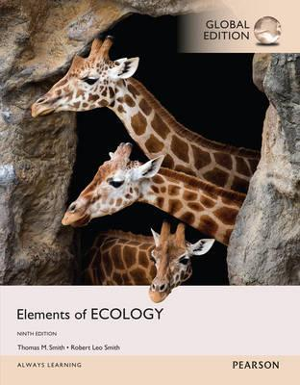
Introduction and definitions
https://www.pearson-studium.de/elements-of-ecology-global-edition.html

Slide 3
Introduction to Ecology
Ecology is the study of the relationship between organism and their environment.
Environment can be organic and inorganic.
Physical and chemical conditions as well as biological or living components of an organism’s surroundings.
Relationships include interactions with physical World as well as with members of the same and other species.

Slide 4
Introduction to Ecology
The term ecology comes from a Greek word.
Oikos→ family house hold
Logy → the study of ….
The root Word is the same with Economics
Economics→ management of household.

Slide 5
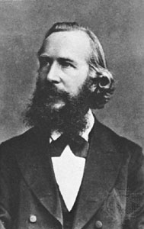
Introduction to Ecology
German zoologist Ernst Haeckel (1)
By ecology we mean the body of knowledge concerning the economy of nature – the investigation of the total relations of the animal both to its inorganic and to its organic; including above all, its friendly and inimical relations with those animals and plants with which it comes directly or indirectly into contact – in a word, ecology is the study of all those complex interrelationships referred to by Darwin as the conditions of the struggle for existence.
Ernst Haeckel, 1866.
The struggle for existence?

Slide 6
struggle for existence
Darwin considered the struggle for existence in a wide sense, including the competition of organisms for a possession of common places in nature, as well as their destruction of one another. He showed that animals and plants, remote in the scale of nature, are bound together by a web of complex relations in the process of their struggle for existence. "Battle within battle must be continually recurring with varying success" wrote Darwin, and "probably in no one case could we precisely say why one species has been victorious over another in the great battle of life (2).

Slide 7
struggle for existence
is a corner stone for ecology sicence.
It is a mechanism of natural history and examines the processes that control the distrubition and abundance of organism.
For more information

Slide 8
Organism and Environment
Organism interact with the environment at many levels.
physical and chemical conditions;
Ambient temperature,
Moisture
Oxygen concentrations
Carbon dioxide concentrations,
Ligt intensity
All influence biological processes for surviving and growth

Slide 9
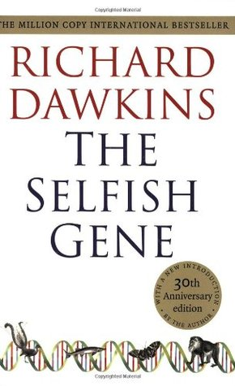
For survival → acquire essential resources from environment
→ must protect itself from being other organism’s resources (being eaten by others)
What is this for?
To pass its genes on to successive generations!

Slide 10
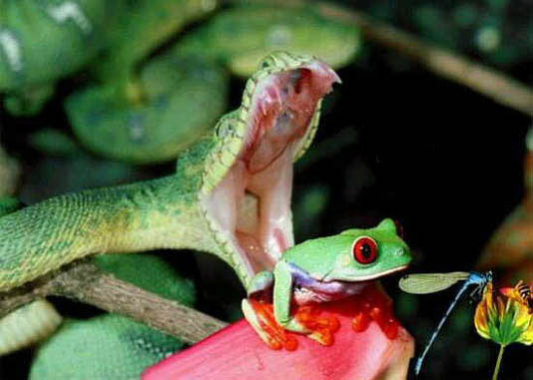

Slide 11
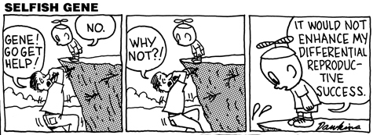
Environment
Environment is the place where each organism carries out the struggle for existence- a physical location in time and space.

Slide 12
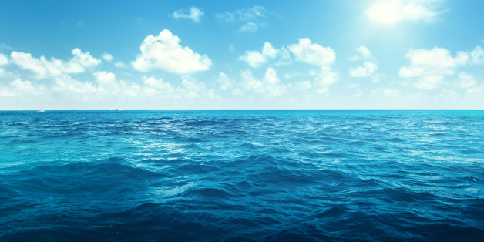
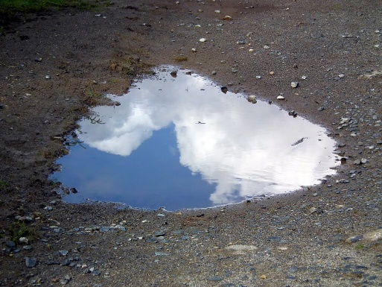
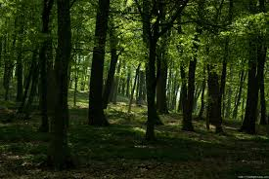
Environment
Can be large as the oceans,
Can be transisent as a puddle on surface after rain
Environment includes physical conditions, other organisms that coexist within.
This entity called ECOSYSTEM.

Slide 13
Ecosystem
Organism interact with the environment in the context of ecosystem.
The eco part relates to environment
The system part implies that the ecosystem functions as a collection of related parts that function as a unit.
In a broad meaning, ecosystem consists of two components

Slide 14
The living: BIOTIC
The nonliving: ABIOTIC
Biotics describe living or once living components of a community; for example organisms, such as plants and animals
Abiotics describe non-living chemical and physical parts of the environment that affect living organisms and the functioning of ecosystems

Slide 15
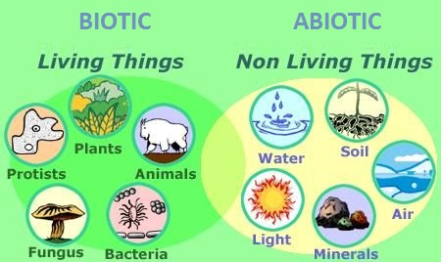
Ecosystem
https://socratic.org/questions/is-sunlight-a-biotic-factor-or-an-abiotic-factor

Slide 16
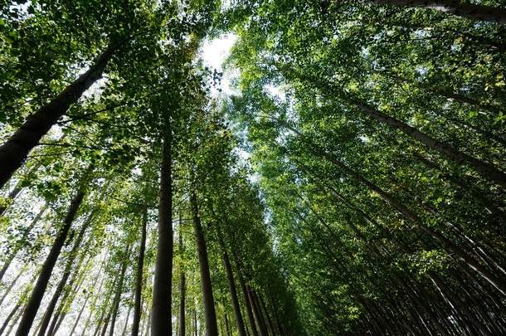
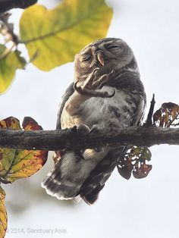
What are the abiotic and biotic components of forest ecosystem?
Atmosphere
Climate
Soil
Water
Plants
Animals
Microorganisms
What trees do?
What birds do?
What insects do?
Describe their interactions.

Slide 17
Ecological systems form a Hierarchy
Continuing with forest example…
Various kinds of organisms inhabit forest make up populations.
POPULATION?
In ecological meaning; population is a group of individuals of the same species that occupy given area.

Slide 18
Community
Populations in the ecosystem do not functions independently.
Compete with other populations for resources
Some populations can be food resources for another
Two populations can mutually benefit each other.
All populations of different species living and interacting within ecosystem collectively called COMMUNITY.

Slide 19
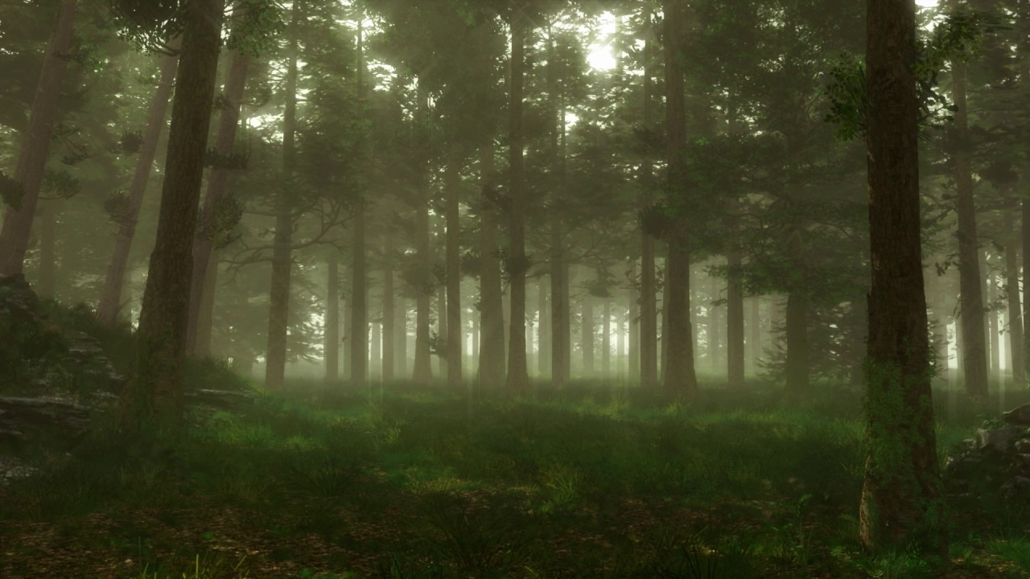
Ecosystem has many levels
Level 1. individual organisms both respond and influence the abiotic environment
Level 2. populations
Level 3. community
Level 4. individuals compete for resources
Level 5. microorganisms help decay of a dead organism.

Slide 20
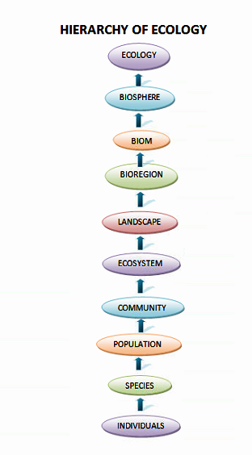
Ecological systems form a Hierarchy

Slide 22
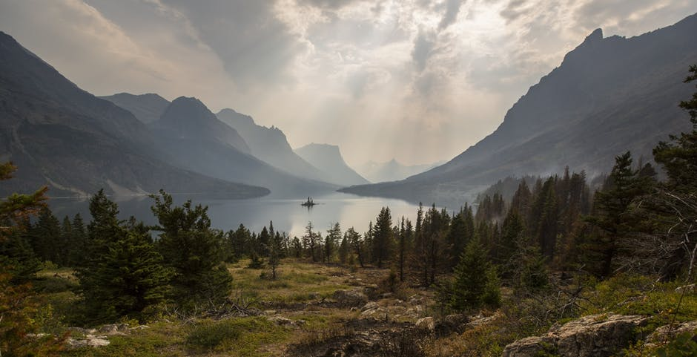
Landscape
All communities and ecosystems exist in in the broader spatial context of landscape.
Landscape: an area of a land or water, composed of a patchwork of communities and ecosystem.

Slide 23
Biomes and Biosphere
The broad-scale regions dominated by similar types of ecosystems (tropical rain forests, deserts etc) called biomes.
The highest level of organisation of ecological system is biosphere.
Biosphere: the thin layer surrounding the earth that supports all life. (also known as the ecosphere)
the part of the earth's environment where life exists (https://dictionary.cambridge.org/dictionary/english/biosphere)

Slide 24
Inportance of Ecology
Learning ecology is important to maintain coexistence.
If we dont understand ecology degradation of land and environment which is home to other species thus leading to extinction and endangerment of species because of lack of knowledge. e.g. dinosaurs ,mammoth, white shark ,black rhinos , sperm whales etc.

Slide 25
References
1- https://www.britannica.com/science/ecology
2- Gause, 1934.) «The Struggle for Existence» Chapter I THE PROBLEM)
3- https://socratic.org/questions/is-sunlight-a-biotic-factor-or-an-abiotic-factor
4- https://dictionary.cambridge.org/dictionary/english/biosphere
← Source material of this lecture
Further reading
https://asantos.webs.ull.es/The%20Struggle%20for%20Existence.pdf
http://s-f-walker.org.uk/pubsebooks/pdfs/Richard_Dawkins_The_Selfish_Gene.pdf

