Slide 1
Case Presentation Healthy Life Style
Associate Professor A. Selda Tekiner
Family Physician

Slide 2
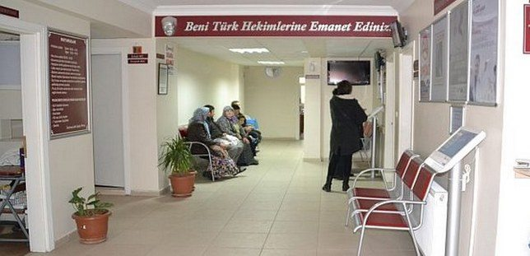
You are working at a «Family Health Center» in a district with a population of about 20.000.

Slide 3
A woman you've never met before wants you to examine her and wants you to be her family physician.
In fact, she doesn’t have any active complaint right now.

Slide 4
She then moved from her village where she had lived for years to the county.
She has 3 children and they left home after they got married.
Age: 50 years old
History: When you ask her to tell you about herself, she first says that her husband died in a car accident two years ago.

Slide 5
Her apperance is overweight
She always feels tired
She does not go to her garden/field in the village
Her relatives care for her animals in the village

Slide 6
She leaves the home only for urgent needs, she always stays at home
She has insomnia, she can’t sleep at night
She smokes 2-3 cigarettes a day (after her husband’s death)
Meanwhile she says that; her husband was addicted to cigarettes and smoked a lot in the house. She rarely accompanied him and smoked.
She has irregular menses and hot flashes

Slide 7
A neighbour who was a nurse has measured her arterial blood pressure (when her husband died) and told that her blood pressure is high and advised her to go to a doctor

Slide 8
She knows her blood pressure was rising when she had a headache and was drinking lemon water or eating garlic, she doesn’t use any medication for blood pressure.
A doctor she went to 6 months ago told her she had diabetes.
She hasn't had a doctor visiting regularly.

Slide 9
What to do

Slide 10
In primary health care, every interview may not end with a clinic decision.
At this stage there is not enough data to make clinical decisions about the patient.

Slide 11
IS SHE HEALTHY?

Slide 12
The definition of health according to World Health Organisation (WHO)
Health is a state of complete physical, mental, and social well-being and not merely the absence of disease or infirmity.
Preamble to the Constitution of the WorldHealth Organization, 1946.

Slide 14
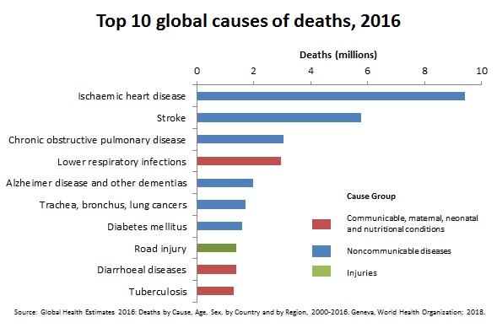

Slide 15
CASE
What the anamnesis tell us?

Slide 16
Problem list
Hypertension
Diabetes
Depression
Nicotine addiction
Obesity
Immobility
Menapouse

Slide 17
First we have to understand our patient, then we have to understand how possible diseases and psychosocial-cultural dynamics affect each other. This requires long-term follow-up.
We can manage these patients in primary care.

Slide 18
Physical Examination of the woman
TA: 130/80 mmHg,
Pulse 86/min
Height: 160 cm, Weight: 77 kg, BMI: 30 kg/m²
Heart and lung sounds normal
Abdomen seems obese

Slide 19
HYPERTENSION
Measurements made with the correct technique 3 times:
values above systolic blood pressure 140 mmHg or diastolic blood pressure 90 mmHg
Our measurement in our patient is 130/80 mmHg. We don't have a previous measurement document. Therefore, hypertension cannot be diagnosed at this stage in this case.
Notes:
For the diagnosis of hypertension,

Slide 21
LABORATORY TESTS
Despite the patient's high fasting blood glucose and history of diabetes (?), HbA1c is in normal range.
DIAGNOSTIC CRITERIA for DM: 1- In two measurements made on different days, fasting blood glucose > 126 mg/dl
2- In the presence of symptoms > 200 mg/dl in random measurement
3- HbA1c >6.5%
Hb:11g/dl
FPG:139
HbA1c: 5.9%
Total Cholesterol: 213 mg/dl
LDL (LDL- C): 139 mg/dl
Cholesterol HDL : 34 mg/dl
Trigliserid: 160 35 – 150 mg/dL

Slide 22
The diagnosis of diabetes has not been confirmed because there is only one measurement we have. This needs to be verified with a new analysis.
The strange point here is that despite the patient's high fasting blood sugar and history of diabetes, HbA1c is normal
Was she really hungry? Or Laboratory error?
When this patient's detailed nutritional history was taken, it was observed that she had been drinking honey syrup every morning for years and did not report it because she did not eat anything.
The patients should stop eating and drinking 8 hours before the test.
We should tell the patient that she/he can only drink pure water if she/he is thirsty.

Slide 23
It is seen that the patient's blood lipid profile is not optimal. Cholesterol treatment should also be included in the treatment plan.
Lifestyle changes such as diet and exercise should be recommended in addition to smoking cessation intervention
When these are not enough cholesterol-lowering drugs should be switched.

Slide 24
Our patient seems to have never recovered after her husband's death.
Prolonged grief disorder should also come to mind.
What is grief disorder? What is prolonged/complicated grief disorder? The doctor should distinguish these situations.
Because antidepressant drugs have no efficacy in prolonged grief disorder. The patient should be encouraged to talk about her loss. And maybe a specialist consultation is needed..
The doctor should also know the dynamics of family crisis such as children leaving the nest, moving, divorce…

Slide 25
Obesity, sedantary life style, smoking.
We should talk about these issues!!!
In addition, menopause and its natural process should be talked about;
Calcium, vitamin D support and regular exercise should be considered.

Slide 26
In primary health care services, we often encounter such undissociated, unorganized diseases
Disease findings are often not diagnostic in the early period. Here, if the process is not managed well and a trusting, sharing and healing relationship cannot be established with the patient, the risk of making mistakes increases.

Slide 28
TIPS FOR MAINTAINING A HEALTHY LIFESTYLE AND BODY WEIGHT
1-Measure and Watch Your Weight
2- Limit Unhealthy Foods and Eat Healthy Meals
3-Drink Water and Stay Hydrated, and Limit Sugared Beverages
4- Exercise Regularly and Be Physically Active
5-Reduce Sitting and Screen Time
6- Get Enough Good Sleep
7-Find Ways to Manage Your Emotions
8-Avoid negative people in your life.
9-Avoid negativity within yourself.
Stop smoking.
Do not forget to eat breakfast and choose a nutritious meal with more protein and fiber and less fat, sugar, and calories, Cut down on processed foods.

Slide 29
Examples from literature
1- Adults who do not smoke, consume a healthy diet, and engage in sufficient physical activity can substantially reduce their risk for early death. Earl S. Ford, et al,Healthy lifestyle behaviors and all-cause mortality among adults in the United States, Preventive Medicine, Volume 55, Issue 1, 2012
2- good friendships and a regular family life are important for students to have a Healthy Lifestyle. The students having difficulty in such aspects may be encouraged to benefit from school guidance services. Students are increasing their negative life behavior in advanced classes. Çalışkan, C., Arberk, K., & Üner, S. (2017). Healthy Lifestyle Behaviors of University Students. Prehospital and Disaster Medicine, 32(S1)
3- We found that a low-risk lifestyle is associated with lower risk of stroke, especially ischemic stroke, which adds to the data on the prevention of multiple chronic diseases, including CHD and diabetes. This study further supports the beneficial impact of a low-risk lifestyle on the primary prevention of chronic disease and long-term well-being. Stephanie E. Chiuve Primary Prevention of Stroke by Healthy Lifestyle Circulation August 26, 2008 Vol 118, Issue 912 Aug 2008
4- In this large prospective cohort of apparently healthy women, a healthy lifestyle consisting of abstinence from smoking, low body mass index, moderate alcohol consumption, regular exercise, and healthy diet was associated with a significantly reduced risk of total and ischemic stroke Kurth T, Moore SC, Gaziano JM, et al. Healthy Lifestyle and the Risk of Stroke in Women. Arch Intern Med. 2006;166(13):1403–1409. doi:10.1001/archinte.166.13.1403

Slide 30
As the population ages, a major challenge is to consider how to increase the quality and years of healthy life. Research on extrinsic determinants of ill health has focused mainly on behavioral risk factors, including tobacco use, poor diet, physical inactivity, and alcohol misuse, which the World Health Organization (WHO) has estimated to account for over one third of the global chronic disease burden. In this review we aim to reveal the current knowledge base on lifestyle factors for a healthy aging. We not only mention the facts on well-known lifestyle factors such as smoking, physical inactivity and alcohol use but also try to review the less-well known aspects of lifestyle factors such as nutrition and sun-exposure.

Slide 31
The world’s biggest killer is ischaemic heart disease, responsible for 16% of the world’s total deaths.
Since 2000, the largest increase in deaths has been for this disease, rising by more than 2 million to 8.9 million deaths in 2019.
Stroke and chronic obstructive pulmonary disease are the 2nd and 3rd leading causes of death, responsible for approximately 11% and 6% of total deaths respectively.

Slide 32
Non-communicable diseases accounted for 81 per cent of the deaths. The greatest causes of deaths were chronic obstructive pulmonary disease (450,000 deaths); stroke (400,000 deaths) and ischaemic heart disease (350,000 deaths). Occupational injuries caused 19 per cent of deaths (360,000 deaths).

Slide 33
S.D.Ü. Týp Fak. Derg. 2006:13(4)/ 43-48
Aydýn, Toplum ve Birey Ýçin Saðlýklý Yaþlanma

Slide 34
THANK YOU

