Slide 1
Motivation
Motivation is an important part of animal nature:
Motivation connects observable behavior to internal states

Slide 2
Yerkes-Dodson Law

Slide 3
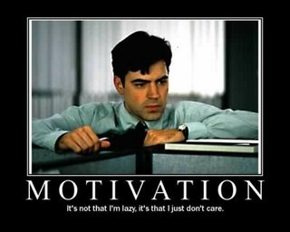
Motivation
Motivation

Slide 4
Motivation
Psychologists see motivation as being an important part of human nature:
Motivation connects observable behavior to internal states
Motivation accounts for variability in behavior
Motivation creates perseverance despite adversity
Motives relate biology to behavior

Slide 5
Types of Motivation
Drive: Biologically instigated motivation. A state of tension is created, which humans will seek to correct.
Drinking water
Motive: Motivational process that is learned.
Achievement
While some motivated behaviors clearly fall into one of these two categories, many have roots in both biology and cognition/learning.

Slide 6
Extrinsic vs. Intrinsic Motivation
Extrinsic Motivation: A desire to perform a behavior because of promised reward or threats of punishments.
Intrinsic Motivation: A desire to perform a behavior for its own sake and to be effective.
Examples?

Slide 7
So which type of motivation is better? Which produces more, positive results?
Research indicates that intrinsic motivation has an edge over extrinsic motivation in most cases.
This does not mean that extrinsic motivation isn’t good or does not work. In many cases, the two work together.
For example, the journalism students who wash cars as a fund raiser all spring and summer to pay for their trip to the national convention in St. Louis in the fall are working to make money….extrinsic motivation. Their desire to go to the convention, however, is intrinsic motivation.

Slide 8
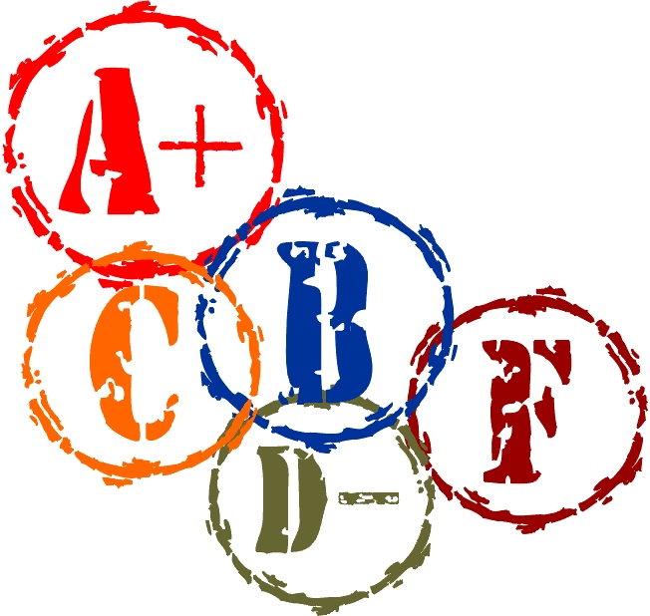
Problems with Extrinsic Motivation
A primary concern about external rewards, however, is that behaviors maintained by extrinsic motivation alone may not be enough to be effectively sustained once the motivation is gone.
Example: Will a student’s grades go down if their parents stop giving them money for earning As and Bs?
Evidence suggests that the removal of an extrinsic motivation will result in behavior levels lower than before the rewards were given.

Slide 9
Overjustificaion
The overjustification effect is the idea that if we give extrinsic rewards or motivators for things that people already love to do and would do without a reinforcer, eventually the person’s intrinsic motivation will be replaced by that extrinsic motivation.
Ex: Professional athletes, musicians

Slide 10
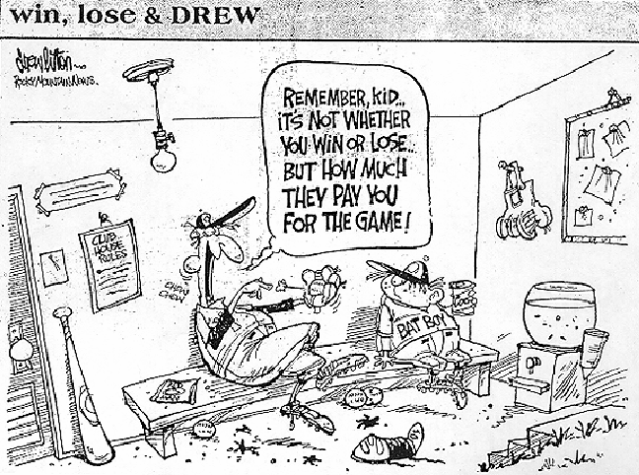

Slide 11
Theories of Motivation
Instinct Theory: The theory that all behaviors will be determined by innate factors and biologically based behaviors that generally lead to survival.
The term instinct was becoming overused, so the psychologist changed the phrase they use to fixed-action patterns.
Birds migrating, salmon returning to creeks to spawn
Why do you think this theory became outdated?
Does this theory really explain behavior?

Slide 12
Drive Reduction Theory
Drive-Reduction Theory: The idea that a physiological need creates a state of tension (a drive) motivating and organism to satisfy their needs.
Drive-reduction theory states that a person will eat food as a result of a drive of hunger (a state of tension that humans seek to correct).
The theory aims for homeostasis, or biological balance
Drive-reducing behaviors
(eating, drinking)
Need
(food, water)
Drive
(hunger, thirst)

Slide 13
And tables to compare data
 | A | B | C
Yellow | 10 | 20 | 7
Blue | 30 | 15 | 10
Orange | 5 | 24 | 16

Slide 14
89,526,124$
185,244 users
100%
That’s a lot of money
And a lot of users
Total success!

Slide 15
Let’s review some concepts
Yellow
Is the color of gold, butter and ripe lemons. In the spectrum of visible light, yellow is found between green and orange.
Blue
Is the colour of the clear sky and the deep sea. It is located between violet and green on the optical spectrum.
Red
Is the color of blood, and because of this it has historically been associated with sacrifice, danger and courage.
Yellow
Is the color of gold, butter and ripe lemons. In the spectrum of visible light, yellow is found between green and orange.
Blue
Is the colour of the clear sky and the deep sea. It is located between violet and green on the optical spectrum.
Red
Is the color of blood, and because of this it has historically been associated with sacrifice, danger and courage.

Slide 16
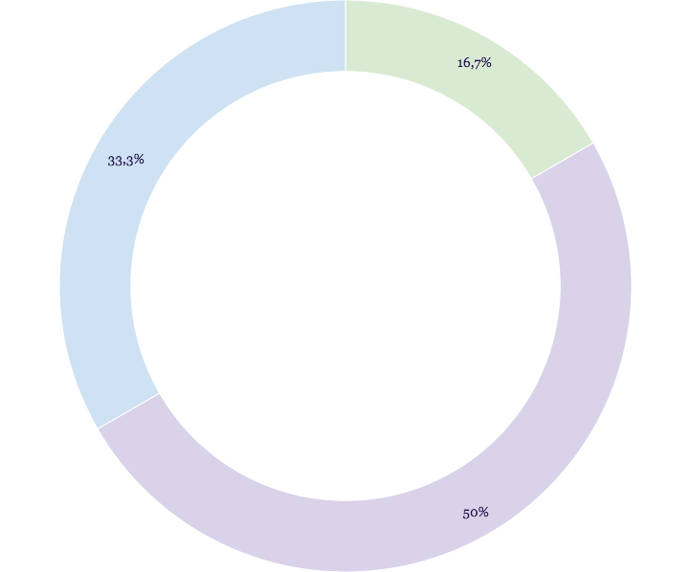
You can insert graphs from Google Sheets

Slide 17
iPhone project
Show and explain your web, app or software projects using these gadget templates.
Place your screenshot here

Slide 18
Tablet project
Show and explain your web, app or software projects using these gadget templates.
Place your screenshot here

Slide 19
Thanks!
Any questions?
You can find me at @username and user@mail.me

Slide 20
Credits
Special thanks to all the people who made and released these awesome resources for free:
Presentation template by SlidesCarnival
Photographs by Unsplash

Slide 21
Presentation design
This presentation uses the following typographies and colors:
Titles: Abril Fatface
Body copy: Raleway
You can download the fonts on this page:
https://www.fontsquirrel.com/fonts/abril-fatface
https://www.fontsquirrel.com/fonts/raleway
Pastel green #bdece5
Pastel blue #afcfec
Violet #c0cafc
You don’t need to keep this slide in your presentation. It’s only here to serve you as a design guide if you need to create new slides or download the fonts to edit the presentation in PowerPoint®

Slide 22
SlidesCarnival icons are editable shapes.
This means that you can:
Resize them without losing quality.
Change fill color and opacity.
Change line color, width and style.
Isn’t that nice? :)
Examples:

