Slide 1
Special working methods
Working Under Low Pressure
Glass materials with scratches or cracks on the outer surface should not be used.
Vacuumed glass should not be heated in one direction.
Only spherical glassware should be used.
When large volume glass containers are vacuumed, the glass container must be surrounded by a wire cage in case the glass is broken and scattered.

Slide 2
Compressed Gases
Carefully read the label before using or storing compressed gas. The MSDS will provide any special hazard information. Always use the minimum size cylinder required to perform the work.
Cylinders of compressed gases must be handled as high energy sources. When storing or moving a cylinder, have the cap securely in place to protect the stem. Use suitable racks, straps, chains or stands to support cylinders.
Compressed gas cylinders pose a crush hazard to hands and feet.
Do not expose cylinders to temperature extremes.
Do not store cylinders or lecture bottles with the regulator in place. If the regulator fails, the entire contents of the gas cylinder may be discharged.
Always use the correct regulator. Do not use a regulator adapter. Oil or grease on the high pressure side of an oxygen cylinder can cause an explosion. Do not lubricate an oxygen regulator.
Cylinders of toxic, flammable or reactive gases should be stored and used in a fume hood or with local ventilation.
Never bleed a cylinder completely empty. Leave a slight pressure to keep contaminants out.
Always wear safety glasses when handling compressed gases.

Slide 3
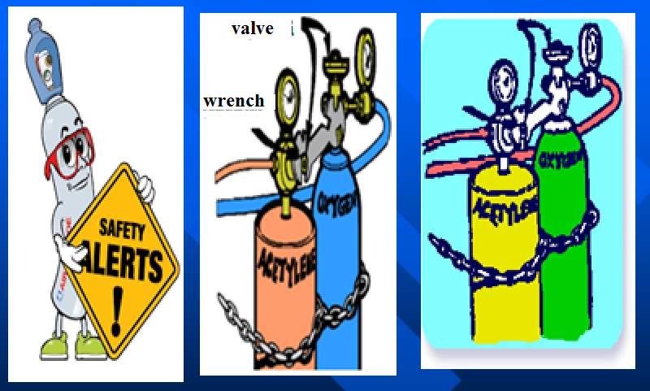

Slide 4
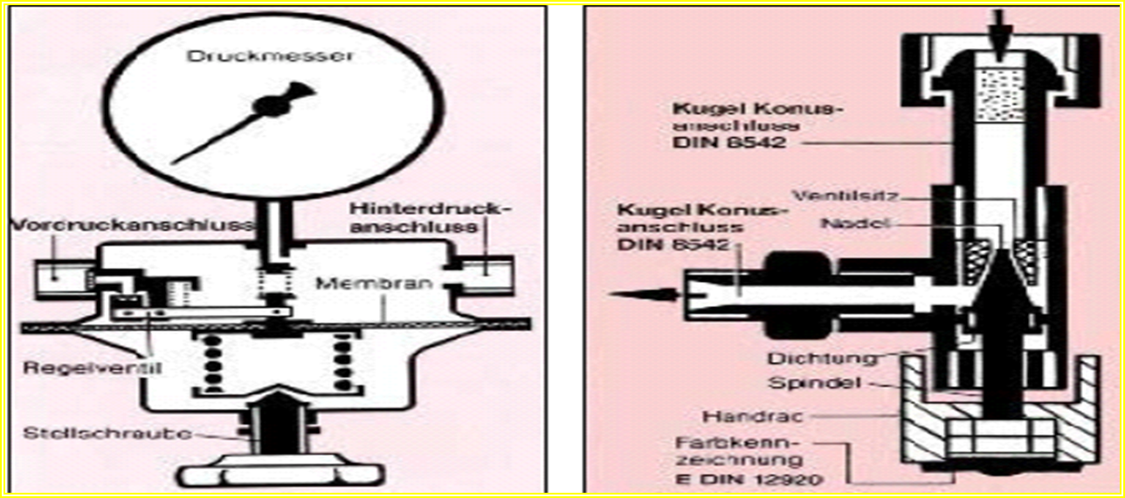
Taking gas from pressure cylinder
Gases under high pressure such as H2, N2, O2, inert gases, hydrocarbons, CO2, CO are taken from the tube by means of pressure gauge.
Liquefied gases such as ammonia, HCl, SO2 and Cl are removed from the tube by means of a needle valve.

Slide 5
Connection of manometer

Slide 6
Working Under High Pressure
The maximum pressure at which the pressure receptacles can be used is known and care must be taken not to exceed this pressure during the reaction.
Connections to pressure vessels should only be turned on and off once system pressure is reduced to atmospheric pressure.
Autoclave should be used if the pressure and temperature are not known at the end of the reaction.

