Slide 1
SYLLABUS
WEEK | SUBJECT
1 | Vitamins (structure & functions)
2 | Oil soluble vitamins
3 | Water soluble vitamins
4 | Minerals in foods
5 | Organic acids in foods
6 | Food Pigments
7 | Food Enzymes
8 | MIDTERM EXAMS WEEK
9 | Phenolic compounds in foods
10 | Natural toxic compounds in foods
11 | Food aromas
12 | Food preservatives
13 | Residues and contaminants in foods
14 | Chemical composition of major foods
HW

Slide 2
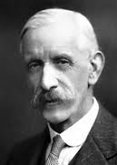
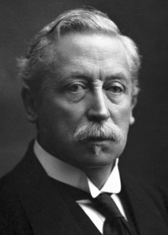
VITAMINS
Frederick Hopkins postulated that some foods contained "accessory factors" — in addition to proteins, carbohydrates, fats etc. — that are necessary for the functions of the human body (1912). Hopkins and Christiaan Eijkman (who in 1897 discovered that feeding unpolished rice instead of the polished variety to chickens helped to prevent beriberi in the chickens) were awarded the Nobel Prize for Physiology or Medicine in 1929 for their discoveries.
1929 Nobel
Sir Frederick Gowland Hopkins
(1861-1947)
Christiaan Eijkman
(1858-1930)

Slide 3
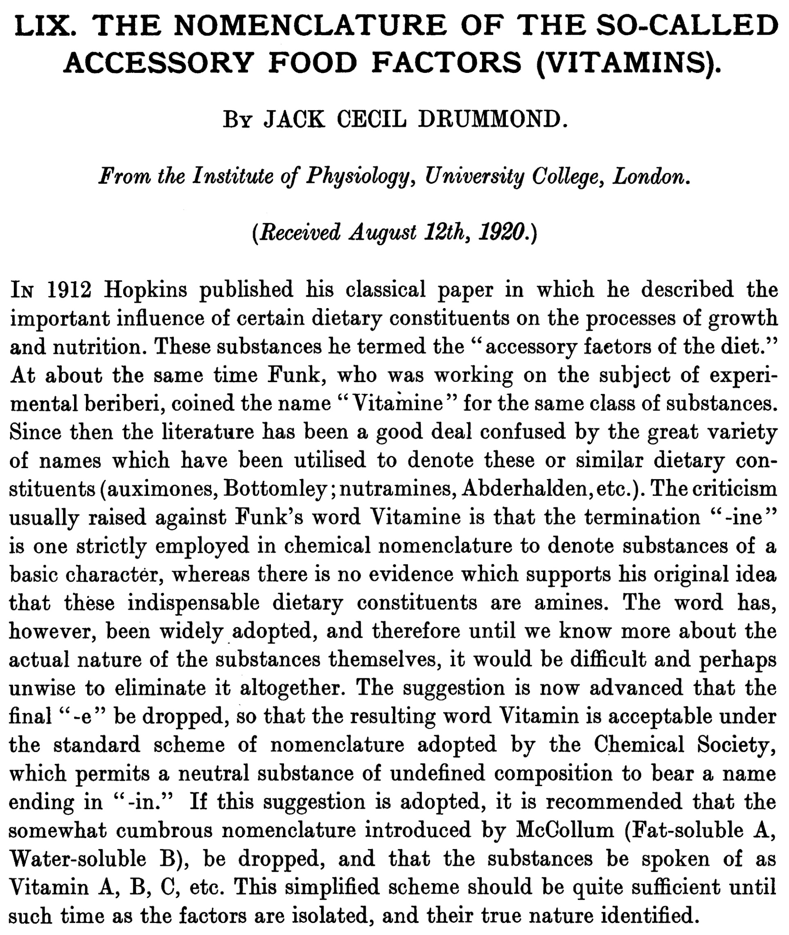
Max Nierenstein a friend and reader of Biochemistry at Bristol University reportedly suggested the "vitamine" name (from "vital amine"). The name soon became synonymous with Hopkins' "accessory factors", and, by the time it was shown that not all vitamins are amines, the word was already commonly used.
In 1920, Jack Cecil Drummond proposed that the final "e" be dropped to deemphasize the "amine" reference, after researchers began to suspect that not all "vitamines" (in particular, vitamin A) have an amine component.

Slide 4
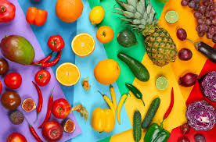
VITAMINS
Vitamins are defined as «small organic molecules present in diet which are required in small amounts»
Most of the vitamins are not synthesized in the body and hence they must be supplied in the diet.
Some are present as precursors. The precursor forms of vitamins are called as provitamins. In the body these provitamins are converted to vitamins. For example, the body synthesizes vitamin A from the β-carotene in vegetables like carrots and sweet potatoes.
Vitamins are a necessary part of the biochemical reactions in the body. They are involved in a number of processes, including mineral and bone metabolism, and cell and tissue growth, and they act as cofactors for energy metabolism.

Slide 5
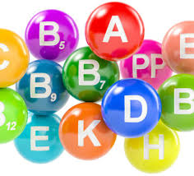
Classification of Vitamins
Vitamins are divided into two groups.
1. fat soluble vitamins
2. water soluble vitamins.
Fat Soluble Vitamins
-They are vitamins A, D, E and K.
They have some common properties:
1. Fat soluble.
2. Require bile salts for absorption.
3. Stored in liver.
4. Stable to normal cooking conditions.
5. Excreted in feces.
6. Can accumulate in the lipids stored in the body. If excess vitamins are retained in the lipid stores in the body, hypervitaminosis can result.
Oil-soluble: 4
Water soluble: 9 (Vit. C + 8 B group)
Water Soluble Vitamins:
-They are members of vitamin B complex and Vitamin C.
Their common properties are :
Water solubility.
Except Vitamin B12 others are not stored.
Unstable to normal cooking conditions.
Excreted in urine.
move easily through bodily fluids, which are water based, so they are not stored in the body.

Slide 6
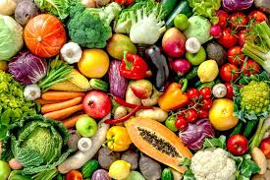
BIOLOGICAL IMPORTANCE
1. Vitamins are essential for growth, maintenance and reproduction. However, they are not used for energy production.
2. Fat soluble vitamins are required for normal color vision, blood clotting, bone formation and maintenance of membrane structure.
3. Most of the water soluble vitamins function as coenzymes or prosthetic groups of several enzymes involved in carbohydrate, lipid and amino acid metabolism etc.
4. Vitamins A and D act as steroid hormones.
5. Deficiency of fat soluble vitamins produce night blindness, skeletal deformation etc.

Slide 7
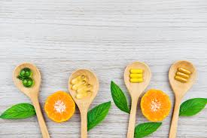
BIOLOGICAL IMPORTANCE
6. Deficiency of water soluble vitamins produce beriberi, glossitis, pellagra, anaemia, and scurvy.
7. Some vitamin analogs are used for medicinal purposes. For example folic acid analogs are used as anticancer agents and antibiotics.
8. Moderate consumption of some vitamins is found to decrease occurrence or severity of some diseases. For example carotenes, Vitamin E and Vitamin D consumption at moderate level reduces incidence of cancer and cardiovascular diseases.

Slide 8
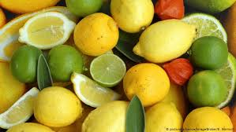
BIOLOGICAL IMPORTANCE
9. Consumption of vitamin C in significant amounts reduces severity of flu. They slow down ageing process also. However, excessive consumption of fat soluble vitamins leads to toxicity.
10.Vit B12, Folic acid and Vit B6 are beneficial to coronary artery disease patients.

Slide 9
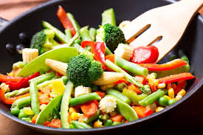
Effects of Cooking
various vitamins are susceptible to loss from heat—such as heat from boiling, steaming, frying, etc.
The effect of cutting vegetables can be seen from exposure to air and light.
Water-soluble vitamins such as B and C dissolve into the water when a vegetable is boiled, and are then lost when the water is discarded
Some vitamins may become more "bio-available" – that is, usable by the body – when foods are cooked.

