Slide 1
Electrochemical energy storage: batteries and capacitors
ENE 304 Materials in Energy Technologies

Slide 2
The fundamental science behind energy storage
Advantages of the lithium-ion batteries :
1. When compared to other batteries of the rechargeable family, lithium-ion batteries are lighter.
2. Lithium-ion batteries do not have memory effect.
3. Lithium-ion batteries are more resistant to overcharge and less chance of leakage of electrolyte.
4. Lithium-ion batteries do not contain any toxic or hazardous elements.
5. Lithium-ion batteries have low self discharge rate.

Slide 3
The fundamental science behind energy storage
Disadvantages of the lithium-ion batteries :
1. The lithium-ion batteries are more expensive than nickel-cadmium batteries.
2. Internal resistance of the lithium-ion batteries increases with cycling and age.
3. The lithium-ion batteries are fragile and they require a protection circuit to maintain safe operation.

Slide 4
The present status of advanced batteries
Any cathode material for a lithium-ion battery must satisfy the following requirements.
(a) The cathode material must contain a readily reducible/oxidizable ion such as a transition metal.
(b) The cathode material must react with lithium reversibly.
(c) The cathode material must react with lithium with a reaction of high energy for high voltage.
(d) In order to provide high power, the cathode material should react with Li very rapidly.
(e) To relieve the need for a conductive additive, the cathode material should ideally be a good electronic conductor.

Slide 5
The present status of advanced batteries
LiTiS₂, LiCoO₂, andLiFePO₄ illustrate the full range of properties expected for a cathode material.
LiTiS2, LiCoO2, andLiFePO4 have a transition-metal ion that can be oxidized on removal of lithium.
The resulting irregularity causes capacity loss on cycling.
LiTiS2, LiCoO2, andLiFePO4 react with lithium with a relatively high free energy of reaction, but with LiCoO2 illustartes the highest value.
LiTiS2, LiCoO2, andLiFePO4 react with lithium very rapidly. LiCoO2 shows the slowest lithium diffusion in the lattice.

Slide 6
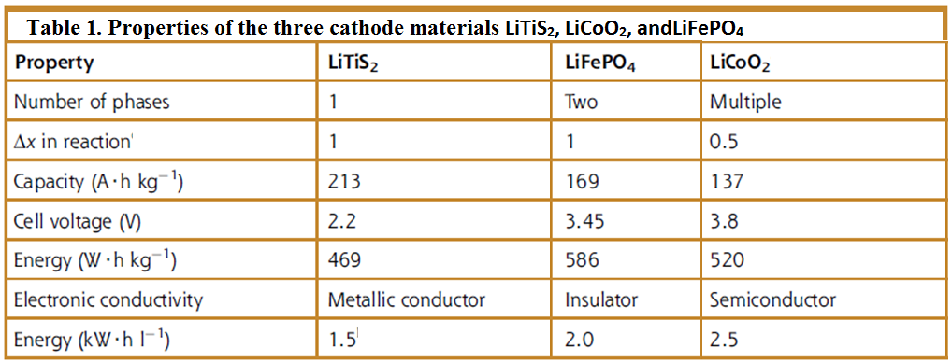
The present status of advanced batteries

Slide 7
The present status of supercapacitors
Capacitors differ from batteries in that they store energy as a charge on the surface of the electrical surface rather than the chemical reaction of the bulk material.
Hence, the electrodes do not have to be structurally altered and have a longer lifetime - essentially unlimited under perfect conditions.
They tend to have much higher rate characteristics than batteries, are almost instantly charged or discharged,
They are therefore well suited for repeated applications such as regenerative breaking and subsequent accelerating applications.

Slide 8
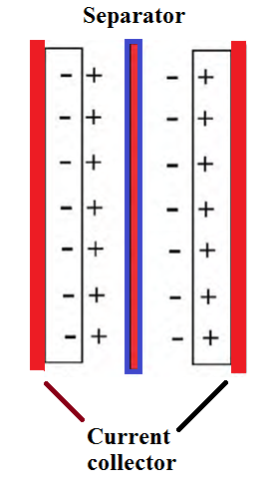
The present status of supercapacitors
Since capacitors use only the surface of the material for charge storage, they are very limited in energy-storage capability.
Moreover, capacitors provide a rather low quality of energy; typically the voltage varies in a continuous manner from the charging voltage to 0 V.
Figure 2. Schematic representation of energy
storage in an electrochemical capacitor

Slide 9
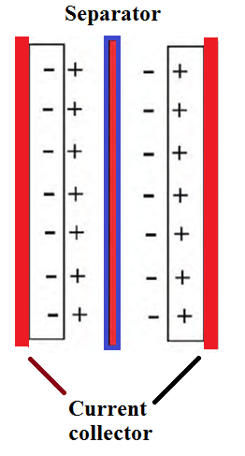
The present status of supercapacitors
Electrochemical capacitor is a type of capacitors, which utilizes high-surface-area carbon for the electrodes and sulfuric acid or acetonitrile as the electrolyte.
Moreover, electrochemical capacitors can be classified into two groups: supercapacitors and pseudocapacitors.
Supercapacitors are the electric double-layer capacitors, where the energy is stored at the surface of the material in the double layer.
Figure 2. Schematic representation of energy
storage in an electrochemical capacitor

Slide 10
References
M. Stanley Whittingham, Electrochemical energy storage: batteries and capacitors, in Fundamentals of Materials for Energy and Environmental Sustainability (Eds. David S. Ginley, David Cahen), Cambridge University Press, 2012.
http://www.upsbatterycenter.com/blog/li-batteries/
http://www.jmbatterysystems.com/technology/cells/how-cells-work

