Slide 1
REPRODUCTIVE HERD HEALTH
Prof.Dr. Şükrü Küplülü

Slide 2
ABORTION

Slide 3
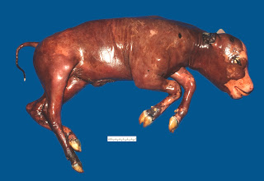
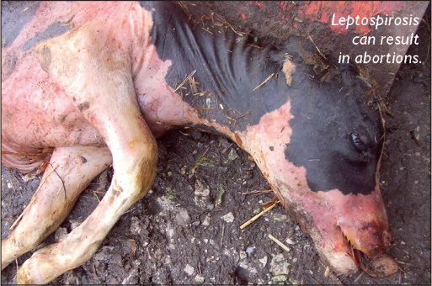
Abortion
Abortion: 45-270 of pregnancy. days
Infectious
Non-Infectious
www.vetsonline.com

Slide 4
Infectious abortions
BACTERIAL REASONS
B.abortus, campylobacter fetus, leptospira, listeria
VIRAL REASONS
BHV 1, IBRV, BVD
PROTOZOON SOURCES
Neospora caninum
MYCOTIC SOURCES

Slide 5
Specific Abortion Factors
Brucella abortus
Leptospira
hardjobovis
hardjoprajitro
Listeria monocytogenes
BVD
BHV1
Neospora caninum
http://www.vectortemplates.com/raster/maps-world-map-02.png

Slide 6
Neosporosis
http://neosporosis.wikispaces.com/

Slide 7
Neosporosis
Infection Days | 14. day | 46.dat | 60. Day and later
Antibody Response | ANTIBODY PRODUCTION BEGINS | ANTIBODY PRODUCTION | ANTIBODIES CANNOT BE DETERMINED IN THE BLOOD
SPORADIC ABORTUS
WIDE ABORTUS
REPEATS ABORTUS

Slide 8
Neosporosis
Infected calves;
ataxia
Weakness in reflexes
Exophthalmos may be seen.
Under the Influence of Neosporosis
Resorption of the embryo can be formed.
Mumification cases can be seen.
Live puppies can be born.

Slide 9
Neosporosis diagnostic methods
Diagnosis method | Morbid substance
IFAT | Blood serum and milk
ELISA | Blood serum and milk
Histological Examination | Lesions in the Brain (Fetus)
PCR | Fetal tissue and fluids

Slide 10
Brucellosis Factor: B.abortus
The causative agent is intracellular pathogen.
It usually enters the body orally.
House flies (Musca domestica) are effective in spreading infection.
Abortion can be seen within 2 weeks-5 months after infection.

Slide 11
Brusellosis
Source:
Waste fetuses-placentas
Uterine currents
Milk-urine-semen-feces.
The agent can survive at high humidity and low ambient temperatures.

Slide 12
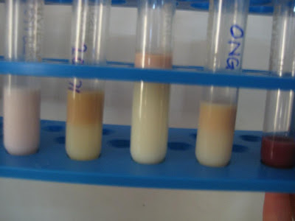
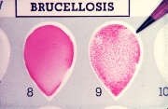
Brusellosis Diagnosis
Blood serum and milk samples can be taken for serological testing purposes.
Milk samples should be taken from each breast lobe.
Abort material should be sent to lab in cold chain.
audreysadventuresinindia.blogspot.com.tr/
http://www.fao.org

Slide 13
Brusellosis Protection
Calves and pregnant heifers should be vaccinated.
Use of infected semen should be avoided.
Live vaccines should not be used in pregnant women.
S19
45/20
RB51
Disinfection should be considered.
Biosecurity is important.

Slide 14
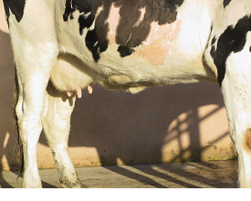
Leptospirozis Clinical Forms Hardjobovis-Hardjoprajitro
Udder Form
Sudden decrease in milk yield.
Loose Breast
Colostrum-like secretion
Sometimes bloody milk
Abortion Form
It happens in the second half of pregnancy.
Udder form can be seen together
Normal looking fetus
http://www.nadis.org.uk/bulletins/leptospirosis-in-cattle.aspx
www.vetsonline.com

Slide 15
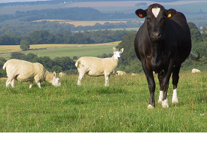
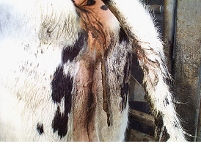
Infection spread of leptospirosis abortions
Contamination (cow-sourced)
Pee
Abortion Fetus
Uterine discharge
Transition from bull with semen
Sheep-induced contamination
grassland
Drinking water
http://www.nadis.org.uk/bulletins/leptospirosis-in-cattle.aspx

Slide 16
Leptospirosis Abortion Treatment-Prevention
Antibiotic therapy
Dihydrostreptomycin (25mg / kg)
Amoxicillin (15mg / kg)
Vaccination programs
Type-specific vaccines available
Vaccination from age 5 months
2 doses of vaccine at least 4 weeks apart
Vaccines prevent abortion but bacterial scatter continues

Slide 17
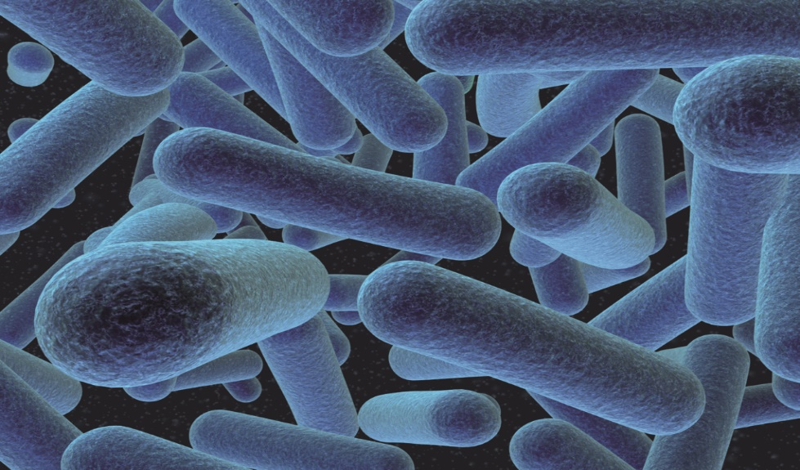
Listeriosis Abortions Listeria monocytogenes
Microorganism;
3- 45 ° C
It can grow between pH 5.6 and 9.6.
It is originated from soil and digestive system.
It usually causes sporadic abortion.
http://www.intechopen.com/books/probiotic-in-animals/the-use-of-probiotic-strains-as-silage-inoculants

Slide 18
Listeriosis Abortion Transmissions Listeria monocytogenes
the INHALATION
DIRECT CONTACT
DIGESTIVE SYSTEM
VENERAL TRANSMISSION

Slide 19
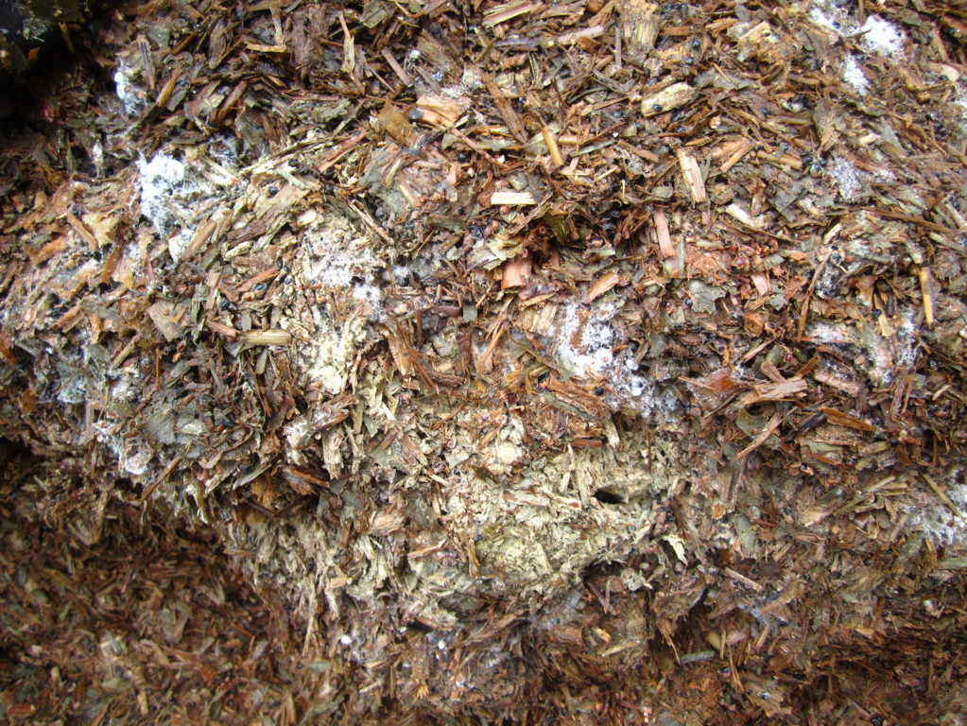
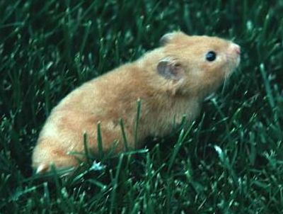
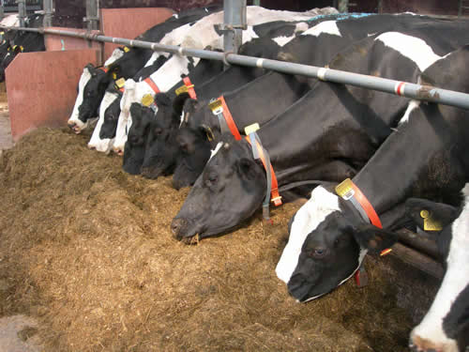
Listeriosis Abortions Listeria monocytogenes
www.intechopen.com
www.kidport.com
http://www.afbini.gov.uk

Slide 20
Diagnosis of Listeriosis Abortions
Fetus;
otolitic
Non-specific disorders
Fetal septicemia is seen.
http://www.nadis.org.uk

Slide 21
BVD-MD Abortions
Factor: Pestivirus family
Medicine:
Type 1: Non Cytopathic Common cause of disease
Type 2: Cytopathic Virulence High-Superinfection
Reservoir:
Wild animals like deer
Persistent Infected Animals
IBR-Parainfluenza-RSV.

Slide 22
BVD-MD Abortions Clinical Forms
Digestive system form
Diarrhea
Gastrointestinal ulceration
Respiratory tract infection
thrombocytopenia
Reproductive system form
Early embryonic death
the mummification
Abortions
Infertility

Slide 23
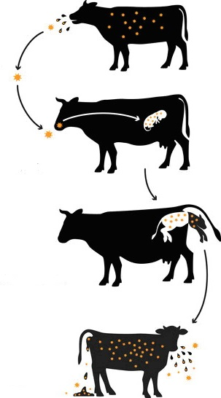
BVD-MD Abortion Pathogenesis
Infection Source:
Persistent Infected Animals
Nature
Horizontal transmission
www.kreis-paderborn.de

Slide 24
IBR Abortions , Bovine Herpes Virus 1
Factor: Herpesvirus family
BHV 1 has two subtypes.
IBR
They cause IPV.
The incubation period varies between 10-20 days.
Herpesviruses are in latent form and are reactivated as a result of immunosuppression.

Slide 25
BVD-MD Abortions Bovine Viral Diarrhea Virus
Diagnostic Methods
Virus detection in fetal fluids PCR (DNA isolation)
Blood sample in EDTA tubes
Nasopharyngeal swap ELISA (Antibody)
Antibody level in tank milk
If an infected animal is found in the herd, blood samples must be taken twice from the whole flock at 6-week intervals and sent to the laboratory.

Slide 26
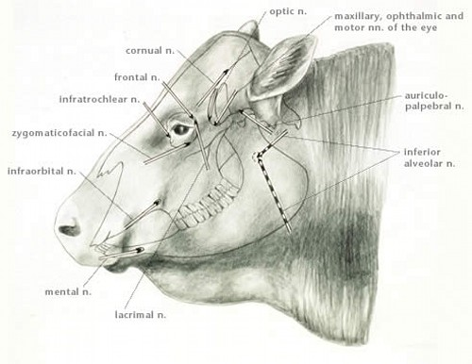
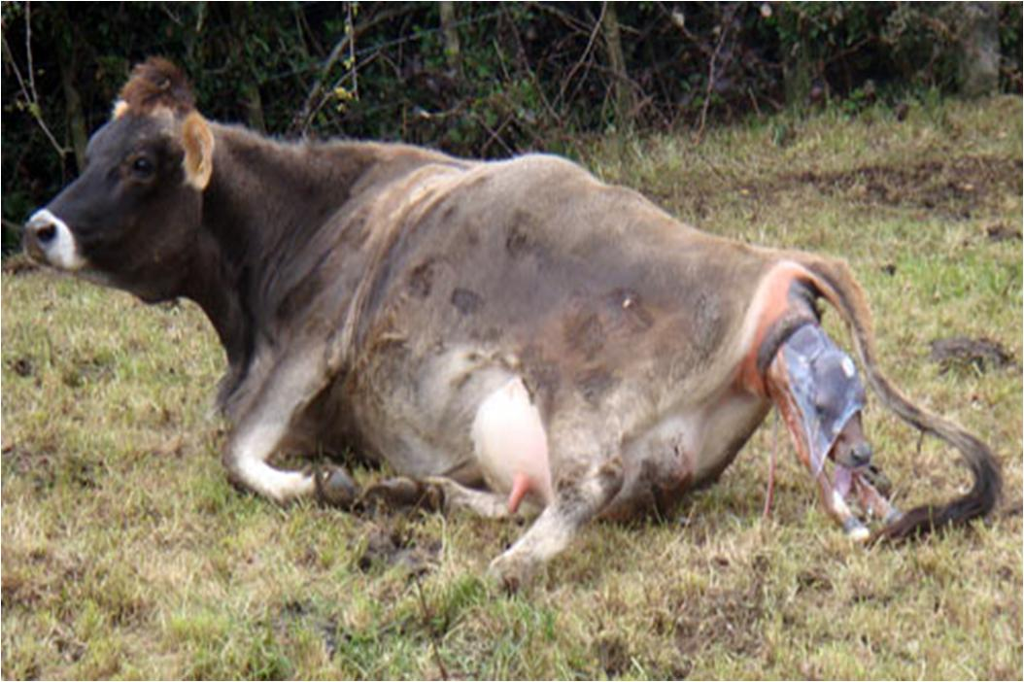
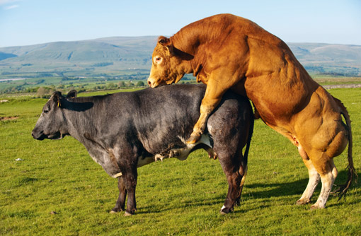
IBR Abortions Bovine Herpes Virus 1
Corticosteroid injections stimulate virus scattering.
Latent infection can be found in 10% of clinically normal animals.
http://www.merckvetmanual.com
https://thevaliens.files.wordpress.com/2012/10/cow-giving-birth.jpg
http://gatewayvet.ca/gvs-health-la-preg-bull.html

Slide 27
IBR Abortions Bovine Herpes Virus 1
The disease can occur in 5 forms.
Respiratory System Form
Reproductive System Form
Generalize / Alimenter Form
Encephalitic Form
Other

