Slide 1
SEUE1003 WATER LITERACY
assıst. Prof. Şeyda Fikirdeşici Ergen

Slide 2
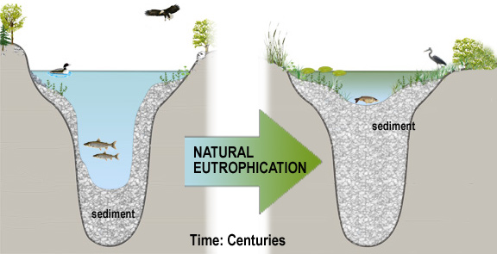
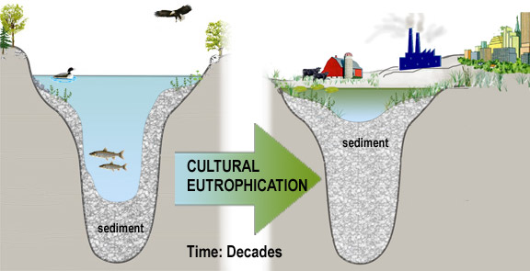
Types of Eutrophication
Natural Eutrophication
Cultural Eutrophication
Sewage wastes
erosion of rocks
soil structure of lake floor
forest fires
industrial and domestic wastewater
plant pollen
erosion
drainage waters from
agricultural land and
fertilization
detergents
Humans can speed up the process of eutrophication by adding excess nutrients and sediment, It is a process that has happened in a short time like decades. This type of eutrophication is called cultural eutrophication because humans cause it.
Eutrophication is a natural process that a lake goes through over hundreds to thousands of years. Natural eutrophication is also sometimes referred to as lake aging.
Notes:
There are two types of eutrophication. Natural and cultural eutrophication. Eutrophication is the process in which lakes receive nutrients (phosphorus and nitrogen) and sediment from the surrounding watershed and become more fertile and shallow. The additional nutrients are food for algae and fish, so the more eutrophic a lake is, the more living organisms it sustains. When a lake becomes shallower from added sediment, even more plants can grow because the littoral area (the area of the lake that is shallow enough for light to reach the bottom) increases in overall percentage. Eutrophication is a natural process that a lake goes through over hundreds to thousands of years. Natural eutrophication is also sometimes referred to as lake aging.
By human activity can dramatically increase eutrophication, leading to major ecological changes in decades, rather than centuries.

Slide 3
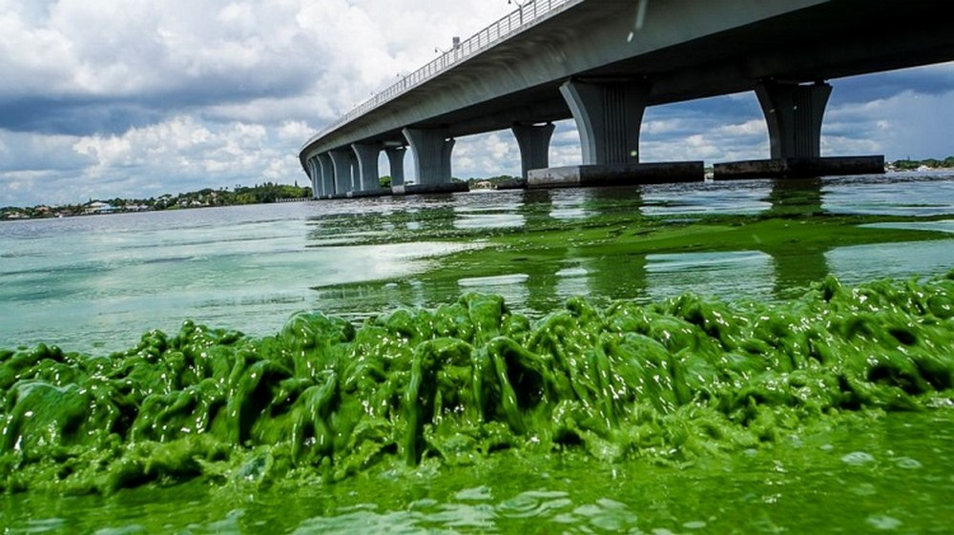
POSSIBLE SOLUTIONS FOR EUTROPHICATION

Slide 4
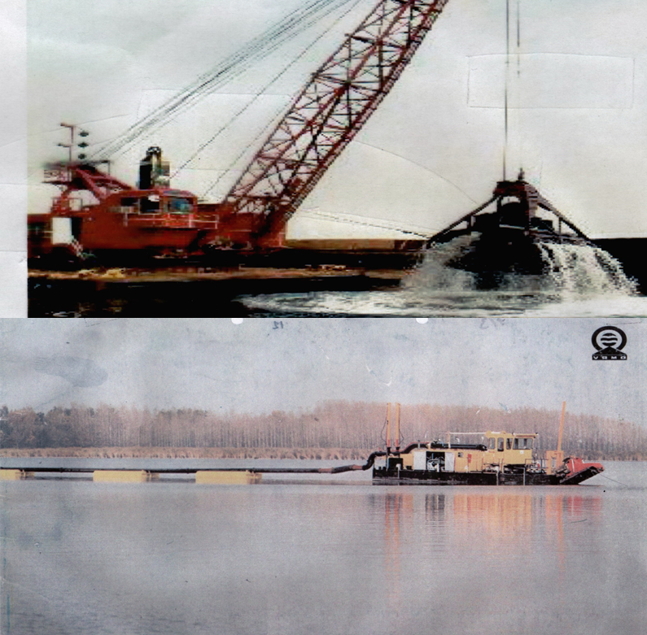
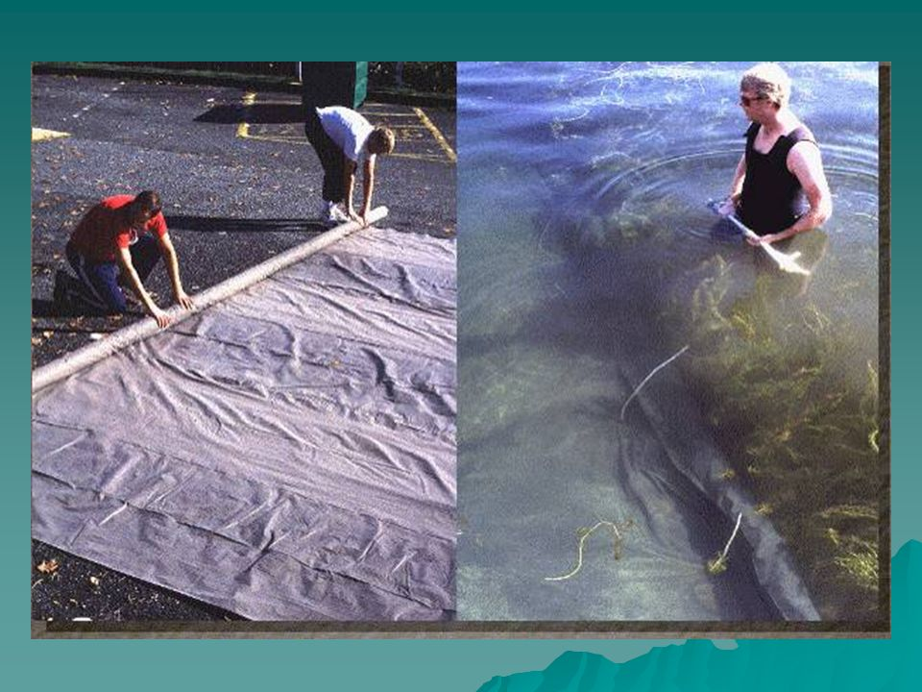
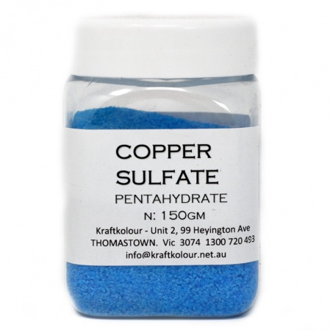
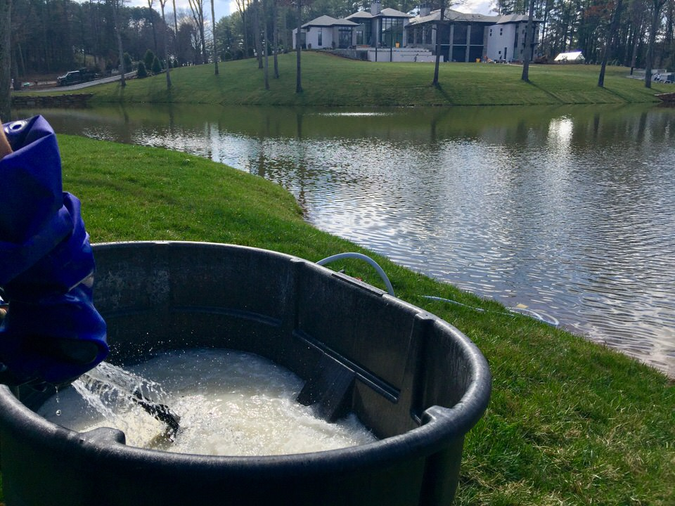
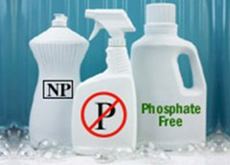
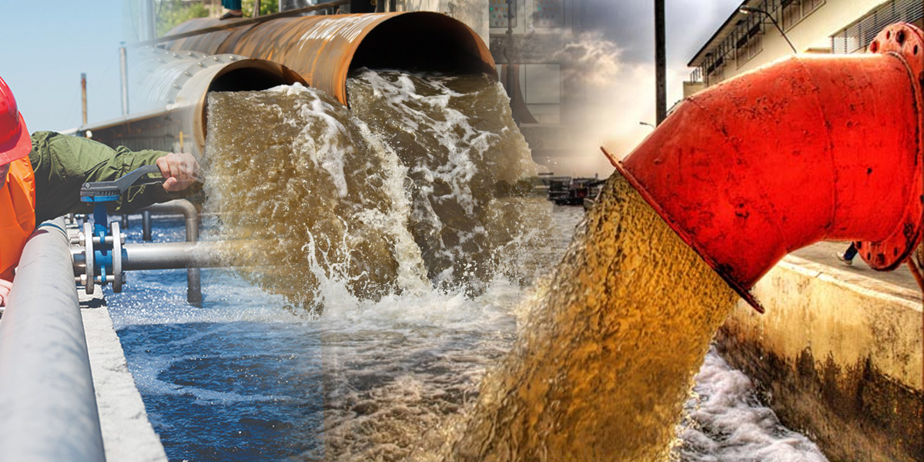
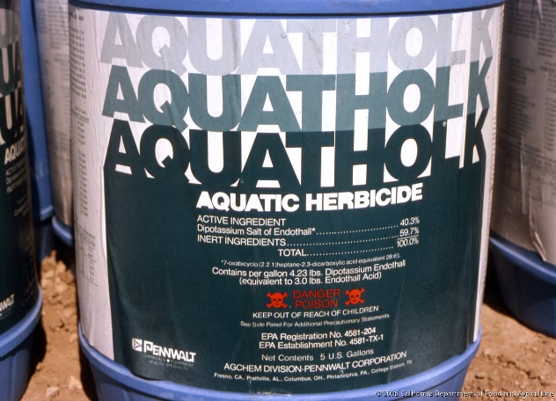
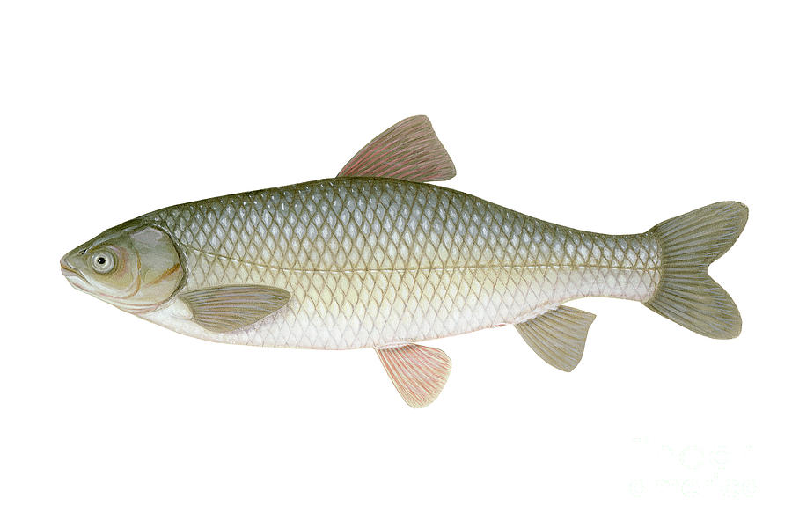
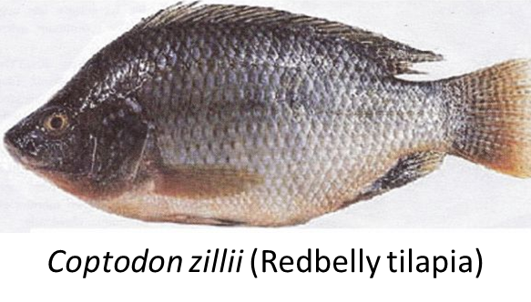
POSSIBLE SOLUTIONS FOR EUTROPHICATION
Control of Phosphorus and Nitrogen Bringing Water Resources to the Lake
Promoting Phosphorus-Free Detergent Usage
Nutrient (Phosphorus and Nitrogen) Inactivation (Aluminum Sulphate Method)
Covering Bottom Sludge (Forming Benthic Cover)
Sediment Scraping
Chemical Control Method (Use of Algisides and Herbicides)
Macrofit Removal Method (Cutting Method)
Biological Control (Fish Storage) Method
Ctenopharyngodon idella (Grass carp)
Notes:
However, even if the input of external nutrient (phosphorus and nitrogen) can be prevented, lakes have an internal nutrient (phosphorus) load from sediment.
Normally phosphorus has a flow from water to sediment. However, its release from sediment occurs as a result of the decrease in oxygen and this is the main cause of algae increase. For this reason, it is common that the lake conditions can not be improved by decreasing the nutrient load of the lakes which are shallow and extremely eutrophic.

Slide 5
References
Tanyolaç, J. 2000. Limnoloji. Hatiboğlu Yayınevi, Ankara.
Wetzel, G.R. 2017. editor Ergönül, M.B. Limnoloji, Göl ve Nehir Ekosistemleri. 3. baskıdan çeviri. Nobel Yayıncılık, Ankara.
"Nürnberg, G.K., 2017. Attempted management of cyanobacteria by Phoslock (lanthanum-modified clay) in Canadian lakes: water quality results and predictions. Lake Reserv. Manag. 33, 163–170. doi:10.1080/10402381.2016.1265618"
"Pérez-Sirvent, C., Hernández-Pérez, C., Martínez-Sánchez, M.J., García-Lorenzo, M.L. and Bech, J. 2017. Metal uptake by wetland plants: implicationsfor phytoremediation and restoration. J Soils Sediments, 17:1384–1393"
Kometa, S. S., Kimengsi, J. N. And Petiangma, D.M. 2018. Urban Development and its Implications on Wetland Ecosystem Services in Ndop, Cameroon, Environmental Management and Sustainable Development, Vol. 7, No. 1
Phytoremediation - Hinchman, Negri, and Gatliff, 2017. Argonne National Laboratory and Applied Natural Sciences, Inc., Phytoremediation: Using Green Plants to Clean Up Contaminated Soil, Groundwater, and Wastewater
Khan, M. Nasir and Mohammad, F. (2014 ) "Eutrophication of Lakes" in A. A. Ansari, S. S. Gill (eds.), Eutrophication: Challenges and Solutions; Volume II of Eutrophication: Causes, Consequences and Control, Springer Science+Business Media Dordrecht
" Chislock, M.F.; Doster, E.; Zitomer, R.A.; Wilson, A.E. (2013). ""Eutrophication: Causes, Consequences, and Controls in Aquatic Ecosystems"". Nature Education Knowledge. 4 (4): 10. Retrieved 10 March 2018."
"Xie, Zhenglei, Zhang, Hezi, Zhao, Xiaoxiang, Du, Zebing, Xiang, Lixiong, et al. 2016. Assessment of Heavy Metal Contamination and Wetland Management in a Newly Created Coastal NaturalReserve, China Journal of Coastal Research, 32(2) : 374-386."
G. Zhang et al.2016. Heavy metals in wetland soils along a wetland-forming chronosequence in the Yellow River Delta of China: Levels, sources and toxic risks. Ecological Indicators 69 (2016) 331–339
J. Tournebize et al. 2017. Implications for constructed wetlands to mitigate nitrateand pesticide pollution in agricultural drained watershed. Ecological Engineering 103 (2017) 415–425.
Mander, Ü., Tournebize, J., Kasak, K., Mitsch, W.J., 2014. Climate regulation byfree water surface constructed wetlands for wastewater treatment and createdriverine wetlands. Ecol. Eng. 72, 103–115
Fikirdeşici-Ergen, Ş et al. 2018. Bioremediation of heavy metal contaminated medium using Lemna minor, Daphnia magna and their consortium. Chemistry and Ecology. 34(1):43-55
Fikirdeşici-Ergen, Ş and Üçüncü-Tunca, E. 2018. Nanotoxicity Modelling and Removal Efficiencies of ZnONP, International Journal of Phytoremediation 20(1):16-26
Yakup Sedat VELIOGLU, Şeyda FİKİRDEŞİCİ-ERGEN, Pelin AKSU, Ahmet ALTINDAĞ. 2018. Effects of Ozone Treatment on the Degradation and Toxicity of Several Pesticides in Different Groups, Journal of Agricultural Sciences, 24(2):245-255

