Slide 1
Average length of gestation
Species | Length in Days | Avg. in Months*
Cattle | 279-292 | 9
Goats | 145-155 | 5
Sheep | 144-151 | 5
Swine | 112-115 | 3 mo. 3 wks. 3 days
Horse | 330-342 | 11
*Average varies with animals and breeds.

Slide 2
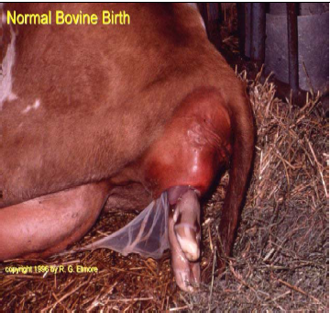
What is Parturition?
Act of process of giving birth
Parturition
Labor
Delivery

Slide 3
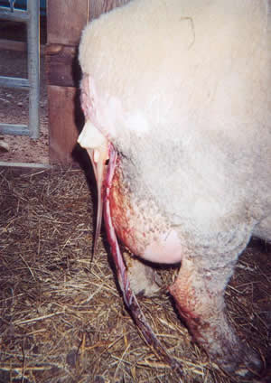
Parturition Names in Species
Cattle: Calving
Sheep: Lambing
Goats: Kidding

Slide 4
Fetal control of parturition
fetus controls time of parturition due to stress response :
lack of space
lack of gas exchange
lack of nutrients

Slide 5
Hormonal changes at the end of gestation
Fetal pituitary - hypothalamus axis essential
increased stress from fetal nutritional demands and placental insufficiency
Hypothalamus release CRH
(Corticotropin releasing hormone)
Anterior pituitary in turn releases ACTH

Slide 6
Hormonal changes at the end of gestation
Fetal adrenal gland
in response to ACTH releases cortisol (corticosteroids)
effects of cortisol on fetus
Lung produces surfactants
liver increases storage of glycogen
thyroid increases metabolism
effects of cortisol on placentome
shift from progesterone to estradiol production
progesterone decreases
estrogen increases
PGF increases

Slide 7
Hormonal changes at the end of gestation
Placentome hormones
estradiol
increase gap junctions in myometrium
leads to better co-ordination and communication among muscle cells in the myometrium
begin to get coordinated contractions toward the cervix
increase in uterine oxytocin receptors
primes cervix to response to relaxin
stimulates ovary to secrete relaxin and oxytocin
acts with PGF to trigger CL regression

Slide 8
Hormonal changes at the end of gestation
Placentome hormones
PGF
regression of CL
synthesis and release of oxytocin and relaxin from ovary (in some species relaxin from placenta)
stimulates most of the contractions in the uterus

Slide 9
Hormonal changes at the end of gestation
progesterone
shift from progesterone to estrogen production leads to its decrease from the placentome
PGF stimulates luteolysis so progesterone from CL decreases
release from "progesterone block“
Oxytocin
stimulates final contractions of uterus but only once fetal head enters cervix

Slide 10
Hormonal changes at the end of gestation
Relaxin
comes from ovary or placenta
synthesis stimulated by PGF
stimulates softening of the cervical connective tissue to cause dilation
promotes elasticity of the pelvic ligaments

Slide 11
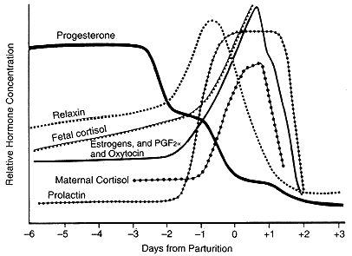

Slide 12
Signs of Approaching Parturition
Distended abdomen
Mammary development & milk secretion
Swollen vulva and relaxed pelvic ligaments
Mucous discharge
Relentlessness and separation from group
Labor and Contractions

Slide 13
Stages of Parturition
Stage 1- Preparatory Stage (2 to 12 hours)
Stage 2- Birthing Process (30 to 180 mins)
Stage 3- Placenta Expulsion (1 hr to 12 hr)

Slide 14
Stage 1- preparatory stage
Characterized by dilation of the cervix.
Rhythmic contractions of the uterus.
At the end of this stage, the cervix expands, allowing the uterus and vagina to become a continuous canal.

Slide 15
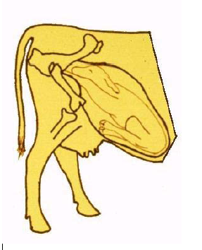
Preparatory Stage (2-6 hours)
Relaxation of the soft
birth canal
b. Relaxation of the bony
birth canal
c. Lubrication of the
birth canal
d. Dilation of the cervix
e. Alignment of the fetus

Slide 16
Stage 2- Birthing Process
Increase in contractions with abdominal pressing.
The placenta, along with the head and forelegs, are forced into the vagina (birth canal).
Presentation is forelegs first with the nose resting on the forelegs.
Anterior “head first”

Slide 17
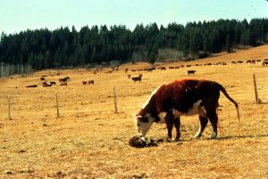
Stage 2- Birthing Process
Cow usually lying down
Fetus enters birth canal
Front feet and head
protrude first
Calf delivery
completed

Slide 18
Stage 2- Birthing Process
strong uterine contractions
rupture of the allantochorion
appearence of amnion
maternal recumbency and straining
not only uterine but abdominal contractions as well
rupture of the amnion and delivery

Slide 19
Stage 3- Placenta Expulsion
Associated with uterine contractions
Normally expelled within 12 hours
Placenta of each species should be expelled within the following time periods
Cow and ewe - 8 to 24 hours

Slide 20
Stage 3- Placenta Expulsion
uterine contractions decrease but continue
chorionic villi loosen
expulsion of placenta
delayed in ruminants due to presence of cotelydons separating independently
suckling induces oxytocin release which triggers further uterine contractions

Slide 21
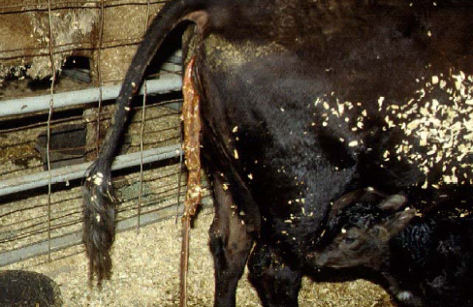

Slide 22
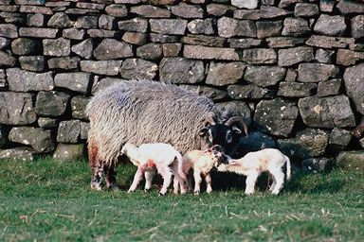

Slide 23
Signs of Parturition in Cattle
One week - mammary glands fill with milk, tail head ligaments relax, and you will see a waxing of teats.
12-24 hours - frequent defecation and urination, anorexia, looking for young, makes a nest or seeks out an isolated area.

Slide 24
Cattle Parturition
Parturition
82% :- occur between noon and midnight, placenta → eaten by cow
Bonding
heritability of maternal behavior :- low in cattle, some breed -- more than the other breed
cow groom their calve -- early postpartum, concentrating on the back and abdomen

Slide 25
Cattle Parturition
Bonding (cont)
critical period for formation of the cow-calf bond -- the first few hours postpartum
Suckling
passive transfer of immunity to calves :- poor in dystocia

Slide 26
Cattle Parturition
Relaxation of the pelvic ligaments
Relaxation of the vulva and perineum
Enlargement and edema of the udder
Mucoid discharge from the vagina and dissolution of the cervical seal
Segregation from the herd along with restlessness and anorexia may be exhibited in the last few hours before parturition and heifers may show signs of abdominal pain.

Slide 27
Signs of Parturition in Sheep
Ten days before lambing the ewes teats become firm and full of milk, her vulva slackens and becomes slightly swollen.
Closer to lambing, the ewe's cervical seal passes from the vulva as a thick, creamy, white mucus.
In the final stages prior to lambing, the ewe becomes anxious and uneasy and continually switches from a reclining to a standing position.

Slide 28
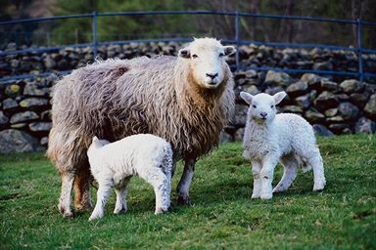
Sheep Parturition
Licking and sucking
Acceptance of the lamb
Mutual recognition by the ewe and lamb
recognition of the lamb by the ewe : depend on at least 3 senses : olfactory, auditory, and vision

Slide 29
Goat Parturition
When parturition approach, multiparous doe, leave the herd -- seek a sheltered place, and defend this area : lick the kid, vocalize frequently
Intensive maternal behavior -- short-lived
the kid -- left the does to hide and the does will rejoin the herd or stay

Slide 30
Induction of Parturition
Indications and contraindications
Criteria
Methods
Complications

Slide 31
Induction of Parturition in Cows
Indications
To prevent dystocias due to feto-pelvic disproportion.
When programming calving and pasture availability.
In the management of medical problems, such as hydrops allantois.
Abortion of small heifers under feedlot conditions
When damaged to an engorged pendulous udder is likely.

Slide 32
Induction of Parturition in Cows
Contraindications
Should not be used in animals that are more than 2-3 weeks away from calving, as such, the breeding date should be known.
Corticosteroids should not be used to induce parturition when there is a dead fetus in utero, e.g. fetal mummification.
Corticosteroids should not be used in animals with known or latent infections because of their immunosuppressive properties.

Slide 33
Induction of Parturition in Cows
Side effects
The most common problem associated with the induction of parturition in cows is retention of the fetal membranes

Slide 34
Induction of Parturition in Cows
Short-acting Corticosteroids
Dexamethasone (20 mg) or flumethasone (10 mg) IM
is about 80% - 90% effective when administered to cows within 2 weeks of full term.
The interval from injection to parturition is about 48 hours ( 24-72 hours).
The incidence of retention of the fetal membranes is estimated to be about 75%.

Slide 35
Induction of Parturition in Cows
Long-acting Corticosteroids
Dexamethasone trimethylacetate (20 mg) or Betamethasone suspension 20 mg) I.M.
30 days before term
Parturition occurs about 15+8 days after injection and is associated with a lower incidence (9 to 22%) of retained fetal membranes .

Slide 36
Induction of Parturition in Cows
Long-acting Corticosteroids
high incidence of calf mortality (17 to 45%) that is thought to be associated with premature placental separation and/or uterine inertia, and the colostrums immunoglobulin concentration is reduced.
Shorter calving patterns can be attained by injecting a short acting corticosteroid or prostaglandin 7 to 12 days after the long-acting injection. Most cows tend to calve 2 to 3 days later.

Slide 37
Induction of Parturition in Cows
Prostaglandins
PGF₂ alpha (Lutalyse®) (25 mg), Cloprostenol (Estrumate ®) (500 ug) and other synthetic analogs I.M. injection.
Calving occurs 24 to 72 hours later in 90-100% of cows treated.
are effective even when the fetus/placenta is not viable. Calf viability is good if given less than 2 weeks prior to term.
The incidence of retained fetal membrane is similar to the short acting corticosteroids.
Higher incidence of dystocia than with the corticosteroids.

Slide 38
Induction of Parturition in Cows
Corticosteroid-Prostaglandin Combination
With this combination, calving occurs sooner than for either drug alone (34.6+-1.4 hours).
The incidence of retained fetal membranes is equally as high as when each drug is used alone.
500 ug cloprostenol I.M. or 25 mg PGF2 alpha (lutalyse ®) I.M. and 25 mg. dexamethasone I.M.
The advantages may be outweighed by the cost.

Slide 39
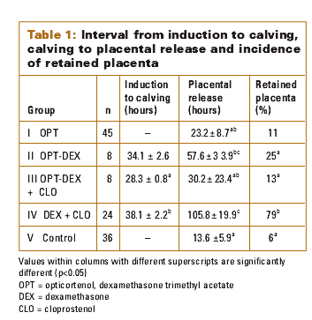

Slide 41
Induction of Parturition in Cows
Short-acting Corticosteroids and Estrogens Combinations.
20-25 mg estradiol I.M. and 25 mg dexamethasone I.M. tends to shorten the average interval to calving
reduces the incidence of induction failures.
procedure decreased the incidence of retained fetal membranes.???
Estrogens produces residues in milk which limits the use of this method in dairy cattle.

Slide 42
Induction of Parturition in ewe
Dystocia due to feto-pelvic disproportion is not common.
may be used in the management of ewes with pregnancy toxemia.
16 mg dexamethasone I.M. injection within 5 days of term, result in normal parturition in 2 to 3 days.
two I.M. injections of 1-2 mg of estradiol benzoate (EB) 5 to 6 days before term or single injection of 15 mg EB 5 days before term. - dystocia, poor lamb survival.

Slide 43
Induction of Parturition in Goats
Advantages
Improved kid survival, especially in severe weather
Reduced kid and doe mortality because of better observation by the owner and earlier intervention in cases of dystocia.
increased predictability of the time of parturition.
Increased ability to obtain kids free of colostrum and with minimal contact with the mother.
This is important in disease control e.g. caprine arthritis encephalitis and mycoplama.

Slide 44
Induction of Parturition in Goats
Disadvantages
Owner reluctance to interfere with the normal process.
Increased responsibility on the owner to keep accurate breeding records and to guarantee no subsequent breedings, accidental or otherwise.

Slide 45
Induction of Parturition in Goats
Procedure
Prostaglandin (5 to 10 mg PGF2 alpha or 62.5 to 125 ug cloprostenol) at 144 days of gestation results in delivery between 27-35 hours after injection.
20 mg dexamethasone produces delivery in 1-2 days

Slide 46
Post- calving problems
Haemorrhage
Uterus rupture
Uterine prolapse
Milk fever
Ketosis
Retained placenta
Metritis
Downer’s cow syndrome

Slide 47
Haemorrhage
Birth canal
Rupture of tissue
Broad ligament rupture
TX:
- Depended on degree
- Oxytocin

Slide 48
Uterus rupture
High incidence in cattle and goat
Fetopelvic disproportion
Diag: serosa, intestine, rumen
Tx: oxytocin
ABO

Slide 49
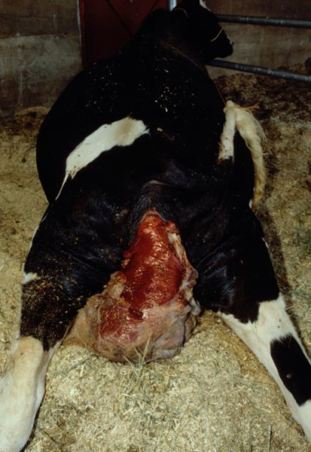
Uterine prolapse
Post calving 2-3 days
Old- cattles, calcium, …
Diag: prolapsed of uterus
TX: decrease size
purse sting fixation

Slide 50
Milk fever
Calcium ➔ 3-7 %
Vit D
Depress, anorexia, low temp, recumbency
Tx: slow calcium IV

Slide 51
Ketosis
2 wks PP
Ketone bodies
Milk drop.
Feed drop.
TX: Dexa, Propylene glycol
BCS management before calving

Slide 52
Retained placenta
Retained fetal membrane
Low Vit E, Se, D
TX: oxytocin within 24 hrs
Manual removal??
ABC=> OTC
Prevent: ADE, Se supplement 2 wks before calving

Slide 53
Metritis
From retained fetal membrane
Dystocia
Vaginal discharge
Tx: OTC 1 g. infuse

Slide 54
Downer’s cow syndrome
Low mineral (calcium)
Acute mastitis
Obturator damage
Tx: Calcium
Supportive

