Slide 1
Solar thermoelectrics
ENE 304 Materials in Energy Technologies

Slide 2
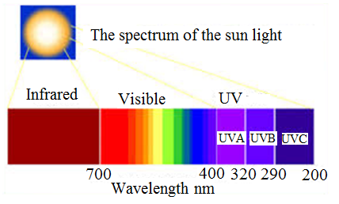
Solar thermoelectrics
Regarding solar energy conversion, while photovoltaic devices use the UV region, thermoelectric devices use the IR region to generate electricity.
In a solar photovoltaic-thermoelectric hybrid system, a highly efficient solar collector converts solar radiation into heat, which is then converted into electrical power that can be used by thermoelectric devices.
Figure 1. Solar spectrum
(Modified from *http://www.macular.com.sg/index.php/info/solar-spectrum)

Slide 3
Solar thermoelectrics
Moreover, thermal energy part of the solar light can be stored in a thermoelectric devices, which can be used to charge the battery without sunshine.
Such a thermoelectric device needs to operate at about 700°C and the materials have to show high ZT values around this temperature.
Figure 1. Solar spectrum
(Modified from *http://www.macular.com.sg/index.php/info/solar-spectrum)

Slide 4
Thermoelectrics: power from waste heat
In the consumer goods sector, these coolers can be found, for example, in the cool boxes used during camping and in the refrigerator of a silent hotel.
Thermoelectric devices are simply composed of a thermocouple used in many applications as a temperature sensor.
The first thermoelectric materials could only be generated at great cost and only produced a few watts.
Today, there are 1000 watts generating systems.
New materials and processing methods allow more temperature differentials to be used, so power output will continue to rise.

Slide 5
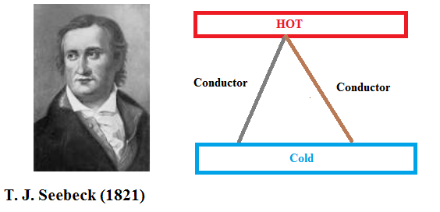
Historical perspective
Thermoelectrics: power from waste heat
According to the principle of Seebeck effect, temperature fifference generates a voltage between two different materials.
In the 1800s, the field of thermoelectricity began with the discovery of the Seebeck effect.
The seebeck effect is also known as thermoelectric effects.
Figure 2. Seebeck effect (Modified from *https://www3.nd.edu/~sst/teaching/AME60634/lectures/AME60634_F13_thermoelectric.pdf)

Slide 6
Historical perspective
The Seebeck effect can be measured as a voltage that is proportional to difference in temperature.
The proportionality constant α is called the Seebeck coefficient or thermopower.

Slide 7
Historical perspective
The thermocouple is a simple temperature sensor, which is composed of two dissimilar metals joined together at one end.
The thermocouple is based on the Seebeck effect in an open-loop configuration.
The thermocouple allows the direct conversion of thermal energy into useful electrical energy when the loop is closed.
The conversion efficiency of the thermoelectric devices depends on a dimensionless quantity called the thermoelectric figure of merit, ZT,
ZT factor can be determined using the following material parameters:
-the thermopower (α),
-the electrical conductivity (σ),
-the thermal conductivity (k).

Slide 8
Historical perspective
Until the mid-1900s, with the emergence of semiconductor material research, it was not known that thermoelectric materials and devices were important.
Semiconductor materials allow control of band adjustment and carrier concentration, thus allowing optimization of a particular set of materials.
A thermoelectric couple consists of n-type and p-type materials, and in typical thermoelectric devices, numerous pairs are then electrically connected in series and thermally parallel.
Thermoelectric devices convert thermal gradients directly into electrical power and operate with solid state conversion, which is quiet, non-mechanical and provides long-term stability.

Slide 9
Historical perspective
The thermoelectric devices can be used either for cooling purposes, which is known as the Peltier effect or for power generation purposes, which is known as the Seebeck effect.
Hence heat, especially waste heat can be converted directly into useful electrical energy using the thermoelectric devices.
In a pure photoelectric device the IR spectrum of the sun ligth is therefore waste heat that is not being utilized by the device.
This part of the sun light can be used with the help of the thermoelectric devices.

Slide 10
References
Terry M. Tritt, Xinfeng Tang, Qingjie Zhang and Wenjie Xie, Solar thermoelectrics: direct solar thermal energy conversion, in Fundamentals of Materials for Energy and Environmental Sustainability (Eds. David S. Ginley, David Cahen), Cambridge University Press, 2012.

