Slide 1
ANKARA UNIVERSITY DEPARTMENT OF ENERGY ENGINEERING NUMERICAL METHODS
INSTRUCTOR
DR. ÖZGÜR SELİMOĞLU

Slide 2
CONTENTS
Numerical Differentiation
a) Finite Difference Approximations
b) Richardson Extrapolation

Slide 3
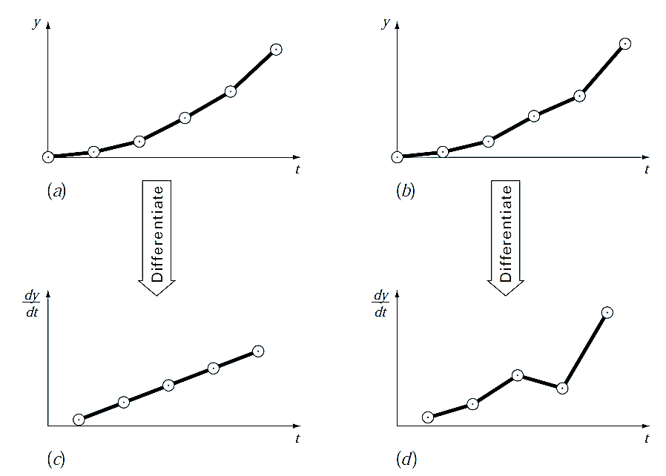
NUMERICAL DIFFERENTIATION
Numerical differentiation deals with the following problem: We are given the function y = f (x) and wish to obtain one of its derivatives at the point x = x_{k}.
The term “given” means that we either have an algorithm for computing the function, or we possess a set of discrete data points (x_{i} , y_{i} ), i = 0, 1, . . . , n.
In either case, we have access to a finite number of (x, y) data pairs from which to compute the derivative.
Numerical differentiation is related to interpolation, one means of finding the derivative is to approximate the function locally by a polynomial and then to differentiate it. An equally effective tool is the Taylor series expansion of f (x) about the point x_{k} , which has the advantage of providing us with information about the error involved in the approximation.
Numerical differentiation is not a particularly accurate process. It suffers from a conflict between round off errors (caused by limited machine precision) and errors inherent in interpolation. For this reason, a derivative of a function can never be computed with the same precision as the function itself.
Figure 1: Illustration of how small data errors are amplified by numerical differentiation: (a) data with no error, (b) data modified slightly, (c) the resulting numerical differentiation of curve (a), and (d) the resulting differentiation of curve (b) manifesting increased variability. In contrast, the reverse operation of integration [moving from (d) to (b) by taking the area under (d)] tends to attenuate or smooth data errors.

Slide 4
Finite Difference Approximations
Taylor series expansions derive finite difference approximations of derivatives.
It developed forward, backward and centered difference approximations of first and higher derivatives.
High- accuracy divided-difference formulas can be generated by including additional terms from the Taylor series expansion.
(a)
It can be solved for first derivative.
(b)
It is referred to as the «first forward difference» and h is called the step size, that is , the length of the interval over which the approximation is made.
It is termed a ‘’forward’’ difference because it utilizes data at i and i+1 to estimate the derivative.
The Taylor series can be expanded backward to calculate previous values on the basis of a present value, as in
(c)
It is referred to as the «first backward difference ».
A third way to approximate the first derivative is called «centered difference».
(d)

Slide 5
Finite divided difference can be represented generally as;
(e)
or
(f)
where Δf_{i} is referred to as the first forward difference and h is called the step size, that is, the length of the interval over which the approximation is made. It is termed a “forward” difference because it utilizes data at i and i + 1 to estimate the derivative (Fig. 2a). The entire term Δf/h is referred to as a first finite divided difference.
This forward divided difference is but one of many that can be developed from the Taylor series to approximate derivatives numerically. For example, backward and centered difference approximations of the first derivative can be developed in a fashion similar to the derivation . The former utilizes values at x_{i−1} and x_{i} (Fig. 2b), whereas the latter uses values that are equally spaced around the point at which the derivative is estimated (Fig. 2c). More accurate approximations of the first derivative can be developed by including higher-order terms of the Taylor series.

Slide 6
Graphical representation

Slide 7
Backward Difference Approximation of the First Derivative: The Taylor series can be expanded backward to calculate a previous value on the basis of a present value, as in
(1)
Truncating this equation after the first derivative and rearranging yields
(2)
∇ f₁ is referred to as the first backward difference. See Fig. 2b for a graphical representation
Centered Difference Approximation of the First Derivative: A third way to approximate the first derivative is to subtract Eq. (1) from the forward Taylor series expansion:
(3)
to yield
Figure 2 :Graphical depiction of (a) forward, (b) backward, and (c) centered finite-divided-difference approximations of the first derivative.

Slide 8
which can be solved for
Or
(4)
Equation (4) is a centered difference representation of the first derivative. Notice that the truncation error is of the order of h² in contrast to the forward and backward approximations that were of the order of h. Consequently, the Taylor series analysis yields the practical information that the centered difference is a more accurate representation of the derivative (Fig. 2.c). For example, if we halve the step size using a forward or backward difference, we would approximately halve the truncation error, whereas for the central difference, the error would be quartered.
Notes:
Truncation error depends on h2 for the central version.

Slide 9
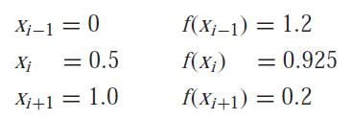
Example 1: Use forward, backward and a centered difference approximation to estimate the first derivative of function:
at x = 0.5 using a step size h = 0.5. Also repeat the computation using h = 0.25 and compare the accuracy.
Solution:
Note that the derivative can be calculated directly as below and can be used to compute the true value as f’(0.5)=−0.9125
For h = 0.5, the function can be employed to determine
These values can be used to compute the forward divided difference [Eq. (e)],
the backward divided difference [Eq. (c)],
... | x _{i-2} | x _{i-1} | x _{i} | x _{i+1} | x _{i+2} | ...
.... | x-2.h | x-h | x | x+h | x+2.h | ...

Slide 10
and the centered divided difference [Eq. (4)],
For h = 0.25,
which can be used to compute the forward divided difference,
the backward divided difference,
and the centered divided difference,
For both step sizes, the centered difference approximation is more accurate than forward or backward differences. Also, as predicted by the Taylor series analysis, halving the step size approximately halves the error of the backward and forward differences and quarters the error of the centered difference.

Slide 11
Finite Difference Approximations of Higher Derivatives: Besides first derivatives, the Taylor series expansion can be used to derive numerical estimates of higher derivatives. To do this, we write a forward Taylor series expansion for f (x_{i+2}) in terms of f (x_{i}):
(5)
Equation (3) can be multiplied by 2 and subtracted from Eq. (5) to give
which can be solved for
(6)
This relationship is called the second forward finite divided difference. Similar manipulations can be employed to derive a backward version
and a centered version
(7)
As was the case with the first-derivative approximations, the centered case is more accurate. Notice also that the centered version can be alternatively expressed as
Thus, just as the second derivative is a derivative of a derivative, the second divided difference approximation is a difference of two first divided differences.

Slide 12
High-accuracy Differentiation Formulas: As noted above, high-accuracy divided-difference formulas can be generated by including additional terms from the Taylor series expansion. For example, the forward Taylor series expansion can be written as [Eq. (3)]
(8)
which can be solved for
(9)
Truncated this result by excluding the second- and higher-derivative terms and were thus left with a final result of
(10)
In contrast to this approach, we now retain the second-derivative term by substituting the following approximation of the second derivative [recall Eq. 6)]
(11)
into Eq. (9) to yield
(12)
or, by collecting terms,
(13)
Notice that inclusion of the second-derivative term has improved the accuracy to O(h²). Similar improved versions can be developed for the backward and centered formulas as well as for the approximations of the higher derivatives.

Slide 13
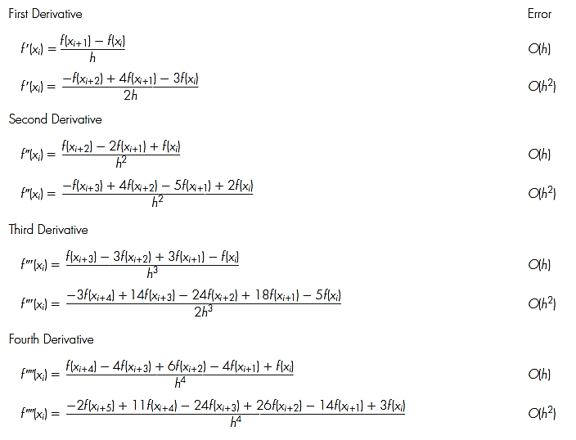
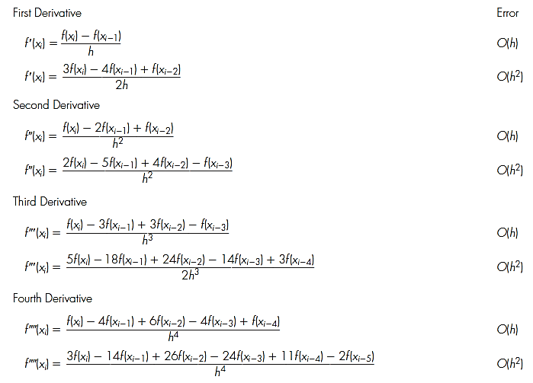
Figure 3: Forward finite-divided-difference formulas: two versions are presented for each derivative. The latter version incorporates more terms of the Taylor series expansion and is, consequently, more accurate.
Figure 4: Backward finite-divideddifference formulas: two versions are presented for each derivative. The latter version incorporates more terms of the Taylor series expansion and is, consequently, more accurate.

Slide 14
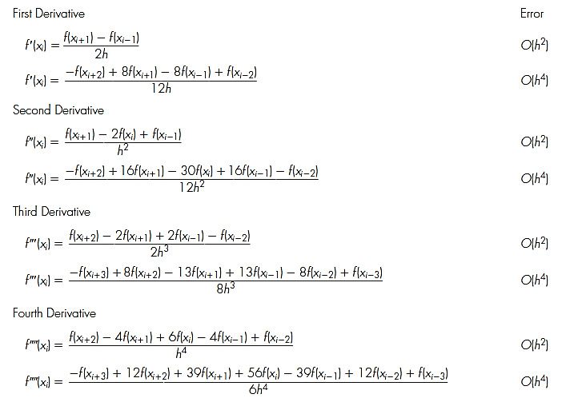
Figure 5 : Centered finite divided difference formulas: two versions are presented for each derivative. The latter version incorporates more terms of the Taylor series expansion and is, consequently, more accurate.

Slide 15
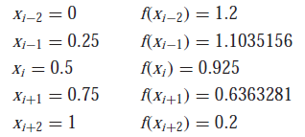
Example 2: Recall that in Example 1 we estimated the derivative of
at x = 0.5 using finite divided differences and a step size of h = 0.25,
where the errors were computed on the basis of the true value of −0.9125. Repeat this computation, but employ the high-accuracy formulas from Figs.3 through 5.
Solution: The data needed for this example is
The forward difference of accuracy O(h²) is computed as (Fig. 3)
The backward difference of accuracy O(h²) is computed as (Fig.4)
The centered difference of accuracy O(h⁴) is computed as (Fig.5)
As expected, the errors for the forward and backward differences are considerably more accurate than the results from Example 1. However, surprisingly, the centered difference yields a perfect result. This is because the formulas based on the Taylor series are equivalent to passing polynomials through the data points.
... | x _{i-2} | x _{i-1} | x _{i} | x _{i+1} | x _{i+2} | ...
.... | x-2.h | x-h | x | x+h | x+2.h | ...
Notes:
O(h) order h
O(h2) order h2

Slide 16
Example 3: Use forward, backward difference approximations of O(h) and O(h²) ; a centered difference approximation of O(h²) and O(h⁴) to estimate the first derivative of f(x)= 0.1x⁵-0.2x³+0.1x-0.2
at x = 0.1 Compare numerical solution at h=0.1.
Solution: The data needed for this example is
The forward difference of accuracy O(h) and O(h²) are computed as ;
x_{i+2} | x+2h | = 0.3 | f(x_{i+2}) | f(0.3) | _{= - 0.17516}
x_{i+1} | x+h | = 0.2 | f(x_{i+1}) | f(0.2) | _{= - 0.181568}
x_{i} | x | = 0.1 | f(x_{i}) | f(0.1) | _{= - 0.190199}
x_{i-1} | x-h | = 0 | f(x_{i-1}) | f(0) | _{= -0.2}
x_{i-2} | x-2h | = -0.1 | f(x_{i-2}) | f(-0.1) | _{= - 0.2098}
f’(0.1)= $\frac{f\left(0.2\right)−f(0.1)}{h}$= $\frac{\text{− 0.181568}\text{−(−0.190199)} }{0.1}$ =0.08631
f’(0.1)= $\frac{−f\left(0.3\right)+4f\left(0.2\right)−3f(x)}{2h}$= $\frac{\begin{aligned}\text{0.17516 }\text{+4(}\text{− 0.181568 }\text{)−3}\text{(−0.190199) } \\ \end{aligned}}{0.2}$ =0.0993

Slide 17
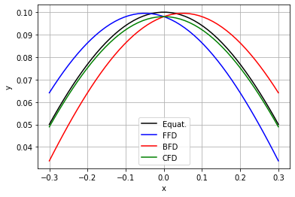
The backward difference of accuracy O(h) and O(h²) are computed as ;
f’(0.1)= $\frac{f\left(0.1\right)−f(0)}{h}$= $\frac{\text{−} \text{0.190199}\text{−(−0.2)} }{0.1}$ =0.09801
f’(0.1)= $\frac{3f\left(0.1\right)−4f\left(0\right)+f(−0.1)}{2h}$= $\frac{\begin{aligned}\text{0.17516 }\text{+4(}\text{− 0.181568 }\text{)−3}\text{(−0.190199) } \\ \end{aligned}}{0.2}$
=0.098015
The centered difference of accuracy O(h) and O(h²) are computed as ;
f’(0.1)= $\frac{f\left(0.2\right)−f(0)}{2h}$= $\frac{\text{− 0.181568}\text{−(−0.2)} }{0.2}$ =0.09216
f ’(0.1)= $\frac{−f\left(0.3\right)+8f\left(0.2\right)−8f\left(0\right)+f(−0.1)}{12h}$
= $\frac{\begin{aligned}\text{− 0.17516 }\text{+8(}\text{− 0.181568 }\text{)−8}\text{(}\text{−0.2}\text{)}\text{− 0.2098} \\ \end{aligned}}{1.2}$ =0.09401
Approximation of the equation in the range (-0.3, 0.3). (O(h))

Slide 18
Richardson Extrapolation
Richardson extrapolation is a simple method for boosting the accuracy of certain numerical procedures, including finite difference approximations.
To this point, we have seen that there are two ways to improve derivative estimates when employing finite divided differences: (1) decrease the step size or (2) use a higher-order formula that employs more points. A third approach, based on Richardson extrapolation, uses two derivative estimates to compute a third, more accurate approximation.
Richardson extrapolation provided a means to obtain an improved integral estimate I by the formula [Eq. (14)]
(14)
where I(h₁) and I(h₂) are integral estimates using two step sizes h₁ and h₂. Because of its convenience when expressed as a computer algorithm, this formula is usually written for the case where h₂ = h₁/2, as in
(15)
In a similar fashion, Eq. (15) can be written for derivatives as
(16)
For centered difference approximations with O(h²), the application of this formula will yield a new derivative estimate of O(h⁴).

Slide 19
Example 4: Using the same function as in Example 2, estimate the first derivative at x = 0.5 employing step sizes of h₁ = 0.5 and
h₂ = 0.25. Then use Eq. (16) to compute an improved estimate with Richardson extrapolation. Recall that the true value is −0.9125.
Solution: The first-derivative estimates can be computed with centered differences as
And
The improved estimate can be determined by applying Eq. (16) to give
which for the present case is a perfect result.
D(x_{i})= $\frac{f\left(x_{i+2} \right)−f(x_{i−2})}{(x_{i+2})−(x_{i−2})}$
D(x_{i-1})= $\frac{f\left(x_{i+1}\right)−f(x_{i−1})}{(x_{i+1})−(x_{i−1})}$

Slide 20
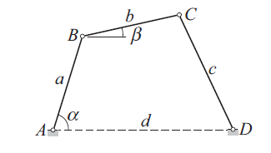
Example 5:
The linkage shown has the dimensions a = 100 mm, b = 120 mm, c = 150 mm, and d = 180 mm. It can be shown by geometry that the relationship between the angles α and β is
If link AB rotates with the constant angular velocity of 25 rad/s, use finite difference approximations of O(h²) to tabulate the angular velocity dβ/dt of link BC against α.
Solution: The angular speed of BC is
where dβ/dα can be computed from finite difference approximations using the data in the table. Forward and backward differences of O(h²) are used at the endpoints, and central differences elsewhere. Note that the increment of α is

Slide 21
The computations yield
The complete set of results is

Slide 22
REFERENCES
Jaan Kiusalaas, “Numerical Methods in Engineering with Python 3”,3rd Edition, Cambridge, NY, 2013
S.C. Chapra and R.P. Canale, “Numerical Methods for Engineers”, 6th ed., McGraw-Hill,, NY, 2010

