Slide 1
PROPERTIES OF PACKAGING MATERIALS
Instructor
Assist. Prof. Dr. Eda Demirok Soncu
E-mail: edemirok@eng.ankara.edu.tr
Phone: +90312 203 3300 (3639 ext.)
Office: 2nd floor #212
Fde 216 food packagıng

Slide 2
Properties of packaging materials
The characteristics of materials used in packaging determine its functions
Packaging materials should be used to slow down the physicochemical and microbial changes in the food product

Slide 3
Properties of packaging materials
In order to evaluate the function of packaging material
It is important to consider the contact time between the product and the material, which depends on mass transfer
It is important to consider the contact time between the external atmosphere, the material and the internal atmosphere, which depends on the permeability of the packaging.

Slide 5
Properties of packaging materials
Permeability (Barrier properties)
Physical and mechanical properties
Migration
Water vapor permeability
Mechanical strenght
Class 1: No or negligible migration
Class 2: Migration independent of the packaged product
Oxygen permeability
Thermal conductivity
Light permeability
Radiation barrier
Class 3: Migration linked to interaction with the product

Slide 6
PERMEABILITY (BARRIER PROPERTIES)

Slide 7
Permeability
Permeability is a defining characteristic of packaging and determines the mass transfer through the packaging material
These bidirectional transfers (from the external to the internal atmosphere and vice versa) can occur in the liquid phase, or more commonly in the gas phase (oxygen, water vapor, volatile substances)
Permeability have significant influence on the shelf life, safety, and quality of packaged food products

Slide 8
Permeability
Theory of permeation involves a transfer by molecular diffusion induced by a difference in concentration of the gas on either side of the material
Permeation is often described as a succession of three steps:
The penetrant adsorbs onto the material
The penetrant diffuses through the material under the effect of a concentration gradient
The penetrant desorbs by evaporation

Slide 9
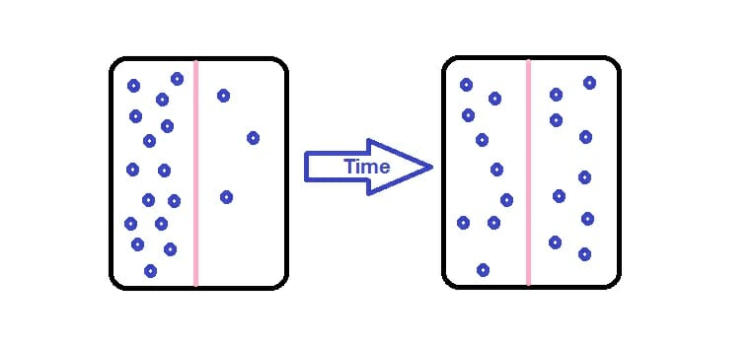
What is diffusion?
Diffusion is the net movement of anything (for example, atom, ions, molecules) from a region of higher concentration to a region of lower concentration
High concentration
Low concentration
In the case of equilibrium state, diffusion will stop

Slide 11
1) Water vapor permeability
Food products tend to dry out or gain moisture if they are not packed appropriately. For example,
Dried milk and protein powders tend to agglomerate
Deep-fried products, cookies, and wafers tend to lose their crispy texture upon absorption of moisture
On the other side, fresh products (fruits and vegetables) requires packaging materials with a certain amount of mass transfer to maintain an optimal level of oxygen required by the product for respiration and to prevent excessive condensation or water vapor within the package.

Slide 12
1) Water vapor permeability
The water vapor transmission rate (WVTR), a standard practice to measure water permeability, determines the ability of a package to allow water vapor to pass through it.

Slide 13
2) Oxygen permeability
Oxygen is responsible from many undesirable changes in foods. For example;
discoloration of fresh and processed meat products due to oxidation of color pigments
off-flavor development or rancidity in products rich in oil due to lipid oxidation (meat and meat products, oils, butters etc…)
mold growth in cheese and bread and microbial spoilage in several food products due to presence of aerobic environment

Slide 14
2) Oxygen permeability
Oxygen-sensitive food products require packaging with adequate oxygen barrier properties
The oxygen transmission rate (OTR) is measured as the number of milliliters of oxygen that pass through one square meter of packaging in 24 hours at one unit of atmospheric pressure
(mL oxygen / m² 24h atm)
Factors such as temperature and humidity influence the oxygen barrier properties and must be considered during the selection of a specific packaging material

Slide 15
3) Light permeability
Light-mediated oxidation creates unpleasant odors and taste in dairy products, meat and meat products, and fats and oils due to lipid oxidation
When the products are illuminated, some vitamins (A, B, and C) are degraded and discoloration is seen due to pigment oxidation
Therefore, light-sensitive food products require packaging with adequate light barrier properties

Slide 16
Parameters affecting permeability
Permeability depends on the four important factors, which are given below
physical properties of the material
the penetrant
the medium (environmental) conditions
selective permeability

Slide 17
Physical properties of the material
It is possible to equate the structure of a material to that of a sieve
If the mesh is small and it is difficult to change its dimensions, the energy required for the transfer of the diffusing material is high and therefore permeability is low
Most of packaging material (except for a welded metal box or a glass jar, which are gas-tight) has gas permeability in different concentrations
Therefore, a suitable choice must be made between the types of materials or their combinations in order to optimize permeability with regard to different gases

Slide 18
Properties of the penetrant
The dimensions, configuration, polarity and condensation capacity of the diffusing gas all affect permeability
The size of the penetrating gas molecules mainly influences diffusion and solubility coefficients. For example;
diffusion decreases as the diameter of the diffusing compound increases
solubility increases as the molar volume of the diffusing compound increases
Additionally, interactions between the packaging and the penetrant based on their respective polarity, thus significantly altering the permeability of the penetrant or other molecules

Slide 19
Environmental conditions
There is two important environmental factors that affect permeability
Temperature and pressure
Diffusion increases with temperature; therefore, permeability increases with increasing temperature
For simple gases (oxygen, carbon dioxide, nitrogen), the transfer rate through the material is directly proportional to the partial pressure gradient
The transfer of oxygen through the packaging occurs when the external partial pressure of the gas exceeds the internal partial pressure.

Slide 20
Selective permeability
Packaging materials, particularly plastic polymers, can be more permeable to certain compounds than others. Regarding most polymers;
permeability to carbon dioxide is about three times greater than that of oxygen
permeability to carbon dioxide is six to eight times greater than nitrogen

Slide 21
How can we decide the most appropriate packaging option in terms of permeability?
Permeability properties of packaging materials change depends on various factors
There is therefore no general solution for packaging permeability
Barrier properties should be evaluated case by case for each type of food and the most suitable packaging option should be choosen according to following factors;
Type of gas (oxygen, water vapor, volatile substances)
The type and thickness of packaging material
The sensitivy of the food products against to undesirable reactions (oxidation, microbial growth, chemical reactions…)
The desired shelf life

Slide 22
PHYSICAL AND MECHANICAL PROPERTIES

Slide 23
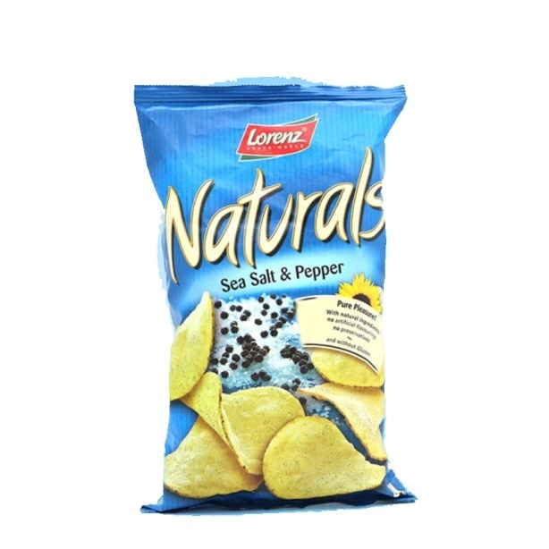
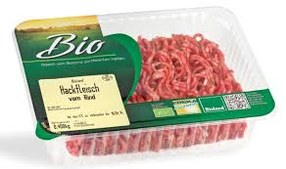
1) Mechanical strenght
Packaging protects products from external impact by its mechanical strength, which depends on the rigidity of the packaging material
Products can also be protected by gas packaging (e.g. bags of crisps, modified atmosphere packaged meat products)
The strength of the material can be evaluated by burst, compression and perforation tests

Slide 24
2) Thermal conductivity
It is preferable to choose packaging with high thermal conductivity where heat treatment (pasteurization, sterilization) is carried out
Metal cans and laminated carton packages are frequently used packaging materials in milk, fruit juice, canned foods etc…due to their high thermal conductivity
“Thermal conductivity is defined as the amount of heat per unit time per unit area that can be conducted through a plate of unit thickness of a given material”

Slide 25
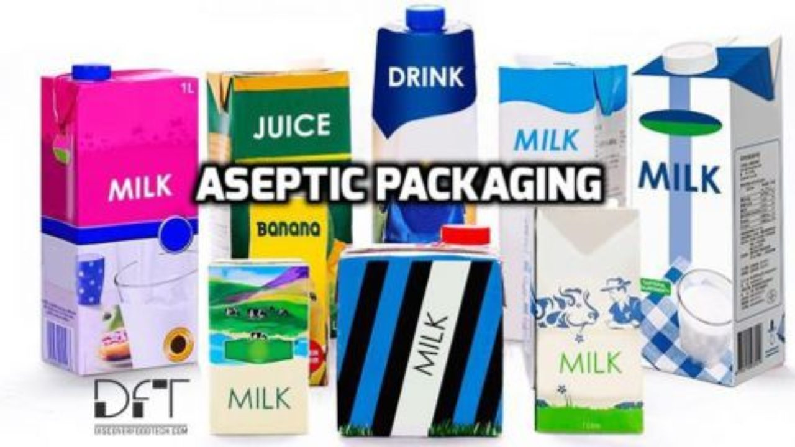
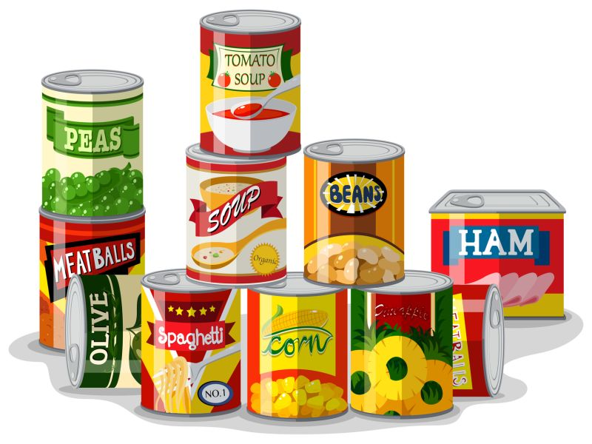

Slide 26
3) Radiation barrier properties
Ultraviolet light rays are tend to denature food products
Because of this problem, food products can be preserved by opaque packaging, which does not give permission for light transmission
When transparent packaging is necessary such as beverages, tinted packaging should be choosen in order to prevent light transmission

Slide 27
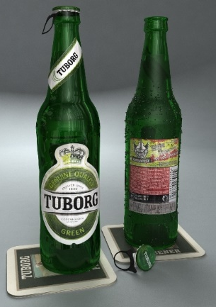
Tinted packaging
Tinted packages are able to block ultraviolet lights; therefore they are frequently used in the beverages industry in order to prevent quality
Beer industry
Sparkling water / carbonated water
3/9/2021

Slide 28
MIGRATION

Slide 29
Definition of migration
Migration corresponds to the transfer of substances from the packaging material to the product by physicochemical reactions, except for elements that could be separated from the packaging due to mechanical stress

Slide 30
Potential migrants
Identification, measurement and determination of the legal limits of potential migrants is an important issue for packaging industry
These migrants can have several sources;
They may be present in the raw material used to make the packaging (metal, wood tannins, sand in glass, residues from the synthesis of monomers, substances incorporated during recycling, etc.)
They may have been incorporated intentionally or unintentionally during the processing of the raw material (monomers, additives, catalysts, degradation products of these additives and polymers, etc.)
they may appear during storage (reactivity of additives, degradation of material, reactivity between food constituents and the container) or heating of the packaged product (microwaving)

Slide 31
Classification of materials
Packaging materials are classified one of three groups in terms of their migration properties
Class 1: No or negligible migration
Class 2: Migration independent of the packaged product
Class 3: Migration linked to interaction with the product

Slide 32
Class 1: No or negligible migration
No migration is observed in a range of product-packaging combinations
This is particularly seen in the case of dry-food conditions
It is certainly asserted that no exchange between the food and most packaging materials are occured

Slide 33
Class 2: Migration independent of the packaged product
This class mainly includes plastics polymers
Plastic polymers are formed from great numbers of monomers
These monomers and other products are revealed from polymers as a result of thermal degradation during the manufacture of packaging or photodegradation by radiation (ultraviolet or ionizing)**
These are small molecules such as ethylene, propylene, styrene, vinyl chloride
**Note: Most plastic packaging materials are sterilized by radiation before the food products are filled into it (aseptic packaging)

Slide 34
Class 2: Migration independent of the packaged product
The contamination of food products by the diffusion of gaseous monomers is less critical
Since they are volatile and their concentration is below the legal limits at the time of package opening
The amount of product that migrates by diffusion is related to time, the surface of the packaging and the initial concentration of the migrant in the packaging material

Slide 35
Class 3: Migration linked to interaction with the product
In this case, migration is controlled by the properties of the two phases that are in direct contact, such as with liquids
Three possibilities can arise if the packaging material comes into contact with the contents
Chemical or electrochemical reactions
Ion exchange between the packaging material and the food
Absorption of liquids

Slide 36
1) Chemical or electrochemical reactions (mostly metal cans)
Chemical or electrochemical reactions revelaed between the packaging wall and the contents
For example, metals (tinfoil, aluminum) can react with acids in the food (especially fruit and vegetables) to form hydrogen gas and metal ions causing corrosion
Tin, which forms the outer layer of cans, is covered with a thin layer of oxides, which reduces its reactivity to acids
However, this layer is not resistant to highly acidic media, which is why products with a pH below 4–4.5 are usually packaged in cans covered with epoxy-based protective coatings

Slide 37
1) Chemical or electrochemical reactions (mostly metal cans)
Electrochemical phenomena occurs where the two metals in a can (e.g. iron and tin) come into contact with the liquid at the pores of the coating
When the damaged cans are used, the reaction between tin and the sulfur in tomato puree or peas are responsible for the formation of tin sulphide
Tin sulphide is insoluble, but highly colorful, dotting the metal can with black or brown spots

Slide 38
Class 2: Ion exchange between the packaging material and the food (mostly glass and ceramic packaging)
Silicon dioxide is the main component of glass packaging materials
Other elements such as sodium, calcium, magnesium, cadmium and lead (common metals used in the production of crystal glass) are present for practical and economic reasons
The surface of glass can act as an ion exchanger when it comes into contact with solutions containing ionic species: proton and cation exchanges (sodium, cadmium, etc.) can occur in the presence of acid.
For most glass and ceramics used, these exchanges are limited given the low concentrations.
For example, a one-liter bottle (product/packaging contact surface of 500 cm²) transfers 25 mg of sodium in six months.

Slide 39
Class 3: Absorption of liquids by the packaging material (mostly plastic or paper packaging)
Liquid products tend to penetrate into the plastic material
Additives, which are used in the production of packaging materils, can then leak into the food product through the liquid medium absorbed in the packaging
For paper packaging, the extraction of migrants is very rapid as the penetration of liquid into the packaging is very fast.

Slide 40
References
Jeantet, R. et al. (2016). Packaging (Part 5) In Handbook of Food Science and Technology 2/Food Process Engineering and Packaging. John Wiley&Sons, Inc. USA. 347 pages
Singh, P. et al. (2017). Food Packaging Materials: Testing and Quality Assurance. CRC Press Taylor&Francis Group. 357 pages

