Slide 1
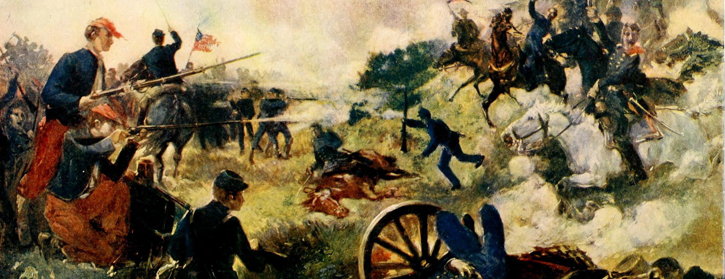
The American Civil War
This Photo by Unknown Author is licensed under CC BY-SA
AKE 117 AMERICAN HISTORY
DR. GAMZE KATI GÜMÜŞ

Slide 2
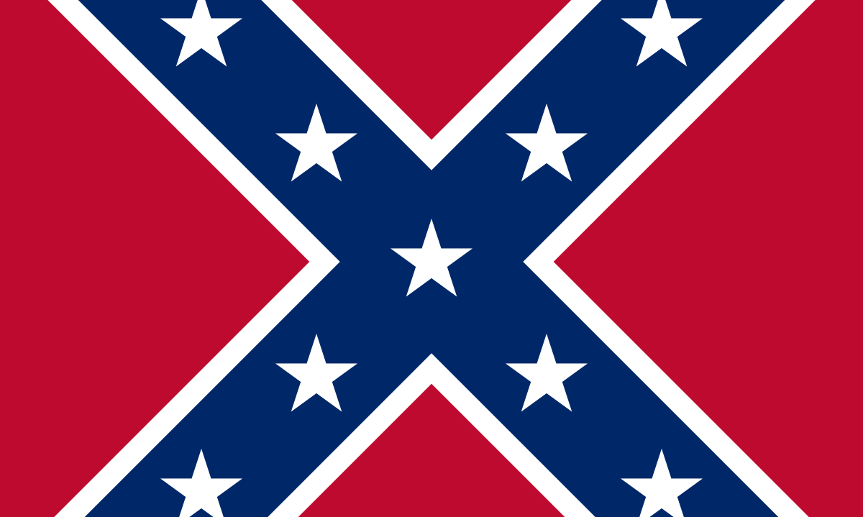
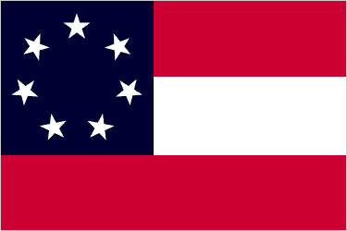
The Confederate States
When Lincoln was elected the President of US in 1860, 11 states seceded from the nation. These confederate states, which acknowledged Jefferson Davis as their president, were:
South Carolina
Mississippi
Florida
Alabama
Georgia
Louisiana
Texas
Virginia
North Carolina
Tennessee
Arkansas
[Arizona, Missouri, Kentucky]*
This Photo by Unknown Author is licensed under CC BY-SA
Notes:
From History.com and Britanncia.com

Slide 3
The Union
Maine
New York
New Hampshire
Vermont
Massachusetts
Connecticut
Rhode Island
Pennsylvania
New Jersey
Ohio
Indiana
Illinois
Kansas
Michigan
Wisconsin
Minnesota
Iowa
California
Nevada
Oregon
Notes:
https://www.nps.gov/civilwar/facts.htm

Slide 4
Border States
Maryland
Delaware
West Virginia
Kentucky
Missouri
Notes:
https://www.nps.gov/civilwar/facts.htm

Slide 5
Importance of the Border States for the Confederacy
Population was almost doubled
Natural resources
Foundries and factories
Skilled artisans
Economic and psychological strength

Slide 6
Importance of the Border States for the Union
Capital City
Preserving the capital
Transportation
Maintaining the river transportation along the Ohio
Communication
Ensuring the traffic on the Mississippi and the communitication with Kansas and the Pacific Coast

Slide 7
Notes:
https://www.reddit.com/r/MapPorn/comments/6is40c/map_of_confederate_union_and_border_states_900x567/

Slide 8
Civil War Facts

Slide 9
Finance
On the homefront, the Union had $234,000,000 in bank deposit and coined money or specie while the Confederacy had $74,000,000 and the Border States had $29,000,000.
Notes:
This and following … slides are from https://www.nps.gov/civilwar/facts.htm

Slide 10
Populations
The population of the Union was 18.5 million. In the Confederacy, the population was listed as 5.5 million free and 3.5 million enslaved. In the Border States there were 2.5 million free inhabitants and 500,000 enslaved people.

Slide 11
Agriculture
With the exception of rice and tobacco, the Union had a clear agricultural advantage. Particularly horses: the Union had twice that of the Confederacy, 3.4 million to the CSA's 1.7.
The Union led corn production with 400 million bushels compared to the 250 million bushels in the Confederacy and 150 million bushels in the Border States.
The Confederacy produced nearly all of the nation's rice which amounted to 225 million bushels.
The Confederacy led tobacco production with 225 million pounds compared to 110 million pounds produced in the Border States and 50 million pounds produced in the Union.
The Union led wheat production with 100 million bushels produced in comparison to 35 million bushels in the Confederacy and 20 million bushels in the Border States.
The Union was attributed with having 40 million heads of livestock compared to 35 million in the Confederacy and only 10 million in the Border States.

Slide 12
Industry
The Union had 101,000 factories, while the Confederacy had 21,000 and the Border States had 9,000.
The Union had 1.1 million factory workers, while the Confederacy had 111,000 and the Border States had 70,000.
The Union had 20,000 miles of railroad compared to 9,000 in the Confederacy and 1,700 in the Border States.

Slide 13
Enlistment
Enlistment strength for the Union Army is 2,672,341 which can be broken down as:
· 2,489,836 white soldiers
· 178,975 African American soldiers
· 3,530 Native American troops
Enlistment strength for the Confederate Army ranges from 750,000 to 1,227,890. Soldier demographics for the Confederate Army are not available due to incomplete and destroyed enlistment records.

Slide 14
Civilian Occupations
Farmers comprised 48 percent of the civilian occupations in the Union. Others included mechanics, 24 percent; laborers, 16 percent; commercial, 5 percent; miscellaneous, 4 percent; and professional occupations, 3 percent.
Farmers comprised 69 percent of the civilian occupations in the Confederacy. Others included laborers, 9 percent; mechanics, 5.3 percent; commercial, 5 percent; professional occupations, 2.1 percent; and miscellaneous, 1.6 percent.

Slide 15
The Bloodiest Battles
The bloodiest battles of the Civil War were:
· Gettysburg: 51,116 casualties
· Seven Days: 36,463 casualties
· Chickamauga: 34,624 casualties
· Chancellorsville: 29,609 casualties
· Antietam: 22,726 casualties
Note: Antietam had the greatest number of casualties of any single-day battle.

Slide 16
Troops
In July 1861, the two armies were nearly equal in strength with less than 200,000 soldiers on each side; however, at the peak of troop strength in 1863, Union soldiers outnumbered Confederate soldiers by a ratio of 2 to 1. The size of Union forces in January 1863 totaled over 600,000. Two years later, that number had not changed dramatically for the Union Army but had dropped to about 200,000 for the Confederate Army.

Slide 17
Casualties
The 642,427 total Union casualties have been divided accordingly:
· 110,100 killed in battle
· 224,580 diseases
· 275,174 wounded in action
· 30,192 prisoners of war
The 483,026 total Confederate casualties have been divided accordingly:
· 94,000 killed in battle
· 164,000 diseases
· 194,026 wounded in action
· 31,000 prisoners of war

Slide 18
Prisoners
Of the 211,411 Union soldiers captured 16,668 were paroled on the field and 30,218 died in prison. Of the 462,634 Confederate soldiers captured 247,769 were paroled on the field and 25,976 died in prison.
Notes:
End of info from nps.gov

Slide 19
Enlistment
Even though many men rushed to serve in the ranks of the Union and Confederacy at the beginning of the war, the numbers declined as their romantic view of what this war would be was smashed by the reality of the civil war.
Discipline, monotony, enemy attacks, and diseases were some of the problems faced by the soldiers.

Slide 20
When enlistment numbers dropped, both governments opted for drafts.
Notes:
https://newfieldhistoricalsociety.org/html/civilwar/draft.html

Slide 21
The Confederacy
The Union
South
The Rebels
Grey
North
Yankees
Blue

Slide 22
Union & Confederate Uniforms
Notes:
https://practicalfamily.org/cycle-3-civil-war-unit/civil-war-uniforms/

Slide 23
The Confederate States
They adopted the Constitution of the United States with the addition of the Confederacy’s recognition of “the right of property in negro slaves.”
Even though the Confederacy strived for legitimacy, they were never recognized as a sovereign country.

Slide 24
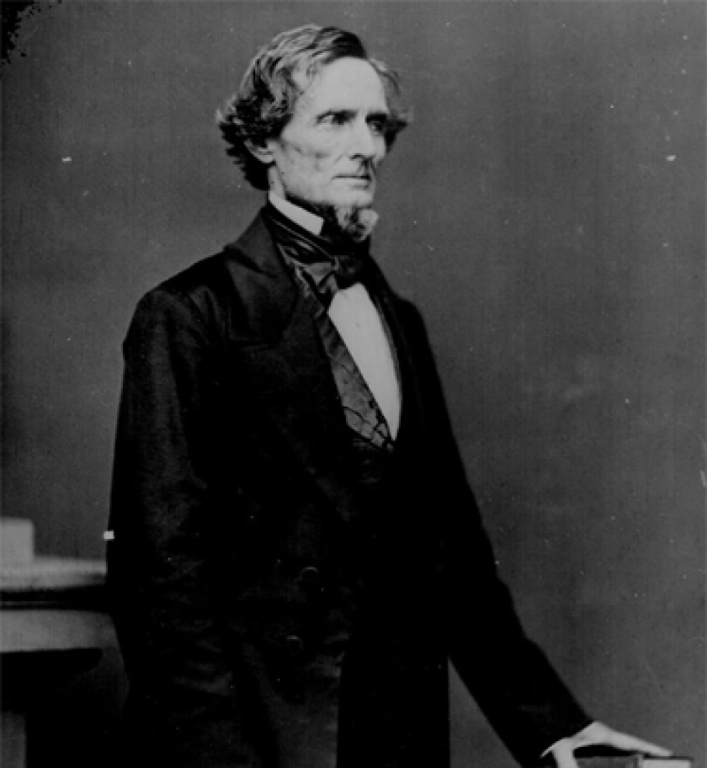
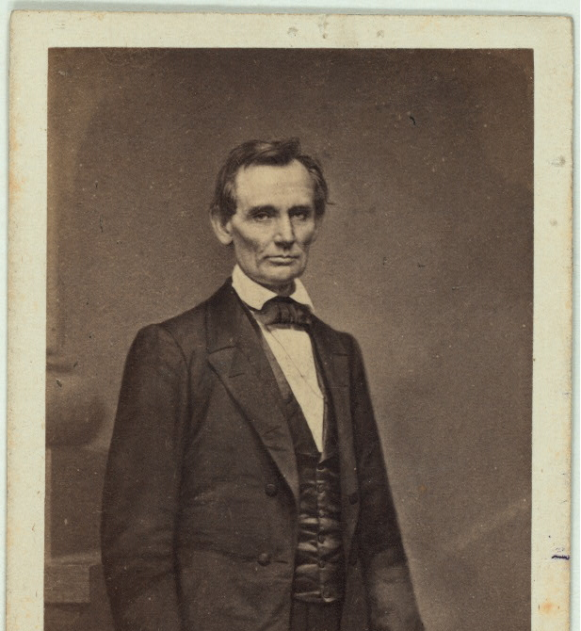
Notes:
https://cosmolearning.org/images/abraham-lincoln-february-27-1860-773/
https://www.latimes.com/opinion/la-xpm-2013-jun-02-la-oe-fehrman-jefferson-davis-presidential-library-20130602-story.html

Slide 25
The Initiation of the War: Fort Sumter
Charleston authorities cut off the food supply of Major Robert Anderson’s garrison
Confederate authorities decided that Anderson had to surrender even though the fort offered no military threat
Southerners fired the first shot

Slide 26
Finance and Diplomacy
Money was scarce for both governments.
Lincoln and Davis both had problems with their Secretaries of State.
The South, which provided cotton to the industrial Britain and France hoped that they would recognize the Confederacy.
The North, on the other hand, hoped that the rising anti-slavery sentiments in Europe would let those countries help the Northern cause. However, Lincoln government’s refrainment from anti-slavery discourse (in order not to lead to the secession of border states) during the early years of the war, forestalled the help of European anti-abolitionists.

Slide 27
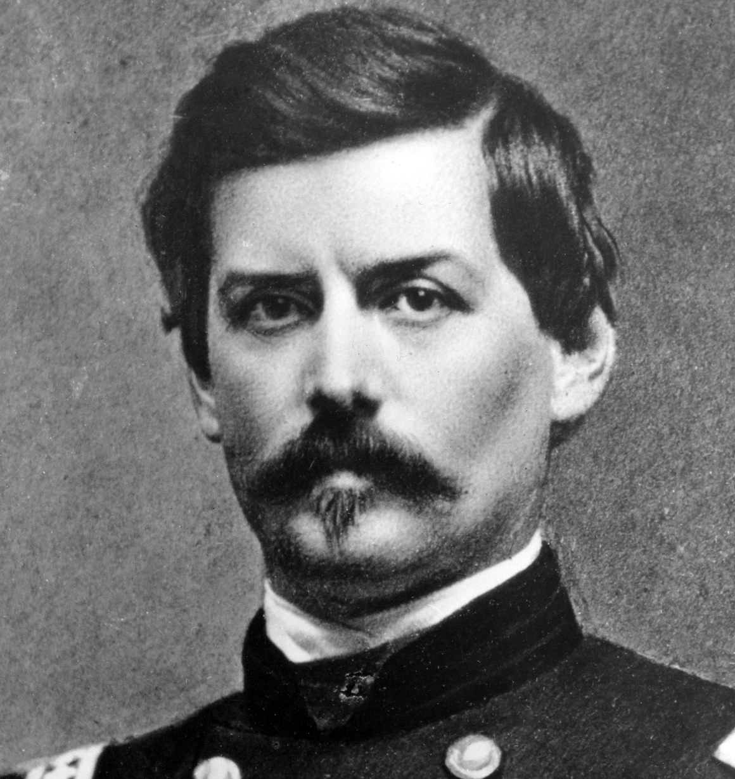
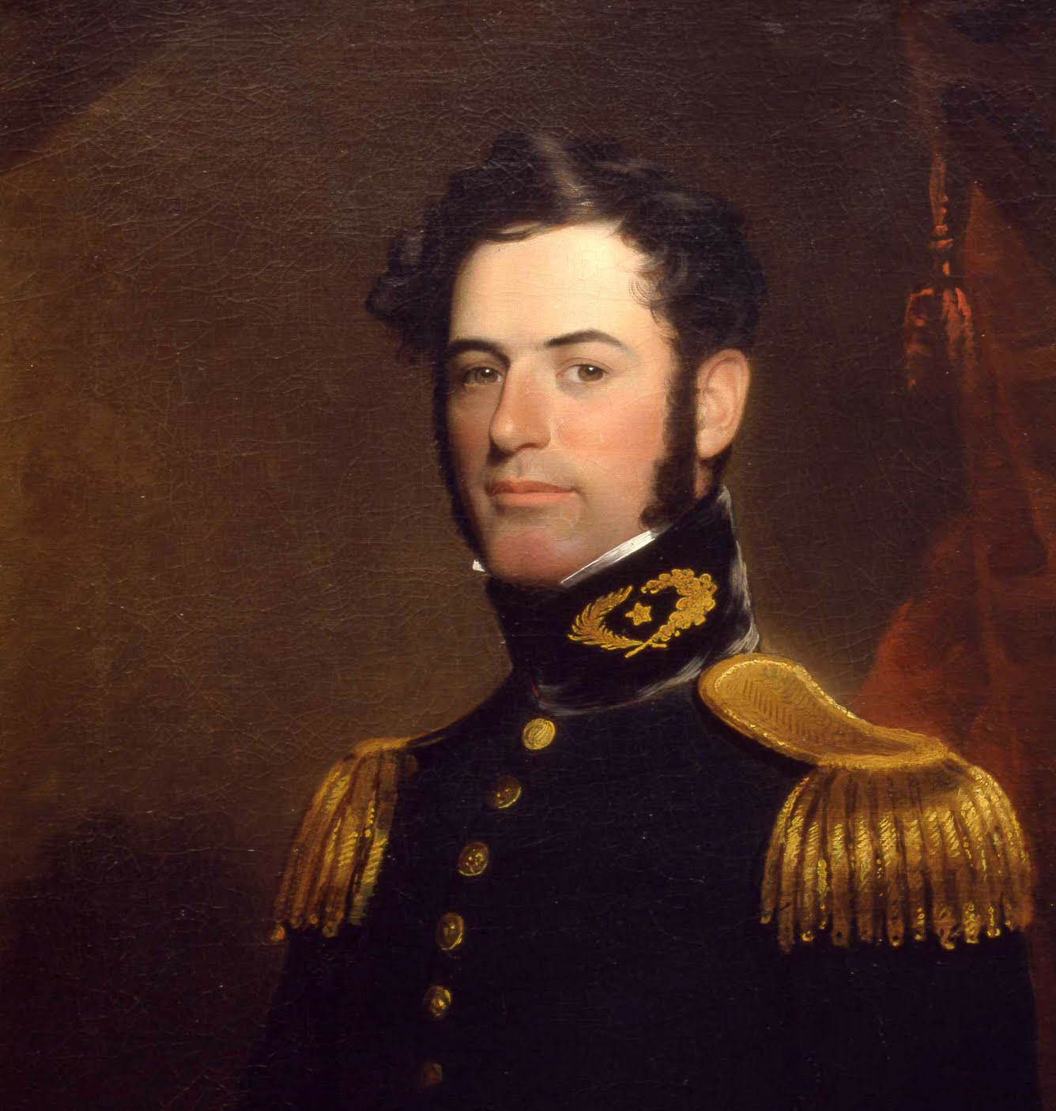
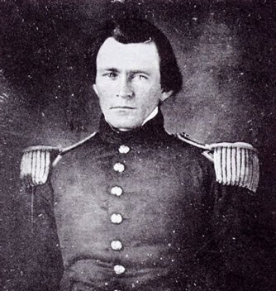
George B. McClellan Robert E. Lee Ulysses S. Grant Union Confederacy Union (18th US President)
Notes:
https://rusi.org/event/general-robert-e-lee-study-leadership
https://www.britannica.com/biography/George-B-McClellan
https://www.nps.gov/articles/000/ulysses-s-grant-in-st-louis-1854-1860.htm

Slide 28
Chronology
1850
Fugitive Slave Law
1853
Upsurge of political nativism: the Know-Nothings
1860
Abraham Lincoln elected president
1861
Mississippi, Florida, Alabama, Georgia, Louisiana, and Texas secede
1861
Jefferson Davis becomes the president of the Confederate States of America
1861
Inauguration of Lincoln
1861
Fort Summer and the beginning of the war
1861
Virginia, North Carolina, Tennessee and Arkansas secede
1862
Lincoln issues preliminary Emancipation Proclamation

