Slide 1
ANKARA UNIVERSITY DEPARTMENT OF ENERGY ENGINEERING NUMERICAL METHODS
INSTRUCTOR
DR. ÖZGÜR SELİMOĞLU

Slide 2
CONTENTS
Finding roots of equations
Systems of equations
Zeros of Polynomials
c) Other Methods

Slide 3
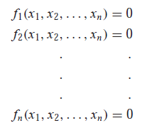
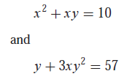
SYSTEMS OF EQUATIONS
To this point, we have focused on the determination of the roots of a single equation. A related problem is to locate the roots of a set of simultaneous equations,
(1)
The solution of this system consists of a set of x values that simultaneously result in all the equations equaling zero.
Present methods for the case where the simultaneous equations are linear—that is, they can be expressed in the general form;
(2)
where the b and the a’s are constants. Algebraic and transcendental equations that do not fit this format are called nonlinear equations. For example,
are two simultaneous nonlinear equations with two unknowns, x and y. They can be expressed in the form of Eq. (1) as
(3.a)
(3.b)

Slide 4
Thus, the solution would be the values of x and y that make the functions u(x, y) and v(x, y) equal to zero. Most approaches for determining such solutions are extensions of the open methods for solving single equations. In this section, we will investigate two of these: fixed-point iteration and Newton-Raphson.
Fixed-Point Iteration
The fixed-point-iteration approach can be modified to solve two simultaneous, nonlinear equations. This approach will be illustrated in the following example.
Problem Statement: Use fixed-point iteration to determine the roots of Eq. (3). Note that a correct pair of roots is x = 2 and y = 3. Initiate the computation with guesses of x = 1.5 and y = 3.5.
Solution: Equation (3.a) can be solved for
(4)
and Eq. (3.b) can be solved for
(5)
Note that we will drop the subscripts for the remainder of the example. On the basis of the initial guesses, Eq. (4) can be used to determine a new value of x:
This result and the initial value of y = 3.5 can be substituted into Eq. (5) to determine a new value of y:

Slide 5
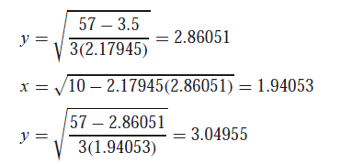
Thus, the approach seems to be diverging. This behavior is even more pronounced on the second iteration:
Obviously, the approach is deteriorating.
Now we will repeat the computation but with the original equations set up in a different format. For example, an alternative formulation of Eq. (3.a) is
and of Eq. (3.b) is
Now the results are more satisfactory:
Thus, the approach is converging on the true values of x = 2 and y = 3.

Slide 6
Example 1: Use fixed-point iteration to determine the roots of x² -x – 1=0. That a correct of root is x = 2.
Solution: f(x) x² -x – 1=0
g(x) x=1+1/x
1 | x₁ | =2
2 | x₂ | = 1+1/x₁=1+1/2=1.5
3 | x₃ | =1+1/x₂=1+1/1.5=1.6666
4 | x₄ | =1+1/x₃=1+1/1.6666=1.6
5 | x₅ | ₌1+1/x₄=1+1/1.6=1.625
6 | x₆ | =1+1/x₅=1+1/1.625=1.615385
7 | x₇ | =1+1/x₆=1+1/1.615385=1.619
8 | x₈ | =1+1/x₇=1+1/1.619=1.6176
9 | x₉ | =1+1/x₈=1+1/1.6176=1.61819
10 | x₁₀ | =1+1/x₉=1+1/1.61819=1.6179

Slide 7
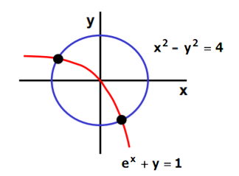
Example 2: Solve the following system of equations
Select a starting values for x and y, such as x₀=0 and y₀=0. Put the functions into the form « x=g₁ (x,y) » , « y=g₂ (x,y) ».
Solution: Use x₀ and y₀ in g functions to calculate new values( x_{new}, y_{new}).
x e^{x}=1-y ln(e^{x})= ln(1-y) log _{e}e^{x}=ln(1-y) x= ln(1-y) x=g₁(y) =ln(1-y)
y - y²=4-x² y= - $\sqrt{4−x2}$ y=g₂= - $\sqrt{4−x2}$
x₁=g1(y₀) | ln(1-0)=ln(1) | 0
x₂=g2(y₁) | ln(1-(-2))=ln(3) | 1,0986
x₃=g3(y₂) | ln(1-(-1,671))=ln(1) | 0,9824
x₄=g4(y₃) | ln(1-(-1,7421))=ln(2,7421) | 1,008724
y₁=g1(x₀) | $−\sqrt{4−02}$=$\sqrt{4}$ | - 2
y₂=g2(x₁) | $−\sqrt{4−(\text{1,0986 })2}$=$\sqrt{2,9394}$ | -1,671
y₃=g3(x₂) | $−\sqrt{4−(0,9824)2}$=$\sqrt{3,0348}$ | -1,7421
y₄=g4(x₃) | $−\sqrt{4−(\text{1,008724 })2}$=$\sqrt{2,9825}$ | -1,727
The solution is converging to the exact solution of x=1.004169 , y= - 1.729637

Slide 8
Newton-Raphson
Recall that the Newton-Raphson method was predicated on employing the derivative (that is, the slope) of a function to estimate its intercept with the axis of the independent variable.
(6)
where x_{i} is the initial guess at the root and x_{i+1} is the point at which the slope intercepts the x axis. At this intercept, f(x_{i+1}) by definition equals zero and Eq. (6) can be rearranged to yield
(7)
The multi-equation form is derived in an identical fashion. However, a multivariable Taylor series must be used to account for the fact that more than one independent variable contributes to the determination of the root. For the two-variable case, a first-order Taylor series can be written for each nonlinear equation as
(8.a)
And
(9.b)
Just as with fixed-point iteration, the Newton-Raphson approach will often diverge if the initial guesses are not sufficiently close to the true roots. Although there are some advanced approaches for obtaining acceptable first estimates, often the initial guesses must be obtained on the basis of «trial and error» and knowledge of the physical system being modeled.

Slide 9
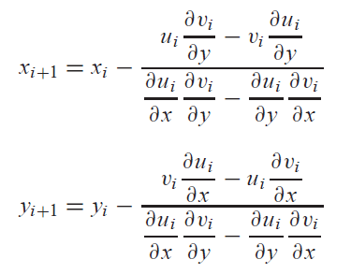
Just as for the single-equation version, the root estimate corresponds to the values of x and y, where u_{i+1} and v_{i+1} equal zero. For this situation, Eq. (8) can be rearranged to give
(9.a)
(9.b)
Note that this is a two function with two unknown linear equation. You can check the determinant of the equation matrix to validate that it has a real solution.
Because all values subscripted with i’s are known (they correspond to the latest guess or approximation), the only unknowns are x_{i+1} and y_{i+1}. Thus, Eq. (9) is a set of two linear equations with two unknowns .
For x_{i+1} :
For y_{i+1} :
x_{i+1} = x_{i} - $\frac{f1 f2−f3 f4}{f5 −f6}$
(10.a)
y_{i+1} = y_{i} - $\frac{f1 f2−f3 f4}{f5 −f6}$ (10.b)
Equation (10) is the two-equation version of the Newton-Raphson method.
f₁=u_{i}
f₂=$\frac{∂\text{v} \text{i} }{∂y}$
f₃=v_{i}
f₄=$\frac{∂\text{u} \text{i} }{∂y}$
f₅=$\frac{∂\text{u} \text{i} }{∂x}\frac{∂\text{v} \text{i} }{∂y}$
f₆=$\frac{∂\text{u} \text{i} }{∂y}\frac{∂\text{v} \text{i} }{∂x}$
f₁=v_{i}
f₂=$\frac{∂\text{u} \text{i} }{∂x}$
f₃=u_{i}
f₄=$\frac{∂\text{v} \text{i} }{∂x}$
f₅=$\frac{∂\text{u} \text{i} }{∂x}\frac{∂\text{v} \text{i} }{∂y}$
f₆=$\frac{∂\text{u} \text{i} }{∂y}\frac{∂\text{v} \text{i} }{∂x}$

Slide 10
Example 3: Use the multiple-equation Newton-Raphson method to determine roots of Eq. (a,b). Note that a correct pair of roots is x = 2 and y = 3. Initiate the computation with guesses of x = 1.5 and y = 3.5.
(a)
(b)
Solution: First compute the partial derivatives and evaluate them at the initial guesses of x and y:
Thus, the determinant of the Jacobian matrix for the first iteration is
The values of the functions can be evaluated at the initial guesses as
These values can be substituted into Eq. (10) to give
Thus, the results are converging to the true values of x = 2 and y = 3. The computation can be repeated until an acceptable accuracy is obtained.

Slide 11
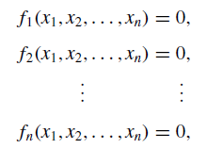
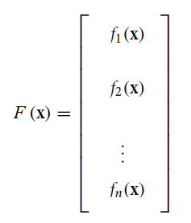
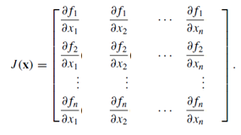
The Jacobian Matrix
In the vector calculation, the Jacobi matrix is the matrix containing all first-order partial derivatives of a vector-valued function. When this matrix is a square matrix, that is, if the number of inputs of the function is the same as the vector components of the output number, the determinant of this matrix is called the Jacobi determinant.
A system of nonlinear equations has the form
Equations matrix
(a)
Define the matrix J(x) by .The matrix J is the derivative of the F matrix according to its variables.
(b)

Slide 12
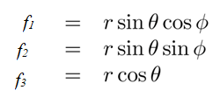
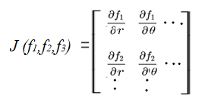
Example (Jacobian Matrix): Find the Jacobian matrix transformation of its equations and calculate its determinant.
Solution :
$\frac{∂f1}{∂r}$ = sin $θ\cos{ }∅$ $\frac{∂f1}{∂θ}$ = r cos $θ\cos{ }∅$ $\frac{∂f1}{∂∅}$ = - r sin $θ\sin{ }∅$
$\frac{∂f2}{∂r}$ = sin $θ\sin{ }∅$ $\frac{∂f2}{∂θ}$ = r cos $θ\cos{ }∅$ $\frac{∂f2}{∂∅}$ = r sin $θ\cos{ }∅$
$\frac{∂f3}{∂r}$ = cos $θ$ $\frac{∂f3}{∂θ}$ = - r sin $θ$ $\frac{∂f3}{∂∅}$ = 0
=r² sin $θ$

Slide 13
The Newton-Raphson method for variables two and more :
The two-equation Newton-Raphson approach can be generalized to solve n simultaneous equations.
To derive the Newton-Raphson method for a system of equations, we start with the Taylor series expansion of f_{i}(x) about the point x:
(11.a)
Dropping terms of order $∆$x², we can write Eq. (11.a) as
(11.b)
where J(x) is the Jacobian matrix (of size n ×n)made up of the partial derivatives
(12)
Note that Eq. (11.b) is a linear approximation (vector $∆$x being the variable) of the vector-valued function f in the vicinity of point x.
Let us now assume that x is the current approximation of the solution of f(x) = 0, and let x + $∆$x be the improved solution. To find the correction $∆$x, we set f(x + $∆$x) = 0 in Eq. (11.b). The result is a set of linear equations for $∆$x :
(13)
Because analytical derivation of each ∂f_{i} / ∂x _{j} can be difficult or impractical, it is preferable to let the computer calculate them from the finite difference approximation
(14)
where h is a small increment of x _{j} in direction of x _{j} where the direction is shown by the unit vector e_{j} . This formula can be obtained from Eq. (11.a) after dropping the terms of order $∆$x² and setting $∆$x = e _{j} h.

Slide 14
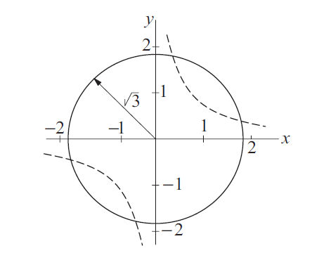
Example 4: Determine the points of intersection between the circle x² + y² = 3 and the hyperbola xy = 1.
Solution: The equations to be solved are
(15.a)
(15.b)
The Jacobian matrix is
Thus the linear equations J(x)$∆$x = −f(x) associated with the Newton-Raphson method are
(16)
By plotting the circle and the hyperbola , we see that there are four points of intersection. It is sufficient, however, to find only one of these points, because the others can be deduced from symmetry. From the plot we also get a rough estimate of the coordinates of an intersection point, x = 0.5, y = 1.5, which we use as the starting values.

Slide 15
The computations then proceed as follows.
First Iteration: Substituting x = 0.5, y = 1.5 in Eq. (16), we get
the solution of which is $∆$x = $∆$y = 0.125. Therefore, the improved coordinates of the intersection point are
Second Iteration: Repeating the procedure using the latest values of x and y, we obtain
which yields $∆$x = $∆$y = −0.00694. Thus
Third Iteration: Substitution of the latest x and y into Eq. (16) yields
The solution is $∆$x = $∆$y = −0.00003, so that

Slide 16
Subsequent iterations would not change the results within five significant figures. Therefore, the coordinates of the four intersection points are
Alternate Solution: If there are only a few equations, it may be possible to eliminate all but one of the unknowns. Then we would be left with a single equation that can be solved by the methods described.
which upon substitution into Eq. (16) yields x² + 1/x² − 3 = 0, or
The solutions of this biquadratic equation are x = ±0.618 03 and ±1.618 03, which agree with the results obtained by the Newton-Raphson method.

Slide 17
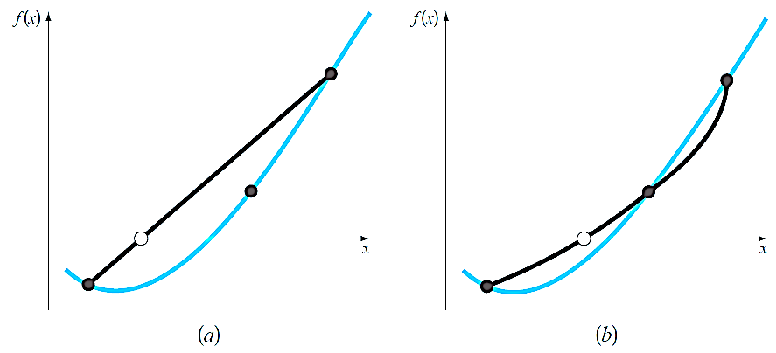
OTHER METHOD
BRENT’S METHOD
Inverse Quadratic Interpolation
Inverse quadratic interpolation is similar to the secant method. As in Fig. 1.a, the secant method is based on computing a straight line that goes through two guesses. The intersection of this straight line with the x axis represents the new root estimate. For this reason, it is sometimes referred to as a linear interpolation method.
Now suppose that we had three points. In that case, we could determine a quadratic function of x that goes through the three points (Fig. 1.b). Just as with the linear secant method, the intersection of this parabola with the x axis would represent the new root estimate. And as illustrated in Fig. 1.b, using a curve rather than a straight line often yields a better estimate.
Figure 1: Comparison of (a) the secant method and (b) inverse quadratic interpolation. Note that the dark parabola passing through the three points in (b) is called “inverse” because it is written in y rather than in x.

Slide 18
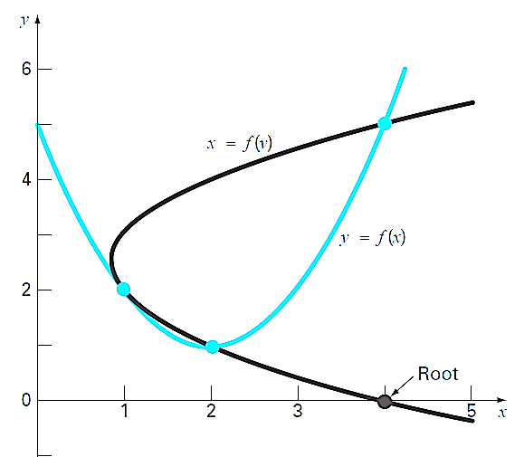
The difficulty can be rectified by employing inverse quadratic interpolation. That is, rather than using a parabola in x, we can fit the points with a parabola in y. This amounts to reversing the axes and creating a “sideways” parabola (the curve,
x = f (y), in Fig. 2).
If the three points are designated as (x_{i−2}, y_{i−2}), (x_{i−1}, y_{i−1}), and (x_{i} , y_{i} ), a quadratic function of y that passes through the points can be generated as
(17)
The root, x_{i+1}, corresponds to y = 0, which when substituted into Eq. (6.9) yields
(18)
As shown in Fig. 2, such a “sideways” parabola always intersects the x-axis.
Figure 2: Two parabolas fit to three points. The parabola written as a function of x, y = f(x), has complex roots and hence does not intersect the x axis. In contrast, if the variables are reversed, and the parabola developed as
x = f (y), the function does intersect the x axis.

Slide 19
Example 5: Develop quadratic equations in both x and y for the data points depicted in Fig. : (1, 2), (2, 1), and (4, 5). For the first, y = f (x), employ the quadratic formula to illustrate that the roots are complex. For the latter, x = g(y), use inverse quadratic interpolation (Eq.10) to determine the root estimate.
Solution: By reversing the x’s and y’s, Eq. (17) can be used to generate a quadratic in x as
or collecting terms
This equation was used to generate the parabola, y = f(x), in Fig.

Slide 20
The quadratic formula can be used to determine that the roots for this case are complex,
Equation (17) can be used to generate the quadratic in y as
or collecting terms
Finally, Eq. (6.10) can be used to determine the root as

Slide 21
REFERENCES
Jaan Kiusalaas, “Numerical Methods in Engineering with Python 3”,3rd Edition, Cambridge, NY, 2013
S.C. Chapra and R.P. Canale, “Numerical Methods for Engineers”, 6th ed., McGraw-Hill, NY, 2010

