Slide 1
Mesleki Yabancı Dil 2

Slide 2
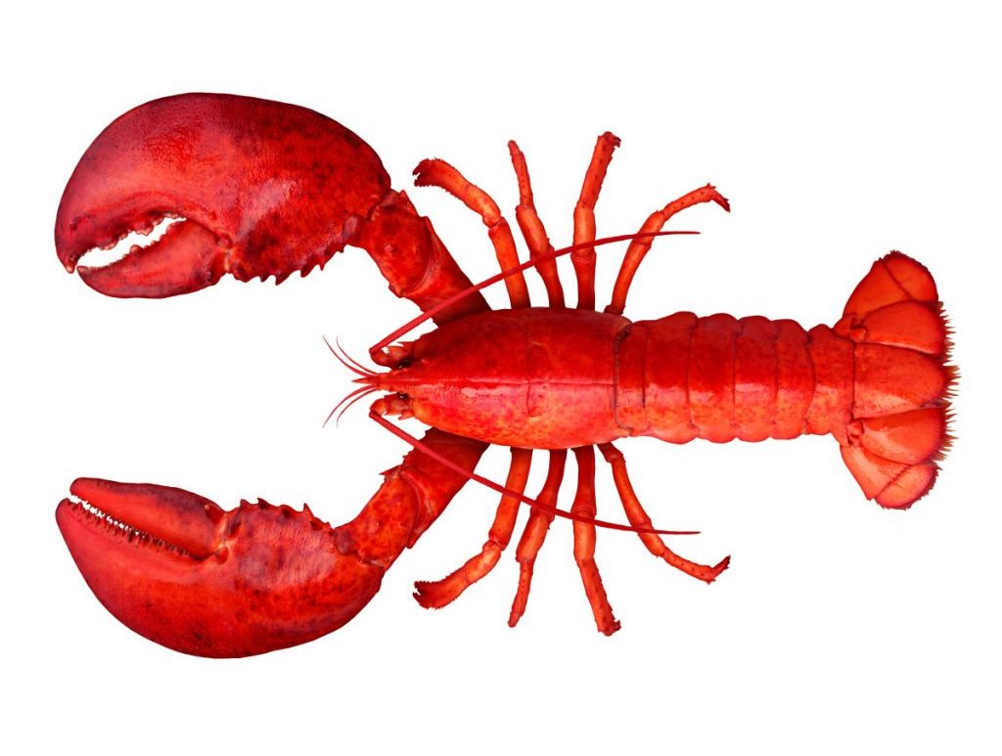
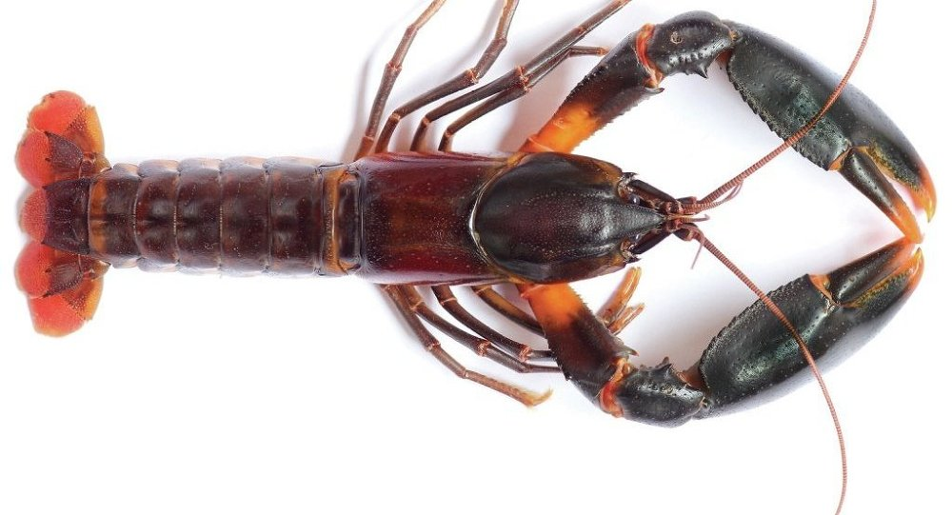
Crayfish : Kerevit/Tatlı su ıstakozu Lobster : Istakoz
Kıreyfish Labstır

Slide 3
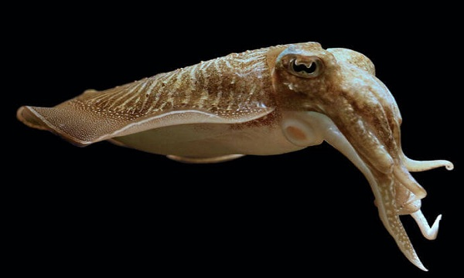
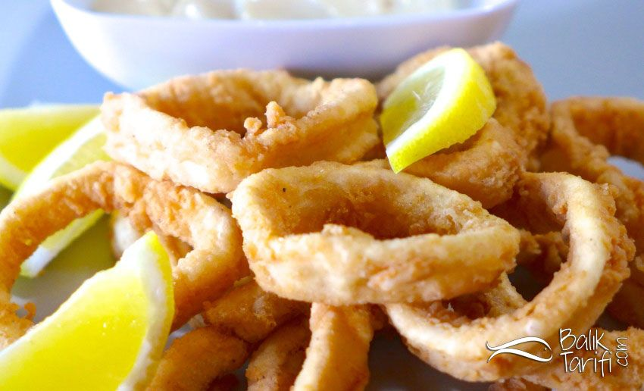
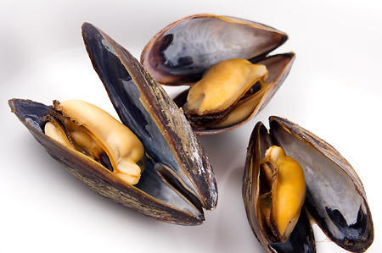
Calamary/Squid : Kalamar/Mürekkep Balığı Mussel : Midye
Kalımery/Sukued Meesıl

Slide 4
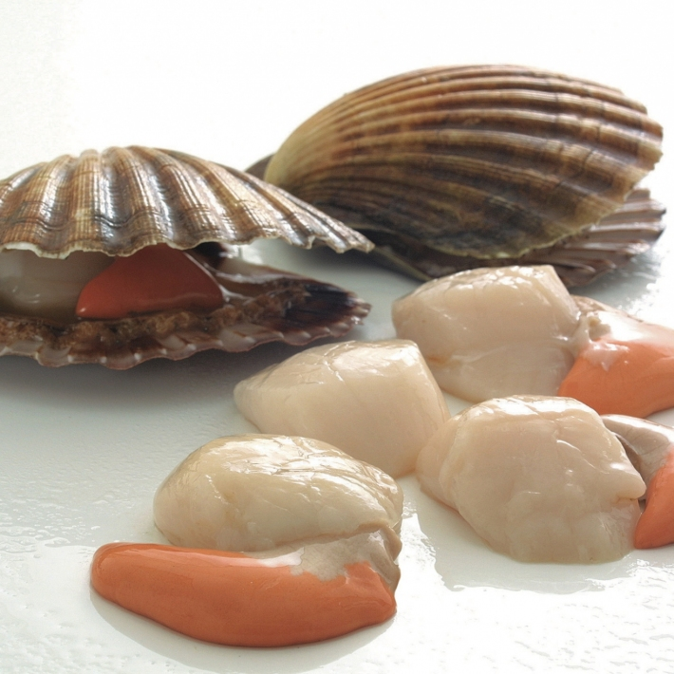
Oyster : İstiridye Scallop : Deniz Tarağı
Oystır Sıkelıb

Slide 5
………….. is valued as a complete protein food containing all the amino acids necessary for the human body.
………….. digests somewhat slowly, but 95 percent of ……. protein and 96 percent of the fat are digested. Fats tend to retard the digestion of other foods; thus, ……. with a reasonable proportion of fat remains longer in the stomach, delaying hunger and giving “staying power.” Extractives in ……….. cause a flow of saliva and gastric juices, creating the desire to eat and ensuring ease of digestion.

Slide 6
A ………………… is used for mixing liquids.
A ………………… is used for grating nutmeg, cheese, ginger root and lemon peel.
Use a ……………… to wash fresh vegetables, drain pasta, rinse berries, salad greens or canned beans.
A ………………... serves many functions. You can use it to serve soup or add broth to risotto.
A thin, flexible ………………… is used for taking eggs, pancake, etc., out of a frying pan.
With …………….. You can push spaghetti into boiling water, pick up sausages and hot-dogs from the grill, and turn steaks without piercing them.

Slide 7
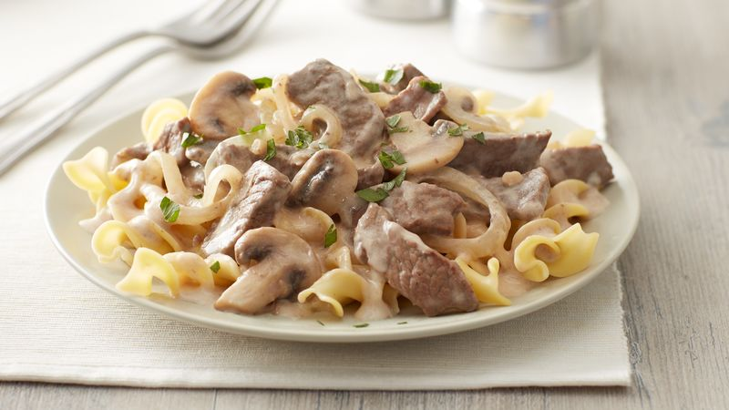
Beef Stroganoff (Dana Strogonof) Recipe
Ingredients
1 red onion
1 clove of garlic
1 lemon
2 handfuls of wild mushrooms
2-3 sprigs of fresh parsley
500 g fillet steak
1 teaspoon paprika
Olive oil
1 knob of unsalted butter
1 small glass of brandy
50 ml sour cream

Slide 8
Method
1. Peel and finely chop the onion and garlic, then finely grate the lemon zest. Clean and tear the mushrooms. Pick (ayıklamak) and finely chop the parsley.
2. Place the beef between 2 sheets of clingfilm. Bash (sertçe vurmak) with a rolling pin until ½ cm thick, then cut into finger-width (parmak kalınlığı, eni) slices.
3. Mix the paprika, lemon zest, and a pinch of sea salt and black pepper together, and use to dust the beef.

