Slide 1
Epidermophyton Genus

Slide 2
First article of Epidermophyton was published in 1870 by Harz, about a Tinea cruris case
Epidermophyton cinsine ait ilk bilimsel bildiri Harz tarafından 1870 yılında Tinea cruris vakasından izole edilerek yapılmıştır.
In the beginning it was called Acrothecium floccosum; then in 1923 Ota and Langeron named it as Epidermophyton floccosum
Acrothecium floccosum olarak bildirilen etken, 1923 yılında Ota ve Langeron tarafından Epidermophyton floccosum olarak yeniden isimlendirilmiştir
In Epidermophyton genus there are 2 species described
Epidermophyton floccosum (Mostly in gogs)
Epidermophyton stockdaleae (Non pathogen)

Slide 3
Usually isolated from the cases of tinea corporis, tinea pedis, tinea cruris and tinea ungium
There is no need for spesific medium for the isolation of agent. SDA and 25C is optimal.
In solid media they develop expanded hyphae like other dermathophytes. Macroconidias are long and thin shaped with 1-9 septums. They do not include microcodias
The most important virulence factor is its proteinase enzyme that it produces at 37C

Slide 4
Treatment:
Topical and systemic antifungals,
Thiabendazole, Miconazole, Ecoconazole, Ketoconazole, İtraconazole, Clotrimazole, Terbinafine
The most effective one is Terbinafine which can be used both topically and systematically

Slide 5
Dermatophilosis Genus

Slide 6
Dermatophilosis (Mycotic Dermatitis), is characterised by exudative dermatitis which is observed in leg, head and neck skin of animals Etken Dermatophilus congolensis.
Aerobic, Motile spores (They have flagella to move independently. When it finds suitable environmental conditions spores will develop branched filaments)
Mostly seen in hot and moistured climate
They can not be found in the environment. Only observed on the skin and hair

Slide 7
The lesions are mostly observed on the back, head, neck and the both sides of the bodies of horses, cows, sheeps and goats
There are papules, vesicles, oedema and suppuration which can also be misdiagnosed as skin infections
Between knee joint and nail coroner of sheeps there can be found 2-4 cm lesions called “Strawberry Foot Rot”

Slide 8
Treatment – Protection
The treatment of new infection is easy and sometimes animal can recover spontaneously. However treatment of the chronic infections are very difficult
Pomat iodure, iodophorm ointment, %5 salicylic acid and topical antifungal agents can be used
If necessary Penisilin-Streptomisin can be used
For the foot lesions zinc sulphate or copper sulphate can be used
Maintaining the skin of animals dry is the most important prevention strategy. Insect and arthropode control must be performed

Slide 9
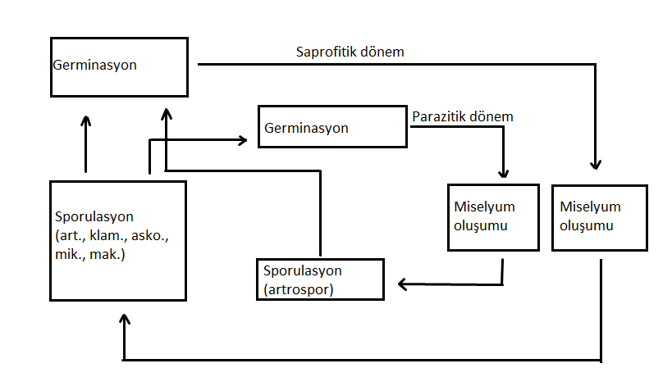
Dermatofitlerin genel yaşam dönemleri

Slide 10
Aspergillosis

Slide 11
Aspergillus species lead to respiratory system infections and sometimes they can also rarely cause systemic infections
Aspergillozis, Aspergillus türleri tarafından oluşturulan, genellikle solunum sistemine yerleşen ve bazen de generalize (sistemik) durum gösteren bir mantar hastalığıdır.
Main species that causes infections in animals are:
Aspergillus fumigatus the major agent. Beside this;
Aspergillus niger,
Aspergillus flavus,
Aspergillus terreus,
Aspergillus nidulans
A. fumigatus and A. flavus have endotoxin. A. flavus also synthesised a very potent toxin called aflatoxin.

Slide 12
Epidemiology
The intake of Aspergillus spores by inhalation leads to the frequent observation of respiratory system infections
Spores can be observed in soil, decayed food and plants. Inhalation of these spores by the animals that are fed in these environments lead to Aspergillosis
Sporlara toprakta, çürümüş veya çürümekte olan gıdalarda, bitkilerde oldukça sık rastlanmaktadır. Böyle yerlerde yaşayan ya da beslenen hayvanlarda solunum yolu ile sporların alınması sonucunda Aspergillozis meydana gelir.
In the tissue and pathologic materials the conidiums, coniophores and micelial elements can be seen
Dokularda veya patolojik maddelerde genellikle konidiumlara, konidiofor ve miselyal elementlere rastlanır.
All animals are susceptible. In-appropriate caring and nutrition rules are the predisposition factors for the disease
Hastalığa hemen her hayvanda rastlanmaktadır. Kötü bakım-besleme koşulları ve hijyenik olmayan ortamlar predispose edici faktörlerdendir.
Transmission from animal to animal is very rare in comparison to the other fungal infections
Hayvandan hayvana bulaşma, diğer mantar infeksiyonlarına göre daha nadir rastlanmaktadır.

Slide 13
Diagnosis
Clinical Diagnosis: Clinical findings are mostly observed in the respiratory and digestion systems. In some animals abortions dur to the fungi can also be observed.
Aspergillus infections are frequently seen in the poultry. Acute Aspergillosis are observed in young animals, Chronic Aspergillosis is seen in adults.
Culture: Tissue with lesions and other materials can be cultured on SDA with antibiotic and incubated at 25C. The colonies can be evaluated for the both macro and micro morphological characteristics.
In order to diagnose Aspergillus species the conidiophore, vesicle, sterigma and conidial chain must be evaluated. The head of the conidia must be investigated for its shape and colour; the structure of ascospores; the sequence number of sterigma; the length of conidiophofore and the size of the conidium is important.

Slide 14
- Microscopy: The materials are stained and investigated for the presence of conidophores, conidiums, vesicle, sterigma and hyphae
Treatment
Topical antifungal agents,
Amphotericin-B , Enilconazole, Miconazole , Terbinafine
Systemic antifungal agents,
Amphotericin-B ( 1.5 mg/kg, 5 days)
Fluconazole ( 5 mg/kg, 7 days )
İtraconazole ( 5-15 mg/kg, 21 days )
Ketoconazole ( 10-30mg/kg, 21 days)
Voriconazole ( 5-10 mg/kg,7 days)

