Slide 1
REPRODUCTIVE HERD HEALTH
Prof.Dr. Şükrü Küplülü

Slide 2
COLOLOSTRUM MANAGEMENT IN NEWBORNS

Slide 3
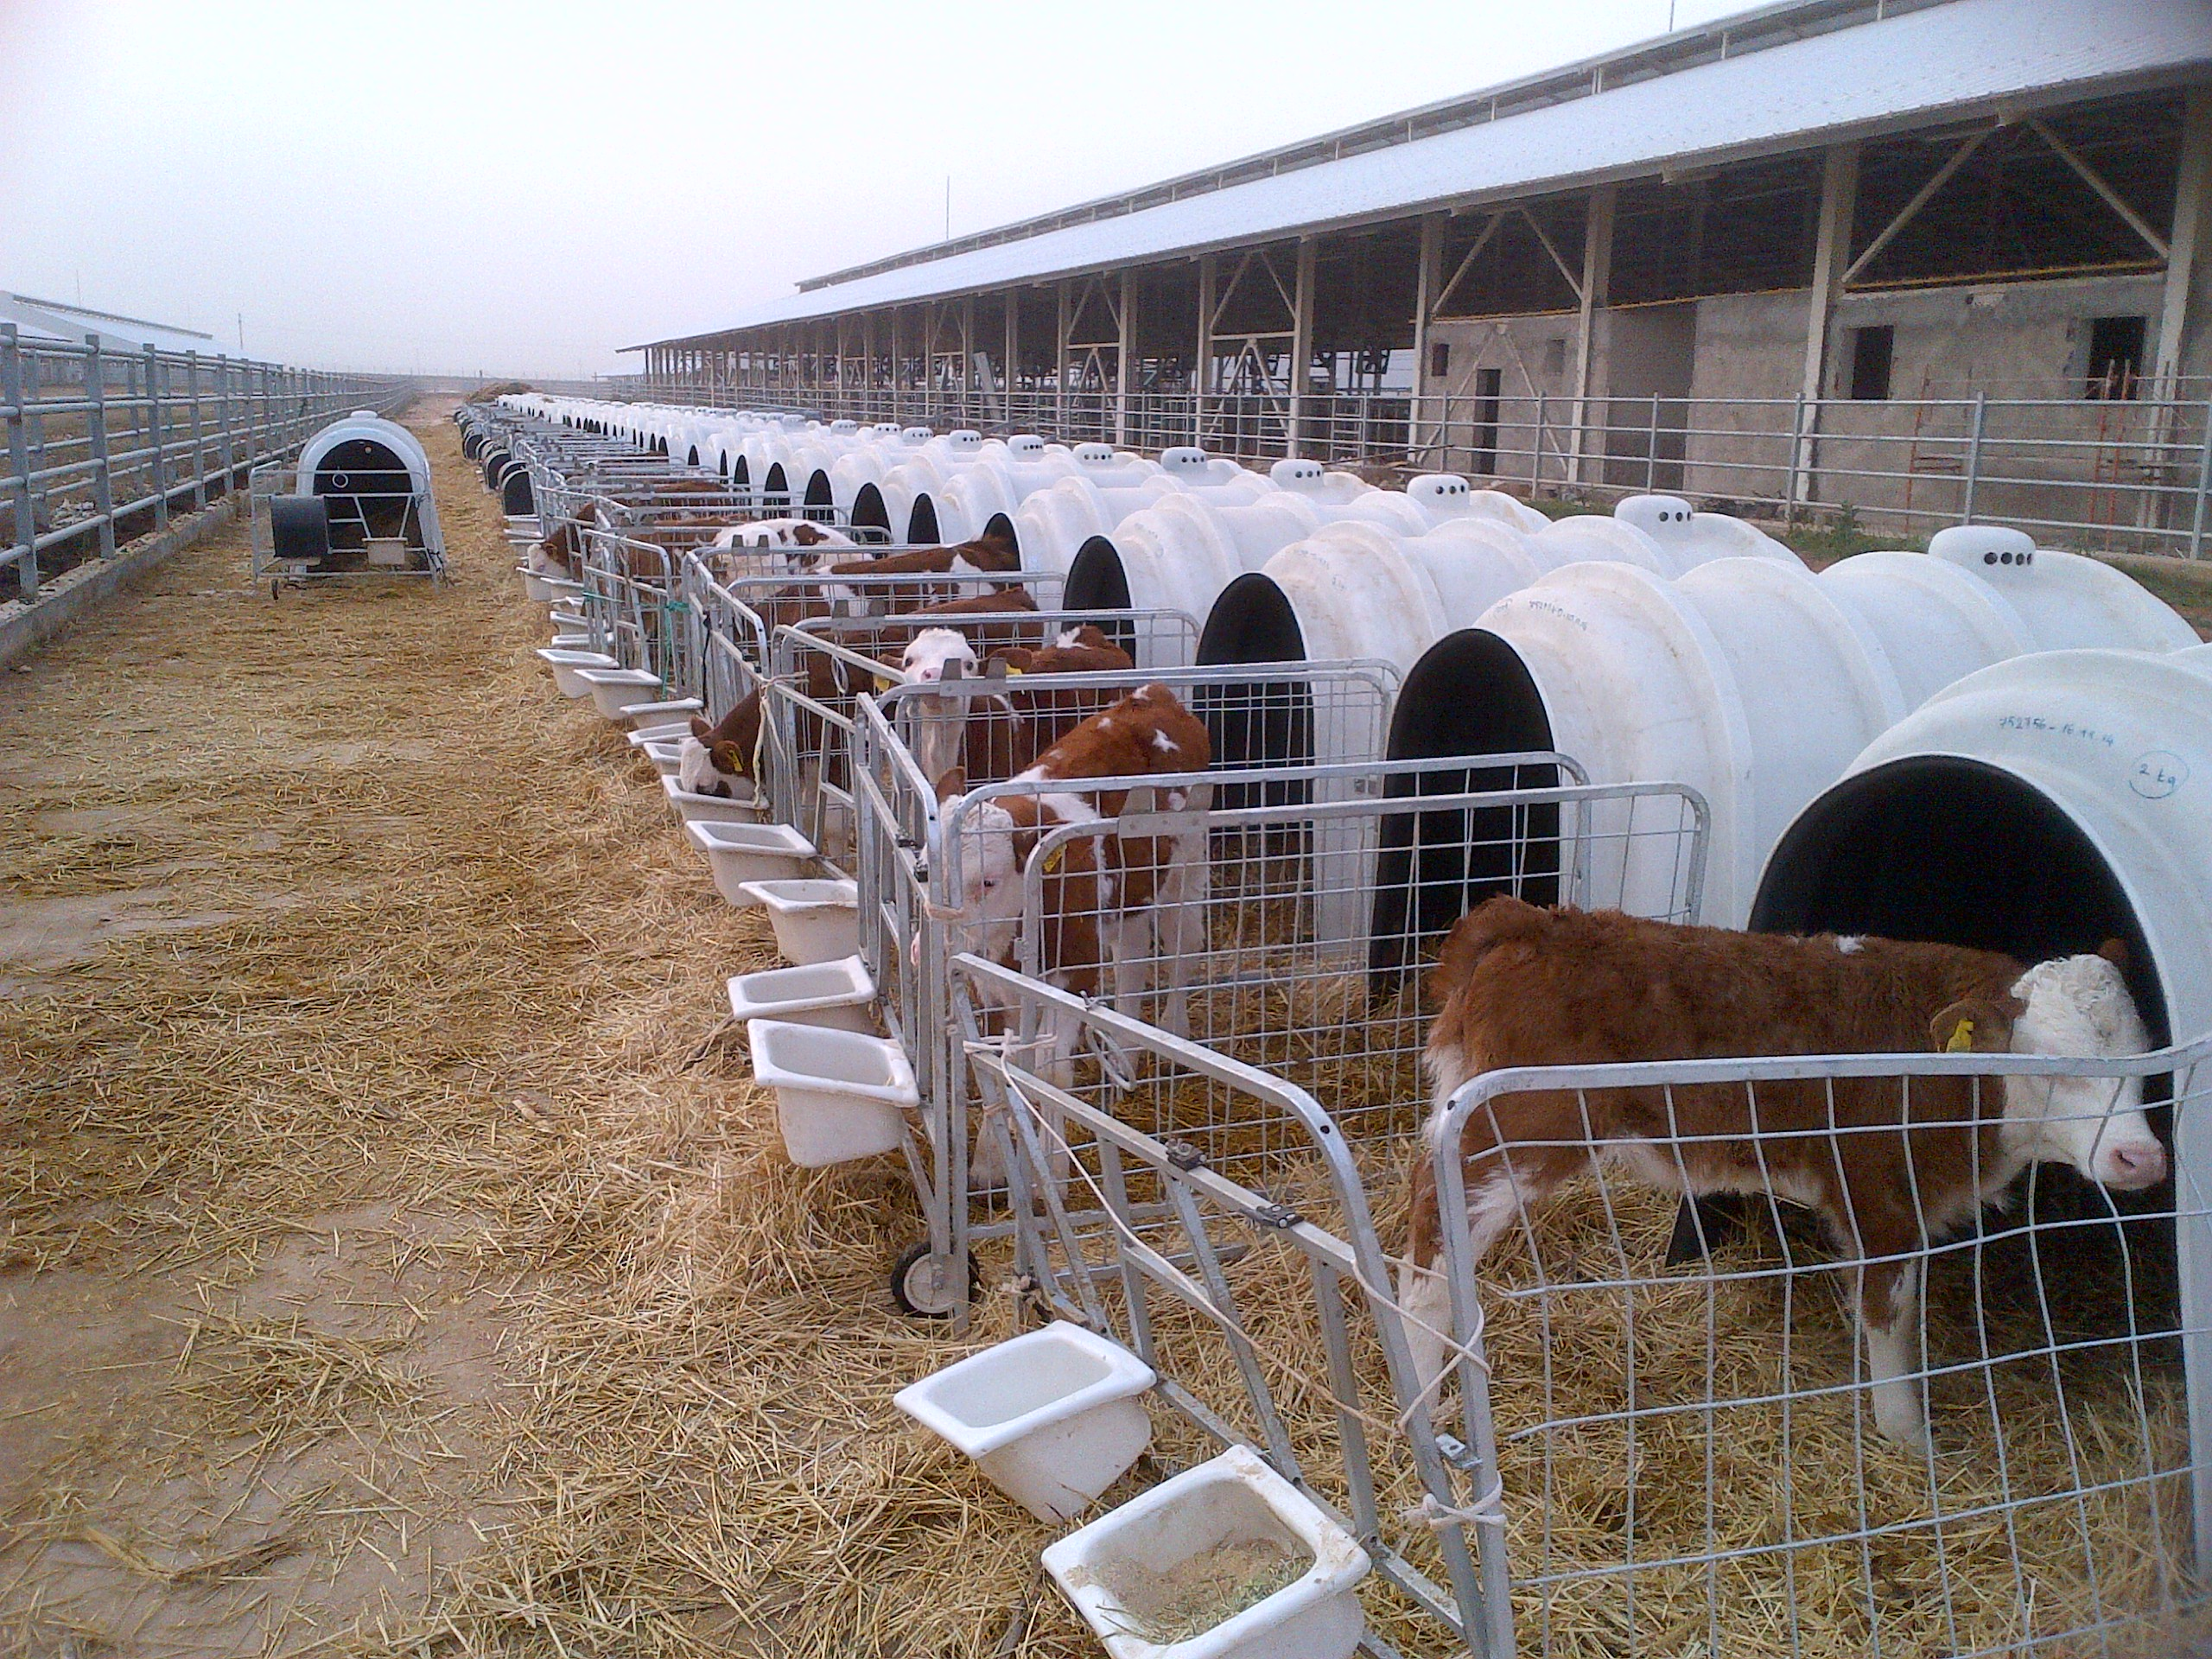
colostrum management
The continuity of the herd in cattle breeding depends on the success of the healthy calf breeding program
(Küplülü ve Vural, 2015 TİGEM)

Slide 4
Colostrum management
15-20% of calf deaths are
due to misfeeding methods.
(Küplülü ve Vural, 2015 TİGEM)

Slide 5
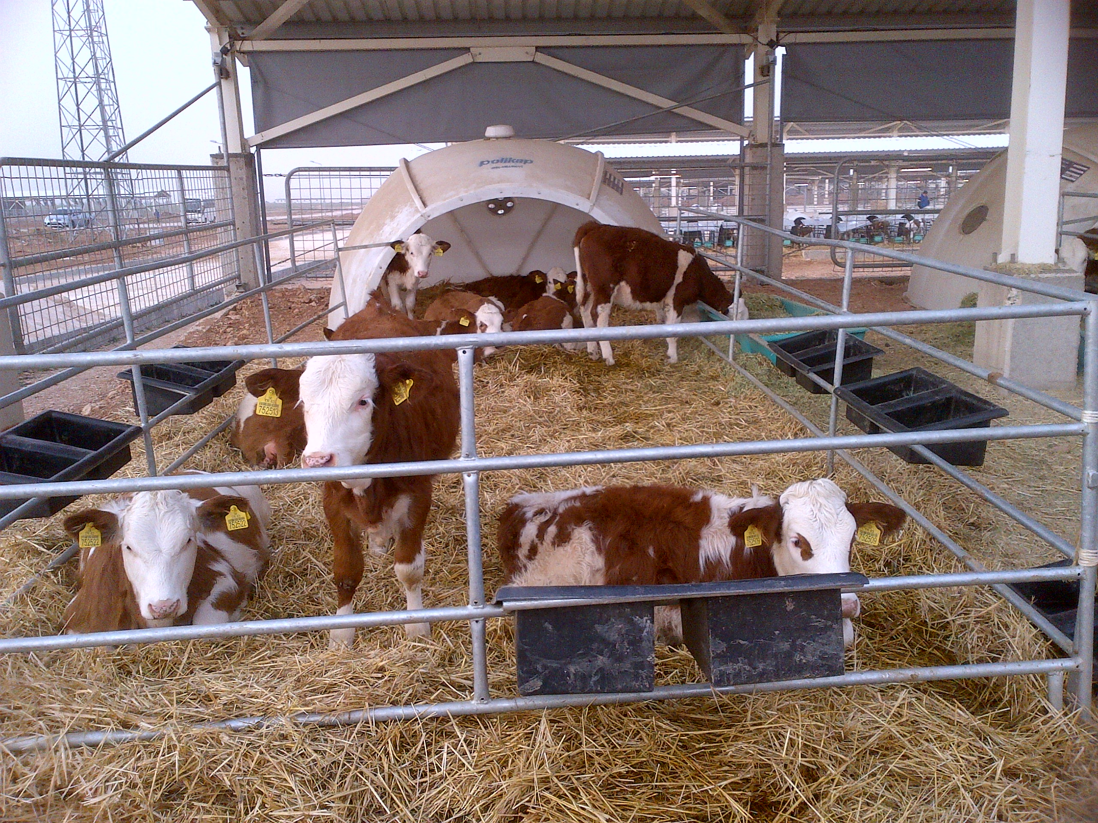
Colostrum management
With a good care-feeding method, the mortality rate can be reduced to 3-5%.
(Küplülü ve Vural, 2015 TİGEM)

Slide 6
Colostrum management
colostrum is a unique food source for minimizing health problems
jeffreydachmd.com
(Küplülü ve Vural, 2015 TİGEM)

Slide 7
Colostrum management
Colostrum starts to be produced during colostrogenesis. especially Ig is different from normal milk. After 24 hours, it starts to return to normal milk. It becomes normal at 72 hours.
askthefarmers.com
(Küplülü ve Vural, 2015 TİGEM)

Slide 8
Colostrum management
Immediately after birth, the offspring should
absorb their mother to provide passive immunity.
askthefarmers.com

Slide 9
Colostrum management
(Küplülü ve Vural, 2015 TİGEM)

Slide 10
Colostrum management
According to Ig concentration, colostrum is divided into three classes:
a) Weak <22 mg / ml
b) Medium 22-50 mg / ml
c) Very good> 50 mg / ml
(Küplülü ve Vural, 2015 TİGEM)

Slide 11
Colostrum management
Level of immunoglobulin fractions of colostrum and normal milk
(Küplülü ve Vural, 2015 TİGEM)

Slide 12
Colostrum management
colostrum consumption after birth

Slide 13
Colostrum management
Factors affecting colostrum quality
Race
Age
Colostrum administration time
Feeding before birth
Corticosteroid use
Early birth

