Slide 1
PACKAGING of beverages
Instructor
Assist. Prof. Dr. Eda Demirok Soncu
E-mail: edemirok@eng.ankara.edu.tr
Phone: +90312 203 3300 (3639 ext.)
Office: 2nd floor #212
Fde 216 food packagıng

Slide 2
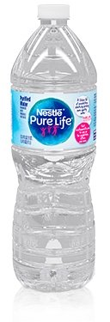
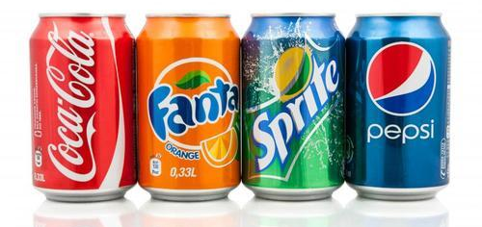
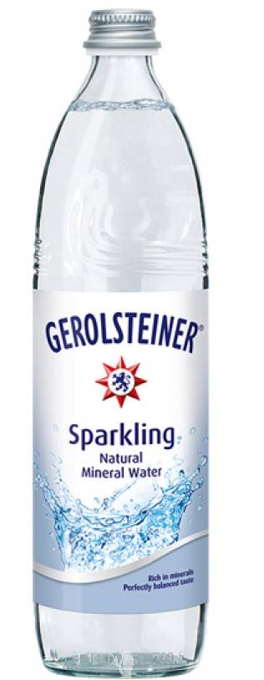
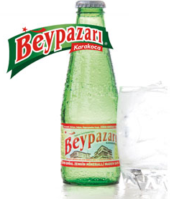
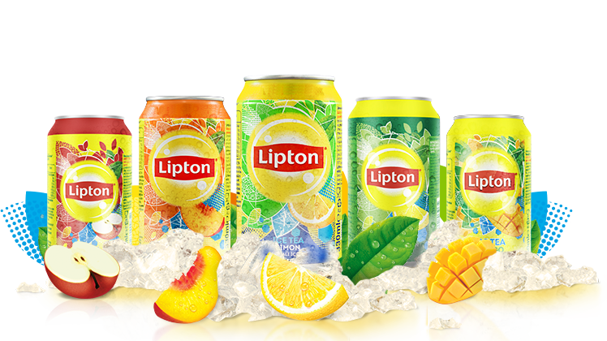
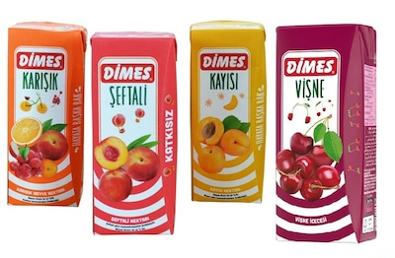
Diversity of beverages
Carbonated soft drinks
Bottled water
Soft drinks
(non-carbonated)
Natural mineral water

Slide 3
Diversity of beverages
Natural mineral water: It is natural water that contains natural CO₂ and natural mineral
Soft drinks (non-carbonated): They were prepared by dissolving granulated sugar in specially treated water, or alternatively by diluting liquid sugar with this water. A variety of ingredients, including fruit juice or comminuted fruit, preservatives, artificial sweeteners , antioxidants, flavoring and coloring agents, and acidulants (invariably either citric or phosphoric acid), were then added

Slide 4
Diversity of beverages
Carbonated soft drinks: They are produced in one of three ways
Premix method: The ingredients (except carbonated water) are made up as a concentrated syrup. After pasteurization, this syrup is mixed with the required amount of carbonated water and then filled into the containers
Postmix method: The concentrated syrup is dosed into each container and the container filled up with carbonated water
A less frequently used method is to make up the product at drinking strength, inject CO₂ in a suitable system, and then fill the containers

Slide 5
WHAT ARE QUALITY CHANGES ?

Slide 6
Summary of indices of failure

Slide 7
1) Physical deterioration
Loss of contents and loss of carbonation are main physical changes in beverages
To prevent these physical changes;
Quality checks for container body and seal between container and closure is crucial. The primary function of packaging is retention of liquid inside the container; therefore container leakage is undesirable
For carbonated drinks, packaging plays a greater role by retaining the CO₂, which gives the product one of its principal characteristics. Gas permeability rate of packaging is important to control loss of carbonation over the shelf life

Slide 8
2) Physicochemical deterioration
The main physicochemical changes in beverages are
Taste deterioration
Loss of odor and-flavor or off-flavor formation
Change in appearance
Change in color
Presence of unwanted contaminants
Oxygen, light and heat are the factors that negatively affect these physicochemical changes

Slide 9
Effect of oxygen and light on beverage quality
For bottled water; headspace O₂ results in green appearance formation at the bottom of the bottle during storage due to development of algal spores
For carbonated or non-carbonated soft drinks;
Degradation of some flavor components that are widely used in citrus- flavored products (such as orange, lemon)
Undesirable flavor formation
Degradation of color compounds (especially yellow, orange, red), which results in bleaching effect

Slide 10
What is the solution for oxidation?
The options for the prevention of oxygen or light induced oxidation
The use of ascorbic acid, as O₂ scavenger
The use of antioxidants
The use of metal containers, which have no-light transmission,
The use of colored bottles (tinted packaging) can minimize light or oxygen-induced reactions
During product mixing and packaging, prevention of oxygen ingress

Slide 11
Effect of heat on beverage quality
Depending on the type of product and its ingredients, pasteurization may be necessary to ensure microbiological stability for espeacially non-carbonated soft drinks
For this heat treatment;
Time-temperature condition is important. In general HTST (high temperature short time) process is preferred
Immediate cooling just after pasteurization is also important
If improper conditions are used for pasteurization, cooked flavor or darkened color are formed

Slide 12
3) Microbial deterioration
All beverages are acidic in nature; therefore, principal risk for microbial change is spoilage bacteria such as Lactobacillus and Alicyclobacillus, yeasts and molds
The main effects of microbial contamination
Development of off-flavors
The change of physical appearance
Bottle bursting, damage and injury due to additional CO₂ production by yeasts in carbonated beverages

Slide 13
How microbial changes are prevented?
Microbial deterioration in beverages can be prevented by using some treatments such as
Treatment of bottle with chlorine or ozone before filling
Exposure of bottle to UV light irradiation before filling
Hygiene and sanitation in plant and production lines
Filtration to remove microorganisms before filling
Naturally presence of CO₂, which has an inhibiting effect on microorganism, in carbonated beverages
Pasteurization for non-carbonated soft drinks

Slide 14
WHICH TYPE OF PACKAGING SYSTEM SHOULD BE USED FOR BEVERAGES?

Slide 15
Metal containers
Metal packaging material used | Metal cans are manufactured from aluminum as two-piece cans (can body and one end) using the “drawn and wall ironed” (DWI) process. The inner surface should be coated
Barrier properties of packaging material | They provide best condition to prevent loss of CO₂.
What are the disadvantages? | For beverage cans made from tinplate, control of migration of iron into the beverage is critical, because extremely small levels of iron (0.5 ppm) can affect the flavor of the beverage

Slide 16
Glass containers
What are the advantages? | ---It has impermeable properties, odor resistance, good transparency, tamper resistance ---It is suitable and shows thermal strenght for pasteurization. However, for such products, there is usually a practical volumetric limit of about 0.3 to 0.5 L
What are the disadvantages? | ---Its weight and fragility. These disadvantages effectively limit the maximum size of container when glass is used to contain carbonated beverages to about 1.0 to 1.5 L ---Glass has little protection against the adverse effects of visible light

Slide 17
Plastic bottles (PET bottles)
What are the disadvantages? | ---They are permeable to gases. Loss of CO₂ percentage is 15% over 26 weeks for 1.5 or 2 L of bottles and 15% about 10-12 weeks. Therefore, the loss of carbonation is a determining factor for shelf life ---They have poor oxygen barrier properties. To improve this condition, commercial O₂ scavengers are incorporated into PET --- Migration of acetaldehyde (AA), which is formed in PET as a thermal degradation product formed during the melting. It results in sweet, plastic-like, and fruity flavor formation ---Migration of plasticizers when PET bottles are reused in the home ---Antimony trioxide is used as an additive and initiator in the manufacture of 90% of the PET. Migration of antimony (Sb), which is a toxic trace element

Slide 18
The factors that affect the odor and taste of carbonated beverages in PET bottle
Ingress of O₂
Loss of CO₂
Scalping of outside odors
Migration from plastic material
Absorbation of flavor compounds by plastic material

Slide 19
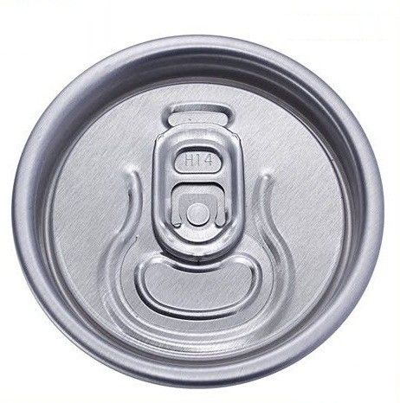
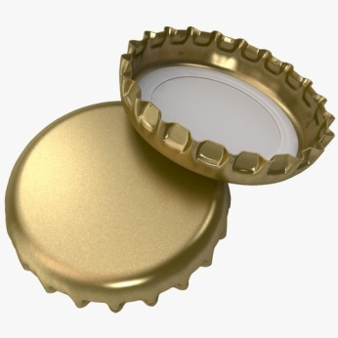
Closures for beverage containers
There are four type of closure
Too large a closure can create leakage due to internal pressure of CO₂ and particularly the conditions that may arise if the product is to be subjected to pasteurization
Too small a closure can give rise to problems at the time of filling
Ring pull
Crown cork
Aluminum roll-on pilfer-proof (ROPP) cap
Molded plastic cap

Slide 20
PACKAGING of vegetable oıls
Instructor
Assist. Prof. Dr. Eda Demirok Soncu
E-mail: edemirok@eng.ankara.edu.tr
Phone: +90312 203 3300 (3639 ext.)
Office: 2nd floor #212
Fde 216 food packagıng

Slide 21
Sources of vegetable oil
Vegetable oils are derived from
annual plants such as sunflower and soybean
perennial plants such as palm and olive
seeds such as palm kernels and cottonseeds
fruits such as olive, avocado, palm, and coconut

Slide 22
DETERIORATIVE REACTIONS IN VEGETABLE OILS

Slide 23
What are deteriorative reactions?
Deteriorative reactions in vegetable oil are listed as follow
Enzymatic reactions
Lipases
Lipoxygenases
Polyphenoloxidases
Oxidative rancidity
Absorption of flavor
Migration of substance from packaging

Slide 24
Deteriorative reactions
ENZYMATIC REACTIONS
Lipases | ---Lipase triggers the release of fatty acids from the triglyceride molecule in the presence of moisture ---This reaction results in undesired acidity and off-flavor formation
Lipoxygenases | Undesirable flavor compounds, such as aldehydes and alcohols, are formed as a result of lipoxygenases activity with polyunsaturated fatty acids
Polyphenoloxidases | --Polyphenols are important compounds of vegetable oils --They are prone to oxidation by polyphenoloxidases, which results in browning and influence oxidative stability of the oil during storage

Slide 25
Deteriorative reactions
Oxidative rancidiy | ---Oxidative rancidity is a complex of chemical changes that imply a series of reactions between unsaturated fatty acids with O₂ ---It is responsible for the formation of rancid taste, toxic compounds and for the reduction in nutritional quality ---Oxygen, light and heat are triggering factors
Absorption of flavor | ---Plastic packaging materials are able to absorb different compounds, such as flavor compounds and fatty acids, from vegetable oils ---On the other side, some flavor compounds can absorb by oil through packaging material ---These two conditions is also called as flavor scalping ---Flavor scalping is an important phenomena, since it results in decrease in characteristic sensory properties

Slide 26
Deteriorative reactions
Migration of substance from packaging | ---Plastic additives and residual monomers or oligomers are not chemically bound to the polymer and can, therefore, move freely within the polymer matrix ---Consequently, they can dissolve in the food product and thus adversely affect the flavor and acceptability of the food ---PET monomers, oligomers, vinyl chloride monomer of PVC, plasticizers, colorants, stabilizers, and different additives used for flexibility purposes are prone to migrate into oily foods ---The migration of acetaldehyde from PET bottles is a major problem, as its presence may affect the organoleptic properties of oil

Slide 27
WHICH TYPE OF PACKAGING SYSTEM SHOULD BE USED FOR VEGETABLE OILS?

Slide 28
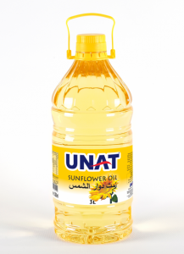
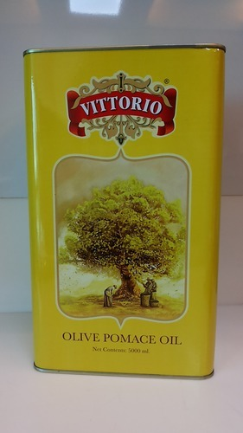
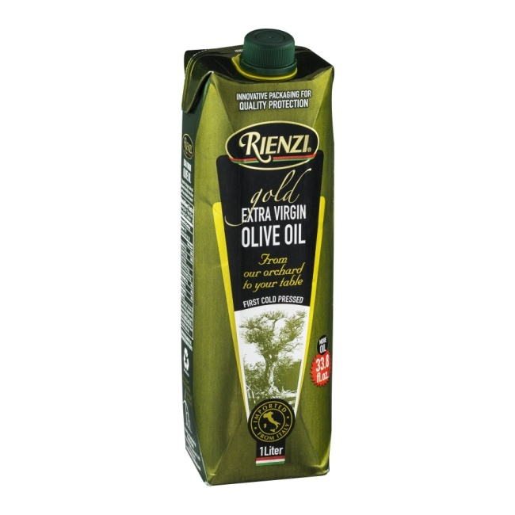
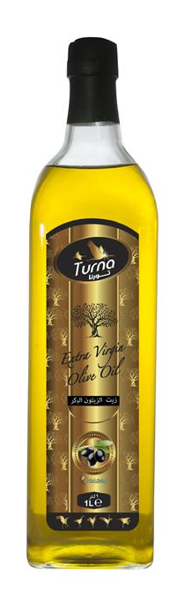
Types of packaging for vegetable oils
Tinplate cans, glass bottles, PET, or HDPE plastic bottles, and paper-based cartons are commonly used packaging materials for vegetable oils

Slide 29
General requirements of packaging material for vegetable oil
Oxygen permeability and light transmission
Vegeteble oils are sensitive against to oxygen and light; therefore, O₂ permeability and the light transmission of the packaging walls are the major ones
Oxygen permeability is a property of plastic materials only, whereas light transmission is important both for glass and plastics
Metal containers are totally impermeable to gas and light
Plastic and glass containers should have high barrier properties for oxygen and light

Slide 30
General requirements of packaging material for vegetable oil
Packaging inertness
Oil–package interactions can affect product shelf life, reducing nutritional value and stability by flavor scalping or increasing the level of chemical contamination by migration
Therefore, packaging material should be inert as much as possible
Glass is the most inert material, followed by metals and plastics

Slide 31
General requirements of packaging material for vegetable oil
Filling and closing technologies
In order to reduce the O₂ residual inside the bottles, the oil is generally treated with gaseous N₂, to lower the initial level of residual O₂ to below 0.5 ppm. Gaseous N₂ can be pressurized by injecting liquid N₂ into the headspace prior to closing
On the other hand, to reduce O₂ ingress during shelf life, the effectiveness of the closures is also very important. For that, closure should be closed hermetically. It should be easy-opened and re-closed

Slide 32
References
Robertson, G.L. (2010). Packaging and the shelf life of water and carbonated drinks (Chapter 9 pages 158-175) In Food Packaging and Shelf Life: A Practical Guide. CRC Press Taylor&Francis Group
Robertson, G.L. (2010). Packaging and the shelf life of vegetable oils (Chapter 17 pages 318-334) In Food Packaging and Shelf Life: A Practical Guide. CRC Press Taylor&Francis Group

