Slide 1
Principles of formal e-mailing

Slide 2
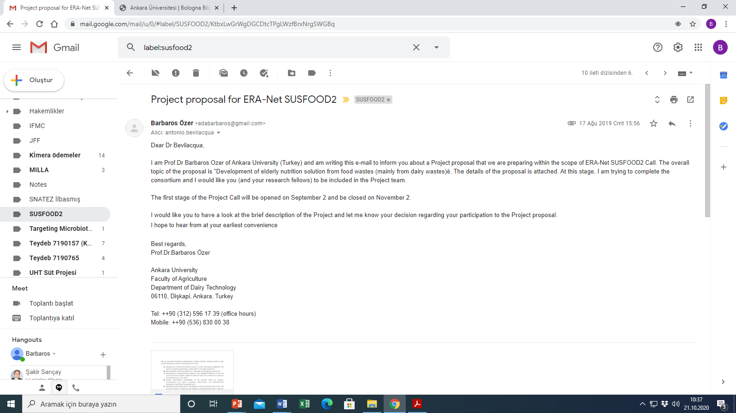

Slide 3
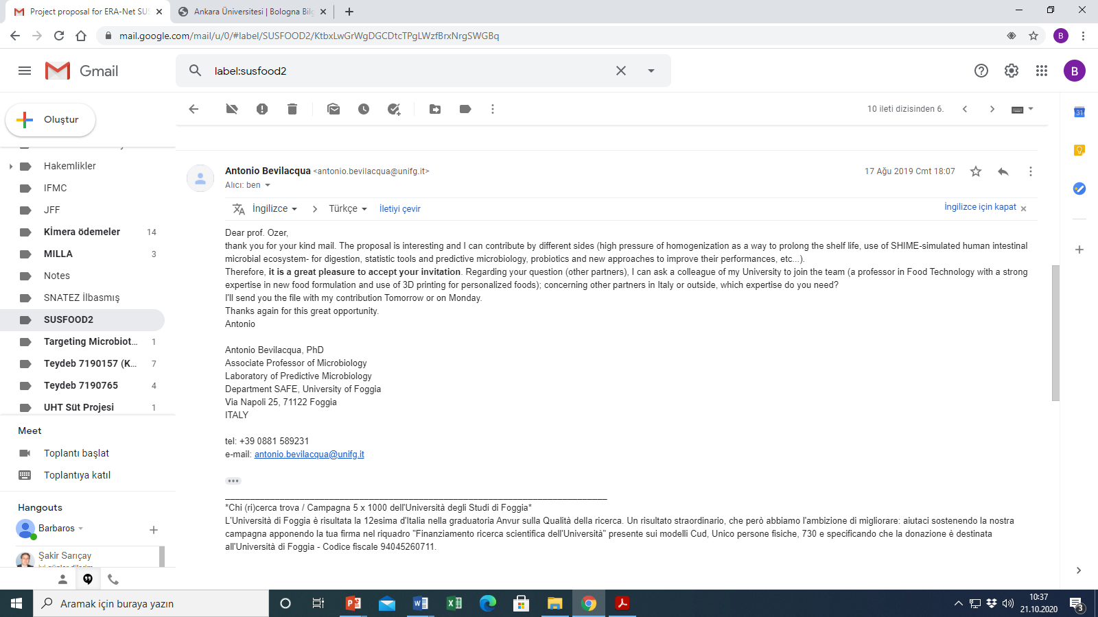

Slide 4
