Slide 1
Vitamins
Vitamins are a group of organic nutrients
They can not be synthesized in sufficient quantities by our bodies; therefore, they must be obtained from the diet
The functions of vitamins;
They prevent/retard oxidative reactions depends on their antioxidant property
They play a role in cell signalling, tissue growth etc…
They present in the structure of enzyme

Slide 2
Minerals
Minerals are crucial inorganic elements, which are required by all living organisms to maintain life cycle
Minerals play an important role in order to support biochemical processes such as
building bones and teeth
transmitting nerve signals
energy conversion from food
vitamin biosynthesis

Slide 3
Color
Color plays an important role in foods in terms of their visual quality and acceptability by consumer.
Color is naturally formed with the presence of color compounds in the structure of food
Color may considerably change during processing as a result of some chemical changes
Formation of brown-colored compounds during Maillard reaction
Conversion of chlorophyll (bright green) to pheophytin (olive green) during boiling or cooking of green vegetables.
Color is supported by the addition of natural/synthetic colorants
FDE 101-BCFE
02.10.2018

Slide 4
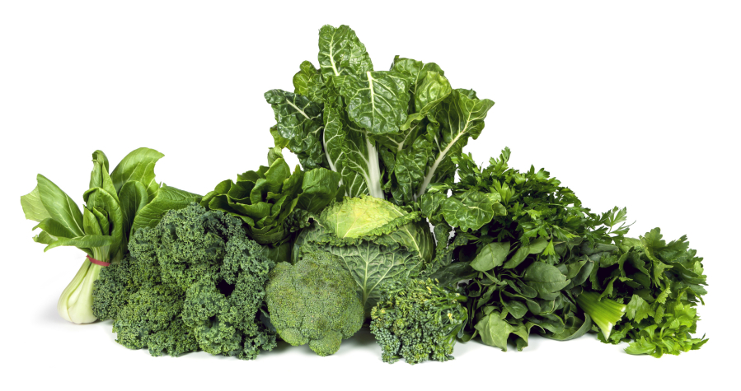
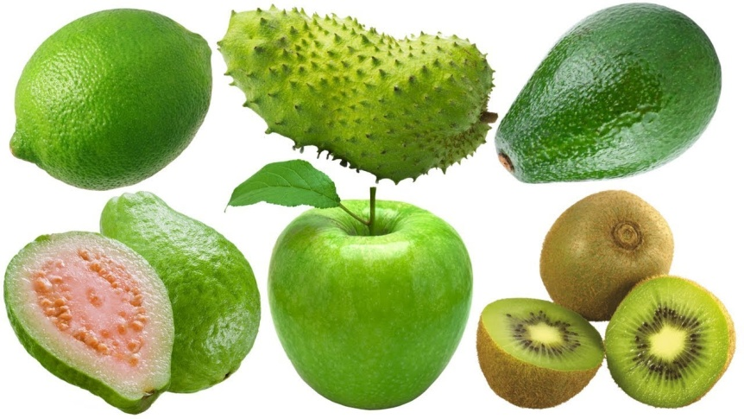
Chlorophylls
Chlorophylls are green pigments present in leafy vegetables, fruit, and algae.
They are unstable to heat and insoluble in water.

Slide 5
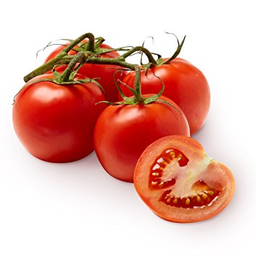
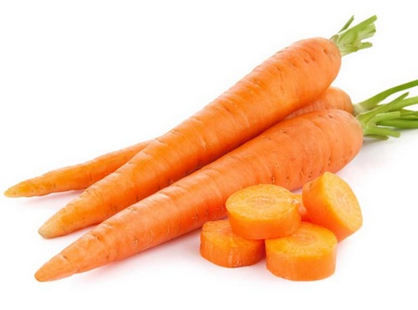
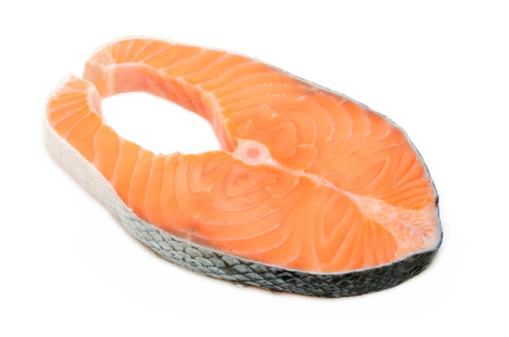
Carotenoids
Carotenoid pigments give yellow and orange colors in fruit and vegetables
Lycopene is responsible for the red color in tomato
Β-carotene is responsible for the orange color in carrot
Astaxanthin is responsible for the pink color in salmon

Slide 6
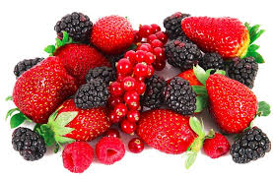
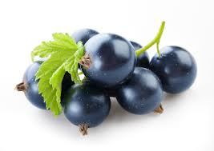
Anthocyanins
Anthocyanins are phenolic compounds which are present in fruit and vegetables
They give red, violet, and blue colors
Berries, blackcurrants, grapes, cherries, eggplants are rich in anthocyanins

Slide 7
Flavonoids
Flavonoids (anthoxanthins), which are glycosides with a benzopyrene nucleus, have low coloring power.
They may be involved in discolorations. For example;
They can impart blue or green colors when combined with iron
They are potential substrates for enzymatic browning reactions and cause formation of undesirable color compounds.

Slide 8
Flavor compounds found in the foods
Sulphur compounds
Carbonyl compounds
Acids
Esters
Terpenoids
Flavonoids
Hydroxy compounds

Slide 9
References
Campbell-Platt, G. (2009). Food Science and Technology. Chapter 2: Food chemistry pages 24-25. Blackwell Publishing. (In the library of our department)
deMan, J.M. (1999) Principles of food chemistry. (3rd ed.) Pages 242-259. An aspen publication, Maryland, USA.
deMan, J.M. (1999) Principles of food chemistry. (3rd ed.) Pages 355-387. An aspen publication, Maryland, USA.
Shakuntala Manay, N. & Shadaksharaswamy, M. (2008). Foods Facts and Principles. (3rd ed.) Pages 94-100. New Age International Ltd. Publishers, Delhi, India. (In the library of our department)

