Slide 1
WOUNDS AND HEALING
Ebru Arioglu Inan, PhD

Slide 2
Reference book
First aid manual, 5th edition, the step by step guide for everyone
All of the material presented in this ppt is taken from “First aid manual, 5th edition, the step by step guide for everyone” (https://kuiyem.ku.edu.tr/wp-content/uploads/2016/12/American-College-of-Emergency-Physicians-ACEP-First-Aid-Manual.pdf)

Slide 3
Circulatory system (heart, blood vessels)
Severe bleeding (internal/external), fluid loss (burns) may disrupt the system
Wound: a break in the skin or the internal body surfaces

Slide 4
Heart pumps the blood to the body by rhytmic contractions (beat)
There is a network of vessels; arteries, veins, capillaries
The force exerted by the blood flow through the main arteries is called blood pressure

Slide 5
-Diastole: blood enters the heart
-Systole:
Atrial systole: it is squeezed out of the atria (collecting chambers)
Ventricular systole: blood leaves the heart

Slide 6
In diastole, the heart relaxes. Oxygenated
blood from the lungs flows through the
pulmonary veins into the left atrium.
The venae cavae (large veins that enter the heart) brings deoxygenated blood to the right atrium

Slide 7
In atrial systole, the two atria contract and
the valves between the atria and the ventricles
(pumping chambers) open so that blood flows
into the ventricles.
During ventricular systole, the ventricles contract. The
blood flows into the aorta (main artery), aorta carries the blood to the rest of the body.
The right ventricle pumps blood into the pulmonary arteries, the blood is carried to the lungs to collect more oxygen.

Slide 8
Blood (approx. 5 liters)
%55 plasma (red/white blood cells, platelets;remaining %45)

Slide 9
When a blood vessel is damaged, the vessel constricts, and a series of chemical reactions occur to form a blood clot—a “plug” over the damaged area.
If large blood vessels are torn or severed, uncontrolled blood loss may occur before clotting can take place, and shock may develop.

Slide 10
Types of bleeding
-Bleeding from arteries
Profuse, blood will be lost with each heart beat
If a main artery is injured, circulating blood volume will fall rapidly

Slide 11
-Bleeding from veins
Blood is darker red.
It is under less pressure than arterial blood, but vein walls can widen greatly and the blood can “pool” inside them (varicose vein).
If a large or varicose vein is damaged, blood will gush from it profusely.

Slide 12
-Bleeding from capillaries
It occurs with any wound
Blood loss may be brisk at first, but usually slight
A blow may rupture capillaries under the skin, causing bleeding into the tissues (bruising).

Slide 13
Healing of the wounds
When a blood vessel is severed or damaged, it constricts (narrows) in order to prevent excessive amounts of blood from escaping.
Injured tissue cells at the site of the wound, together with specialized blood cells called platelets, then trigger a series of chemical reactions that result in the formation of a substance that forms a mesh.

Slide 14
This mesh traps blood cells to make a blood clot.
The clot releases a fluid known as serum, which contains antibodies and specialized cells; this serum begins the process of repairing the damaged area.

Slide 15
At first, the blood clot is a jellylike mass.
Fibroblast cells form a plug within the clot.
Later, this dries into a crust (scab) that seals and protects the site of the wound until the healing
process is complete.

Slide 16
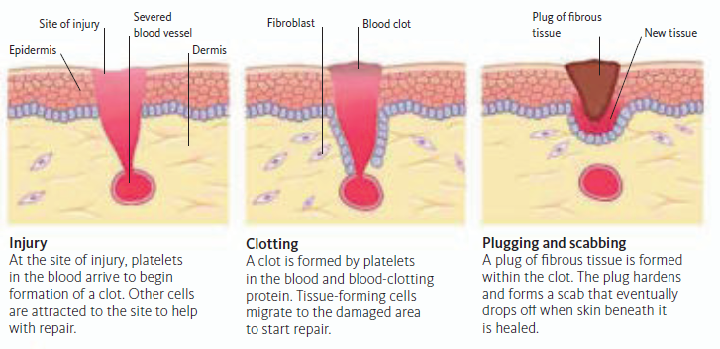
https://kuiyem.ku.edu.tr/wp-content/uploads/2016/12/American-College-of-Emergency-Physicians-ACEP-First-Aid-Manual.pdf

Slide 17
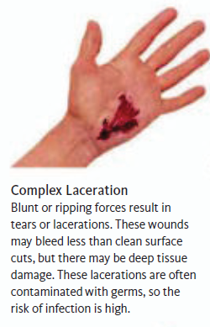
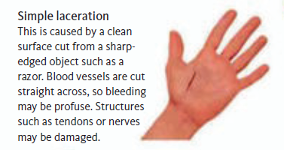
Types of wound
https://kuiyem.ku.edu.tr/wp-content/uploads/2016/12/American-College-of-Emergency-Physicians-ACEP-First-Aid-Manual.pdf

Slide 18
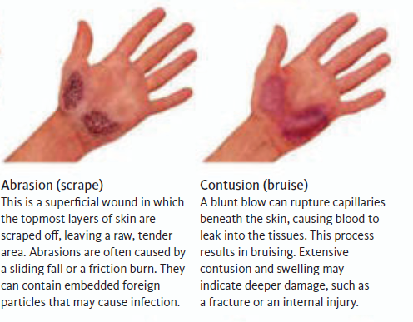
https://kuiyem.ku.edu.tr/wp-content/uploads/2016/12/American-College-of-Emergency-Physicians-ACEP-First-Aid-Manual.pdf

Slide 19
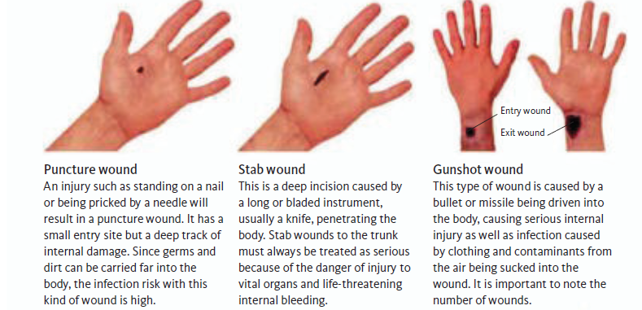
https://kuiyem.ku.edu.tr/wp-content/uploads/2016/12/American-College-of-Emergency-Physicians-ACEP-First-Aid-Manual.pdf

Slide 20
SHOCK
This is a life-threatening condition that occurs when the circulatory system fails and vital organs such as the heart and brain are deprived of oxygen.
It requires immediate emergency treatment.
Shock can be made worse by fear and pain.
The most common cause of shock is severe blood loss. If this exceeds 1.2L shock will develop.
This degree of blood loss may result from external bleeding.
It may also be caused by: hidden bleeding from internal organs, blood escaping into a body cavity, or bleeding from damaged blood vessels due to a closed fracture.

Slide 21
Loss of other body fluids can also result in shock.
Conditions that can cause severe fluid loss include diarrhea, vomiting, bowel obstruction, serious burns, and blood infection.
Shock may also occur when there is sufficient blood volume but the heart is unable to pump the blood around the body.
This can be due to severe heart disease, heart attack, or acute heart failure (cardiogenic shock).
Other causes of shock include overwhelming infection (septic shock), severe allergic reaction (anaphylactic shock), and spinal cord injury (neurogenic shock).

Slide 22
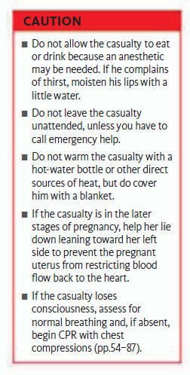
https://kuiyem.ku.edu.tr/wp-content/uploads/2016/12/American-College-of-Emergency-Physicians-ACEP-First-Aid-Manual.pdf

Slide 23
-Blood loss;
Less than 0,75L: little or no effect
0.75-1.5L:heart and respiratory system quicken. Small blood vessels in nonvital areas, such as the skin, shut down to divert blood and oxygen to the vital organs, so the skin may feel cool, especially at the fingers and toes. Anxiety is common
1.5-2L: Heart and respiratory rates increase even more. Blood pressure drops and the brain may not receive enough oxygen, leading to increased anxiety and/or confusion. The pulse at the wrist may become undetectable
More than 2L:Heart and respiratory rates increase until the body can no longer sustain them,at which time point they decrease, a very ominous sign that often precedes death. Skin may be cool and pale. The casualty is likely to be unconcious

Slide 24
Recognition:
Initially:
A rapid pulse. Pale, cold, clammy skin. Sweating
As shock develops:
Rapid, shallow breathing. A weak, “thready” pulse. Gray-blue skin (cyanosis), especially inside the lips. A fingernail or earlobe, if pressed, will not regain its color immediately. Weakness and dizziness. Nausea, and possibly vomiting. Thirst
As the brain’s oxygen supply
weakens:
Restlessness and aggressive behavior. Yawning and gasping for air. Unconsciousness
Finally, the heart will stop!!
https://kuiyem.ku.edu.tr/wp-content/uploads/2016/12/American-College-of-Emergency-Physicians-ACEP-First-Aid-Manual.pdf

Slide 25
What should you do?
Recognize shock
Treat any obvious cause of shock (severe bleeding, serious burns…)
Improve the blood supply to brain, heart and lungs (help to lie down on a rug/blanket to protect from cold. Raise and support legs above the level of heart)
Call 112 for emergency help.
Loosen tight clothing to reduce constriction at the neck, chest and waist.
Keep the causalty warm (blankets/coats)
Monitor vital signals (level of response, breathing, pulse…)

Slide 26
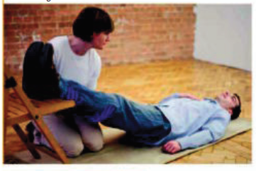
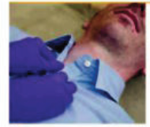
https://kuiyem.ku.edu.tr/wp-content/uploads/2016/12/American-College-of-Emergency-Physicians-ACEP-First-Aid-Manual.pdf

Slide 27
Severe external bleeding
If not controlled, shock may be develop and casualty may lose consciousness.
Bleeding from mouth or nose may affect breathing

Slide 28
What should you do?
First check if an object is embedded in the wound, take care not to press directly on the object.
Do not let the causalty eat or drink (need for anesthetic !!)
If the causalty loses consciousness and is not breathing normally begin CPR with chest compressions
Take care to minimize infection
Call 112 for emergency

Slide 29
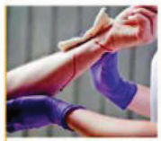
Remove or cut clothing as necessary to expose the wound
Apply direct pressure over the wound with your fingers using a sterile dressing or clean, gauze pad. If you do not have a dressing, ask the casualty to apply direct pressure himself. If there is an object in the wound, apply pressure on either side of the object (opposite).
https://kuiyem.ku.edu.tr/wp-content/uploads/2016/12/American-College-of-Emergency-Physicians-ACEP-First-Aid-Manual.pdf

Slide 30
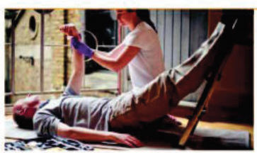
Maintain direct pressure on the wound to control bleeding.
Raise and support the injured limb above the level of the casualty’s heart to reduce blood loss.
Help the casualty lie down—on a rug or blanket if there is one, because this will protect him from the cold.
Since shock may develop raise and support his legs so that they are above the level of his heart.
Ask a helper to call 112 For emergency help, and to give the dispatcher details of the site and extent of the bleeding.
https://kuiyem.ku.edu.tr/wp-content/uploads/2016/12/American-College-of-Emergency-Physicians-ACEP-First-Aid-Manual.pdf

Slide 31
Secure the dressing with a bandage that is firm enough to maintain pressure, but not so tight that it impairs circulation
Call 112 For emergency help if this has not been done already.
If bleeding shows through the dressing, apply a second one on top of the first. If blood seeps through the second dressing, remove both and apply a fresh one, ensuring that pressure is applied accurately at the point of bleeding.

Slide 32
Support the injured part in a raised position with a sling and/or bandage.
Check the circulation beyond the bandage every 10 minutes. If the circulation is impaired, loosen the bandage and reapply.
Monitor and record vital signs—level of response, breathing, and pulse —while waiting for help to arrive.

Slide 33
Internal bleeding
Bleeding inside body cavities may follow an injury, such as a fracture or a blow from a blunt object, but it can also occur spontaneously—for example, bleeding from a stomach ulcer.
The main risk from internal bleeding is shock. In addition, blood can build up around organs such as the lungs or brain and exert damaging pressure on them.

Slide 34
Internal bleeding
Recognition:
Initially, pale, cold, clammy skin. If bleeding continues, the skin may turn blue-gray (cyanosis). Rapid, weak pulse
Thirst
Rapid, shallow breathing
Confusion, restlessness, and irritability
Possible collapse and unconsciousness
Bleeding from body openings (orifices)
In cases of violent injury, “pattern bruising”—an area of discolored
Skin with a shape that matches the pattern of clothes or crushing or restraining objects
Pain
Information from the casualty that indicates recent injury or illness

Slide 35
Suspect internal bleeding if a casualty develops signs of shock without obvious blood loss.
Check bleeding from body openings such as the ear, mouth, and nose. There may also be
bleeding from the urethra, vagina, or anus.
Blood loss from any orifice is significant and can lead to shock! It also may indicate a serious injury or illness.

Slide 36
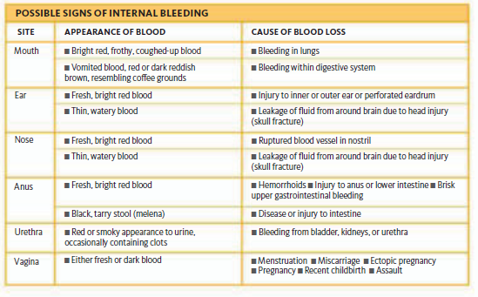
https://kuiyem.ku.edu.tr/wp-content/uploads/2016/12/American-College-of-Emergency-Physicians-ACEP-First-Aid-Manual.pdf

Slide 37
Impalement
If someone has been impaled, for example by falling onto railings, never attempt to lift the casualty off the object involved because this may worsen internal injuries
Do not allow the casualty to eat or drink because an anesthetic may be needed.
Call 112 for emergency help!
Support the casualty’s body weight until the emergency services arrive
Prevent further injury!

Slide 38
Amputation
A limb that has been partially or completely severed can, in many cases, be reattached by microsurgery.
The operation will require a general anesthetic, so do not allow the casualty to eat or drink. It is vital to get the casualty and the amputated part to the hospital as soon as possible.
Shock is possible, and needs to be treated.

Slide 39
Do not wash the severed part.
Do not let the severed part touch the crushed ice when packing it.
Do not allow the casualty to eat or drink because an anesthetic may be needed.
Control bleeding (applying direct pressure, raising the injured part above the causalty’s heart)

Slide 40
Place a sterile dressing or a clean gauze pad on the wound, and secure it with a bandage.
Minimize the effects of shock
Arrange urgent removal to the hospital (call 112, tell that an amputation is involved)
To prevent deterioration of the injured part (wrap the severed part in plastic wrap or or plastic bag. Wrap the package in gauze or soft fabric and place it in a container full of crushed ice. Mark the container with the time of injury and the casualty’s name. Give it to the emergency service personnel yourself)

Slide 41
Crush injury
Traffic accidents and building site collapses are the most common causes of crush injuries.
Other possible cause include explosions, earthquakes, and train crashes.
A crush injury may include a fracture, swelling, and internal bleeding.
The crushing force may cause impaired circulation, resulting in numbness at or below the site of injury. You may not detect a pulse in a crushed limb.

Slide 42
Prolonged crushing may cause extensive damage to body tissues, especially to muscles.
Once the pressure is removed, shock may develop rapidly as tissue fluid leaks into the injured area.
More dangerous, toxic substances build up in damaged muscle tissue around a crush injury.
If released suddenly into the circulation,these toxins may cause the heart to experience a life-threatening rhythm disturbance first or kidney failure later. This process, called “crush syndrome,” is extremely serious and can be fatal.

Slide 43
Do not release a casualty who has been crushed for more than 15 minutes. (you can release the causalty if he/she crushed less than 15 min.)
Control external bleeding, support suspected fracture.
Treat for shock but not raise the legs!
Do not lift heavy objects.
Do not allow the casualty to eat or drink because an anesthetic may be needed.
Call 112!
Monitor vital signs

Slide 44
Cuts and scrapes
Bleeding from small cuts and scrapes is easily controlled by pressure and elevation.
An adhesive bandage is normally all that is required, and the wound will heal by itself in a few days.
Medical help needs to be sought only if: bleeding does not stop; there is a foreign object embedded in the cut; there is a particular risk of infection, from a human or animal bite , or a puncture by a dirty object; or an old wound shows signs of becoming infected.

Slide 45
Clean the wound if it is dirty. (water, alcohol-free wipes). Dry it with a gauze swab and cover with steril gauze.
Raise the wound above the heart
Clean the area around the wound with soap/water, dry.
-

Slide 46
Tetanus risk;
Dirty wound
Never been immunized
Not sure whether up to date on injections
The bacterial cause of tetanus lives in the soil. May enter the wound and release a toxin which causes muscle spasms, paralysis, and death.
It can be prevented by immunization

Slide 47
Bruising
Caused by bleeding into the skin or into tissues beneath the skin, a bruise can either develop rapidly or emerge a few days after injury.
Bruising can also indicate deep injury.
Elderly people and those taking anticoagulant (anticlotting) drugs, such as aspirin or warfarin, can bruise easily.

Slide 48
Raise and support the injured part
Place cold compress over the bruise at least for 10 min

Slide 49
Blisters
Blisters occur when the skin is repeatedly rubbed against another surface or when it is exposed to heat.
The damaged area of skin leaks tissue fluid that collects under the top layer of the skin, forming a blister.

Slide 50
Wash the area with clean water and rinse (if not possible, keep it clean)
Pat the area and surrounding skin with sterile gause pad.
Cover it with a bandage which is larger than the blister

Slide 51
Infected wounds
An open wound can become contaminated with microorganisms (germs).
The germs may come from the source of the injury (finger, mouth, clothing etc)
Bleeding may flush some dirt away; remaining germs may be destroyed by the white blood cells.
However, if dirt or dead tissue remain in a wound, infection may spread through the body.
There is also a risk of tetanus.
Any wound that does not begin to heal within 48 hours is likely to be infected.
A casualty with a wound that is at high risk of infection may need treatment with antibiotics and/or tetanus immunization.

Slide 52
Recognition:
Increasing pain and soreness at the site of the wound
Swelling, redness, and a feeling of heat around the injury
Pus within, or oozing from, the wound
Swelling and tenderness of the glands in the neck, armpit, or groin
Faint red trails on the skin that lead to the glands in the neck, armpit, or groin
If infection is advanced: Signs of fever, such as sweating, thirst, shivering, and lethargy

Slide 53
Cover the wound with a sterile dressing/pad/bandage. (prevent further infection)
Raise and support the injured part
Advise on the infection risk (signs; fever,sweating, shivering, lethargy…)

Slide 54
Foreign object in a wound
If left in a wound, may cause infection/delay healing
If the object is small, it can be taken with a tweezers.
Or rinse the wound with water
If the object is embedded deeply, dont try to remove it (bleeding(further damage risk!)
In this case, cover it with a bandage, seek medicinal help
Tetanus risk!

Slide 55
Same steps with external bleeding (Control bleeding, build up padding, take to the hospital)

Slide 56
Scalp and head wounds
A cut on this area may result in profuse bleeding (many small blood vessels close to skin surface)
More serious injury; skull fracture, neck (spinal) injury
Signs of some head injuries may be masked because of alcohol or drug intoxication

Slide 57
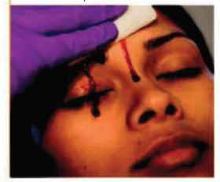
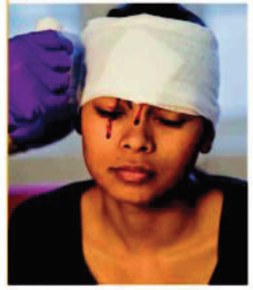
If there are any displaced flaps of skin at the injury site, carefully replace them over the wound
Cover the wound with a sterile dressing or a large clean, gauze pad. Apply firm, direct pressure on the pad to help control bleeding to reduce blood loss, and minimize the risk of shock.
Keep the pad in place with a roller bandage to secure the pad and maintain pressure
Help the casualty lie down with her head and shoulders slightly raised.
If she feels faint or dizzy or shows any signs of shock, call 112!
Monitor and record vital signs

Slide 58
Eye wound
The eye can be bruised or cut by direct blows or by sharp, chipped fragments of metal, grit, and glass.
All eye injuries are potentially serious because of the risk to the casualty’s vision.
Even superficial abrasions to the surface (cornea) of the eye can lead to scarring or infection, with the possibility of permanent deterioration of vision.

Slide 59
-Recognition:
Pain in the eye or eyelids
Visible wound and/or bloodshot appearance
Partial or total loss of vision
Leakage of blood or clear fluid from a wound

Slide 60
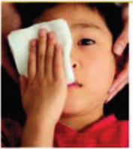
Help the casualty into a half-sitting position or onto on his back, and hold his head to keep it as still as possible. Tell him to keep both eyes still because movement of the “good” eye will cause movement of the injured one, which may damage it further.
Give the casualty a sterile dressing or a clean, nonfluffy pad to hold over the affected eye.
If it will take some time to obtain medical help, secure the pad in place with a bandage. Do not apply pressure to the injured eye.
Prevent further damage!!
Arrange to take to the hospital

Slide 61
Bleeding from ear
This may be due to a burst (perforated) eardrum, an ear infection, a blow to the side of the head, or an explosion.
Symptoms include a sharp pain, earache, deafness, and possibly dizziness.
The presence of blood or blood-stained watery fluid or indicates a more serious, underlying head injury

Slide 62
Help the casualty into a half-sitting position, with his head tilted to the injured side to allow blood to drain from the ear.
Hold a sterile dressing or a clean, gauze pad lightly in place on the ear. Do not plug the ear. Send or take the casualty to the hospital.
If you suspect a head injury, support the casualty’s head in the position you found him and call 112!
Arrange transport to the hospital

Slide 63
Nosebleed
Bleeding from the nose most commonly occurs when tiny blood vessels inside the nostrils are ruptured, either by a blow to the nose, or as a result of sneezing, picking, or blowing the nose.
Nosebleeds may also occur as a result of high blood pressure and anticlotting medication.
A nosebleed can be serious if the casualty loses a lot of blood.
In addition, if bleeding follows a head injury, the blood may appear thin and watery. The latter is a very serious sign because it indicates that the skull is fractured and fluid is leaking from around the brain.

Slide 64
Tell the casualty to sit down and tilt his head forward to allow the blood to drain from the nostrils. Ask him to breathe through his mouth (this will have a calming effect) and to pinch the soft part of his nose for up to ten minutes, holding constant pressure.
Advise the casualty not to speak, swallow, cough, spit, or sniff since this may disturb blood clots that have formed in the nose. Give him a clean cloth or tissue to mop up any dribbling.

Slide 65
After ten minutes, tell the casualty to release the pressure. If the bleeding has not stopped, tell him to reapply the pressure for two further periods of ten minutes.
Once the bleeding has stopped, and with the casualty still leaning forward, clean around his nose with lukewarm water.
Advise him to rest quietly for a few hours.
Tell him to avoid exertion and, in particular, not to blow his nose, because this could disturb any clots.

Slide 66
If bleeding stops and then restarts, help the casualty reapply pressure
If the nosebleed is severe, or if it lasts longer than 30 minutes, arrange to take or send the casualty to the hospital.
Do not let the casualty tip his head back because blood may then run down the throat and induce vomiting.

Slide 67
Knocked out adult tooth
If a secondary (adult) tooth is knocked out, it should be replanted in its socket as soon as possible.
Gently rinse off any dirt before replacing it in the socket.
If this is not possible, ask the casualty to keep the tooth inside his cheek or under his tongue if he feels able to do this without swallowing the tooth.
Alternatively, place it in a small container of milk to prevent it from drying out.

Slide 68
Gently push the tooth into the socket.
Then press a gauze pad between the bottom and top teeth to help keep the tooth in place.
Ask the casualty to hold the tooth firmly in place. Send him to a dentist or the hospital
Do not clean off any fleshy debris—you may damage the tissues, reducing the chance of reimplantation.

Slide 69
Bleeding from the mouth
Cuts to the tongue, lips, or lining of the mouth range from minor injuries to more serious wounds.
The cause is usually the casualty’s own teeth or dental extraction.
Bleeding from the mouth may be profuse and can be alarming.(control bleeding!)
In addition, there is a danger that blood may be inhaled into the lungs, causing problems with breathing (safeguard the airway by preventing any inhalation of blood)

Slide 70
Ask the casualty to sit down, with her head forward and tilted slightly to the injured side, to allow blood to drain from her mouth.
Place a sterile gauze pad over the wound.
Ask the casualty to squeeze the pad between finger and thumb and press on the wound for ten minutes.

Slide 71
If bleeding persists, replace the pad.
Tell the casualty to let the blood dribble out; if she swallows it, it may induce vomiting.
Do not wash the mouth out because this may disturb a clot. Advise her to avoid drinking anything hot for 12 hours
If the wound is large, or bleeding lasts longer than 30 minutes or restarts, seek medical dental advice

Slide 72
Finger wound
Injuries to the fingers are common and can vary from small cuts and scrapes to wounds with underlying damage to bones, tendons, and ligaments.
Injuries to the nails are the most common.
All finger wounds need good management because the hand is a finely coordinated part of the body that must function correctly for many everyday activities.
A cut to a finger may go through the skin only or it can cut through blood vessels, nerves, and tendons that lie just under the skin. There will be bleeding, which can be profuse, and possibly bruising, deformity, or loss of movement or sensation if the underlying structures are damaged.

Slide 73
If the wound to the finger breaks the skin, it should be cleaned with soap and water like any other abrasion.
Press a sterile dressing or clean gauze pad on the wound and apply direct pressure to control bleeding.
Raise and support the injured hand and maintain pressure on the wound until the bleeding stops.

Slide 74
When the bleeding has stopped, cover the wound to protect it.
Use an adhesive dressing or for a larger wound apply a dressing pad, secured with a tubular gauze bandage.
If there is a fracture or dislocation, the finger should be splinted.

Slide 75
Seek medical help if necessary.
If you need to take the casualty to the hospital, support the injured arm in an elevation sling.

Slide 76
Seek urgent medical advice if there is:
Severe pain
Severe bleeding
Missing tissue or nail, or amputation of part of finger
Obvious deformity
A gaping wound
Numbness, weakness, or loss of movement in the finger or hand
A foreign object in the wound

