Slide 1
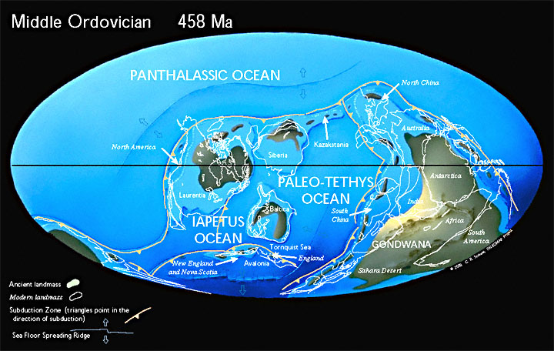
ORDOVİSİYEN DÖNEMİ
490 to 443 Mya
Notes:
Land and Sea
The Ordovician Period lasted about 45 million years, taking place between 490 million to 443 million years ago.
During this period, ancient oceans separated the barren continents of Laurentia, Baltica, Siberia and Gondwana. The area north of the tropics was almost entirely ocean, and most of the world's land was collected into the southern supercontinent Gondwana. Throughout the Ordovician, Gondwana shifted towards the South Pole and much of it was submerged underwater.

Slide 2
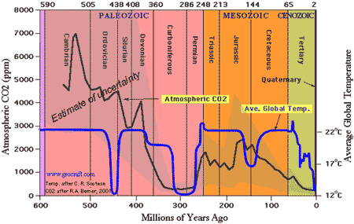
Ortalama Sıcaklık ve Atmosferik CO2
Paleoiklim Yaygın volkanik aktivite, CO2 düzeylerini bugünkü değerlerin 14 ila 16 katına çıkardı. Bu yüksek karbondioksit seviyesi, ekvatordan kutuplara sıcaklıkların sıcak kalmasına neden olan sera etkisine katkıda bulunmuştur.
Notes:
Climate
Widespread volcanic activity drove Co2 levels 14 to 16 times higher than they are today. These high levels of carbon dioxide contributed to the greenhouse effect that caused temperatures from the equator to the poles to remain warm.

Slide 3
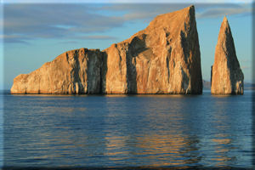
ORDOVİSİYEN İKLİMİ
Alt’ dan Orta Ordovisiye’ne kadar, Dünya hafif bir tropikal iklim yaşıyordu - hava sıcaktı ve atmosfer çok fazla nem içeriyordu. Kısmen kıta üzerinde deniz seviyesinin üstünde yaşam yoktu. Bununla birlikte, deniz seviyesinin altında, zengin okyanus çevresi, artan bir biyolojik ekosisteme katkıda bulunmuştur.
Notes:
From the Lower to Middle Ordovician, the Earth experienced a mild tropical climate — the weather was warm and the atmosphere contained a lot of moisture. Above sea level, on the barren continents, there was no life. Below sea level, however, the rich ocean environment supported a growing biological ecosystem.

Slide 4
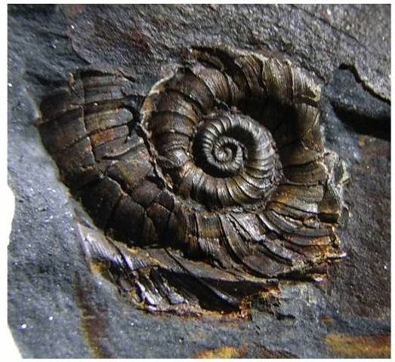
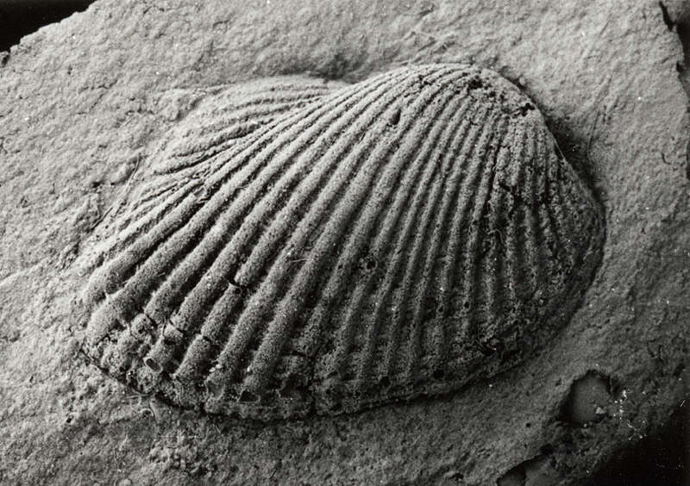
Molluksların Major evrimi
Salyangoz
Bivalve – çift
Kabuklu yumuşakça
Notes:
Specific Characteristics of Living Things
Mollusks
During the Ordovician a major radiation of mollusks also occurred, with thousands of species of mollusks appearing in the fossil record of that time. Mollusks of the time included shelled bivalves, snails, squids and nautiloids. Some mollusks developed buoyancy which enabled them to float.

Slide 5
Notes:
The “Big Five” originated from the Raup and Sepkoski (1982) Science paper. Here, they plotted number of extinctions in marine invertebrate families per million years. 5 specific points (a-e) stand out over the background extinction of 2-4.6 families per million years.

Slide 6
Notes:
Other smaller extinctions have been recognized, as shown here from Sepkoski (1986).

Slide 7
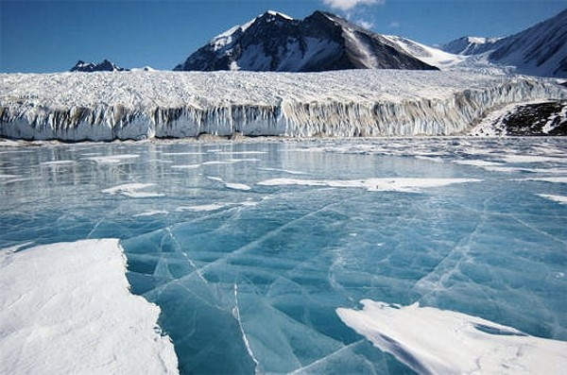
Buzlaşma, Toplu Yokolmaya yol açıyor
CO2 seviyelerine bağlı olarak küresel sıcaklık düşer. Buzullar, deniz seviyesinin düşmesine neden olur. Çok nüfuslu sığ denizler tükenir.
Notes:
Glaciation leads to Mass Extinction
The freezing conditions that seized the planet toward the end of the Ordovician halted the colonization of life on land. When the continent Gondwana finally settled on the South Pole during the Upper Ordovician, massive glaciers formed, causing sea levels to drop and highly populated shallow seas to drain. Global cooling, glaciation, and falling sea levels eliminated habitats along the continental shelves. This resulted in the second largest mass extinction of all time in which 60% of all marine invertebrate genera and 25% of all families went extinct.
Scotese, C.R., “Ancient Oceans Separate the Continents”, Plate tectonic maps and Continental drift animations,PALEOMAP Project (www.scotese.com) November 23, 2013.
Ordovician–Silurian extinction event kills more than 60% of marine species as Gondwana moves into the south polar region. Global cooling, glaciation and falling sea levels eliminate habitats along the continental shelves.

Slide 8
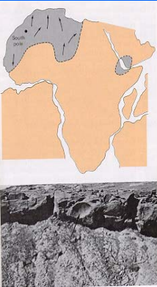
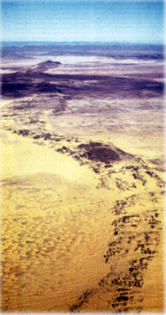
Ordovisiyen buzullaşmasının etkileri
Geç Ordovisiyen buzullaşması, biyosfer, atmosfer ve hidrosferi etkileyen küresel bir olaydır.
Buz tabakası Batı Gondwana merkezindedir ve yaklaşık deniz seviyesinin 50-100 m. düşmesine neden oldu.

Slide 9
Ordovisiyen sonu
Ordovisisyen'in sonunda, buzun güneydeki Gondwana bölgesinin çoğunu kaplamasıyla birlikte Dünya'nın en soğuk zamanlarından birini yaşadı.
Kitlesel yokoluş sırasında hiçbir büyük grup tamamen kaybolmadı. Yiyecek bulabilen, yırtıcı hayvanlardan korunabilen ve yeni ortamda üreyen popülasyonlar ayakta kalmış ve bir sonraki döneme devam etmiştir.

Slide 10
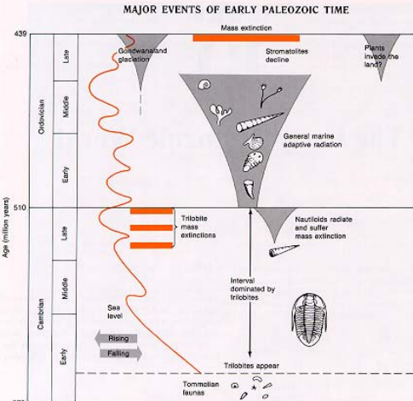
Büyük Erken Paleozoyik olayların bir özeti

Slide 11
KAYNAKLAR
Advilson, Christina, Jennifer Bie, and Chirag Patel. "The Ordovician Period." The Ordovician Period. University of California Museum of Paleontology. Web. 16 Nov. 2013. <http://www.ucmp.berkeley.edu/ordovician/ordovician.php>.
BBC News. BBC, n.d. Web. 3 Dec. 2013. <http://www.bbc.co.uk/science/seamonsters/factfiles/giantorthocone.shtml>.
"Mollusks." Fossil Groups -. N.p., n.d. Web. 01 Dec. 2013. <http://geology.er.usgs.gov/paleo/mollusks.shtml>.
"Ordovician Period." National Geographic. N.p., n.d. Web. 03 Dec. 2013. <http://science.nationalgeographic.com/science/prehistoric-world/ordovician/>.
"Ostracoderm." - New World Encyclopedia. N.p., n.d. Web. 30 Nov. 2013. <http://www.newworldencyclopedia.org/entry/Ostracoderm>.
"Paleoclimate." Encyclopedia Britannica Online. Encyclopedia Britannica, n.d. Web. 23 Nov. 2013. <http://www.britannica.com/EBchecked/topic/431581/Ordovician-Period/258446/Paleoclimate>.
PBS. PBS, n.d. Web. 23 Nov. 2013. <http://www.pbs.org/wgbh/nova/link/hist_03.html>.
Scotese, C.R., “Ancient Oceans Separate the Continents”, Plate tectonic maps and Continental drift animations,PALEOMAP Project (www.scotese.com) November 23, 2013.
"THE ORDOVICIAN PERIOD488 TO 443 Million Years Ago." History of Earth. N.p., n.d. Web. 01 Dec. 2013. <http://www.corzakinteractive.com/earth-life-history/412_ordovician.htm>.

