Slide 1
Sub-Departamento de Língua Portuguesa | Faculdade de Línguas, História e Geografia |
UNIVERSIDADE DE ANKARA
ISP 420 – Portekiz Kültürü | Cultura Portuguesa

Slide 2
Summary
Ditadura.
25 de Abril.
Cultural Features
The 2 main ‘world visions’ and traits of Portuguese culture: An historical conflict until 1980s
Portuguese Culture through its Literature
Orpheu and Pessoa: Modernism
Propaganda and Cinema of the New State

Slide 3
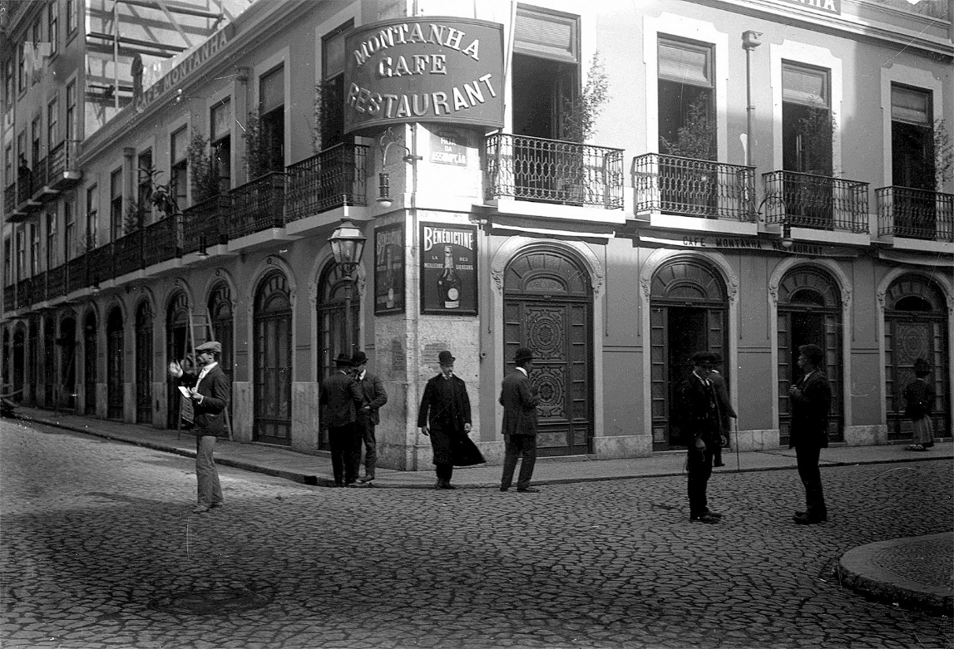
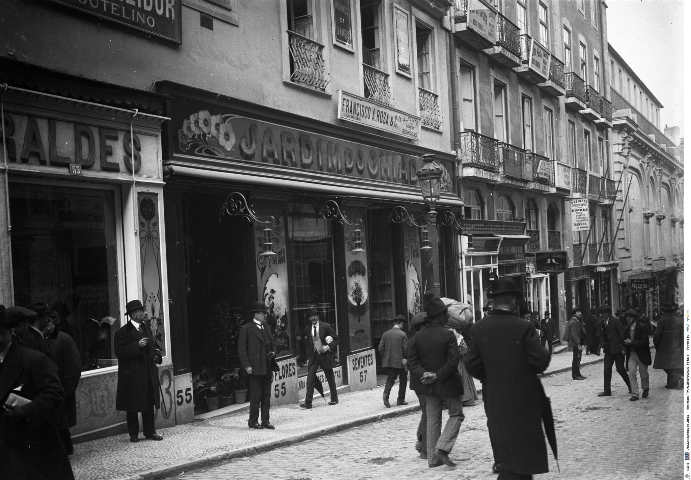
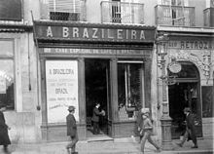
A conflict of two visions: innwards and outwards

Slide 4
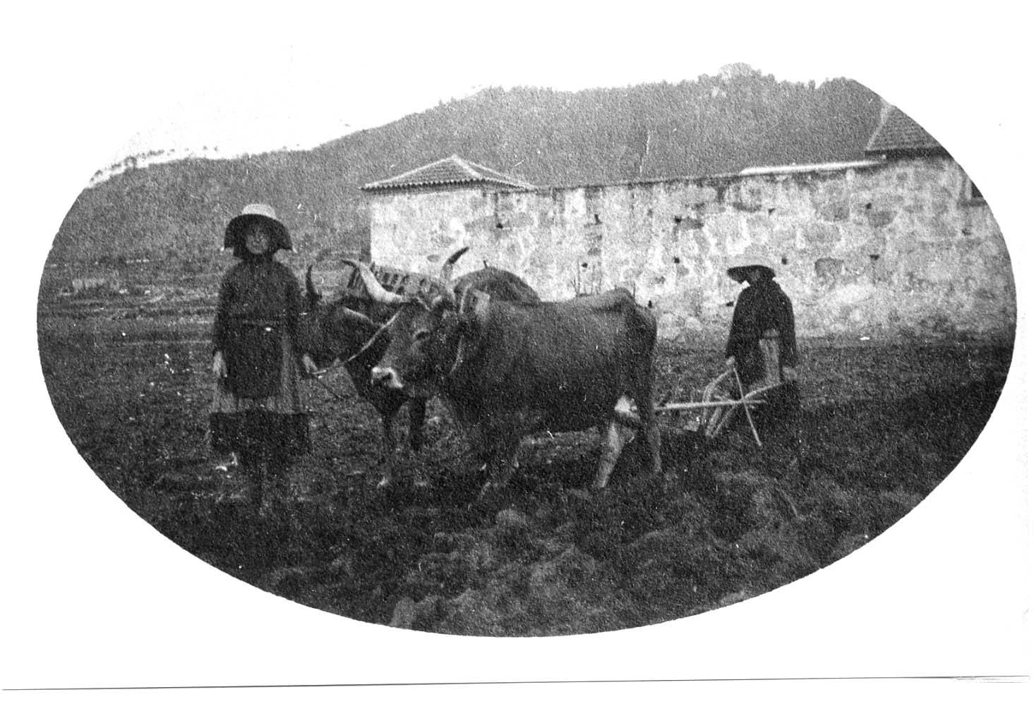
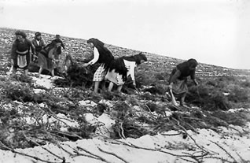
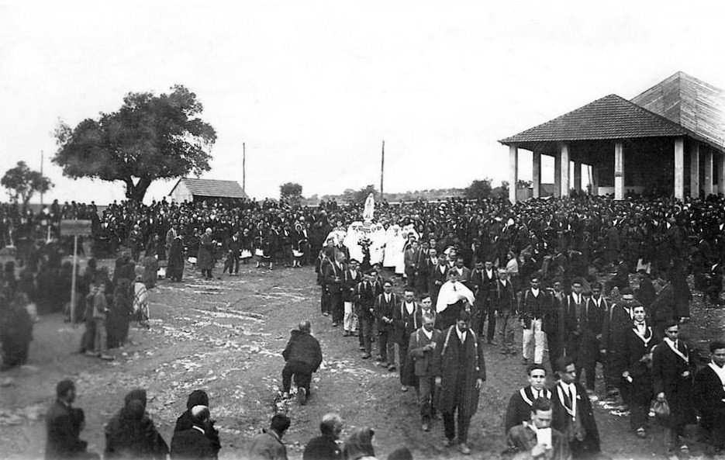
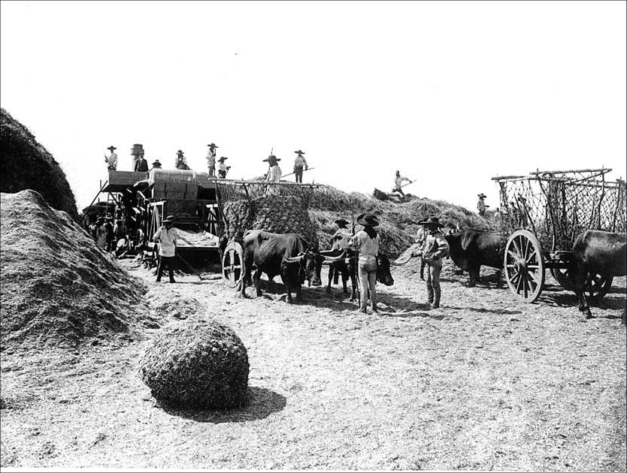
A conflict of two visions: innwards and outwards

Slide 5
Adesão e Repulsa de movimentos Europeus
Three sets of permanent approximation of the portuguese culture and thought to the european reality:
“O vértice histórico-filosófico”: Realismo/ positivismo / Alexandre Herculano / Queda da Monarquia e Mentalidade Republicana até 1926 (Repulsa: Ditadura)
“O vértice literário”: o Orpheu / Pessoa / choque cultural cosmopolita – Modernismo (Repulsa: a propaganda do Estado Novo e seu culturalismo patriótico do Portugal-Nação-Pátria-Deus-Família-Império)
“vértice político-social”: Revolução de 25 de Abril de 1974 abrindo definitivamente Portugal à Europa. (Miguel Real, p.14)

Slide 6
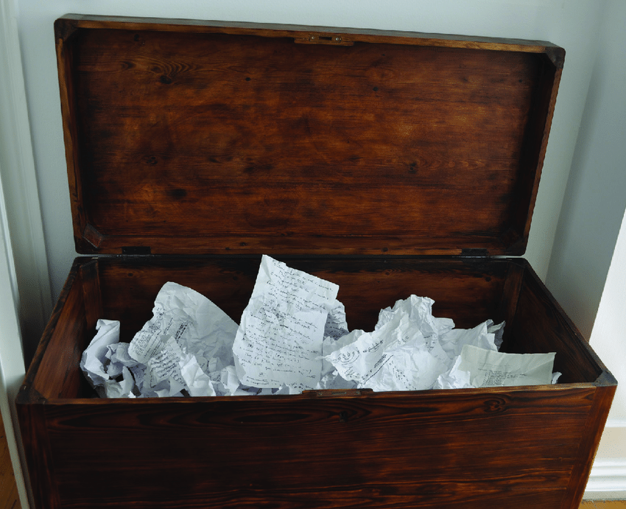
Fernando Pessoa and the Modernist Generation
“Pessoa is the inescapable giant of modern Portuguese letters: through his unique feature of writing different character–poets, who author separate bodies of work with distinctive styles and themes, as well as his involvement in the literary circles of the day, he almost single-handedly brought Modernism to Portugal.” (Castro, p.144)
Pessoa left behind almost 30 thousand
Manuscripts in three wooden chests.
“The three have become one in popular
Mythology, and are referred to as his
famous arca.” (Castro, p.145)
José de Almada Negreiros «Retrato de Fernando Pessoa», 1964, óleo sobre tela, 225 x 226 cm, Museu Calouste Gulbenkian – Coleção Moderna, inv. 64P66

Slide 7
Fernando Pessoa and the Modernist Generation
“Direct communication is felt by the modernist generation to be impossible; poetry must therefore involve a conversion of the poet’s subjective personal emotions into universal images, capable of evoking a similar emotion in the reader” (Castro, 146)
Pessoa’s famous poem ‘Autopsicografia’ (concerned with the making of poetry):
“O poeta é um fingidor
Finge tão completamente
Que chega a fingir que é dor
A dor que deveras sente. (…)”
“The poet is a faker Who's so good at his act He even fakes the pain Of pain he feels in fact. (…)”
José de Almada Negreiros «Retrato de Fernando Pessoa», 1964, óleo sobre tela, 225 x 226 cm, Museu Calouste Gulbenkian – Coleção Moderna, inv. 64P66

Slide 8
Fernando Pessoa and the Modernist Generation
“The difficulty in establishing a consensual English equivalent for fingir – the verb has been variously rendered as ‘to fake’, ‘to feign’, ‘to pretend’, even ‘to lie’ – points to its competing connotations. In
Latin, however, fingere also means to shape, fashion, form or mould, which points at deliberate construction rather than mere play-acting”
“(…)but the point is that Pessoa everywhere denounces the concept of a fixed, knowable self as a fiction. The modernist revelation is that we have no selves, in the conventional sense, to speak of.”
José de Almada Negreiros «Retrato de Fernando Pessoa», 1964, óleo sobre tela, 225 x 226 cm, Museu Calouste Gulbenkian – Coleção Moderna, inv. 64P66

