Slide 1
Transgenesis
Genetiği Değiştirilmiş (GE) Hayvanlar
Genoma transgen olarak adlandırılan yabancı DNA’nın eklenmesi ve canlı bir organizmaya transferi.
http://chem.usu.edu/leochen/htm/research/animal-cancer-model-development-molecular-imaging
Notes:
22 Genetically Engineered (GE) Animals
These techniques are available at least 10 years away from practical application could have dramatic effects on goat breeding if they become practicable.
Transgenesis or Gene transfer
A transgenic animal is one that carries a foreign gene that has been inserted into its genome.
The foreign gene is constructed using recombinant DNA methodology.
The application of transgenic/SCNT (somatic cell nuclear technologies) to improve production traits of economic value, such as increased milk, meat and/or mohair production, has not been reported in goats yet.
why goat?
dairy goats are less expensive,
2. have shorter generation times,
3. produce multiple offspring.
4. cost of maintenance.
5. lower incidence of scrapie
For these reasons, the use of dairy goats as a bioreactor animal is of interest.
Novadays, transgen is a usefull technique for production of expensive human pharmasotics and therapeutics and there are some popular experiments from science direct, which are related with transgenesis….

Slide 2
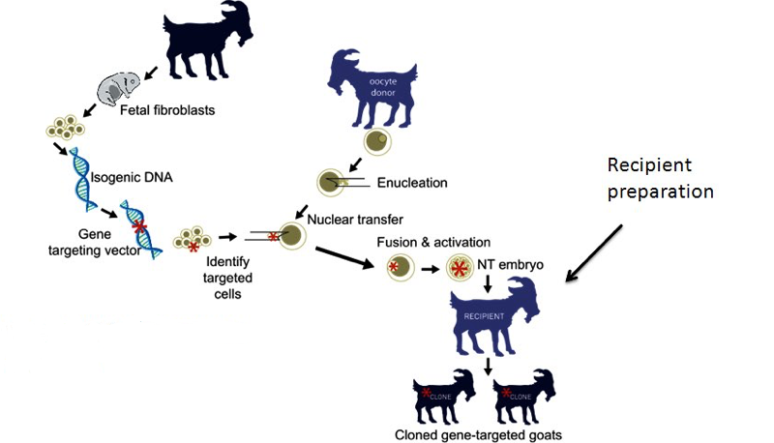
Genetiği Değiştirilmiş (GE) Hayvanlar
http://chem.usu.edu/leochen/htm/research/animal-cancer-model-development-molecular-imaging
Notes:
22 Genetically Engineered (GE) Animals
These techniques are available at least 10 years away from practical application could have dramatic effects on goat breeding if they become practicable.
Transgenesis or Gene transfer
A transgenic animal is one that carries a foreign gene that has been inserted into its genome.
The foreign gene is constructed using recombinant DNA methodology.
The application of transgenic/SCNT (somatic cell nuclear technologies) to improve production traits of economic value, such as increased milk, meat and/or mohair production, has not been reported in goats yet.
why goat?
dairy goats are less expensive,
2. have shorter generation times,
3. produce multiple offspring.
4. cost of maintenance.
5. lower incidence of scrapie
For these reasons, the use of dairy goats as a bioreactor animal is of interest.
Novadays, transgen is a usefull technique for production of expensive human pharmasotics and therapeutics and there are some popular experiments from science direct, which are related with transgenesis….

Slide 3
Genetiği Değiştirilmiş (GE) Hayvanlar
Bu teknikler pratik uygulamadan henüz en az 10 yıl uzakta olsa dahi ileride keçi yetiştiriciliği üzerinde önemli etkileri olabilir. Transgenez veya Gen transferi Transgenik bir hayvan, genomuna eklenmiş yabancı bir geni taşıyan hayvandır. Yabancı gen, rekombinant DNA metodolojisi kullanılarak oluşturulur. Süt, et ve / veya tiftik üretimi gibi ekonomik değerin üretim özelliklerini iyileştirmek için transgenik / SCNT (somatik hücre nükleer teknolojileri) uygulaması henüz keçilerde rapor edilmemiştir.
http://chem.usu.edu/leochen/htm/research/animal-cancer-model-development-molecular-imaging
Notes:
22 Genetically Engineered (GE) Animals
These techniques are available at least 10 years away from practical application could have dramatic effects on goat breeding if they become practicable.
Transgenesis or Gene transfer
A transgenic animal is one that carries a foreign gene that has been inserted into its genome.
The foreign gene is constructed using recombinant DNA methodology.
The application of transgenic/SCNT (somatic cell nuclear technologies) to improve production traits of economic value, such as increased milk, meat and/or mohair production, has not been reported in goats yet.
why goat?
dairy goats are less expensive,
2. have shorter generation times,
3. produce multiple offspring.
4. cost of maintenance.
5. lower incidence of scrapie
For these reasons, the use of dairy goats as a bioreactor animal is of interest.
Novadays, transgen is a usefull technique for production of expensive human pharmasotics and therapeutics and there are some popular experiments from science direct, which are related with transgenesis….

Slide 4
http://chem.usu.edu/leochen/htm/research/animal-cancer-model-development-molecular-imaging
Notes:
22 Genetically Engineered (GE) Animals
These techniques are available at least 10 years away from practical application could have dramatic effects on goat breeding if they become practicable.
Transgenesis or Gene transfer
A transgenic animal is one that carries a foreign gene that has been inserted into its genome.
The foreign gene is constructed using recombinant DNA methodology.
The application of transgenic/SCNT (somatic cell nuclear technologies) to improve production traits of economic value, such as increased milk, meat and/or mohair production, has not been reported in goats yet.
why goat?
dairy goats are less expensive,
2. have shorter generation times,
3. produce multiple offspring.
4. cost of maintenance.
5. lower incidence of scrapie
For these reasons, the use of dairy goats as a bioreactor animal is of interest.
Novadays, transgen is a usefull technique for production of expensive human pharmasotics and therapeutics and there are some popular experiments from science direct, which are related with transgenesis….

Slide 5
http://chem.usu.edu/leochen/htm/research/animal-cancer-model-development-molecular-imaging
Notes:
22 Genetically Engineered (GE) Animals
These techniques are available at least 10 years away from practical application could have dramatic effects on goat breeding if they become practicable.
Transgenesis or Gene transfer
A transgenic animal is one that carries a foreign gene that has been inserted into its genome.
The foreign gene is constructed using recombinant DNA methodology.
The application of transgenic/SCNT (somatic cell nuclear technologies) to improve production traits of economic value, such as increased milk, meat and/or mohair production, has not been reported in goats yet.
why goat?
dairy goats are less expensive,
2. have shorter generation times,
3. produce multiple offspring.
4. cost of maintenance.
5. lower incidence of scrapie
For these reasons, the use of dairy goats as a bioreactor animal is of interest.
Novadays, transgen is a usefull technique for production of expensive human pharmasotics and therapeutics and there are some popular experiments from science direct, which are related with transgenesis….

Slide 6
http://chem.usu.edu/leochen/htm/research/animal-cancer-model-development-molecular-imaging
Notes:
22 Genetically Engineered (GE) Animals
These techniques are available at least 10 years away from practical application could have dramatic effects on goat breeding if they become practicable.
Transgenesis or Gene transfer
A transgenic animal is one that carries a foreign gene that has been inserted into its genome.
The foreign gene is constructed using recombinant DNA methodology.
The application of transgenic/SCNT (somatic cell nuclear technologies) to improve production traits of economic value, such as increased milk, meat and/or mohair production, has not been reported in goats yet.
why goat?
dairy goats are less expensive,
2. have shorter generation times,
3. produce multiple offspring.
4. cost of maintenance.
5. lower incidence of scrapie
For these reasons, the use of dairy goats as a bioreactor animal is of interest.
Novadays, transgen is a usefull technique for production of expensive human pharmasotics and therapeutics and there are some popular experiments from science direct, which are related with transgenesis….

Slide 7
Genetiği Değiştirilmiş (GE) Hayvanlar
Neden keçi?
1. süt keçileri daha ucuzdur,
2. daha kısa nesil süreleri,
3. Birden fazla yavru eldesi.
4. Düşük bakım maliyeti.
5. daha düşük scrapie insidansı
Bu nedenlerden dolayı, süt keçilerinin biyoreaktör hayvan olarak kullanılması ilgi çekicidir. Günümüzde transgen, pahalı insan farmasotikleri ve terapötiklerinin üretimi için yararlı bir tekniktir
http://chem.usu.edu/leochen/htm/research/animal-cancer-model-development-molecular-imaging
Notes:
22 Genetically Engineered (GE) Animals
These techniques are available at least 10 years away from practical application could have dramatic effects on goat breeding if they become practicable.
Transgenesis or Gene transfer
A transgenic animal is one that carries a foreign gene that has been inserted into its genome.
The foreign gene is constructed using recombinant DNA methodology.
The application of transgenic/SCNT (somatic cell nuclear technologies) to improve production traits of economic value, such as increased milk, meat and/or mohair production, has not been reported in goats yet.
why goat?
dairy goats are less expensive,
2. have shorter generation times,
3. produce multiple offspring.
4. cost of maintenance.
5. lower incidence of scrapie
For these reasons, the use of dairy goats as a bioreactor animal is of interest.
Novadays, transgen is a usefull technique for production of expensive human pharmasotics and therapeutics and there are some popular experiments from science direct, which are related with transgenesis….

