Slide 1
BIO311 ACADEMIC PRESENTATION SKILLS
Assoc. Prof. Dr. Fadime Kıran
Assoc. Prof. Dr. İlker Büyük
Assist. Prof. Dr. Şeyda Fikirdeşici Ergen

Slide 2
Avoid multiple charts, lists, and diagrams at the same time

Slide 3
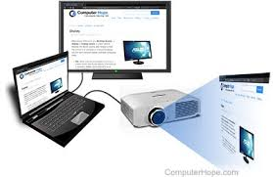
Know and master your presentation technology

Slide 4
Transform Anxiety into Positive Energy

Slide 5
References
Davis, M. 2005. Scientific Papers and Presentations, Revised Edition Elsevier
Wallwork, A. 2016. English for Presentations at International Conferences, Springer.
Carter, M. 2020. Designing Science Presentations, A Visual Guide to Figures, Papers, Slides, Posters, and More, Academic Press.

