Slide 1
THE CREATION
From the website Pinterest

Slide 2
In the Elder Edda a Wise Woman says:
Of old there was nothing,
Nor sand, nor sea, nor cool waves.
No earth, no heaven above.
Only the yawning chasm.
The sun knew not her dwelling,
Nor the moon his realm.
The stars had not their places

Slide 3
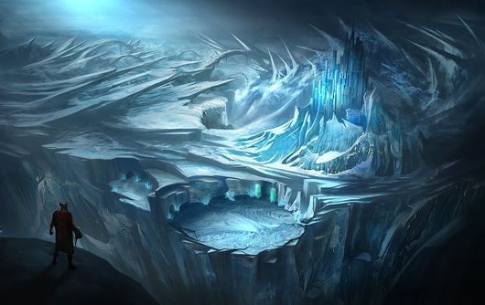
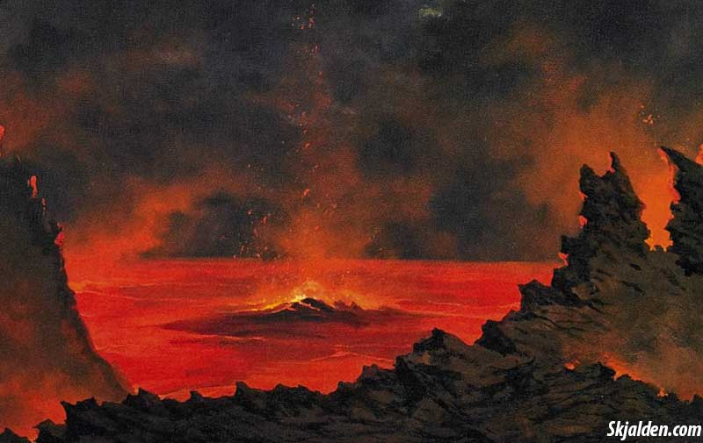
From the website Pinterest
From the website Norse Mythology

Slide 4
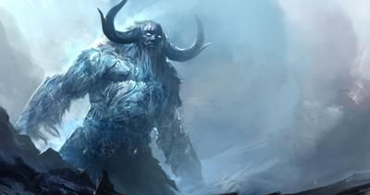
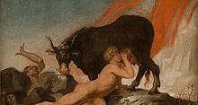
From the website Pinterest
From the website Wikipedia

Slide 5
From the website Alehorn

Slide 6
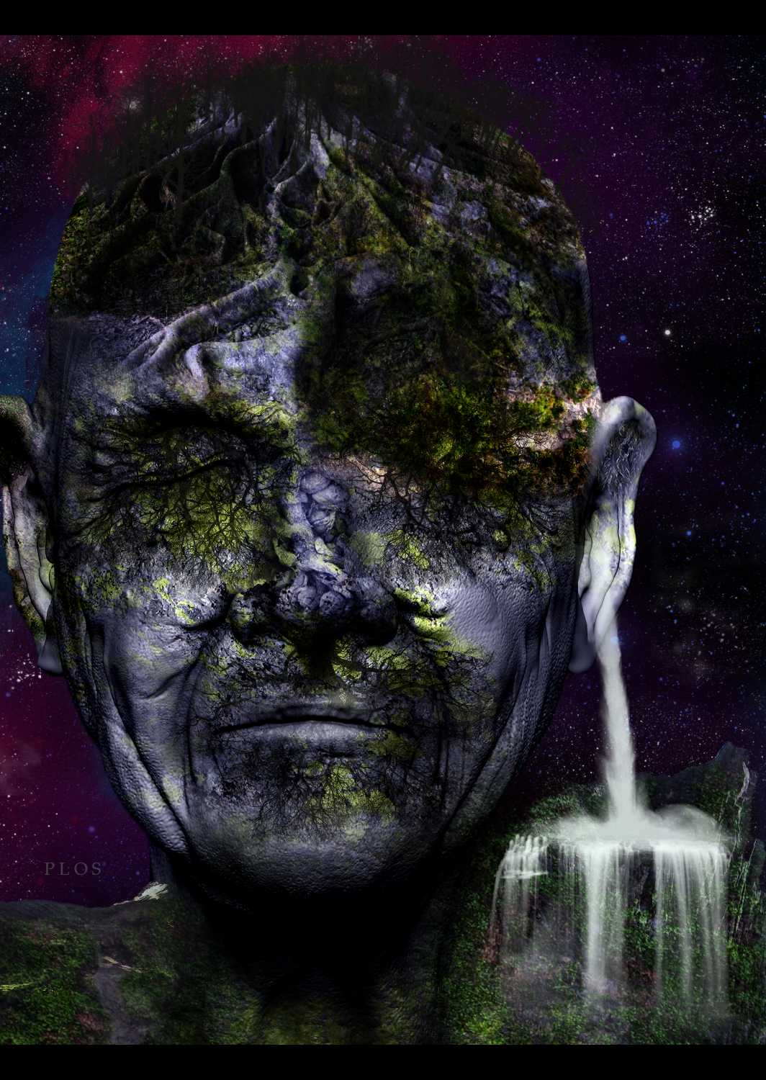
From the website Pinterest

Slide 7
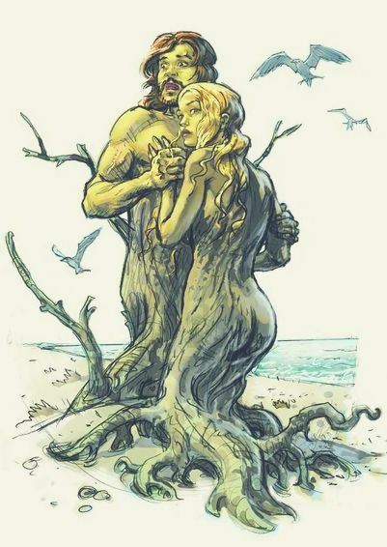

Slide 8
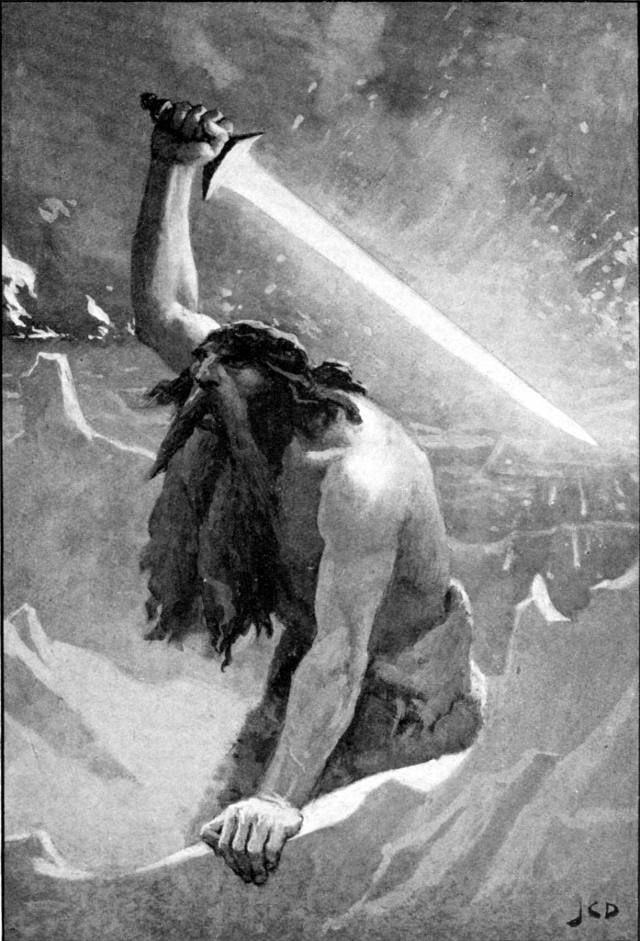
From the website Geekstra

Slide 9
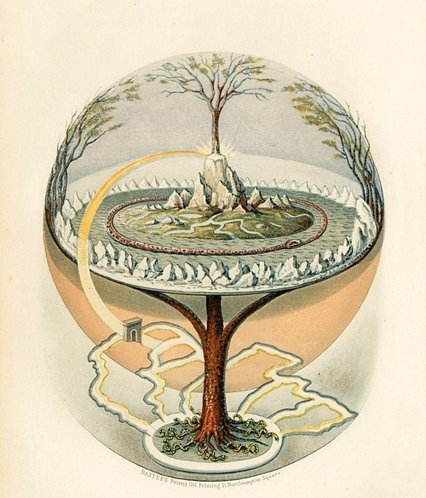
Yggdrasill and The Nine Worlds
From the website World History Encyclopedia

Slide 10
From the website Musescore

Slide 11
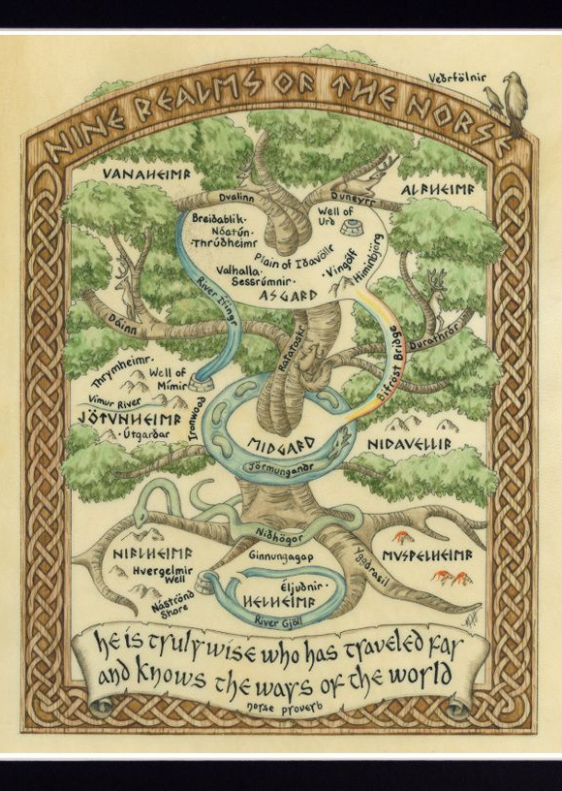
From the website Pinterest

Slide 12
From the website Stringfixer

