Slide 1
Solar System

Slide 2
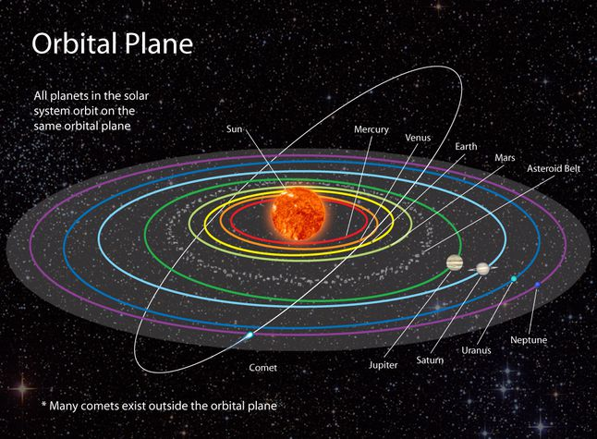
Solar System: Planets, Moons, Asteroids, Comets, Meteors, Kuiper Belt, Oort CloudBulutu
Mercury
Venus
Earth
Mars
Jupiter
Saturn
Uranus
Neptune
Notes:
https://www.nationalgeographic.org/topics/solar-system/?page=2

Slide 3
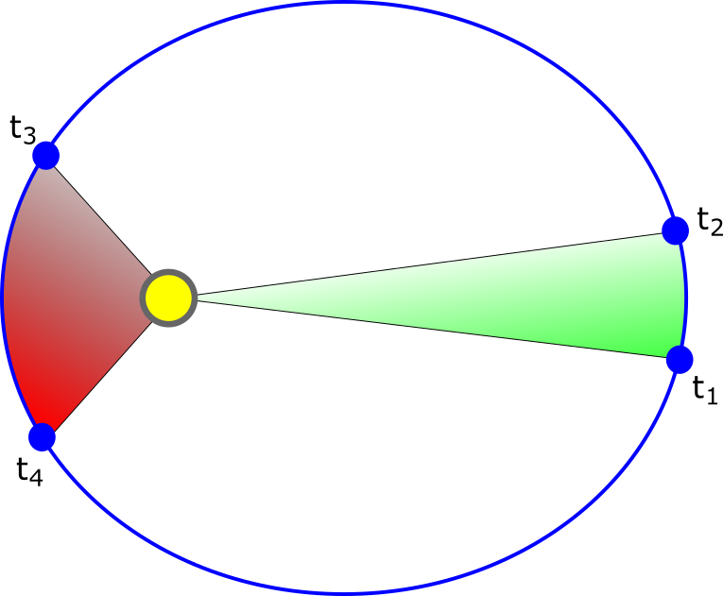
Kepler’s 1. and 2. Law
Notes:
https://www.narom.no/undervisningsressurser/sarepta/rocket-theory/satellite-orbits/keplers-laws/

Slide 4
Kepler’s 3rd Law
(distance)³=(period)² a³ = P² distance is in AU
and period years
.

Slide 5
Bode’s Law
Merkury, Venus, Earth, Mars ect. N=0, 3, 6, 12, 24…

