Slide 1
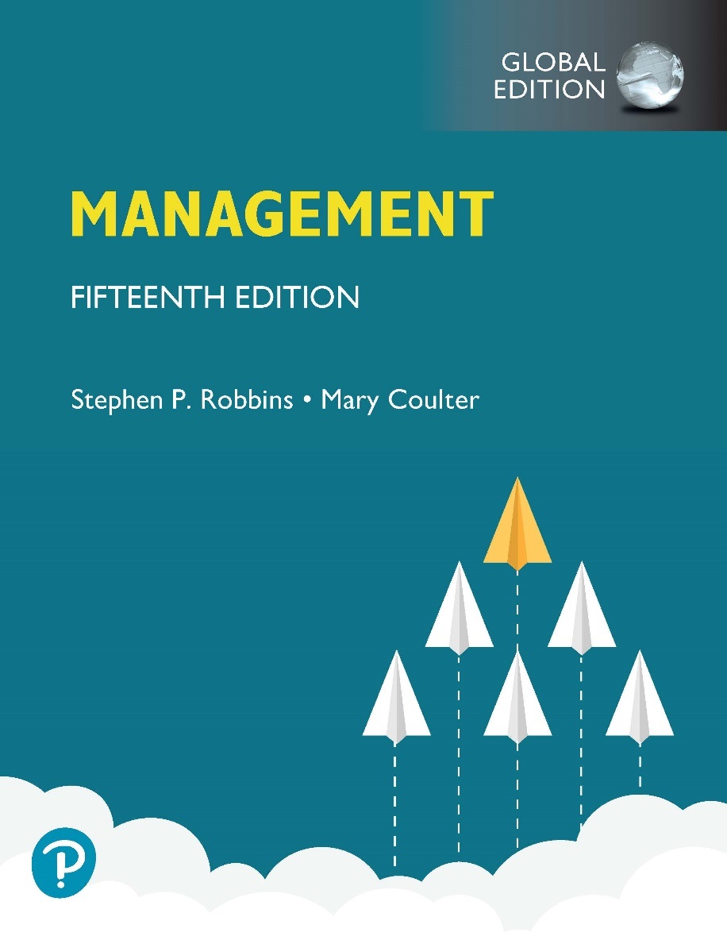
Management
Fifteenth Edition, Global Edition
Chapter 1
Managers and You in the Workplace
Copyright © 2021 Pearson Education Ltd.
Notes:
If this PowerPoint presentation contains mathematical equations, you may need to check that your computer has the following installed:
1) MathType Plugin
2) Math Player (free versions available)
3) NVDA Reader (free versions available)

Slide 2
Learning Objectives
1.1 Tell who managers are and where they work.
1.2 Explain why managers are important to organizations.
1.3 Describe the functions, roles, and skills of managers.
1.4 Describe the factors that are reshaping and redefining the manager’s job.
1.5 Explain the value of studying management.
1.6 Describe the benefits of the Employability Skills Matrix (E S M).

Slide 3
Who Is a Manager?
Manager: someone who coordinates and oversees the work of other people so that organizational goals can be accomplished
Notes:
Managers run large corporations, medium-sized businesses, and entrepreneurial start-ups. They’re found in government departments, hospitals, small businesses, not-for-profit agencies, museums, schools, and even such nontraditional organizations such as political campaigns and music tours. In many organizations, the changing nature of work has blurred the distinction between managers and non-managerial employees. So, how do we define who managers are? A manager is someone who coordinates and oversees the work of other people so that organizational goals can be accomplished.

Slide 4
Exhibit 1.1 Levels of Management
Exhibit 1.1 shows that in traditionally structured organizations, managers can be classified as first-line, middle, or top.
Notes:
In traditionally structured organizations (often pictured as a pyramid because more employees are at lower organizational levels than at upper organizational levels), managers can be classified as first-line, middle, or top management.
Long Description:
It is shaped like a pyramid and has four levels. The levels, from bottom upwards are:
Nonmanagerial employees
First-Line Managers
Middle Managers
Top Managers

Slide 5
Classifying Managers
First-Line Managers: manage the work of non-managerial employees
Middle Managers: manage the work of first-line managers
Top Managers: responsible for making organization-wide decisions and establishing plans and goals that affect the entire organization
Notes:
At the lowest level of management, first-line managers manage the work of non-managerial employees who typically are involved with producing the organization’s products or servicing the organization’s customers. First-line managers may be called supervisors or even shift managers, district managers, department managers, or office managers.
Middle managers manage the work of first-line managers and can be found between the lowest and top levels of the organization. They may have titles such as regional manager, project leader, store manager, or division manager.
At the upper levels of the organization are the top managers, who are responsible for making organization-wide decisions and establishing the plans and goals that affect the entire organization. These individuals typically have titles such as executive vice president, president, managing director, chief operating officer, or chief executive.

Slide 6
Where Do Managers Work?
Organization: a deliberate arrangement of people to accomplish some specific purpose
Notes:
What is an organization? It’s a deliberate arrangement of people to accomplish some specific purpose. Your college or university is an organization; so are fraternities and sororities, government departments, churches, Zynga, your neighborhood grocery store, the United Way, the St. Louis Cardinals baseball team, and the Mayo Clinic, all are considered organizations and have three common characteristics.
First, an organization has a distinct purpose typically expressed through goals the organization hopes to accomplish. Second, each organization is composed of people. It takes people to perform the work that’s necessary for the organization to achieve its goals. Third, all organizations develop a deliberate structure within which members do their work.

Slide 7
Exhibit 1.2 Characteristics of Organizations
Exhibit 1.2 shows the three common characteristics of organizations: distinct purpose, deliberate structure, and people.
Notes:
Organizations have three common characteristics. First, an organization has a distinct purpose that is typically expressed through goals the organization seeks to accomplish. Second, each organization is composed of people. It takes people to perform the work that’s necessary for the organization to achieve its goals. Third, all organizations develop a deliberate structure within which members do their work.

Slide 8
Why Are Managers Important?
Organizations need their managerial skills and abilities now more than ever
Managers are critical to getting things done
Managers do matter to organizations
Notes:
Let’s look at three reasons why managers are important to organizations.
First, managers are important because organizations need their managerial skills and abilities more than ever in uncertain, complex, and chaotic times. As organizations deal with today’s challenges, managers play an important role in identifying critical issues and crafting responses.
Another reason why managers are important to organizations is because they’re critical to getting things done. The job of a manager is to ensure that all the employees are getting their jobs done.
Managers matter. A Gallup poll has found that the single most important variable in employee productivity and loyalty isn’t pay, or benefits, or the workplace environment—it’s the quality of the relationship between employees and their direct supervisors.

Slide 9
Exhibit 1.3 Managers Make a Difference
Exhibit 1.3 shows data on why managers are important. Managers that are not engaged cost organizations billions of dollars through employee turnover.
Notes:
Long Description:
The figure shows an ellipse that has the label “Number 1 Variable in Productivity and Loyalty – Quality of Employee-Supervisor Relationship. Two circles are shown on the circumference of the ellipse with the following text:
Half of US adults have left their jobs to get away from a bad manager.
Over $300 billion each year equals cost of managers who are not engaged.

Slide 10
What Do Managers Do?
Management involves coordinating and overseeing the work activities of others so that their activities are completed efficiently and effectively.
Notes:
Management involves coordinating and overseeing the work activities of others so their activities are completed efficiently and effectively. While coordinating and overseeing the work of others is what distinguishes a managerial position from a non-managerial one, this doesn’t mean that managers can do what they want anytime, anywhere, or in any way. Instead, management involves ensuring that work activities are completed efficiently and effectively by the people responsible for doing them, or, at least that’s what managers should be doing.

Slide 11
Efficiency and Effectiveness
Efficiency: doing things right
getting the most output from the least amount of input
Effectiveness: doing the right things
attaining organizational goals
Notes:
Efficiency refers to getting the most output from the least amount of inputs or resources. Managers deal with scarce resources—including people, money, and equipment—and want to use those resources efficiently.
Effectiveness is often described as “doing the right things,” that is, doing those work activities that will result in achieving goals.
Whereas efficiency is concerned with the means of getting things done, effectiveness is concerned with the ends, or attainment of organizational goals.

Slide 12
Exhibit 1.4 Efficiency and Effectiveness in Management
Exhibit 1.4 shows that whereas efficiency is concerned with the means of getting things done, effectiveness is concerned with the ends, or attainment of organizational goals.
Notes:
Long Description:
“Efficiency (Means)” represents “Resource Usage.” Management strives for “Low Resource Waste,” that is “high efficiency.”
“Effectiveness (Ends)” represents “Goal Attainment.” Management strives for “High Goal Attainment,” that is “high effectiveness.”

Slide 13
Management Functions
Planning: Defining goals, establishing strategies to achieve goals, and developing plans to integrate and coordinate activities
Organizing: Arranging and structuring work to accomplish organizational goals
Leading: Working with and through people to accomplish goals
Controlling: Monitoring, comparing, and correcting work
Notes:
According to the functions approach, managers perform certain activities or functions as they efficiently and effectively coordinate the work of others. What are these functions? Henri Fayol, a French businessman, first proposed in the early part of the twentieth century that all managers perform five functions: planning, organizing, commanding, coordinating, and controlling. Today, these functions have been condensed to four: planning, organizing, leading, and controlling (see Exhibit 1-4).

Slide 14
Exhibit 1.5 Four Functions of Management
Exhibit 1.5 shows the four functions used to describe a manager’s work: planning, organizing, leading, and controlling.
Notes:
As managers engage in planning, they set goals, establish strategies for achieving those goals, and develop plans to integrate and coordinate activities.
When managers organize, they determine what tasks are to be done, who is to do them, how the tasks are to be grouped, who reports to whom, and where decisions are to be made.
When managers motivate subordinates, help resolve work group conflicts, influence individuals or teams as they work, select the most effective communication channel, or deal in any way with employee behavior issues, they’re leading. To ensure goals are met and work is done as it should be, managers monitor and evaluate performance. Actual performance is compared with the set goals. If those goals aren’t achieved, it’s the manager’s job to get work back on track.
This process of monitoring, comparing, and correcting is the controlling function.
Long Description:
The four functions and their component activities are as follows:
Planning: Setting goals, establishing strategies, and developing plans to coordinate activities
Organizing: Determining what needs to be done, how it will be done, and who is to do it
Leading: Motivating, leading, and any other actions involved in dealing with people
Controlling: Monitoring activities to ensure that they are accomplished as planned
The functions are shown to lead to “Achieving the organization’s stated purposes.”

Slide 15
Mintzberg’s Managerial Roles and a Contemporary Model of Managing
Roles: specific actions or behaviors expected of and exhibited by a manager
Mintzberg identified 10 roles grouped around interpersonal relationships, the transfer of information, and decision making
Notes:
Henry Mintzberg, a well-known management researcher, studied actual managers at work. In his first comprehensive study, Mintzberg concluded that what managers do can best be described by looking at the managerial roles they engage in at work. The term managerial roles refers to specific actions or behaviors expected of, and exhibited by, a manager.

Slide 16
Types of Roles
Interpersonal
Figurehead, leader, liaison
Informational
Monitor, disseminator, spokesperson
Decisional
Entrepreneur, disturbance handler, resource allocator, negotiator
Notes:
As shown in Exhibit 1-6, these 10 roles are grouped around interpersonal relationships, the transfer of information, and decision making.
The interpersonal roles involve people (subordinates and persons outside the organization) and other ceremonial and symbolic duties. The three interpersonal
roles include figurehead, leader, and liaison.
The informational roles involve collecting, receiving, and disseminating information. The three informational roles include monitor, disseminator, and spokesperson.
Finally, the decisional roles entail making decisions or choices and include entrepreneur, disturbance handler, resource allocator, and negotiator.

Slide 17
Exhibit 1.6 Mintzberg’s Managerial Roles
Exhibit 1.6 shows the managerial roles identified by Mintzberg.
Notes:
Source: Based on H. Mintzberg, The Nature of Managerial Work (New York: Prentice Hall, 1983).
Long Description:
The model is shaped like a wheel. The ten roles, grouped around interpersonal relationships, the transfer of information, and decision making, are indicated in the spoke of the wheel, and are summarized below:
Interpersonal Roles:
Figurehead
Leader
Liaison
Informational Roles:
Monitor
Disseminator
Spokesperson
Decisional Roles:
Negotiator
Resource Allocator
Disturbance Handler
Entrepreneur

Slide 18
Management Skills
Technical skills
Knowledge and proficiency in a specific field
Human skills
The ability to work well with other people
Conceptual skills
The ability to think and conceptualize about abstract and complex situations concerning the organization
Notes:
What types of skills do managers need? Robert L. Katz proposed that managers need three critical skills in managing: technical, human, and conceptual.
Technical skills are the job-specific knowledge and techniques needed to proficiently perform work tasks. These skills tend to be more important for first-line managers because they typically manage employees who use tools and techniques to produce the organization’s products or service the organization’s customers.
Human skills involve the ability to work well with other people both individually and in a group. Because all managers deal with people, these skills are equally important to all levels of management.
Finally, conceptual skills are the skills managers use to think and to conceptualize about abstract and complex situations. Using these skills, managers see the organization as a whole, understand the relationships among various subunits, and visualize how the organization fits into its broader environment. These skills are most important to top managers.

Slide 19
Exhibit 1.7 Skills Needed at Different Managerial Levels
Exhibit 1.7 shows the relationships of conceptual, human, and technical skills to managerial levels.
Notes:
Long Description:
The three levels are “Lower-Level Managers”, “Middle Manager”, and “Top Managers.”
The three levels are indicated by rectangular bars. Each bar is divided into three types of skills – “Technical”, “Interpersonal”, and “Conceptual”, in parts as required by the corresponding managerial level.
Since all three levels require management of people, “Interpersonal” skills are shown as equally important to all levels.
The other skills are indicated as follows:
Lower-Level Managers: Technical skills are most important. Conceptual skills are least important.
Middle Managers: All 3 skills are equally important.
Top Managers: Conceptual skills are most important. Technical skills are least important.

Slide 20
Challenges Facing Managers Today and into the Future
Focus on technology
Focus on disruptive innovation
Focus on social media
Focus on ethics
Focus on political uncertainty
Focus on the customer

Slide 21
Focus on Technology
Managers must get employees on board with new technology
Managers must oversee the social interactions and challenges involved in using collaborative technologies
Notes:
Managers must work with employees to understand why new technology is an improvement over present ways of conducting business. According to Didier Bonnet, coauthor of Leading Challenge, “The job of a manager is to help people cross the bridge—to get them comfortable with the technology, to get them using it, and to help them understand how it makes their lives better.”
It is a myth that social skills have become less important because there is more technology in the workplace. Particularly in team settings, workers rely on each other’s expertise, and they are able to adapt to changing circumstances that is made possible by software. As a result, managers are continually challenged to oversee team building and problem solving.

Slide 22
Focus on Disruptive Innovation
One of the most critical challenges facing managers today is dealing with disruptive innovation
Disruptive innovation involves new products, processes, or services that radically change the rules of the game
One example is how the automobile destroyed the horse-drawn buggy industry
Notes:
Innovation means doing things differently, exploring new territory, and taking risks. Innovation isn’t just for high-tech or other technologically sophisticated organizations. Innovative efforts can be found in all types of organizations. Disruptive innovation can rapidly make us obsolete or create the need for immediate change. Managers need to be aware of this possibility.

Slide 23
Focus on Social Media
Social media: forms of electronic communication through which users create online communities to share ideas, information, personal messages, and other content
Notes:
Today, the new frontier is social media, forms of electronic communication through which users create online communities to share ideas, information, personal messages, and other content. And employees don’t just use these on their personal time, but also for work purposes. That’s why managers need to understand and manage the power and peril of social media.
Increasingly, many companies encourage employees to use social media to become employee activists. For this purpose, employee activists draw visibility to their workplace, defend their employers from criticism, and serve as advocates, both online and off.
Internally, social media also becomes problematic when it becomes a way for boastful employees to brag about their accomplishments, for managers to publish one-way messages to employees, or for employees to argue or gripe about something or someone they don’t like at work—then it has lost its usefulness. To avoid this, managers need to remember that social media is a tool that needs to be managed to be beneficial.

Slide 24
Focus on Ethics
We commonly see unethical business practices in the news
Examples include pharmaceutical firms raising drug prices by 500% or someone turning in fake receipts for expenses
Organizational survival depends on building trust with customers, clients, suppliers, employees, and other stakeholders
Notes:
Managers need to lead by example and always be ethical to create trust and loyalty in the people around them. Unethical behavior threatens the organization’s survival and your career.

Slide 25
Focus on Political Uncertainty
In the past, major democratic nations like the U S, Canada, and the U K have been relatively stable politically
In the last 10 years these countries have shifted to greater political uncertainty
Brexit and the U S M C A are examples of that shift
Some states, such as California, have placed additional regulations on business
Notes:
What’s emerging in the twenty-first century is an increasing amount of political uncertainty around the world. The change is not limited to nations but also affects states and cities such as Seattle’s minimum wage laws and employee tax to support social causes. This uncertainty and change increases the cost of doing business.

Slide 26
Focus on the Customer
Without customers, most organizations would cease to exist
Managing customer relationships is the responsibility of all managers and employees
Consistent, high-quality customer service is essential
Notes:
You need customers. Without them, most organizations would cease to exist. Yet, focusing on the customer has long been thought to be the responsibility of marketing types. Today, the majority of employees in developed countries work in service jobs. Almost 77 percent of the U.S. labor force is employed in service industries.

Slide 27
The Universality of Management
The reality that management is needed in all types and sizes of organizations, at all organizational levels, in all organizational areas, and in organizations no matter where located
Notes:
We can say with absolute certainty that management is needed in all types and sizes of organizations, at all organizational levels and in all organizational work areas, and in all organizations, no matter where they’re located. This is known as the universality of management (see Exhibit 1-8).

Slide 28
Exhibit 1.8 Universal Need for Management
Exhibit 1.8 shows that management is universally needed in all types of, and throughout all areas of, organizations.
Notes:
Effective management is universally needed in all organizations; therefore it’s imperative to find ways to improve the way organizations are managed. Why? Because we interact with organizations every single day. Organizations influence every aspect of our lives.
Long Description:
The chart shows the text “Management is needed in …” at the center.
Around it, as in a web diagram, the following are shown in text boxes:
All Organization Levels: Bottom to Top
All Organizational Areas: Manufacturing, Marketing, Human Resources, Accounting, Information Systems, etcetera
All Sizes of Organizations: Small to Large
All Types of Organizations: Profit to Not-for-Profit

Slide 29
The Reality of Work
When you begin your career, you will either manage or be managed
Notes:
Another reason for studying management is the reality that for most of you, once you graduate from college and begin your career, you will either manage or be managed. For those who plan to be managers, an understanding of management forms the foundation upon which to build your management knowledge and skills. For those of you who don’t see yourself managing, you’re still likely to have to work with managers.
Also, assuming that you’ll have to work for a living and recognizing that you’re very likely to work in an organization, you’ll probably have some managerial responsibilities even if you’re not a manager. Our experience tells us that you can gain a great deal of insight into the way your boss (and fellow employees) behave and how organizations function by studying management.

Slide 30
Rewards of Being a Manager
Responsible for creating a productive work environment
Recognition and status in your organization and in the community
Attractive compensation in the form of salaries, bonuses, and stock options
Notes:
Despite challenges, being a manager can be rewarding. You’re responsible for creating a work environment in which organizational members can do their work to the best of their ability and thus help the organization achieve its goals. You help others find meaning and fulfillment in their work. You get to support, coach, and nurture others and help them make good decisions. In addition, as a manager, you often have the opportunity to think creatively and use your imagination. You’ll get to meet and work with a variety of people—both inside and outside the organization. Other rewards may include receiving recognition and status in your organization and in the community, playing a role in influencing organizational outcomes, and receiving attractive compensation in the form of salaries, bonuses, and stock options.

Slide 31
Exhibit 1.9 Rewards From Being a Manager
Create a work environment in which organizational members can work to the best of their ability
Have opportunities to think creatively and use imagination
Help others find meaning and fulfillment in work
Support, coach, and nurture others
Work with a variety of people
Receive recognition and status in organization and community
Play a role in influencing organizational outcomes
Receive appropriate compensation in the form of salaries, bonuses, and stock options

Slide 32
Gaining Insights into Life at Work
Students need to understand management principles regardless of career choice
Workplace Confidential boxes located in each chapter will introduce students to various workplace challenges and give advice on how to handle those challenges
Notes:
Remind everyone that you will all be managers of resources or employees if you advance in your career. Understanding management principles will help you navigate the workplace issues you will encounter along the way.

Slide 33
Employability Skills Matrix (E S M)
The E S M will be presented at the beginning of each chapter and focus on key skills covered in that chapter. These include:
Critical thinking
Communication
Collaboration
Knowledge application and analysis
Social responsibility skills
Notes:
These skills are in demand by employers, whether for-profit or not-for-profit. Students need to learn to practice and apply these skills.

Slide 34
Exhibit 1.10 Employability Skills Matrix (E S M)
Notes:
This sample shows how each chapter will begin with a similar ESM graphic showing the chapter skills covered.
Long Description:
The matrix shows the five employability skills as column heads and the features grouped into “Skill Boxes”, “Skill Practice” and “Cases” as row heads. The mapping by employability skill is as follows.
Critical Thinking
Skill Boxes
It’s Your Career
Learning from Failure
Skill Practice
Skill Exercise
My Turn to be a Manager
Cases
Case Applications
Communication
Skill Boxes
It’s Your Career
Skill Practice
Ethical Dilemma
Collaboration
Skill Boxes
Workplace Confidential
Skill Practice
Working Together
Knowledge Application
Skill Boxes
It’s Your Career
Workplace Confidential
Learning from Failure
Skill Practice
Skill Exercise
My Turn to be a Manager
Cases
Case Applications
Social Responsibility
Skill Boxes
It’s Your Career
Skill Practice
Ethical Dilemma
Cases
Case Applications

Slide 35
Review Learning Objective 1.1
Tell who managers are and where they work.
Managers coordinate and oversee the work of other people so that organizational goals can be accomplished.
Managers work in an organization, which is a deliberate arrangement of people to accomplish some specific purpose.

Slide 36
Review Learning Objective 1.2
Explain why managers are important to organizations.
Organizations need their managerial skills and abilities in uncertain, complex, and chaotic times.
Managers are critical to getting things done in organizations.
Managers contribute to employee productivity and loyalty.

Slide 37
Review Learning Objective 1.3 (1 of 3)
Describe the functions, roles, and skills of managers.
Management involves coordinating and overseeing the efficient and effective completion of others’ work activities.
The four functions of management include planning, organizing, leading, and controlling.

Slide 38
Review Learning Objective 1.3 (2 of 3)
Mintzberg’s managerial roles include:
Interpersonal, involve people and other ceremonial/symbolic duties (figurehead, leader, and liaison)
Informational, collecting, receiving, and disseminating information (monitor, disseminator, and spokesperson)
Decisional, making choices (entrepreneur, disturbance handler, resource allocator, and negotiator)

Slide 39
Review Learning Objective 1.3 (3 of 3)
Katz’s managerial skills include:
Technical (job-specific knowledge and techniques)
Human (ability to work well with people)
Conceptual (ability to think and express ideas)

Slide 40
Review Learning Objective 1.4
Describe the factors that are reshaping and redefining the manager’s job.
Managers must be concerned with:
Customer service because employee attitudes and behaviors play a big role in customer satisfaction
Technology as it impacts how things get done in organizations
Social media because these forms of communication are becoming important and valuable tools in managing
Innovation because it is important for organizations to be competitive
Sustainability as business goals are developed
Employees in order for them to be more productive

Slide 41
Review Learning Objective 1.5
Explain the value of studying management.
The universality of management—managers are needed in all types and sizes of organizations
The reality of work—you will manage or be managed
Significant rewards and challenges

Slide 42
Review Learning Objective 1.6
Describe the benefits of the Employability Skills Matrix (E S M)
Helps students develops five critical skills
Critical thinking
Communication
Collaboration
Knowledge application
Social responsibility

