Slide 1
REPLICATION
Replication: Copying to molecule of life
Notes:
A cell copies its DNA before dividing, so that both daughter cells have a complete copy of the genetic information. This lecture explains replication.
DNA replication is a process by which a double-stranded DNA molecule is copied into two, identical DNA molecules.
‹#›

Slide 2
The most important feature of DNA is its ability to replicate itself.
self-duplication
Goal; is the formation of an exact copy of the DNA molecule to transfer the genetic information to subsequent generations.
Notes:
Replication is the process of producing exactly the same genetic material.
DNA is the only molecule that can replicate itself.
The result is a new DNA molecule with the same nucleotide sequence as the original DNA molecule.
In this way, the information carried in DNA passes to the next generations with each replication event
‹#›

Slide 3
When and where DNA replication take place?
The DNA molecule is replicated once per cell cycle.
If there is a problem with DNA replication, cell division will stop.
DNA synthesis occurs at the S phase of the cell cycle in the nucleus.
‹#›
Notes:
‹#›

Slide 4
Notes:
It is Process of duplication of the entire genome prior to cell division
Biological significance is extreme accuracy of DNA replication is necessary in order to preserve the integrity of the genome in successive generations
‹#›

Slide 5
Basic rules of replication
Semi-conservative
Starts from the ‘ replication origins’
Synthesis always in the 5-3’ direction
Can be uni or bidirectional
Semi-discontinuous
RNA primers required
Notes:
‹#›

Slide 6
Notes:
There were three models to explain how does replication occur. DNA replication is explained by a semi-conservative model.
‹#›

Slide 7
Semi-conservative replication
each one of the parent DNA strands is passed to the daugher DNA + one new strand for each
Notes:
‹#›
DNA replication is described as semi-conservative and this is because the daughter molecules produced each contain one strand from the original DNA 'parent' molecule. That one strand is half of the original DNA molecule leading to the term 'semi' and as it was kept, or remains, in the 'daughter' molecules we say it was 'conserved'. Therefore we say that DNA replication is a semi-conservative process.

Slide 8
The Meselson-Stahl Experiment
Concepts of genetics book,11th ed. Chapter 11

Slide 9
Notes:
This model is the process where each strand of two-stranded strand DNA acts as a template and forms a new identical strand of DNA.
Thus, the new DNA molecule formed from a parent molecule carries a chain of parent DNA.
‹#›

Slide 10
Concepts of genetics book,11th ed. Chapter 11

Slide 11
The origin of replication. Where along the chromosome is DNA replication initiated?
DNA replication does not start at any point in the random DNA chain. Initiator proteins identify specific base sequences on DNA called sites of origin
Starts in regions called "REPLICATION ORIGIN"
This point is one in prokaryotic cell, whereas it is much higher in eukaryotic cells (›1000).
Notes:
Prokaryotes – single origin site
Eukaryotes – multiple sites of origin
‹#›

Slide 12
Replication fork
First, at each point along the chromosome where replication is occurring, the strands of the helix are unwound, creating what is called a replication fork. Such a fork will initially appear at the point of origin of synthesis.

Slide 13
Generally, replication in the replication forks proceeds from 5 to 3;
The strand acting as a template is read in the direction from 3 to 5
Reading the old strand 3 to 5
Synthesis a new strand (replication) 5 to 3
Notes:
‹#›

Slide 14
Why does DNA replication only occur in the 5’ to 3’ direction?
When a 3 'hydroxyl group of another nucleotide is attached to the phosphate group at the 5' end of one nucleotide, a phosphodiester bond is formed.
therefore the synthesis direction of DNA is from 5 to 3.

Slide 15
Anti-parallel strand builds in the opposite direction (always in 5’ to 3’ direction)
WHY?
the template DNA is used as a blueprint for the sequence of the new strand, following the rules of complementary bases (e.g. if the nucleotide is adenine in the template DNA, then a thymine is added in the opposite strand). DNA polymerase (the enzyme that carries out DNA synthesis) uses one strand of DNA as a template and adds a new nucleotide to the 3' end of the new elongating strand. DNA polymerase utilizes a deoxyribonucleotide, cleaves the two terminal phosphates from the 5' end of the nucleotide, and uses the free energy to form a phosphodiester bond. Therefore, the newly synthesized DNA strand can only elongate in one direction, 5' to 3'.
Notes:
the template DNA is used as a blueprint for the sequence of the new strand, following the rules of complementary bases (e.g. if the nucleotide is adenine in the template DNA, then a thymine is added in the opposite strand). DNA polymerase (the enzyme that carries out DNA synthesis) uses one strand of DNA as a template and adds a new nucleotide to the 3' end of the new elongating strand. DNA polymerase utilizes a deoxyribonucleotide, cleaves the two terminal phosphates from the 5' end of the nucleotide, and uses the free energy to form a phosphodiester bond between the 5' phosphate of the incoming nucleotide and the 3' hydroxyl end of the last nucleotide in the strand (Figure 2). Therefore, the newly synthesized DNA strand can only elongate in one direction, 5' to 3'.
‹#›

Slide 16
Building blocks for replication:
1. Four types of dNTP (dATP, dGTP, dTTP, dCTP) (substrates)
and Mg ⁺² ion.
2. A short oligonucleotide (Called primer) having a free 3'-OH group
(Without the primer, the DNA polymerase enzyme cannot initiate a new synthesis !!!)
3. A DNA template (DNA strand)
4. Single strand binding proteins (SSBs)
5. Enzymes !!!!!

Slide 17
Enzymes!!!
Topoisomerase also called DNA gyrase------ unwinds double helix
Helicase------ separates double helix at the replication fork (breaking H-bonds between the complementary base pairs (A-T, G-C))
Primase------ makes RNA nucleotides into a primer (Nucleotides for the starting point for DNA replication)
DNA ligase------ links the strands
DNA polymerases ------- synthesise new strand

Slide 19
DNA Polymerase I
Cuts off RNA primers and fills in with DNA (between Okazaki fragments) –lagging strand
Can proofread
DNA Polymerase III
Elongates the strand by adding DNA nucleotides on leading strand
Also proofreads and corrects the DNA strand

Slide 20
Errors in newly synthesized DNA are corrected by 3’-5 ’exonuclease activity

Slide 21
SSB’s single strand binding proteins
Stabilize the DNA strands as they are being replicated
Prevents rejoining of DNA strands

Slide 22
Leading Strand Lagging Strand
Template strand of DNA
Continuous addition of nitrogenous bases
in 5’ to 3’ direction
McGraw-Hill Replication Fork
Other DNA strand
Forms short strands of Okazaki fragments (that will be joined later)
in the 5’ to 3’ direction
DNA Replication You Tube (1:35)

Slide 23
OKAZAKI FRAGMENTS
The short strands of newly made DNA fragments on the lagging strand are called Okazaki fragments after the Japanese Biochemist Reiji Okazaki.

Slide 24
Notes:
1. Replikasyon orjininden replikasyon başlayınca DNA helikaz enzimi ile bazlar arasındaki H bağı kopar.
‹#›

Slide 25
Issues to be resolved
The helix must undergo localized unwinding, and the resulting “open” configuration must be stabilized so that synthesis may proceed along both strands.
As unwinding and subsequent DNA synthesis proceed, increased coiling creates tension further down the helix, which must be reduced.

Slide 26
Issues to be resolved
A primer of must be synthesized so that polymerization can commence under the direction of DNA polymerase III. Surprisingly, RNA, not DNA, serves as the primer.
Once the RNA primers have been synthesized, DNA polymerase III begins to synthesize the DNA complement of both strands of the parent molecule. Because the two strands are antiparallel to one another, continuous synthesis in the direction that the replication fork moves is possible along only one of the two strands. On the other strand, synthesis must be discontinuous and thus involves a different process. (Okazaki!)

Slide 27
Issues to be resolved
The RNA primers must be removed prior to completion of replication. The gaps that are temporarily created must be filled with DNA complementary to the template at each location.
The newly synthesized DNA strand that fills each temporary gap must be joined to the adjacent strand of DNA.

Slide 28
Issues to be resolved
While DNA polymerases accurately insert complementary bases during replication, they are not perfect, and, occasionally, incorrect nucleotides are added to the growing strand. A proofreading mechanism that also corrects errors is an integral process during DNA synthesis.

Slide 29
Notes:
3. RNA polimeraz enzimi replikasyon orjini noktalarından 8-10 nükleotitlik RNA primerini sentezler, ve bu RNA nın 3’ ucuna DNA polimeraz III tarafından yeni nükleotidler eklenir.
‹#›

Slide 31
What happens when the replication reach the ends of the linear chromosomes?
On the lagging strand, the synthesis of DNA does not extend to the very end of the molecule.
Consequently, each time the chromosome is replicated, a small portion of its end is not copied and is lost. Over many rounds of replication, the chromosome will shorten.
To deal with problems, linear eukaryotic chromosomes end in distinctive sequences called telomeres that help preserve the integrity and stability of the chromosomes.
short tandem repeating sequence TTGGGG.
This sequence is present many times on one of the two DNA strands making up each telomere. This strand is referred to as the G-rich strand, its complementary strand, the so-called C-rich strand, which displays the repeated sequence AACCCC.

Slide 32
TELOMERE- TELOMERASE
Notes:
‹#›

Slide 33
TELOMERAZ

Slide 36
TELOMERASE ACTIVITY
Embryonic cells
Germ cells
Continuously proliferating cells (Hematopetic stem cells, active lymphocytes, intestinal cells)
Cancer cells
Under normal conditions, somatic cells do not show telomerase activity.
In somatic cells:
There is a close relationship between telomere loss and old age
PROGERIA (Rapid Aging Disease), severe telomere shortening and loss are observed.

Slide 39
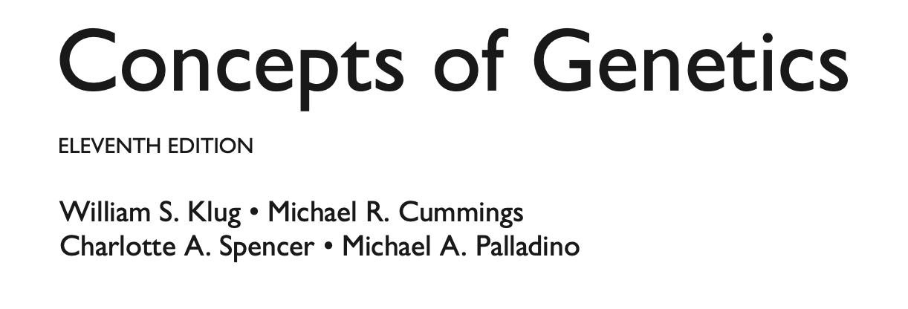

Slide 40
http://www.wiley.com/college/pratt/0471393878/student/animations/dna_replication/

