Slide 1
Week-3 Pharmacotherapeutics of the Digestive System

Slide 2
Salivary stimulants
Reflex acting
Aromatic bitterers
Jensiane powder
Citrus peel extract
Strychnos seed powder
Directly acting
Arecholine
Pilocarpine
Carbacole

Slide 3
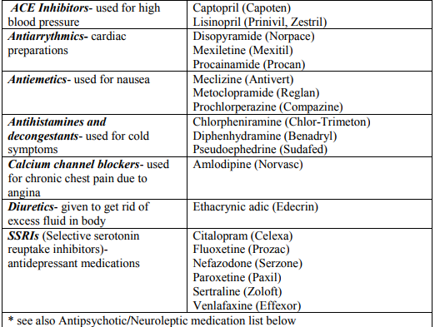
Salivary deppressants
Cause dry mouth-xerostomia
Parasympatholytics
Atropine
Caoline

Slide 4
Appetite
Stimulants
Benzodiazepine (alfazepame, Diazepame, chlordiazepside)
Anticonvulsants (gabapentine, pregabaline)
Antideppressants- Seratonine receptor blockers(S1A-R)- mirtozopine, amitriptyline
Antipsychotics (olanzapine, quetiapine)
Anabolic steroids (oxandrolone)
Cannabinoids (dronabiol)
Corticosteroids (Dexamethasone, prednisone, hydrocortisone)
Pregnane steroids (megestrol, medroxyprogesterone)
Prokinetics- Metaclopromide
Hydrazine sulfate (bloks glyconeogenesis)
Some vitamines (A and B), anabolic substances
Reflex stimulants (stryknine, jensiane)

Slide 5
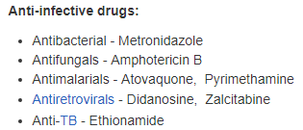
Appetite
Deppressants
Adrenergic drugs (alpha 1 and beta 2)
amphetamine, dopamine, ephedrine, fendimetrazine, fenylpropanolamine, fentermine, mazindole, diethylpropion
Selective seratonin reptake inhibitors (fluoxetine, fenfluramine, dexfenfluramine)
Seratonin reuptake inhibitor (sibutramine)

Slide 6
Esophageal Obstruction
Esophageal obstruction (choke) occurs when the esophagus is obstructed by food or foreign object
Parasympatomimetics are contraindicated since they increase spasms
Seratonine receptor blockers (ketanserine, ritanserine- 5HT2)
Neuroleptics
Specific spasmolytic drugs: acepromazine may be used (0.05–0.1 mg/kg, IV, IM, or SC in cattle). Low dose of xylazine (0.05 mg/kg, IM in cattle) or detomidine (0.02–0.05 mg/kg, IM in cattle)

Slide 7
Stimulation of acid secretion
Translocation - H+/K+-ATPases - apical membrane of the parietal cell.
Rest (not stimulated)- H+/K+-ATPases - vesicles inside the cell.
Stimulated- vesicles fuse with the plasma membrane- increase the surface area of the plasma membrane + number of proton pumps in the membrane.
Regulatory molecules
For stimulation of acid secretion = acetylcholine, histamine, gastrin
For inhibition= somatostatin.

Slide 8
Stimulation of acid secretion
AcH- neurotransmitter- enteric neurons.
Histamine - paracrine - released from enterochromaffin-like cells.
Gastrin - hormone - released by G cells (endocrine cells that are located in the gastric epithelium).
Somatostatin - endocrine cells of the gastric epithelium (act as either a paracrine or a hormone).

Slide 9
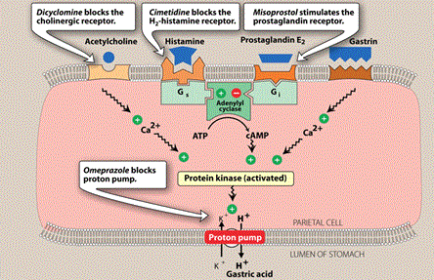
Stimulation of acid secretion

Slide 10
H2 antagonists- H2RA- H2 blockers
Block the action of histamine at the histamine H2 receptors of the parietal cells in the stomach.
This decreases the production of stomach acid.
H2 antagonists can be used in the treatment of dyspepsia, peptic ulcers

Slide 11
H2 antagonists- H2RA- H2 blockers
Cimetidine, ranitidine, famotidine, nizatidine, muzolimine
Ranitidine, X 3–13 ED50 cimetidine
Famotidine X 20–150 ED50 cimetidine
Also strengthens - gastric mucosal defenses - enhances cytoprotection.
Cimetidine- inhibition of CYPs(microsomal enzyme activity)- reduction of the metabolism (warfarin, phenytoin, lidocaine, metronidazole, theophylline) (inhibition by ranitidine is low; famotidine almost no effect)
Cimetidine – dogs- 3–5 hr (inh. Gastric acid secr).
Ranitidine – dogs- 8 hr
Famotidine- longer (adm once a day).
Oral bioavailability low- large dose required

Slide 12
Proton Pump Inhibitors
Irreversibly block the H+/K+-ATPase proton pump - gastric parietal cell.
Deactivation of the proton pump
Inactive form- neutrally charged (lipophilic)-activated parietal cells- readily crosses cell membranes into intracellular compartments (like the parietal cell canaliculus) that have acidic environments- concentrate
Acid-catalyzed cleavage of a chiral sulfoxide bond (except esomeprazole and dexlansoprazole which are nonchiral) into active sulfenic acid and/or sulfonamide.
Irriversibly bind covalently to cysteine residues on the H+/K+ ATPase- inhibit acid secretion until replacement pumps can be synthesized

Slide 13
Proton Pump Inhibitors
In dogs and horses- single dose of omeprazole- inhibition of acid secretion for 3–4 days- accumulation of the drug in parietal cell canaliculi + irreversible nature of proton pump inhibition.
Human formulations are used in dogs and cats.
Adverse effects: hypergastrinemia (mucosal cell hyperplasia), hypertrophy of the gastric rugae, development of carcinoids, acute renal failure, disorders of calcium homeostasis, exacerbate NSAID-induced intestinal - contraindicated for chronic therapy.
Omeprazole is also a microsomal enzyme inhibitor (CYP2C19)

Slide 14
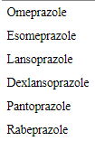
Proton Pump Inhibitors
All currently approved PPIs are benzimidazole derivatives: heterocyclic organic molecules that include both a pyridine and benzimidazole moiety linked by a methylsulfinyl group.

Slide 15
PG Analogues
Decrease acid secretion, increase mucus and bicarbonate secretion, decreased vascular permeability, and increased cellular proliferation and migration
PGE1, PGE2 and PGI2
Rizoprostil
Misoprostol (ecbolic effect)
Enprostil
Arboprostil
Trimoprostil

Slide 16
Misoprostol
Synthetic prostaglandin E1 analogue
Dogs to reduce the risk of GI ulcers- chronic NSAID therapy.
Suppresses gastric acid secretion- inhibition of the activation of histamine-sensitive adenylate cyclase.
Adverse effects: diarrhea and flatulence.
Contraindicated in pregnant dogs-ecbolic

Slide 17
Antiacids
Neutralizes stomach acidity and is used to relieve heartburn, indigestion or an upset stomach
Treat the symptoms of too much stomach acid such as stomach upset, heartburn, and acid indigestion.
Relieve symptoms of extra gas such as belching, bloating, and feelings of pressure/discomfort in the stomach/gut.

Slide 18
Antiacids
Common antacids- bases of aluminum, magnesium, or calcium (aluminum hydroxide, magnesium oxide or hydroxide, and calcium carbonate).
Neutralize stomach acid - form water and a neutral salt.
Not absorbed systemically.
Decrease pepsin activity-bind bile acids in the stomach and stimulate local prostaglandin (PGE₁) production.
magnesium hydroxide and aluminum hydroxide combination=optimal buffer
Renal insufficiency- hypermagnesemia (caution)
Interfere drugs (eg, digoxin, tetracyclines, fluoroquinolones).
Aluminum-containing antacids- impair absorption of phosphate.
Constipating effect
Laxative effect

Slide 19
Helicobacter pylori- Combo treat
- Amoxycilline
Clarithromycine
Metronidazole
PPI
-omeprasole
-lansoprasole
-pantoprasole
Bizmuth subsalicylate or subcitrate
sometimes
2 from here (sometimes tetracycline)
1 from here

Slide 20
Sucralfate
Antiulcerative
Cytoprotective effect - GI mucosa.
Disassociates-acid environment- to sucrose octasulfate and aluminum hydroxide.
Prevention of “back diffusion” of hydrogen ions, inactivates pepsin, and adsorbs bile acid.
Increases the mucosal synthesis of prostaglandins
No adverse effects.
polymerizes to a viscous, sticky substance
creates a protective effect by binding to ulcerated mucosa.

Slide 21
Ruminotorics
Promote forestomach function (fermentation and motility)
Glucogenic substrates, minerals, cofactors, and bitters (eg, nux vomica) have limited application in current therapy of ruminoreticular indigestion.
Physiologic approach- better.
Magnesium oxide or magnesium hydroxide- significant decrease in rumen fermentation and a decrease in number of rumen protozoa.
Mineral oil (1–2 L) or dioctyl sodium sulfosuccinate (DSS, 90–120 mL in 1–2 L of water) administered PO or via nasogastric tube followed by gentle ruminal massage can help promote the dissolution and passage of impacted fibrous ruminal omasal or abomasal contents.
Fresh ruminal fluid is considered to be the best available “ruminotoric»

Slide 22
Antifoaming Agents
Acute frothy bloat - reduce foam stability and to promote release of free gas,
Poloxalene-drench or by stomach tube (25–50 g) Prevention as as a top dressing to feed (1 g/45 kg body wt/day).
Polymerized methyl silicone
Docusate sodium in emulsified soybean oil
Vegetable oils alone (peanut oil, sunflower oil, or soybean oil)
Ionophores (such as monensin) in the ration / controlled-release capsules.

Slide 23
Ruminoreticular Acidifying Agents
Treatment of
Ruminal stasis (intraruminal pH >7.5)
Acute ammonia poisoning (increases the activity of urease and facilitates the absorption of free ammonia)
Administration of weak acids- cold water- return the pH of ruminoreticular content toward physiologic levels, promotes the uptake of volatile fatty acids, depresses the absorption of ammonia, and inhibits excessive urease activity.
Acetic acid (4%–5%) or vinegar (cattle: 4–8 L; sheep: 250–500 mL)
Lactic acid, proprionic acid, ortophosphoric acid, betaine

Slide 24
Ruminoreticular Antacids
Treatment of ruminal lactic acidosis (pH <5.5) -grain engorgement or soluble carbohydrate overload.
Correction of fluid and electrolyte balance and restoration of a viable microbial population.
Magnesium hydroxide (cattle: 100–300 g; sheep: 10–30 g) and magnesium carbonate (cattle: 10–80 g; sheep: 1–8 g).
Antacids ~10 L warm water
PO of activated charcoal (2 g/kg) - inactivating toxins.
Sodium bicarbonate (baking soda)- accompanied by rapid release of large amounts of CO₂.
Decreased rumen motility+ acute rumen acidosis, -increased risk- life-threatening free gas bloat.

Slide 25
Modulators of Ruminoreticular Motility
Cholinergics (parasympathomimetics- neostigmine, physostigmine, bethanechol),
Adrenergics, antidopaminergics, serotonergics, motilin agonists, opioid receptor blockers, or sodium channel blockers (lidocaine).

Slide 26
Emetics
Drugs inducing vomiting
Centrally acting (act on chemoreceptor trigger zone)
Apomorphine
Morphine der. Semisynthetic, dopaminergic agonist in CTZ, respiratory depression
Prostaglandine F2α
Xylazine
Reflex acting
Sodium chloride
Sodium carbonate
Cupper sulfate
Zinc sulfate
Mustard
Digital powder
Asprin
Hydrogen peroxide
Both reflex and centered
Ipecacuancha (Cephalepsis ipecacuanha)

Slide 27
Do not induce emesis
Corrosive poisoning (acid/alkali)
CNS stimulant poisoning
Unconscious animals
Morphine and phenothiazine poisoning
Rodent, horse, cattle
Halogenated compound poisoning
After 2 hours post ingestion

Slide 28
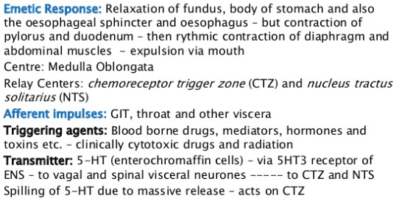
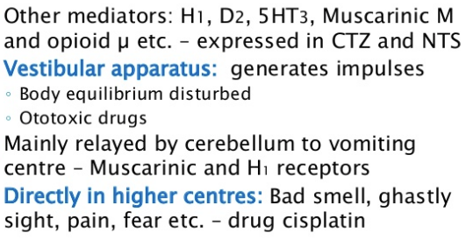
Antiemetics
Drug that is effective against vomiting and nausea.
Treat motion sickness and the side effects of opioid analgesics, general anaesthetics, antipsychotic medication, severe cases of gastroenteritis and chemotherapy directed against cancer.

Slide 29
Antiemetics
1. Protectors of gastric mucosa
Diluted glycerine
Gum (arabic gum)
Carboxylmethylcellulose
Licoriche root (Glycyrrhiza glabra)
Propylene glycol
Dextrose
2. Local Acting Antiemetics
Antiacids (magnesium oxide, magnesium carbonate, sodium bicarbonate, calcium carbonate)
Inert covering substances (pectine, caoline and bismuth salts)
Local neuronal deppressants (benzocaine, ametocaine, menthol)
3. Central Acting
Sedative-hipnotics
Cloralhydrate
Barbiturates
Sodium bromide
Potassium bromide
Ammonium bromide
Cloretone
Tranqulisants
Antihistaminics
Glycocorticoids
Dopamine antagonits
Metaclopromide
Cisapride
Haloperidole
Domperidone
Droperidole
Fenothiazine derivate neuroleptics
Seratonine antagonists
Andosterone
Dolasetrone
Granisetrone
Ciproheptadine

Slide 30
Antiemetic
Anticholinergics: Hyocine, Dicyclomine
H1 antihistminics: Diphenhydramide, doxylamine, cyclizine, meclizine, cinnarazine, promethazine, dimenhydrinate
Neuroleptics (D2 blockers): (Phenothiazine- acepromazine, chlorpromazine, prochlorperazine, haloperidole
Prokinetics: metoclopramide, domperidone, cisapride, mosapride, tegaserod
5HT3 antagonists: onsansetron, granisetron, dolasetron
Glycocorticoids (betametasone, dexamethasone)
Cannabinoids (Dronabiol)
NK1 receptor antagonists (substance P antg)- aprepitant, maropitant

Slide 31
Motion sickness
Neuroleptics
Acepromazine
Chlorpromazine
Triflupromazine
Triethylperazine
Droperidole
Haloperidole
Pimozide
Atropin like drugs (atropine, propantheline)
Antihistaminics (dimenhydrinate, diphenhydramine, promethasine)
Substance P receptor antagonists (aprepitant, maropitant)
Dopamine antagonists (methylchlopromide, domperidone, trimethobenzamide)

Slide 32
Digestives
Sodium chloride
Sodium sulphate
Synthetic carlsbad salt
Pepsin
Pancreatic enzymes
Pankreatine
Pankrelipase
Prokinetics

Slide 33
Prokinetics (gastroprokinetic agent, gastrokinetic)
Enhances gastrointestinal motility by increasing the frequency of contractions in the intestine or making them stronger, but without disrupting their rhythm
Gastro-esophageal reflux (in some instances), gastroparesis, intestinal pseudo-obstruction, and colonic inertia.

Slide 34
Prokinetics
Metaclopromide
Domperidone
Cisapride
Mosaprid
Tegaserid
Opioid antagonists (aluimopan, methylantrexone)
Motilin
Pentagastrine
Histamin 2 receptor blockers
Trimethobenzamide
Betasole and histamin acid phosphate
Lidocaine
Erythromycine
Parasympathomimetics (carbamylcholine, physistigmine, neostigmine, arecholine)

Slide 35
Metochlopromide
Dopaminergic antagonist (D2)
5-HT3 receptor antagonist
5-HT4 receptor agonist
increases intrinsic acetylcholine release
increase receptor sensitivity to ACh R
Stimulates and coordinates esophageal, gastric, pyloric, and duodenal motor activity.
Increases lower esophageal sphincter tone and stimulates gastric contractions, while relaxing the pylorus and duodenum.
Speeds gastric emptying of liquids but may slow the emptying of solids
Antiemetics (chemotherapy, parvoviral enteritis) gastroesophageal reflux and postoperative ileus.

Slide 36
Cisapride
Does not cross the blood-brain barrier or have antidopaminergic effects.
No antiemetic action or cause extrapyramidal effects (extreme CNS stimulation).
Serotonin 5-HT4 agonist with some 5-HT3 antagonist activity
Increased GI motility and increased heart rate.
Also increase motility of the colon, as well as that of the esophagus, stomach, and small intestine.
Gastric stasis, idiopathic constipation, and postoperative ileus in dogs and cats.

Slide 37
Domperidone
Peripheral dopamine receptor antagonist
Agalactia
Motility of gastric and small-intestinal smooth muscle and has some effect on esophageal motility.
Antiemetic
Relatively safe

Slide 38
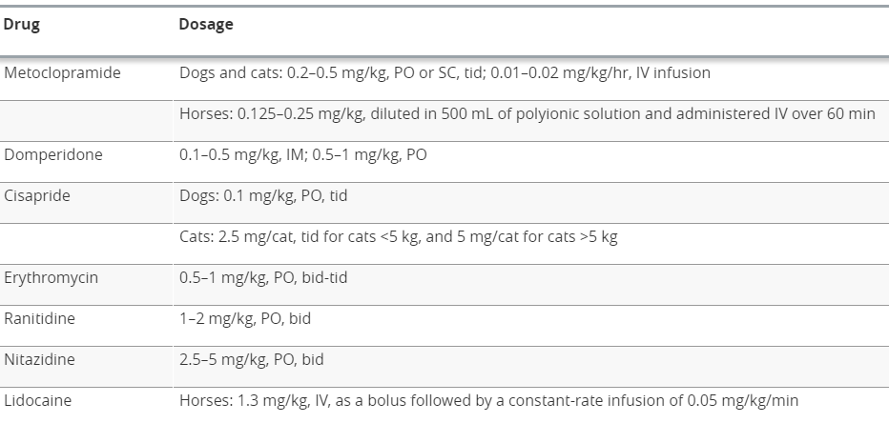

Slide 39
Mild diarrheal-laxative
Medium diarrheal- purgative, cathartic
Strong diarrheal- drastics

Slide 40
Diarrheal drugs
1. Oil-Mechanic stimulants
Liquid parafine
Dioctylsulfosuxinate
2. Intestinal volume increasing
Simple volume increasers
Agar-agar
Sorbitol
Mannitol
Methylcellulose
Carboxymethylcellulose
Brab
Psylium
Lactulose
Salt based stimulants
Magnesium sulphate (Epson salt)
Sodium sulphate (Glauber salt)
Sodium phosphate
Potasium sodium tartarate (Rochella salt)

Slide 41
Diarrheal drugs
3. Irritants
Direct acting
Diphenylmethane derivate
Phenolphthalein
Bisacodyl
Plant oils
Glycerine
Lax seed oil
Olive oil
Other (cotton, corn, almond, nut)
Mercuric compounds
Calomel
Metalic mercury
Other (liquoriche and Grey powder)
Sulphur
Indirect acting (Antraquinone, antracene or emodine)
Dantrone (synthetic antracene)
Senna leaf (emodine, cryzophanic acid, catartin acid, antraglycoside)
Ravend rhizome (Emodine, cryzofanic acid)
Aloes (aloin)
Cascara sagrada (rhamnin)
Drastic resin
Podophillin (calomel vegetale)
Calopa tuberi (Recine de jalap)
Gamboge (Cambogia)
Barium chloride
Croton oil
4. Parasympathomimetics
Arecholine
Carbacol
Physostigmine
Neostigmine

Slide 42
Cathartics and laxatives
Laxatives, purgatives, or aperients are substances that loosen stools and/or increase bowel movements.
Cathartics and laxatives increase the motility of the intestine or increase the bulk of feces.

Slide 43
Cathartics
1. Stimulant cathartics
to stimulate intestinal motility via an irritant effect on the mucosa or stimulation of intramural nerve plexi
Emodine
Vegetable oils
Senna
Bisacodyl
2. Hyperosmotic cathartics
Poorly absorbed in GI- draw fluid
Magnesium salt, sodiım salts, sugar alcohol, polyethylene glycol

Slide 44
Laxatives
1. Bulk (hydrophilic colloid)
Use fiber-draw water
Carbohydrate (corn, soybean, rice hull, peanut
Cellulose, hemicellulose, peçtin, gums, resistent starch
2. Lubricant
Coat the surface of the feces-water-immiscible film,increase water content
Mineral oil, white petroleum
Hairball-cat

Slide 45
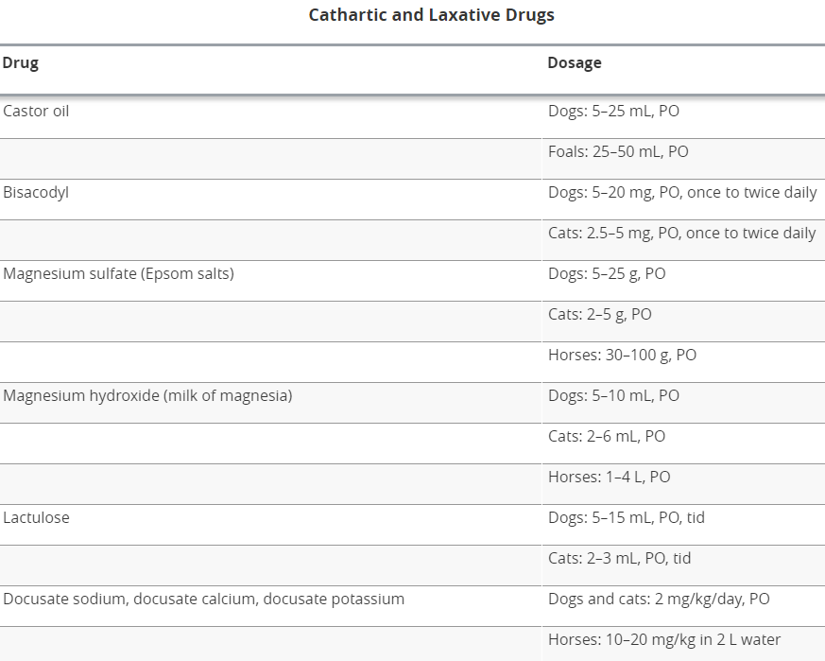

Slide 46
Fecal softeners (Surfactants)
Docusate sodium, docusate calcium, docusate potassium
Salts - decrease surface tension and allow water to accumulate in the feces.

Slide 47
Antidiarrheals
Chemotherapeutics (antibiotics, anthelmintics, antiprotozoer drugs)
Surface (activated carbon, chaoline)
Protectants (bismuth sulbsalycilate, bismuth subcarbonate, pectine, tannic acid)
Spasm relievers (morphine, diphenoxylate, loperamide, atropine)
Astringents (tannic acid)
Water-electrolytes
Other (clorpromazine, clonidine, asprine, indomethasine, flunixine)
Pre/probiotics
Antimicrobials

Slide 48
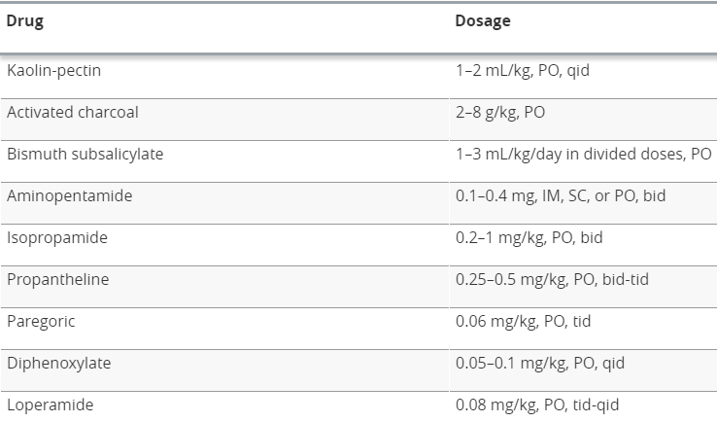
Antidiarhheals
Motility decreasing
Opiats
Loperamide (beware of Collies)
Dephenoxylate (stimulation in cats)
Codein
Opium tincture
Hyosine-N-buthyl bromide
Detomidine
Xylasine
Adsorbants
Activated charcaol
Universal antidote
Kaolin-pectin
Methylcellulose
Magnesium aluminium silicate
Alter water-electrolyte transport
NSAID (PG synthetase inhibitors)
Bismuth subsalycilate

Slide 49
Adsorbants
Activated charcoal
Form of carbon processed to have small, low-volume pores that increase the surface area available for adsorption or chemical reactions.
1-3 g/kg
Carbon vegetale+Carbon animale
Universal antidote (2X activated charcoal, 1X tannic acid, 1X magnesium oxide)
Caolin- natural liquid aluminium silicate
Pectin- naturally occurring substance (a polyscaccaride) found in berries, apples and other fruit (usually apple grind/citrus peel)

Slide 50
Carminatives
Volatile oil containing
Anise seed, red pepper, ginger root powder
Pure volatile oil
Terebynth essence, minth essence
Volatile oil substrate
Menthol, stearopen
S2-R antagonits
Ketanserine, Mianserine
Other
Ether, Chloroform, alcohol, ammonia

Slide 51
Spasm relievers
Atropin (atropin, metanserlin, methylatropine, hyosine-N-buthylbromide)
Opioids (meperidine, morphine, papaverine, pentazosine, oxymorphone)
Neuroleptics (promazine)
Smooth muscle direct acting relaxants (papaverine)
Antinociceptives (flunixine, xylasine)

