Slide 1
Polymer Technology
Chapter 8
Solid-State Properties

Slide 2
Solid-State Properties The Crystalline State Ordering of Polymer Chains
Atactic polyvinyl alcohol (PVC) can bepartly crystalline because of the occurrence of specific interchain interactions, which is the hydrogen bonding.
The specific interactions between the chains are particularly cruical in enhancing the crystallinity of the macromolecule.
Both tacticity and geometric isomerism may favor crystallinity.
As an example, cis-polyisoprene is amorphous; onthe other hand, more easily packed trans-polyisoprene is crystalline.
Most of time, tactic plastics with their more stereoregular chain structures are more likely to be crystalline than their atactic counterparts.
As an example, isotactic polystyrene is crystalline; on the other hand, commercial-grade atactic polystyrene is amorphous.

Slide 3
Solid-State Properties The Crystalline State Crystalline-Melting Temperature
According to the first law of thermodynamics, the free energy of melting per repeating unit of the plastics, ΔGu, can be expressed as
In which ∆Hu and ∆Su are the enthalpy and entropy of melting per repeating unit, respectively. At the equilibrium melting temperature, ΔGu is equal to zero and, hence:

Slide 4
Solid-State Properties The Crystalline State Crystallization Kinetics
For a specified macromolecule, the extent of crystallization attained during melt processing depends on the rate of crystallization and the time during which the melt temperatures are reached.
Above the melting temperature, certain lastics that have low crystallization rates, like poly(ethylene terephthalate), polycaprolactone, and nylon-6,6, can be quenched rapidly enough to obtain the amorphous state.
Other plastics with higher crystallization rates , like polyethylene, can not be quenched quickly enough to hinder the crystallization.
For a specified plastic, the crystallization rate depends on the crystallization temperature of the macromolecule.
The crystallization rate can be followed by a variety of methods, like dilatometric measurement of volume changes, infrared spectroscopy, and optical-microscopic measurement of the growth of spherulite radii with time.

Slide 5
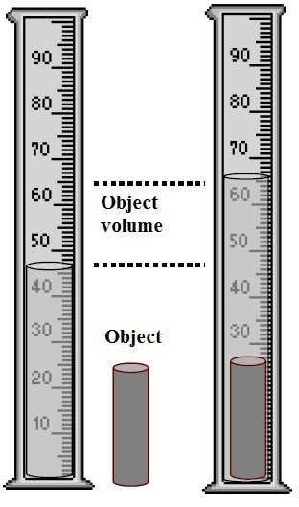
Solid-State Properties The Crystalline State Crystallization Kinetics
The fractional crystallinity of a macromolecule or platic can be calculated or determined by a variety of techniques, including infrared spectroscopy, density, X-ray diffraction measurements and by calorimetric methods.
Density Measurements: Density can be measured at some standard temperature like 23°C by means of a calibrated density-gradient column as shown in the figure on the right.
After the density (ρ) of the semicrystalline sample has been measured, the fractional crystallinity, ø, can be calculated using the following equation

Slide 6
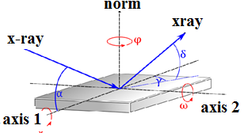
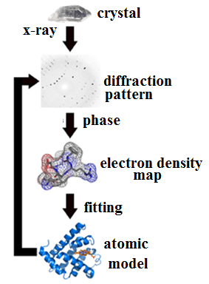
Solid-State Properties The Crystalline State Techniques to Determine Crystallinity
X-Ray Diffraction: X-ray diffraction technique is a widely used method to characterize polymer.
This technique provides information concerning both the crystalline and amorphous states of the macromolecule.
X-rays are high-energy photons, which have short wavelengths and high energy with a wavelength ranging from 0.5 to 2.5 Å.
X-rays may interact with electrons.
When the X-ray beam is focused on a specified material, certain part of the beam will be absorbed, certain part of the beam will be transmitted unmodified, while others will be scattered due to interaction with electrons.
This interaction results in a scattering pattern, a function of the scattering angle.

Slide 7
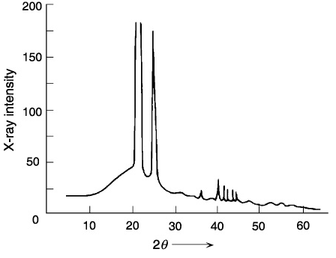
Solid-State Properties The Crystalline State Techniques to Determine Crystallinity
X-ray diffraction pattern is utilized to determine the fractional crystallinity as well as crystalline dimensions withi the macromolecule.
An example of a X-ray diffraction pattern of a highly crystalline polymer is shown in Figure 1 on the right.
As shown on the given figure, there is an appearance of several large, narrow peaks positioned upon a broad background pattern, due to scattering from amorphous regions.
The peaks illustrate scattering from well-defined crystalline regions having regular spacing.
Figure 1 X-ray diffraction pattern of high-density polyethylene

Slide 8
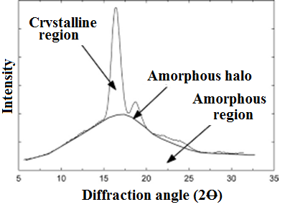
Solid-State Properties The Crystalline State Techniques to Determine Crystallinity
In certain cases, the fractional crystallinity can be determine or calculated by comparing the intensity or height of the amorphous halo (I_{am}) of the crystalline plastics with the intensity (I_{am}º) of a totally amorphous plastic, which can be obtained by rapid quenching from the melt
in which w_{c} is the weight fraction of the crystalline phase within the macromolecule.
The remainin part will be the weight fraction of the amorphous phase.

Slide 9
Solid-State Properties Measurement Techniques
Different experimental techniques can be used to determine or to calculatethe glass-transition and crystalline-melting temperatures in plastics.
As an example, the thermal transitions can be obtained with the dilatometry technique and, especially, with the differential scanning calorimetry technique (DSC).
Another important technique to detect the thermal transitions is recording the response to a cyclical strain with the dynamic-mechanical analysis or electric voltage with the dielectric spectroscopy.
The glass transition temperature and the melt transition temperature can also be detected by measurement of modulus as a function of temperature in tensile test, stress relaxation test, and other mechanical test.

Slide 10
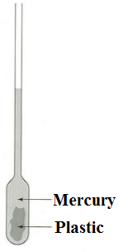
Solid-State Properties Measurement Techniques Dilatometry
The dilatometry is one of the earliest methods used to determine the thermal transitions.
A small sample of plastic is placed into a glass bulb to which a precision-bored, calibrated glass capillary is attached.
Mercury is used to fill the bulb and part of the capillary.
Then, the dilatometer is immersed in a controlled-temperature bath and the height of the mercury in the capillary is noted at different temperatures.
The heating rate is normally kept very small almost 1° to 2° min⁻¹ to ensure thermal equilibrium, especially near the glass transition temperature.
By using this information, the specific volume of the plastic sample can be calclated as a function of the temperature.

Slide 11
Solid-State Properties Measurement Techniques Calorimetry
One of the most widely used methods to determine the glass transition temperature and the melting temperture is differential scanning calorimetry (DSC) technique.
The differential scanning calorimetry method utilize individual heaters to maintain identical temperatures for two small platinum holders, one of which contains a small polymer sample almost 20 mg within a small aluminum pan, and the other platinum holder contains an empty pan, which is the reference.
The temperatures are recorded by use of identical platinum-resistance thermistors.
The differential power needed to maintain both the reference pan and the plastic sample pan at equal temperatures during a programmed heating cycle is noted as a function of temperature.

Slide 12
References
Robert O. Ebewele, «POLYMER SCIENCE AND TECHNOLOGY», CRC Press, 2000.
Fried, Joel R., «Polymer science and technology», Prentice Hall, Third edition.

