Slide 1
MEDICAL STUDENT AND LIFELONG LEARNING
Dr. İpek Gönüllü

Slide 2
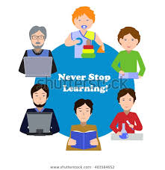
Course content
Learning
Metacognition
Adult Learning
Lifelong learning
Medical student and lifelong learning as a physician

Slide 3
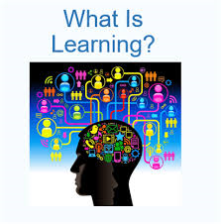

Slide 4
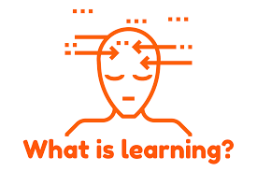
What is learning?
Learning defines as a changing process which evolves as a result of the trainee's experience and their communication with others.
(Driscoll, 2005)

Slide 5
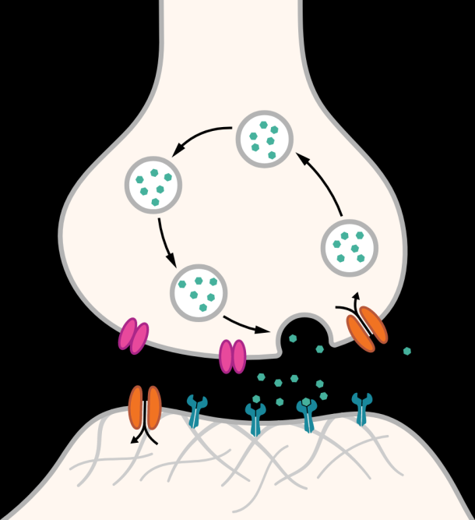
What is learning?
Learning takes place through protein chains formed by biochemical processes in the brain as a result of information repetition and experiences. This process reveals new synaptic bonds between neurons.

Slide 6
What is learning?
“A change in human disposition or capability that persists over a period of time and is not simply ascribable to processes of growth.” — From The Conditions of Learning by Robert Gagne
“The process of gaining knowledge and expertise.” – From The Adult Learner by Malcolm Knowles

Slide 7
What is learning?
“A process that leads to change, which occurs as a result of experience and increases the potential of improved performance and future learning.” – From How Learning Works: Seven Research-Based Principles for
Smart Teaching by Susan Ambrose, et al.

Slide 8
What is learning?
“It has been suggested that the term learning defies precise definition because it is put to multiple uses. Learning is used to refer to
(1) the acquisition and mastery of what is already known about something,
(2) the extension and clarification of meaning of one’s experience, or
(3) an organized, intentional process of testing ideas relevant to problems.
In other words, it is used to describe a product, a process, or a function.” –From Learning How to Learn: Applied Theory for Adults by R.M. Smith

Slide 9
What is learning?
Learning is a process that:
is active - process of engaging and manipulating objects, experiences, and conversations in order to build mental models of the world (Dewey, 1938; Piaget, 1964; Vygotsky, 1986).
builds on prior knowledge - and involves enriching, building on, and changing existing understanding, where “one’s knowledge base is a scaffold that supports the construction of all future learning” (Alexander, 1996, p. 89).

Slide 10
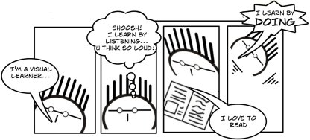
HOW DO YOU LEARN?

