Slide 1
BIO 206 PLANT MORPHOLOGY
LECTURE NOTES
13th WEEK
DR. AYDAN ACAR ŞAHİN

Slide 2
Fruit
= mature ovary/ovaries plus accessory parts (if any)
Accessory parts = structures other than ovary attached to fruit at maturity

Slide 3
Pericarp = fruit wall (mature ovary wall)
Pericarp layers
Endocarp = inner
Mesocarp = middle
Exocarp = outer
(Pericarp layers may not be present or may be only two)

Slide 4
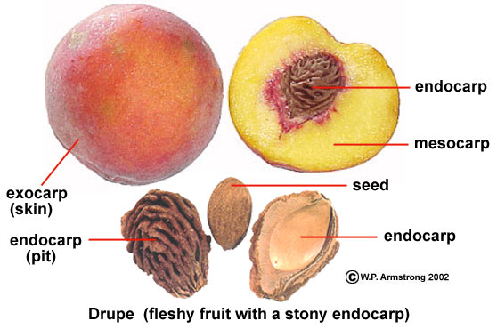

Slide 5
Fruit Classification based on:
1) Simple, aggregate, or multiple
Simple = from 1 ovary of 1 flower
Aggregate = from many ovaries of 1 flower
Multiple = from many ovaries of many fls.

Slide 6
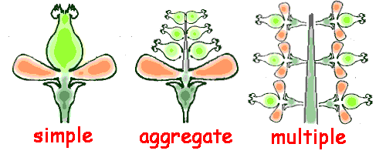

Slide 7
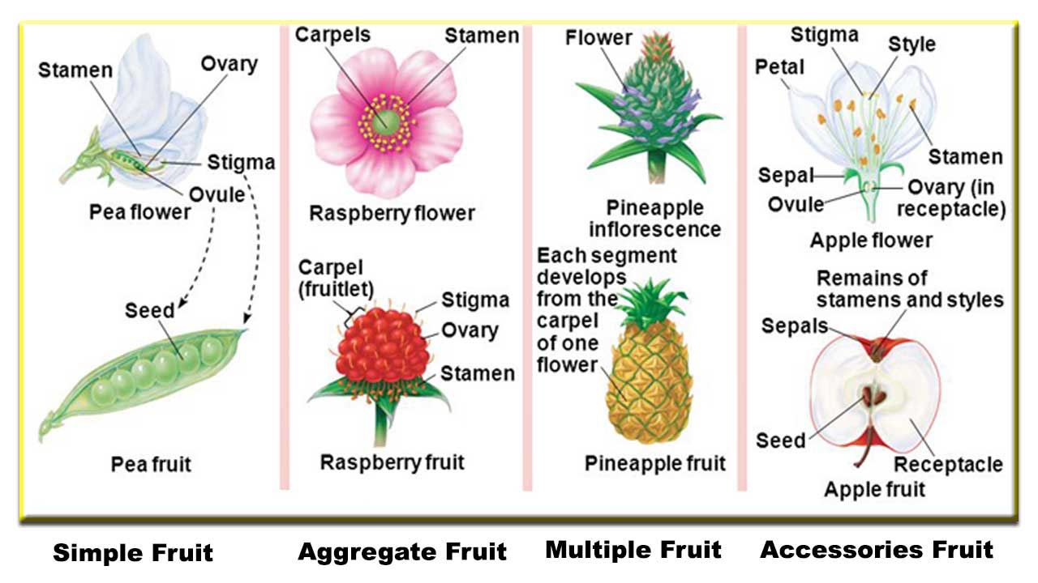

Slide 8
Fruit Classification based on:
2) Dry versus fleshy
3) If dry, dehiscent versus indehiscent
4) Other features: ovary position, pericarp layers, carpel number, locule number, seed number, placentation

Slide 9
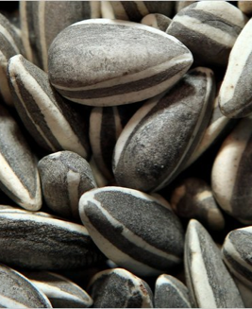
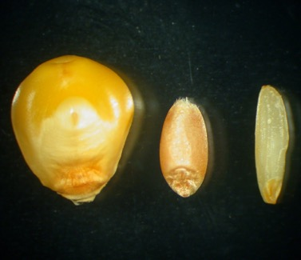
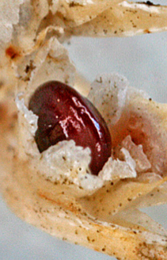
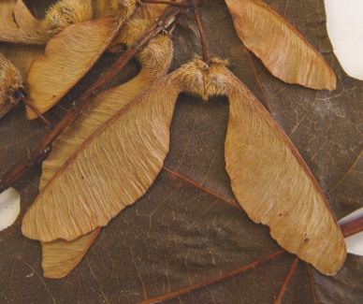
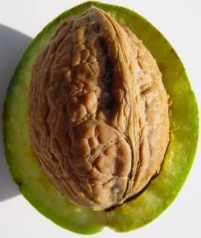
Simple dry, indehiscent fruit
achene -one-seeded,
dry, indehiscent fruit with seed attached to the pericarp at
one point only
grain /
caryopsis -one-seeded, dry,
indehiscent fruit with the seed coat adnate to pericarp wall
utricle -a small, bladdery or
inflated, one-seeded, dry fruit
samara -a winged, dry, usually indehiscent fruit
nut -a oneseeded,
dry indehiscent fruit with a hard pericarp

Slide 10
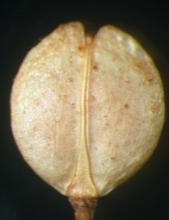
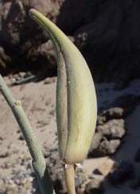
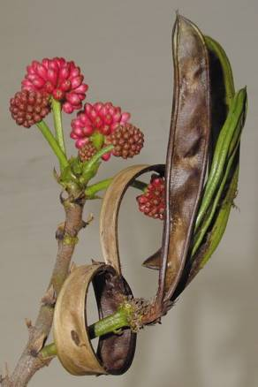
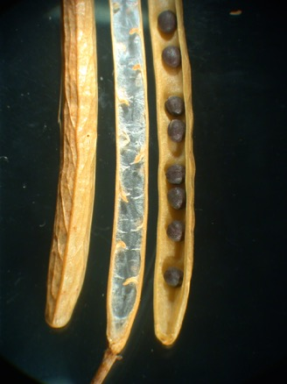
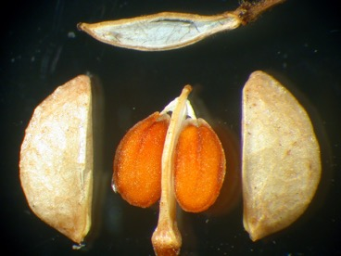
false
septum
follicle -a dry, dehiscent
fruit derived from one carpel that splits along one suture
legume -a dry, dehiscent
fruit derived from one carpel that splits along two longitudinal
sutures; diagnostic of Fabaceae
silique (long)
silicle (short)
-dry, dehiscent fruits derived from a 2-carpeled ovary that dehisces along two sutures with an outer rim, the replum, and a persistent, thin partition, the false septum

Slide 11
capsule -generally dry (rarely fleshy), dehiscent fruits
derived from compound (multicarpeled) ovaries
loculicidal
capsule -longitudinal lines of dehiscence radially aligned with the locules (or between the placentae, if septa absent)
septicidal
capsule -longitudinal lines of dehiscence radially aligned with the ovary septa (or with the placentae, if septa are absent)
circumscissile
capsule -with a transverse line of dehiscence, typically forming a terminal lid or operculum
poricidal
capsule -with dehiscence by means of pores, e.g., Papaver, poppy

Slide 12
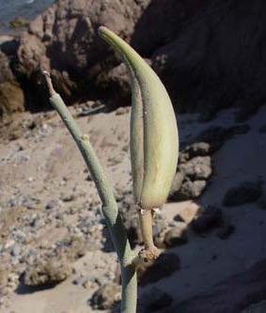
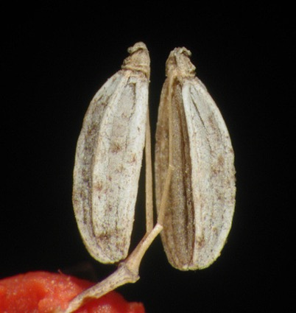
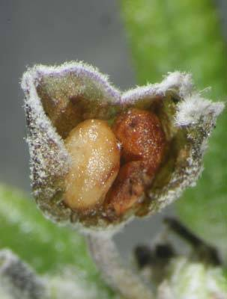
schizocarp of follicles -a fruit in which the (generally two) carpels of a pistil split at maturity, each carpel developing into a unit follicle, as in Asclepias, milkweed
schizocarp of mericarps -a fruit in which the carpels of a single ovary split during fruit maturation, each carpel developing into a unit mericarp, e.g., Apiaceae
schizocarp of nutlets -a fruit in which a single ovary becomes lobed during development, the lobes developing at maturity into nutlets, which split off. E.g., Boraginaceae, most Lamiaceae, which have gynobasic styles

Slide 13
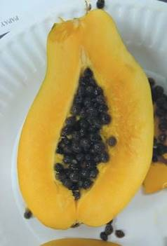
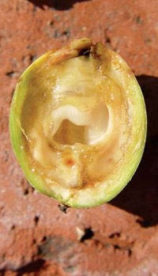
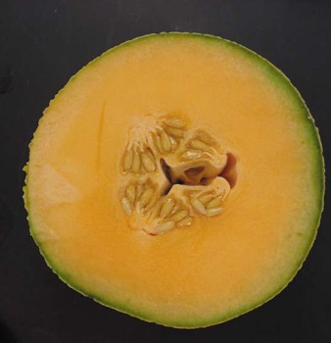
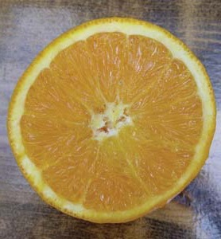
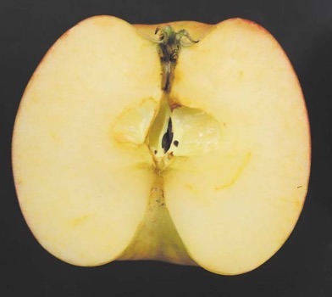
Simple fleshy fruit
berry -general, term for
a fruit with a succulent pericarp
pepo -nonseptate
fleshy fruit with parietal placentation and a leathery
exocarp derived from an inferior ovary, the fruit type of the
Cucurbitaceae.
hesperidium -a septate fleshy fruit
with a thick-skinned, leathery outer pericarp wall and fleshy
modified trichomes (juice sacs) arising from the inner walls, as
in Citrus
pome -a fleshy fruit with a cartilaginous endocarp derived from an inferior ovary, with most of the fleshy tissue derived from the outer, adnate hypanthial tissue, as in Malus (apple) and Pyrus (pear).
drupe -a fruit with a hard, stony endocarp and a fleshy mesocarp

Slide 14
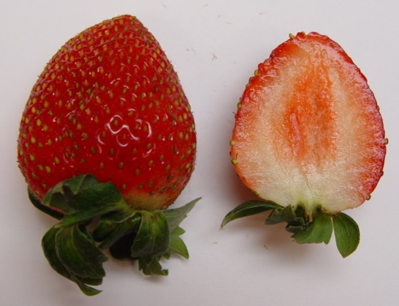
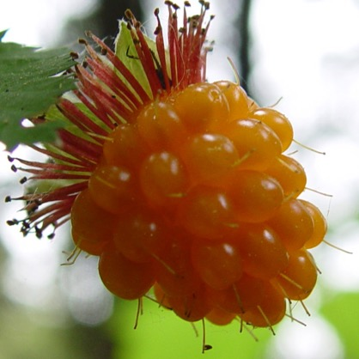
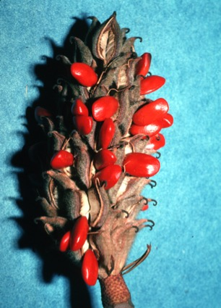
achenecetum -an aggregate fruit of achenes
(Fragaria sp., strawberry, Rosaceae)
drupecetum -an aggregate fruit of drupes
(Rubus sp., blackberry, Rosaceae)
follicetum -an aggregate fruit of follicles
(Magnolia sp., magnolia, Magnoliaceae)

Slide 15
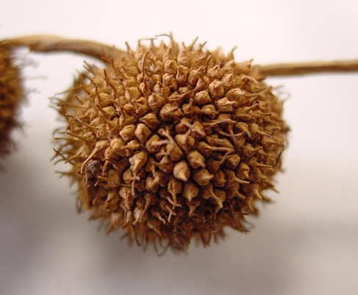
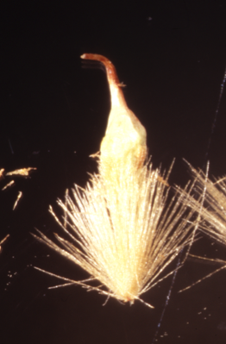
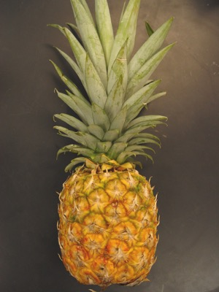
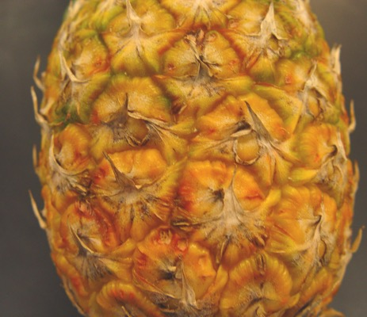
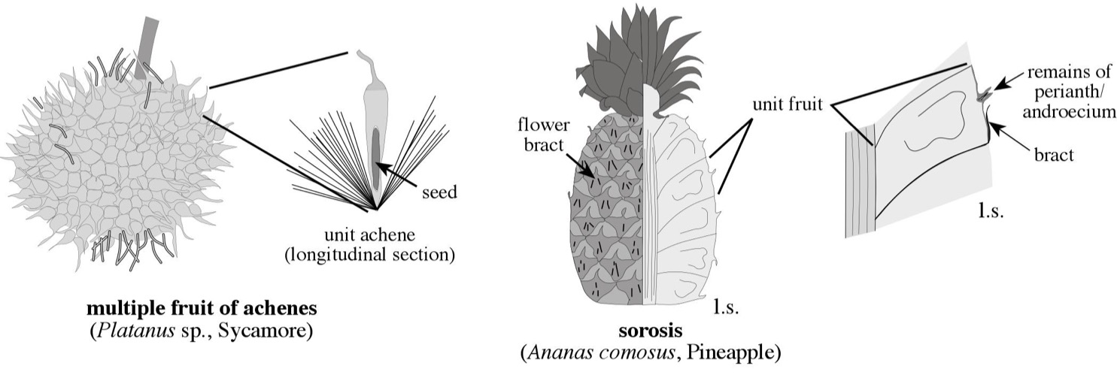
multiple fruit of achenes
(Platanus racemosa, sycamore, Platanaceae)
sorosis = multiple fruit of berries
(Ananas comosus, pineapple, Bromeliaceae)

Slide 16
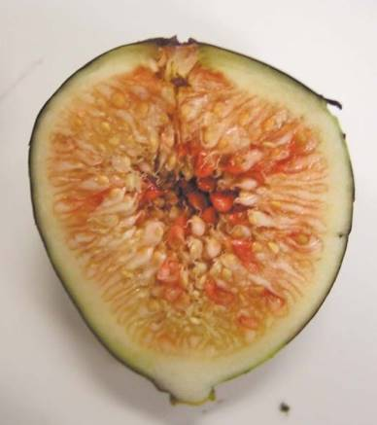
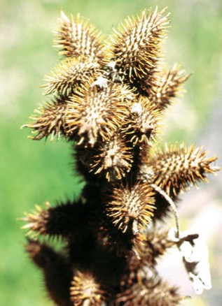
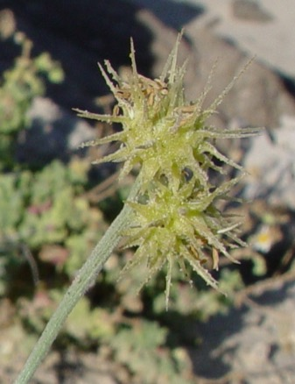
syconium -a multiple fruit in which unit fruits are small achenes covering the surface of a fleshy, inverted compound receptacle, as in Ficus, fig.
bur -a multiple fruit of achenes or grains surrounded
by a prickly involucre, such as in Cenchrus, sandbur
(Poaceae), or Xanthium, cocklebur (Asteraceae).

