Slide 1
BIO311 ACADEMIC PRESENTATION SKILLS
Assoc. Prof. Dr. Fadime Kıran
Assoc. Prof. Dr. İlker Büyük
Assist. Prof. Dr. Şeyda Fikirdeşici Ergen

Slide 2
Why Is Academic Research Important?
Academic research helps in the development of skills. It help students in their personal growth and reach a possible solution. A student learns how to identify a problem.

Slide 3
Materials Required in any Science Presentation
All science presentations basically consist of three components:
1. Scientific Content
2. Visual information
3. Delivery

Slide 4
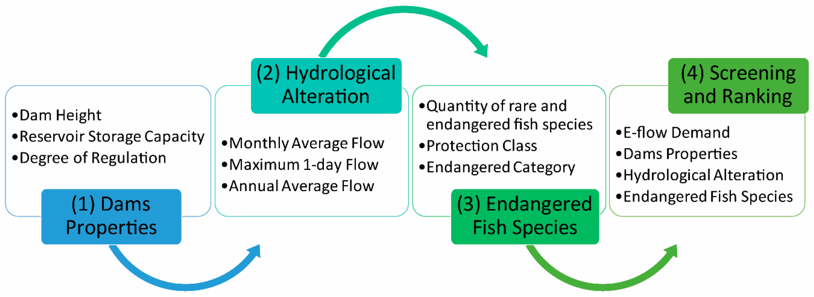
1. Scientific Content
You should choose the subject area.
For example

Slide 5
You should arrange a content brief including style, tone, and level of reader’s assumed knowledge

Slide 6
Any Scientist Can Be a Designer
2. Visual information
You should choose source material and design your presentation.

Slide 7
What is Design?
It is definitely about defining what effect you want to have on an audience and then establishing the best way to reach that objective.
What Design Is Not ?
It is not decoration.

Slide 8
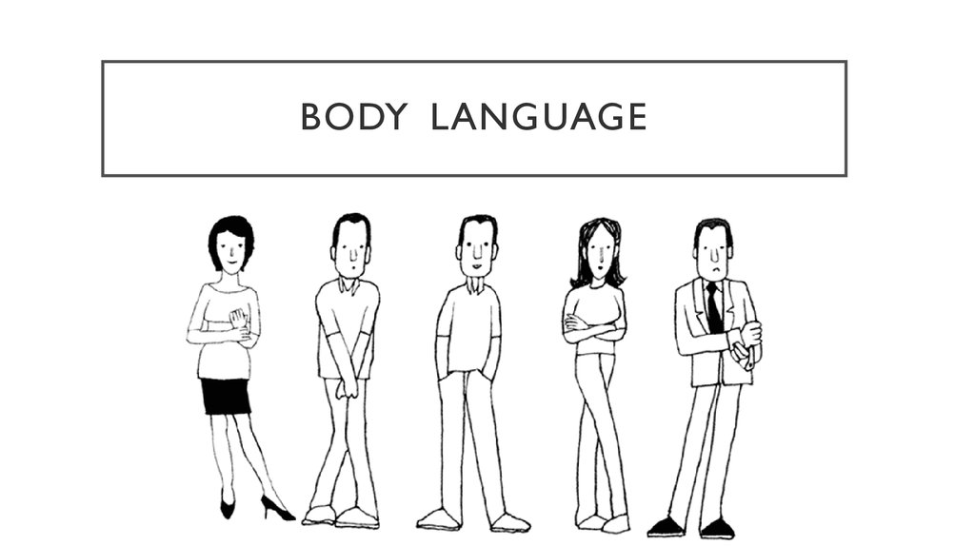
3. Delivery
Your narrative that leads the presentation of your visual information. In a slide presentation, you deliver your narrative orally and with body language.

Slide 9
References
Davis, M. 2005. Scientific Papers and Presentations, Revised Edition Elsevier
Wallwork, A. 2016. English for Presentations at International Conferences, Springer.
Carter, M. 2020. Designing Science Presentations, A Visual Guide to Figures, Papers, Slides, Posters, and More, Academic Press.

