Slide 1
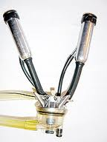
Milking Procedures
Clean udder of debris
Strip 3-4 squirts of milk from each quarter
a. Look for mastitis
b. Stimulation
Pre-dip
Dry teats
Attach milking unit
Automatic take-off
Post-dip teats

Slide 2
Mastitis
Mastitis is inflammation of the mammary gland.
Results when bacteria enter the mammary gland through the teat canal.
May be clinical or subclinical
Elevated SCC
Discolored, thick, bloody, clumpy or stringy milk
“flakes” in the milk

Slide 3
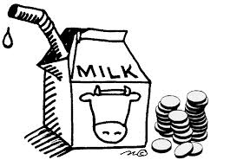
Cost of Mastitis
With each case of mastitis comes:
Lost production
Treatment costs
Milk withdrawal/discard
Loss of premiums
Impact on other body systems?
Cost of mastitis is ~$200/case

Slide 4
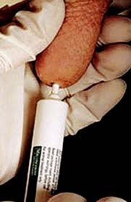
Two Classifications of Mastitis
Environmental
Klebsiella
E. coli
Streptococcus uberis
Strep. dysgalactiae
Contagious
Staphylococcus aureus
Strep agalactiae
Mycoplasma bovis

Slide 5
Sources of Contamination
Environmental
Dirty bedding
Dirty alleyways
Dirty animals
Overcrowding
Dirty hands
Dirty milking parlor
Dirty equipment
Contagious
Contracted from herdmates
Milk leaking in stalls
Milker squawks/liner slips
Dirty parlor equipment
Pre-Dip
Post-Dip

Slide 6
Detecting Mastitis
Inflamed quarter (hot, hard, swollen)
Decreased milk production
Change in consistency or color of milk
Elevated Somatic Cell Count (SCC)
White blood cells
Immune response to infection
California Mastitis Test (CMT)

Slide 7
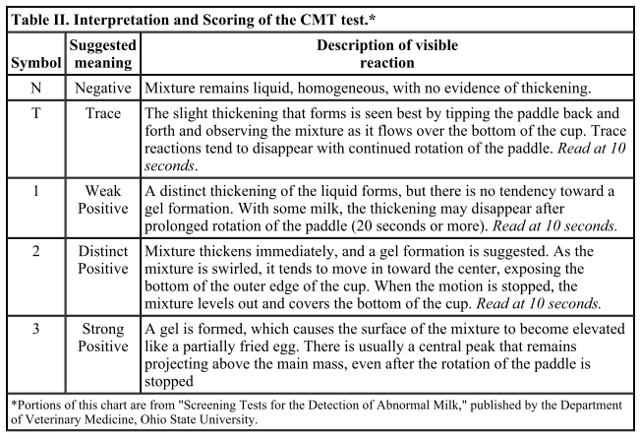
California Mastitis Test

Slide 8
California Mastitis Test

Slide 9
Somatic Cell Count
Linear Score | LogSCC (cells/ml)
1 | 25,000
2 | 50,000
3 | 100,000
4 | 200,000
5 | 400,000
6 | 800,000
7 | 1,600,000
Legal Limit in the U.S. is 750,000 cells/ml
Legal limit in Europe is 400,000 cells/ml
Infection level is >200,000 cells/ml
Herd bulk tank goal: <250,000 cells/ml

Slide 10
Why Do We Worry?
Cow Health and Welfare
Optimized Milk Production
Legal Limits – Marketable Products
Milk Co-op Premiums
Decreased Shelf-life
Decreased Cheese Yield

Slide 11
What Can We Do?
Supportive care
Intra-mammary Antibiotics
Each has specified milk and meat withdrawal
Milk cultures and sensitivity analysis
Dry cow therapy
Antibiotic and teat sealant
Good hygiene, proper milking procedures, teat dipping

