Slide 1
Mesleki Yabancı Dil 2

Slide 3
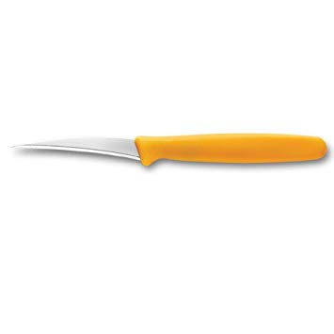
SLICING KNIFE CARVING KNIFE

Slide 5
SHARPENING STEEL KNIFE SHARPENER STELL STEEL

Slide 6
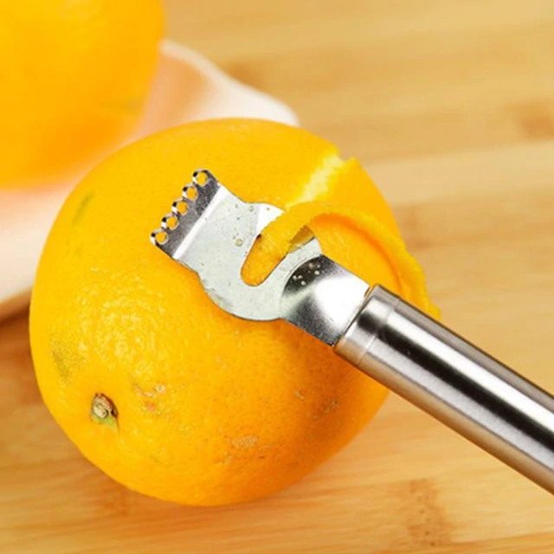
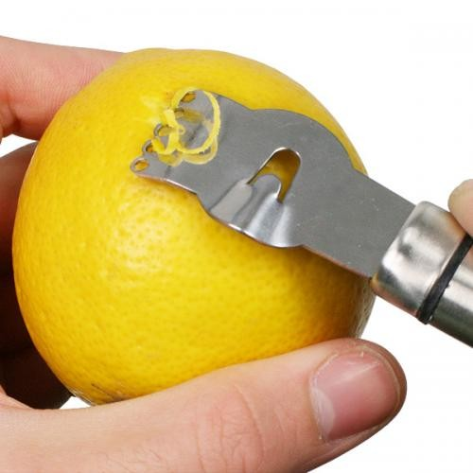
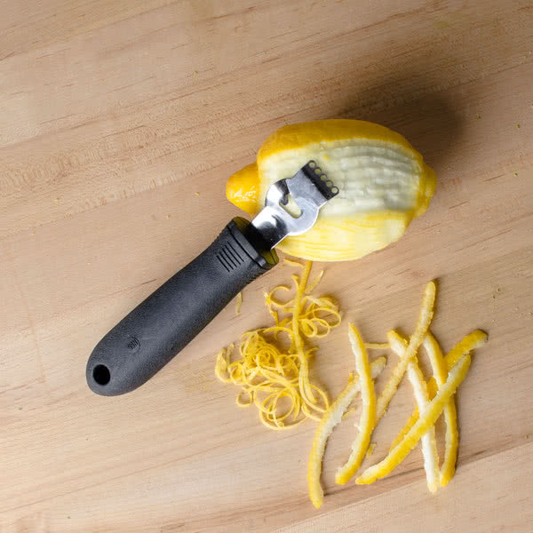
ZESTER

Slide 7
LEMON REAMER

Slide 8
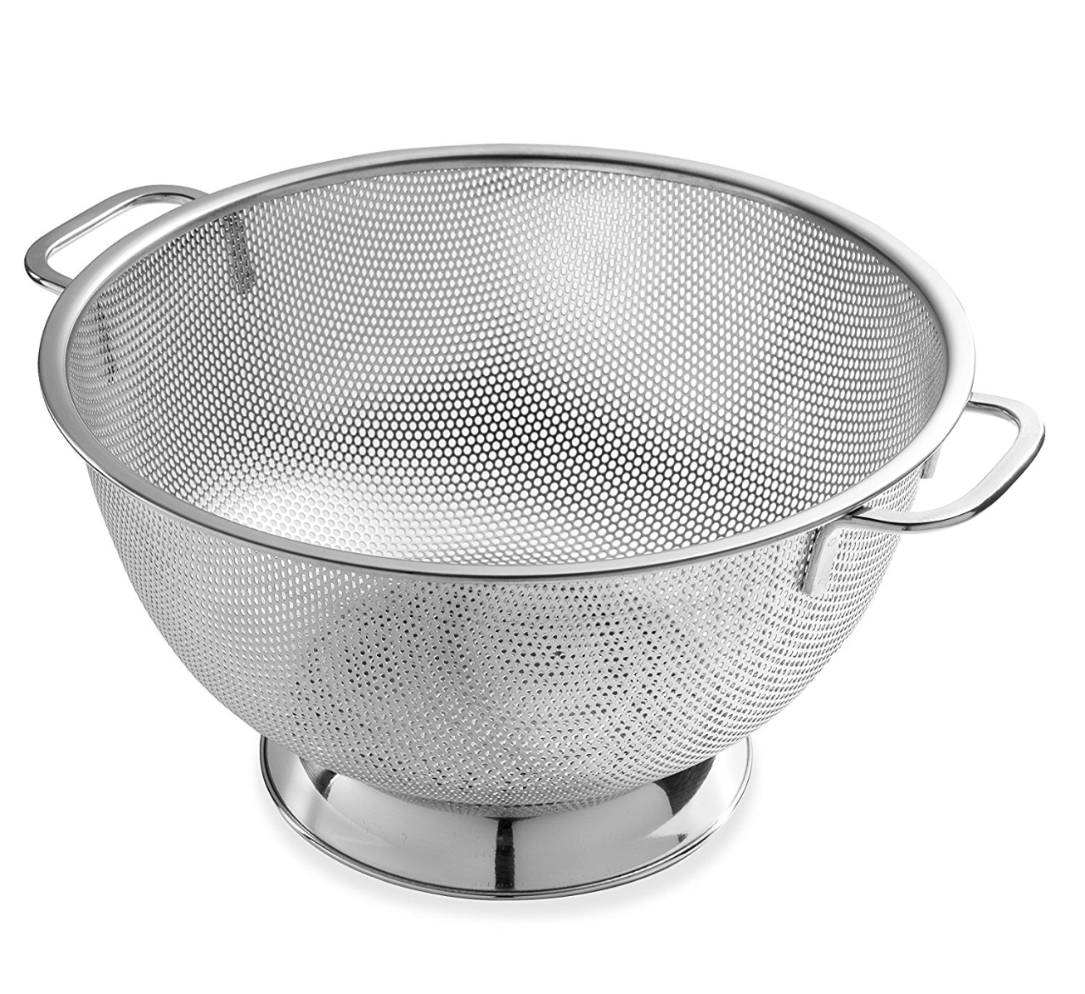
COLANDER kevgir-süzgeç

