Slide 1
ARCHEA, EUBACTERIA AND EUCARYOTIC CELLS
Prof. Dr. Fulya Tekşen

Slide 2
Living organisms are made up of seperate, independent units: CELLS
In general;
Cells of the organisms are divided into 2 groups according to their basic characteristics ;
1- Procaryotic cells
2- Eucaryotic cells

Slide 3
Cells Have Common Characteristics
Independent
Needs Energy
Has hereditary material
Replicate itself
Reproduce and gives its charesteristic properties to the offspring
Made up of proteins, lipids, carbohydrates
Has 6 basic elements C,H,O,N,P,S

Slide 4
PROCARYOTIC CELLS
These organisms do not have nuclear membrane surrounding the hereditary material, generally DNA (Deoksiribonucleic acid).
They are small in size, measuring only few micrometers.
They have a simple appearance most of them being in rod shape and spherical forms.
They can live either as independent organisms or in loosely coordinated communities.
They generally have a protein coat namely CELL WALL outside the plasma membrane

Slide 5
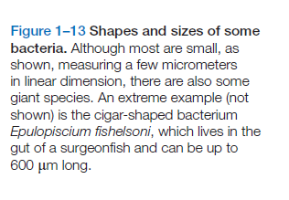
Figure 1:Shapes and Sizes of Procaryotic Cells

Slide 6
The cytoplasm contains DNA, RNA, Proteins, Small molecules needed for living, such as ribosomos, but do not have complex organelles.
They can live in various kind of places (ocean, intestine etc.) and in extreme conditions.
In order to get energy, they can use various sources of organic and inorganic molecules (CO₂, H₂S, H₂) such as sugars, amino acids, hydrocarbons etc. and to obtain ENERGY.

Slide 7
Figure 2: A Procaryotic Celli

Slide 8
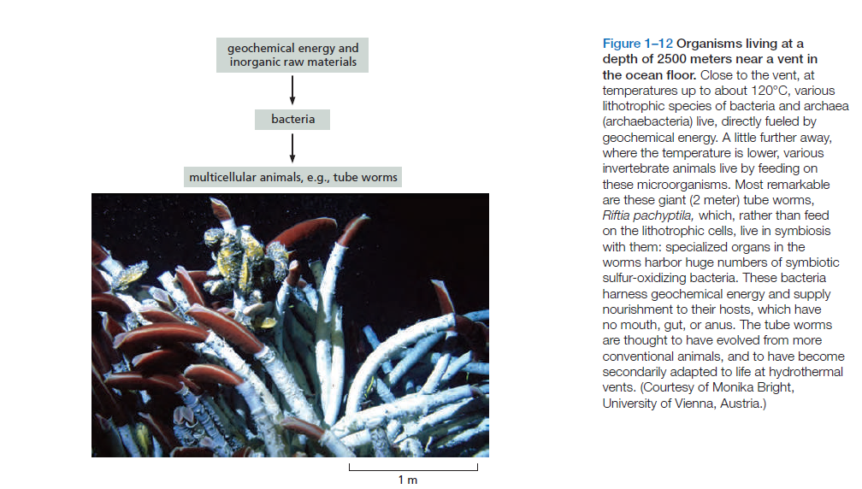
Figure 3: Archaebacteriai

Slide 9
It is interesting to know ;
The estimation showing that, there are a lot of procaryotes living on the earth to be explored.Today, it is thought that there are more than 10 million different species living on the earth and the estimated number is 100 million.
As, most of the procaryotes’ DNA analysis can be done in their natural habitats such as soil, water or even human mouth but cell culture can not be performed using todays’ laboratory techniques.

Slide 10
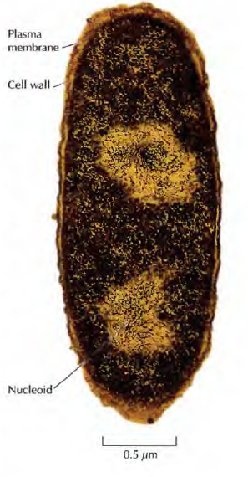
Prokaryotic cell
Figure 4: E.coli

Slide 11
EUCARYOTIC CELLS
Have nucleus
Have complex organelles such as endoplasmic reticulum, mitochondria, Golgi etc.
Divides by mitosis or meiosis
Have cytoskeleton
They are bigger than procaryotes (10-100 µm)

Slide 12
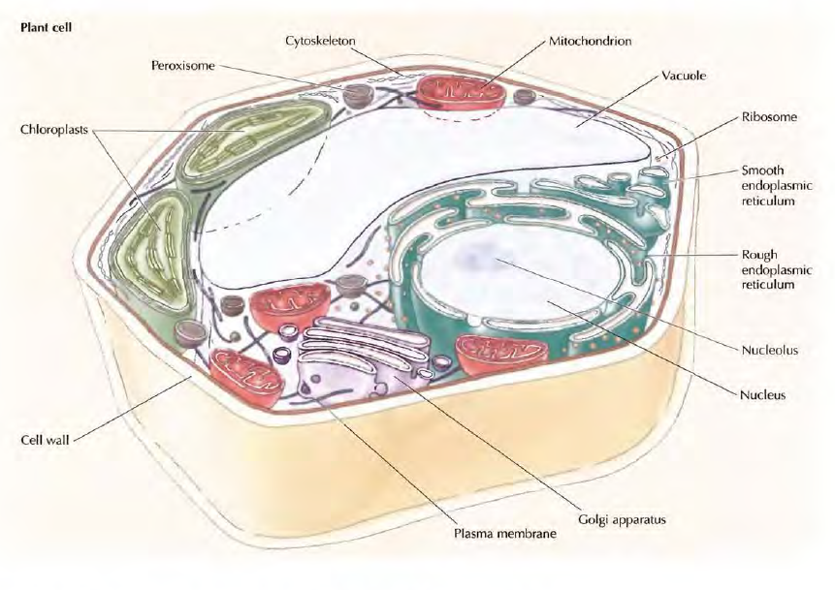
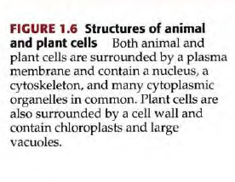
Figure 5: Animal and Plant Cell

Slide 13
ORIGIN OF CELLS
All cells are thought to evolve from a single, common ancesteral cell

Slide 14
First eukaryotic cell is thought to be formed after a particular type of ancient archeal cell enfulged in ancient bacteria.
Figure 6: Formation of Eucaryotic Cell

Slide 15
Classification of living things;
- Comparison of their outward appearances
- Biochemistry of nutritional requirements
- Genome analysis

Slide 16
The tree of life has 3 branches;
1- Archea
2- Eubacteria
3- Eucaryotes

Slide 17
ALL LIVING ORGANISMS
PROCARYOTES
EUCARYOTES
Eubacteria (Bacteria)
Archea
Plants
Animals
Fungi
Protista

Slide 18
EUBACTERIA (BACTERIA)
is found in every place with different shapes.

Slide 19
ARCHEA
are found in bogs, sewage treatment plants, ocean depts, salt brines, hot acid springs, soils, lakes and even in stomachs of cattle.
At molecular level, they are similar to eucaryotes in replication, transcription and translation; but in metabolism and energy conversion, they are more similar to bacteria.

Slide 20
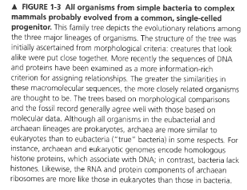
All organisms are probably evolved from a single celled progenitor;
Fig.7: Ancesteral Cell

Slide 21
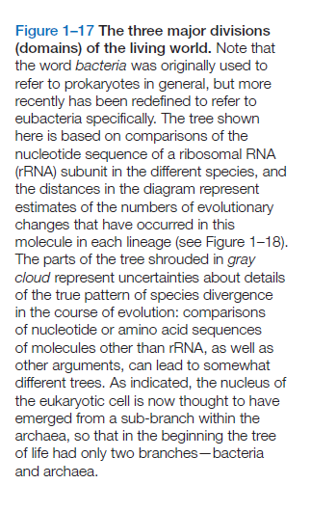
Figure 8: Another appearance,

Slide 22
Translation (RNA ------ Protein)
is FUNDAMENTAL for all living things.
For that reason, rRNA of the ribosome is highly conserved during the evolution.

Slide 23
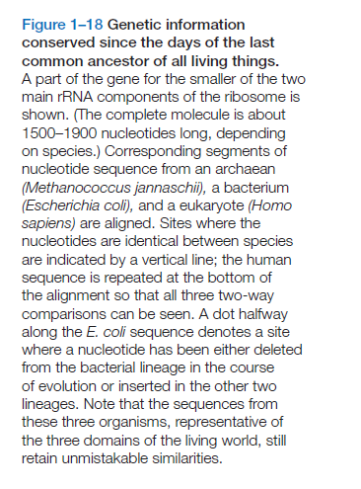
The genome analysis shows;
Figure 9: Conservation of gene in a part of rRNA

Slide 24
In the investigation of evolutinary relationship;
The genome analysis is;
Simpler
More direct
- Powerful

Slide 25
EUCARYOTES
Have 3-30 times more genes than procaryotes
and
More than thousands of non-coding DNA than procaryotes.
But in the development, some of the important genes especially related with basic metabolic functions are conserved during the evolution.

Slide 26
Figure 10: Genome size of some organisms

Slide 27
THE CHANGES IN THE GENOME
The nucleotide sequence of the genome can change due to random accidents or errors.
The changes in the genome of the organisms may be beneficial that gives them advantage to survive (Natural selection) or they may cause serious damage (Mutation).
AND….
Through the repetition of mutation and natural selection;
ORGANISMS EVOLVE.

Slide 28
Some parts of the GENE;
that does not code a protein can change more rapidly, than the parts that code essential proteins for the organisms.
As a result; the latter GENES are higly conserved and are recognizable in all living species, during the evolutionary time of 3.5 billion years.

Slide 29
For example;
rRNA of ribosome is universal in many living things such as; Human, ,E.coli and Methanococcus as the translation of RNA to protein is an essential function in living organisms.

Slide 30
An example of a conserved GENE can be seen in the figüre below;
Figure 11: Similar Genes

Slide 31
EVOLUTION OF THE GENES
In the comparison of the genesof living organisms in the tree of life, it is observed that, the DNA sequence is changed during the evolution.
And new genes are generated from pre-existing genes.

Slide 32
The innovation of the genes occurred in different ways;
- Intragenic mutation: During the DNA replication, different types of error can change the DNA sequence of the gene.
- Gene duplication: An existing gene can be accidentally duplicated and a pair of initially identical genes exist in the same cell.
- DNA segment shuffling: 2 or more existing genes break and rejoin, making a new hybrid gene.
- Horizontal transfer (Intracellular): A piece of DNA can be transferred from the genome of one cell to the other cell.

Slide 33
Figure 12: Genetic Innovation

Slide 34
HOW HOMOLOG GENES OCCUR?
The gene duplication process leads to inappropriate duplication of some part of the genome in one of the copies of genes in a single cell and, make these copies open to mutations and changes that result to differantiate to performe a quite different function from the original gene.
After many million years, analysis of the DNA sequence procaryotes reveals many examples of such families and by the duplication and divergence of genes in this way, one species become endowed with multiple variants of a primordial gene.

Slide 35
WHAT IS A HOMOLOG GENE ?
Genes both that ocur in either gene duplication (Parolog genes) or gradually become different in the course of evolution but continue to have corresponding functions in two sister species (Ortholog genes) are HOMOLOG GENES.

Slide 36
There are 2 types of HOMOLOG genes;
1- ORTHOLOG GENES: Genes in two seperate species, that derive from the same ancesteral gene in the last common ancestor of these two species are called ortholog genes.
2- PARALOG GENES: Related genes that have resulted from a gene duplication within a single genome and diverged in their function is called paralog genes.

Slide 37
Figure 13: Orthologous and Paralogous Genes

Slide 38
Genes;
can be transferred between organisms both in laboratory conditions and in nature.

Slide 39
VIRUSES
The best known example of gene transfer is done by VIRUSES, by entegrating to one species and then to another.
This kind of gene tranfser is common especially in prokaryotes.
The formation of mitochondria and chloroplasts are other examples.
The organisms also take genes from the neighbouring cells, such as the bacteria gaining resistance the antibiotics or the bacteria in the hospitals gaining resistance to various drugs.

Slide 40
Advantages and disadvantages of Unicellular organisms
Although prokaryotes are small organisms such as E.coli 25x10 ⁻¹⁴
g in weight and 1-2 µ in size, they make a huge size in human body such as
1-1.5kg of average human’s weight and a total mass of 10 ¹² kg on the earth.
There is a mutualism between bacteria and human beings.
Such as;
Human beings provide shelter and food for bacteria in the intestines and bacteria helps to the digestion of the food.
But the place of the bacteria may be pathogenic or dangerous to human beings such as the blood stream of the body or the dangerous types may cause diseases such as Vibrio cholerae, Salmonella or Mycobacterium tuberculosis.

Slide 41
COMMON GENES
There are more than 200 common genes in the living organisms comprising the 3 branches
(Archeobacteria, Eubacteria,Eucaryotes) of life tree.

Slide 42
These genes are CONSERVED GENES;
that generally take part in,
- Translation
- Amino acid Metabolism
- Transport

Slide 43
Figure15. Common Gene Families

Slide 44
FIRST EUCARYOTE
Recent genome analysis suggest that,the first eucaryotic cells formed after an archeal cell enfulged an aerobic bacterium.

Slide 45
Figure 16: Mitochondria formation

Slide 46
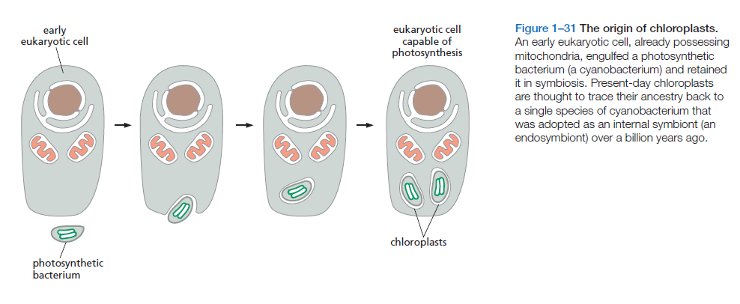
Figure 17: CHLOROPLAST Formation

Slide 47
References
Bruce Alberts, Alexander Johnson, Julian Lewis, David Morgan, Martin Raff, Keith Roberts, Peter Walter-Molecular Biology of the Cell-Garland Science (2015)
Geoffrey M. Cooper & Robert E. Hausman-The Cell. A Molecular Approach-Sinauer Associates (2007)
Harvey Lodish, Arnold Berk, Chris A. Kaiser, Monty Krieger, Matthew P. Scott, Anthony Bretscher, Hidde Ploegh, Paul Matsudaira-Molecular Cell Biology (Lodish, Sixth Edition)-W. H. Freeman (2007)

