Slide 1
Mesleki Yabancı Dil 2

Slide 2
PEELER

Slide 3
FOOD PROCESSOR

Slide 4
PITCHER WATER-BOOTLE

Slide 5
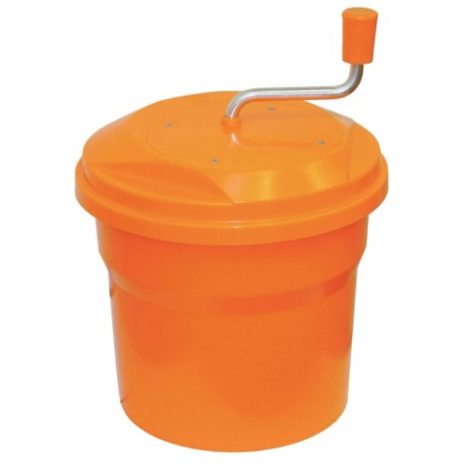
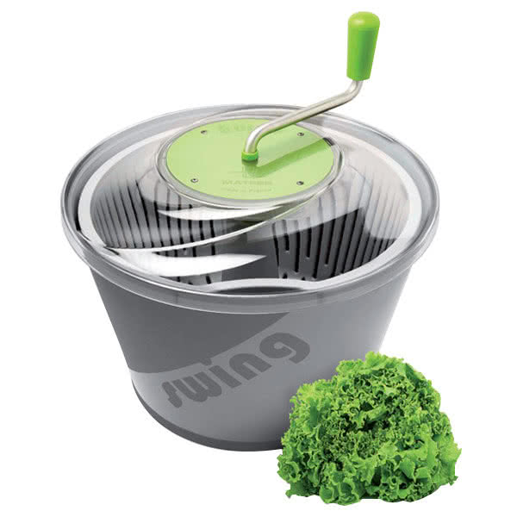
SALAD SPINNER

Slide 6
GASTRONORM PAN GASTRONORM CONTAINER GASTRONORM TRAY

Slide 7
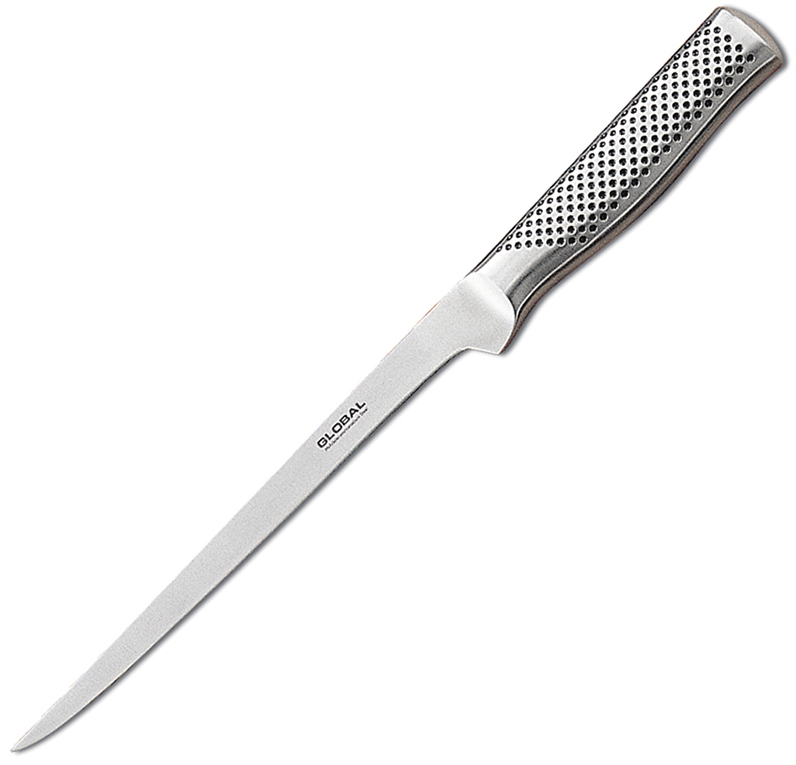
FILLET KNIFE

