Slide 1
The NERVOUS SYSTEM
-2020-
-Internal Medıcıne I-
Prof. Dr. Ebubekir Ceylan

Slide 2
FUNCTIONAL ANATOMY OF THE NERVOUS SYSTEM AND LESION LOCALIZATION
The most important step in the diagnostic evaluation of dogs or cats with neurologic signs is establishing an accurate anatomic diagnosis. A basic understanding of nervous system structure and function is essential to correctly interpret neurologic examination findings and localize lesions to clinically significant regions.
Steps in Neurologic Diagnosis
1. Describe the neurologic abnormalities.
2. Localize the lesion.
3. Describe any concurrent nonneurologic disease.
4. Characterize the onset and progression of the neurologic disease.
5. Generate a list of differential diagnoses.
6. Use ancillary tests, if needed, to make a diagnosis and gauge the prognosis.

Slide 3
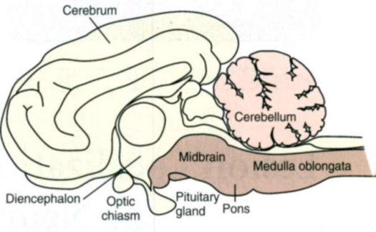
BRAIN
The brain consists of the cerebrum, the brainstem, and the cerebellum. The brainstem is further subdivided from rostral to caudal into the diencephalon (thalamus and hypothalamus), midbrain, pons, and medulla oblongata.
Neurologic abnormalities within the brain can usually be localized on the basis of clinical findings to one of three clinically important regions. These include (1) the forebrain (the cerebrum and diencephalon), (2) the pons and medulla, and (3) the cerebellum.
Regional anatomy of the brain

Slide 4
Signs Caused by Lesions in the Brain
Forebrain Lesions
Seizures
Altered mentation: depression, stupor, coma
Abnormal behavior: agitation, delirium, aggression, loss of learned behaviors
Contralateral:
Blindness with normal pupillary light reflexes
Subtle decrease in skin/facial sensation
Hemi-inattention syndrome
Normal gait
Circling , pacing towards lesion
+ / - Postural reaction deficits in contralateral limbs
Normal or increased (contralateral) spinal reflexes
Brainstem Lesions
Altered mentation: depression, stupor, coma
Multiple cranial nerve deficits (CN3-CN12, ipsilateral)
Upper motor neuron tetraparesis or hemiparesis (ipsilateral)
Postural reaction deficits ipsilateral limbs
Normal or increased (ipsilateral) spinal reflexes
Respiratory and cardiac abnormalities
Cerebellar Lesions
Normal mentation
Ipsilateral menace deficit + / -
Intention tremor
Hypermetric gait, truncal ataxia with normal strength
Normal knuckling and hopping (hypermetric ipsilateral)
Normal spinal reflexes
Possible paradoxical vestibular syndrome

Slide 5
SPINAL CORD
The spinal cord resides entirely within the bony vertebral column. It is composed of a central H-shaped core of gray matter surrounded by white matter. Spinal cord gray matter contains the cell bodies of interneurons and lower motor neurons (LMNs). White matter is composed of nerve fibers organized into columns of ascending and descending tracts.
These long tracts transmit ascending sensory information (proprioception, touch, temperature, pressure, and pain) and descending motor signals between higher centers in the brain and spinal cord neurons.

Slide 6
Lower Motor Neuron signs
The LMN is the efferent neuron that directly connects the central nervous system (CNS) to a muscle or gland. Components of spinal LMNs include the nerve cell bodies within the ventral gray matter, the axons leaving the spinal canal as ventral nerve roots and spinal nerves, and the peripheral nerves formed by the spinal nerves that terminate at the neuromuscular junction in the muscle to produce contraction. Damage to any component of the LMN will result in the appearance of LMN signs in the muscles normally innervated by that particular LMN.
LMN signs include flaccid paresis (weakness) or paralysis (loss of motor function), decreased or absent muscle tone, rapid muscle atrophy, and decreased or absent spinal reflexes. When there is damage to the sensory component of the LMN (the peripheral nerve, spinal nerve, or dorsal nerve root), there may also be a loss of sensation in the skin and limb directly supplied by that LMN.

Slide 7
Upper Motor Neuron Signs
Those motor systems originating in the brain to control the LMN are UMNs. UMNs are responsible for initiating and maintaining normal movement, regulating the muscle tone used to support the body against gravity, and inhibiting myotactic reflexes. Components of the UMN include nerve cell bodies in the cerebral cortex, basal nuclei, and brainstem as well as the motor tracts in the brainstem and spinal cord white matter, which relay information from the higher centers to the LMN . These pathways cross the midline in the rostral brainstem so that forebrain lesions result in contralateral deficits in the limbs, whereas UMN lesions of the spinal cord, pons, or medulla oblongata result in ipsilateral deficits in the limbs. Damage to the UMN nuclei or tracts will cause loss of voluntary motor function and a release of the inhibitory effect of UMNs on all LMNs caudal to the level of injury. The resultant UMN signs in all muscles caudal to the site of the lesion include spastic paresis or paralysis, increased extensor muscle tone, and normal to increased spinal reflexes.
Associated sensory signs such as ataxia and decreased sensation in the skin and limbs caudal to the lesion reflect interruption of the UMN sensory tracts responsible for mediating proprioception (position sense) and pain perception.

Slide 8
Screening Neurologic Examination
A screening neurologic examination takes only a few minutes. Abnormalities of mentation, posture, and gait are initially evaluated. Postural reactions are then evaluated. If abnormalities are detected, evaluation of muscle tone, spinal reflexes, urinary tract function, and sensory perception aids in lesion localization. Finally, cranial nerves are evaluated, and if necessary, localization of a lesion within the brain is attempted.

Slide 9
Components of the Neurologic Examination
Mental state
Posture
Gait
Paresis/paralysis
Ataxia
- Proprioceptive (UMN)
- Vestibular
- Cerebellar
Circling
Lameness
Postural Reactions
Knuckling
Hopping
Wheelbarrowing
Hemiwalking
Muscle tone and size
Spinal reflexes
Perineal reflex/anal tone
Sensory perception (nociception)
Cranial nerves

Slide 10
DIAGNOSTIC APPROACH
Once a neurologic lesion has been localized, it is necessary to generate a list of likely differential diagnoses. This list should take into account the signalment, historical data, the neuroanatomic location of the lesion, and the nature of the onset and progression of neurologic signs. It is important to consider all possible mechanisms or causes of disease that can affect the nervous system. Once a list of likely differential diagnoses has been developed, diagnostic tests can be performed to confirm or exclude each.

Slide 11
1.ANIMAL HISTORY
Patient age, gender, breed, and lifestyle may provide clues regarding the underlying disease. Young animals are most likely to be seen because of congenital or hereditary disorders; they are also at highest risk for intoxications and infectious diseases. Older animals are more susceptible to neoplastic diseases and many of the known degenerative disorders. Certain breeds are predisposed to particular disorders, and there are many congenital and inherited disorders that have been seen in only one or a few breeds. Dogs engaging in particular competitive or working activities (e.g., hunting, herding, racing, jumping) may be at increased risk for specific activity-related injuries. Potential exposure to trauma, toxins, and infectious disorders should be ascertained through careful history taking.

Slide 12
2.DISEASE ONSET AND PROGRESSION
Evaluation of the onset and progression of neurologic signs is of primary importance in prioritizing the list of differential diagnoses. The signs may be peracute and nonprogressive, or they may become progressively more severe with time. In peracute disorders the time of onset of the neurologic signs can be pinpointed exactly, with the animal going from being normal to abnormal within minutes or hours. Signs reach maximal intensity very rapidly and then remain static or improve over time. Examples include external trauma, internal trauma from intervertebral disk extrusion, vascular disorders such as infarcts or hemorrhage, and some rapid-acting intoxications such as strychnine. Rarely, animals with a typically slowly progressive disorder such as a tumor present with a peracute exacerbation of their signs as a result of hemorrhage or fracture at the site of the tumor. A thorough history will often reveal that these animals were not entirely normal before the acute deterioration.
Neurologic disorders with fairly rapid deterioration over days to weeks are classified as subacute and progressive. Infectious and noninfectious inflammatory diseases and some of the more rapidly progressive neoplasms (e.g., lymphomas, metastatic malignancies) usually fall into this category. Metabolic and nutritional disorders and some intoxications can also cause subacute progressive signs. Animals with chronic progressive signs that develop very slowly over many weeks or months are most likely to have neoplastic or degenerative disease.

Slide 13
Characterization of Disease Processes Based on Onset and Progression
Peracute (Minutes to Hours)
External trauma
Hemorrhage
Infarct
Internal trauma (disk extrusion, fracture)
Some intoxications
Subacute Progressive (Days to Weeks)
Infectious disease
Noninfectious inflammatory disease
Rapidly growing tumors (lymphoma, metastatic neoplasia)
Metabolic disorders
Some intoxications
Chronic Progressive (Months)
Most tumors
Degenerative disorders

Slide 14
3.SYSTEMIC SIGNS
Identification of concurrent systemic abnormalities may aid in the diagnosis of neoplastic, metabolic, or inflammatory nervous system disorders. A complete physical examination and ophthalmologic evaluation, including a funduscopic examination, should be performed in every animal with suspected neurologic disease. Laboratory tests and imaging modalities useful for specific evaluation of nervous system disorders are limited, so identification and characterization of associated abnormalities in other tissues can facilitate diagnosis. Ancillary diagnostic tests can then be performed to further evaluate animals with neurologic disease and thereby arrive at a specific diagnosis.

Slide 15
Diagnostic Tests for the Neural System
MINIMUM DATABASE:
Patients with disease confined to the central nervous system (CNS) often have no specific abnormalities on a minimum database consisting of a complete blood cell (CBC) count, serum biochemistry profile, and urinalysis. These tests can be useful, however, in the diagnosis of systemic disorders that have neurologic manifestations and in the identification of the clinicopathologic abnormalities associated with some primary neurologic disorders.
Hematologic findings are rarely specific, but leukocytosis suggests inflammatory disease.
A serum biochemistry profile is most useful in determining the likelihood of metabolic disorders as the cause of neuropathies, encephalopathies, and seizures.
OTHER ROUTINE LABORATORY TESTS
Additional biochemical tests, provocative ammonia tolerance testing, specific endocrine testing
IMMUNOLOGY, SEROLOGY, AND MICROBIOLOGY
Clinicians should routinely perform bacterial culture of the cerebrospinal fluid (CSF), blood, and urine in patients with inflammatory disease of the brain, spinal cord, or meninges.

Slide 16
RADIOGRAPHY
Skull radiographs are a low-yield procedure, they are often performed in animals with disease above the foramen magnum, because finding an area of lysis, a region of tumor calcification, or an intranasal mass aids in diagnosis.
CEREBROSPINAL FLUID COLLECTION
Analysis of CSF can be useful in the diagnostic evaluation of patients with CNS disease. Specific neurologic disorders often cause typical alterations in CSF cytology or protein concentration, aiding diagnosis.
CONTRAINDICATIONS
The animal is first placed under general anesthesia, and the puncture site is prepared in a sterile fashion, thereby minimizing the risk of damage resulting from animal movement and the risk of iatrogenic infections.
Spinal puncture should not be performed in an animal that is an obvious anesthetic risk or that has a severe coagulopathy.
General anesthesia and collection of CSF should not be performed in any patient with suspected increased intracranial pressure without first taking steps to lower the intracranial pressure in order to decrease the risk of brain herniation.

Slide 17
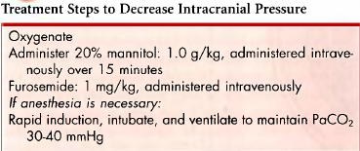
TECHNIQUE
In dogs and cats the most reliable source of CSF for analysis is the cerebellomedullary cistern. The L5-L6 site may also be used, but it is more difficult to obtain a large volume of uncontaminated fluid from this site. Although it has been stated that CSF obtained from the cerebellomedullary cistern best reflects the nature of intracranial disease, whereas fluid from a lumbar tap is more useful in characterizing spinal cord disease, diagnostically the two are not significantly different.
Cisternal Puncture
With the animal under general anesthesia, the clinician should prepare the back of its neck between the ears from the occipital protuberance to C2 for surgery.
If the clinician is right-handed, the animal should be placed in right lateral recumbency with its neck flexed so that the median axis of the head is perpendicular to the spine.
The nose should be elevated slightly so that its midline is parallel to the surface of the table. With the thumb and third finger of the left hand, the clinician should palpate the cranial edges of the wings of the atlas and draw an imaginary line at their most cranial aspect.

Slide 18
The examiner can then use the left index finger to palpate the external occipital protuberance and draw a second imaginary line caudally from that site along the dorsal midline. The needle should be inserted where the two imaginary lines intersect.
While the right hand is used to remove the stylette, the thumb and
first finger of the left hand, which is rested against the spine for support, should grasp and stabilize the hub of the needle.
A sudden "pop" may be felt as the dorsal atlantooccipital membrane and the dura mater and arachnoid mater are penetrated simultaneously. This is not a reliable sign, however, and the level at which the subarachnoid space is reached varies greatly with the breed and individual animal. It is often very close to the skin surface in toy breeds and some cats.
If the needle strikes bone, it should be withdrawn, the patient position and landmarks reassessed, and the procedure repeated.
If whole blood appears in the spinal needle, the needle should be withdrawn and the procedure repeated with another sterile needle. When CSF is observed, the fluid should be allowed to drip directly from the needle into a test tube.
The amount of CSF collected ranges from 0.5 to 3 ml depending on the size of the animal. Simultaneous jugular vein compression may hasten flow but will transiently increase intracranial pressure.

Slide 19
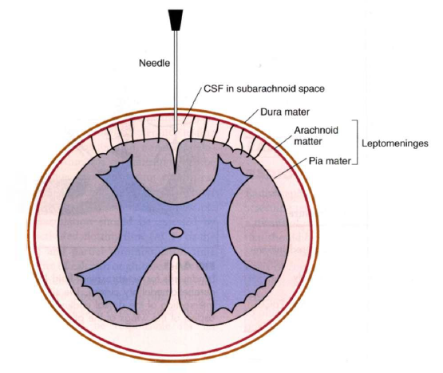
Blood in the CSF may be the result of the disease or of the tap. If it is caused by the procedure, the amount of blood should decrease as the CSF drips from the needle. If this occurs, some of the less contaminated fluid should be collected in a second tube for cytologic evaluation.
Grossly hemorrhagic CSF should always be collected into a tube containing ethylenediaminetetraacetic acid (EDTA) to prevent clotting.

Slide 20
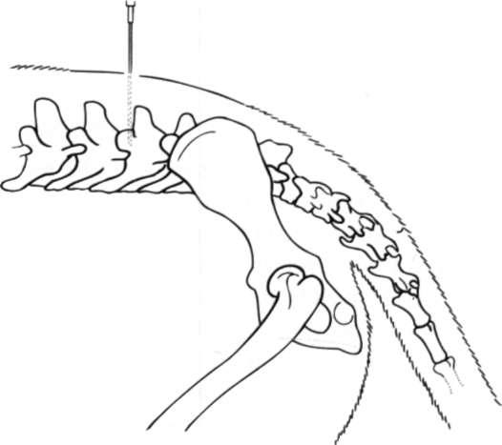
Lumbar Puncture
The animal is placed in lateral recumbency with its trunk flexed. Foam cushions are placed between its limbs and beneath the lumbar region to achieve true lateral positioning.
A 3.- i n c h (8.75-cm) spinal needle is inserted on midline at the cranial edge of the dorsal spinal process of the L5 or L6 vertebra and directed ventrally into the ligamentum flavum.
The needle is passed i n a smooth motion through or alongside the caudal spinal cord and cauda equina into the ventral subarachnoid space. The animal's tail and pelvic limbs may twitch when the cord is penetrated.
Because CSF flow is slower from this site and more likely to be contaminated by blood, cerebellomedullary collection is usually preferred for diagnostic purposes.

Slide 21
ANALYSIS
Normal CSF is clear and colorless. A cell count should be performed and a cytologic preparation made for examination as soon as possible because white blood cells (WBCs) in the CSF deteriorate rapidly. If the sample must be stored for longer than 1 hour before analysis, the specimen should be refrigerated to slow cellular degeneration.
The addition of autologous serum (10% by volume of the sample) will preserve CSF so that cytologic analysis 24 to 48 hours after collection will yield reliable results, but a separate sample must be saved for protein analysis. Alternatively, one drop of buffered 10% formalin can be added for each 0.25 ml of CSF to preserve cytologic features without affecting the protein measurement.
Once the fluid is collected, a total cell count is performed and the concentration of RBCs and WBCs is determined. Cytologic analysis of CSF is necessary even if the W B C count is normal because there may be abnormal cell types or organisms present.
Whenever the CSF is cellular, it should be submitted for Gram's staining and anaerobic and aerobic bacterial culture.
If infectious disorders are considered likely, specific culture techniques can be applied or, when available, PCR can be used to identify infectious agents in CSF.
Antibody titers to a variety of infectious organisms can be measured in CSF, but leakage of antibodies from the serum to the CSF can be problematic.
An immunogolobin G (IgG) index greater than 1 indicates that there is significant intrathecal production of immunoglobulin.
Comparison of CSF and serum titers against a specific organisms can be performed, with a C-value greater than 1 indicating active CNS infection with an organism.

Slide 22
Interpreting Cerebrospinal Fluid Cytology:
Normal: Cell Count <5 White Blood Cells/μl; Protein <25 mg/dl
Normal cell count and differential; slightly increased protein
Extradural spinal cord compression (disk, tumor, malformation)
Brain neoplasia
Degenerative myelopathy
Fibrocartilagenous embolism
Trauma
Polyradiculoneuritis
Lymphocytic Pleocytosis
Viral meningitis/encephalitis (rabies, distemper)
Necrotizing meningoencephalitis (Pugs, Malteses, Yorkshire
Terriers)
Feline polioencephalomyelitis
Central nervous system lymphoma
Mixed Cell Pleocytosis (>50 White Blood Cells/μl; Lymphocytes, Mononuclear Phagocytes, Neutrophils, Plasma Cells)
Canine granulomatous meningoencephalitis
Protozoal infection (neosporosis, toxoplasmosis)
Rickettsial infection (ehrlichiosis, Rocky Mountain spotted fever)
Feline infectious peritonitis meningoencephalitis Lyme neuroborreliosis
Fungal meningoencephalitis (Blastomycosis, Cryptococcosis, Aspergillosis)
Neutrophilic Pleocytosis
Bacterial meningoencephalitis
Fungal meningoencephalitis (Blastomycosis, Cryptococcosis, Aspergillosis)
Steroid responsive meningitis artertis
Rocky Mountain spotted fever
Feline infectious peritonitis meningoencephalitis
Lyme neuroborreliosis
Meningioma
Postmyelographic irritant meningitis
Eosinophilic Pleocytosis
Steroid-responsive eosinophilic meningitis (usually Golden Retrievers)
Parasite migration
Protozoal infection
Fungal meningoencephalitis

Slide 23
ADVANCED DIAGNOSTIC IMAGING
MYELOGRAPHY
In animals with clinical evidence of spinal cord disease or compression, myelography may be used to confirm, localize, and characterize lesions. This procedure is particularly valuable for identifying compression of the spinal cord by herniated disks or tumors. Myelography is rapid and is more readily available and less expensive than other advanced imaging techniques, such as computed tomography (CT) and magnetic resonance imaging (MRI), but it is also associated with a higher rate of complications.
To perform myelography, the clinician anesthesizes the animal and injects a nonionic contrast material into the subarachnoid space at the atlanto-occipital or lumbar (L5/6 or L4/5) space. The contrast material most commonly used for this purpose is iohexol (Omnipaque; Nycomed).
Lumbar myelography is performed with the needle at the L5/L6 (large dogs) or L6/L7 (small dogs and cats) site. Needle insertion is as described for lumbar CSF collection, with the bevel of the needle oriented cranially. Once the needle is in place, a small test volume (0.2 ml) of contrast medium should be injected and lateral radiography or fluoroscopy performed to make sure the injection is not directed into the spinal cord parenchyma.
Seizures occasionally occur in animals recovering from anesthesia after myelography. These seizures can usually be controlled with diazepam (5 to 20 mg, administered intravenously).
A normal myelogram will show contrast material filling the subarachnoid space. This appears as a column of contrast agent on each side of the cord on ventrodorsal views and in the ventral and dorsal columns on lateral views.

Slide 24
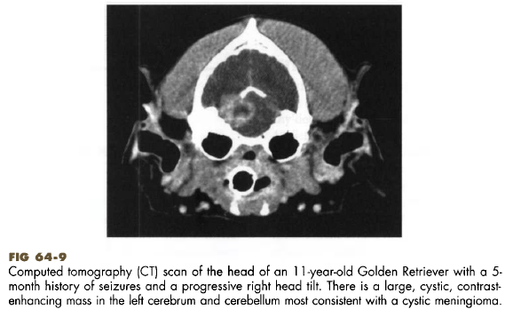
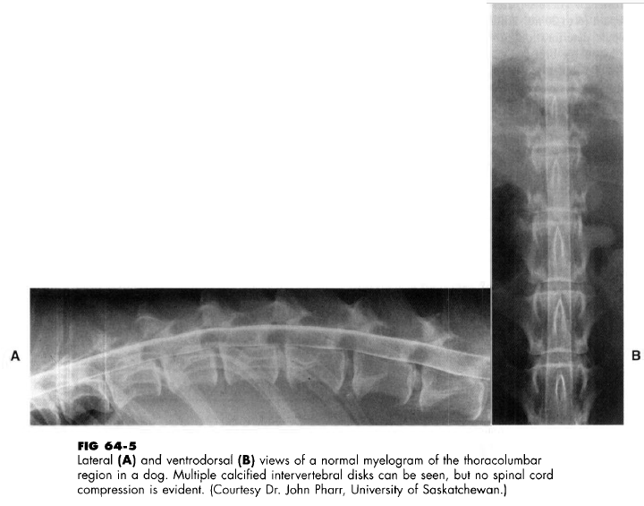

Slide 26
ULTRASONOGRAPHY
This modality can provide valuable information in the diagnostic evaluation of patients with neurologic disease.
COMPUTED TOMOGRAPHY AND MAGNETIC RESONANCE IMAGING
These techniques allow precise topographic mapping of lesions, making them valuable tools in the evaluation of compressive lesions of the brain, spinal cord, or cauda equina when surgery is being considered.
ELECTRODIAGNOSTIC TESTING
Electrophysiologic studies can be used to record electrical activity from muscle or neural tissue and aid in lesion localization and characterization.
ELECTROMYOGRAPHY
Electromyography (EMG) is most useful to confirm a suspected diagnosis of a muscle or peripheral nerve disorder and to identify abnormal muscles for subsequent biopsy.
NERVE CONDUCTION VELOCITIES
The conduction velocity of motor nerves can be determined by stimulating a nerve at two separate sites and recording the time it takes for an evoked muscle potential to occur.
ELECTRORETINOGRAPHY
An electroretinogram (ERG) is a recording of the electrical response of the retina to a flashing light stimulus.
BRAINSTEM AUDITORY EVOKED RESPONSE
The brainstem auditory evoked response (BAER) depicts the response of nervous tissues to an auditory stimulus (a click).
ELECTROENCEPHALOGRAPHY
Electroencephalography provides a graphic record of the spontaneous electrical activity of the cerebral cortex.

Slide 27
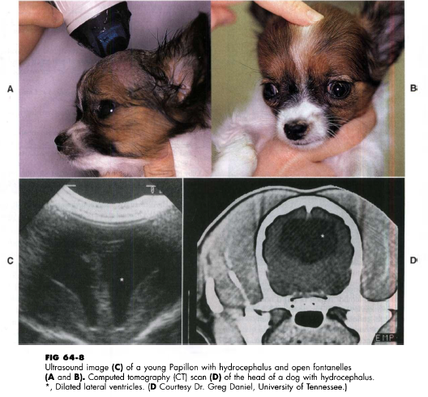

Slide 28
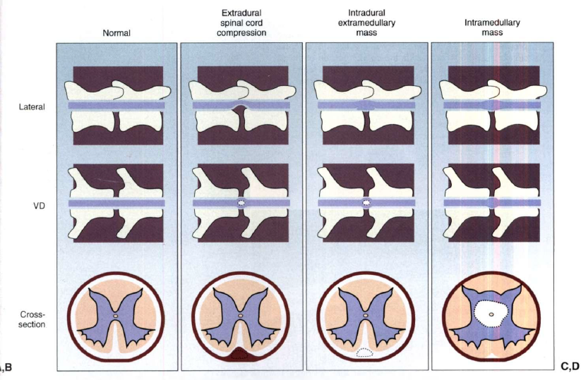
The myelographic appearance of extradural, intradural-extramedullary, and intramedullary spinal cord masses. A, Normal myelogram. B, Ventral extradural spinal cord compression. The leading edge of the contrast material tapers toward the spinal cord, a w a y from the bone on the lateral view. The dorsal column is thinned in this region. On the ventrodorsal view the spinal cord appears widened or flattened, resulting in narrow columns of contrast material. C, Ventral intradural, extramedullary spinal cord compression. The leading edge of the contrast material expands and outlines the lesion, tapering toward the spinal cord and toward the bony margin of the osseous canal, resulting in a filling defect at the site of the lesion and the appearance of a "golf tee sign . " On the ventrodorsal view the spinal cord appears widened or flattened, resulting in narrow columns of contrast material. D, Intramedullary mass or swelling. The leading edges of the contrast material taper toward the bony margin of the osseous canal on both views, with diverging columns of contrast material indicating spinal cord enlargement.

Slide 29
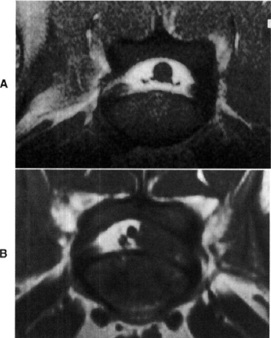
NERVE BIOPSY
It may be useful to obtain nerve biopsy specimens in an effort to evaluate peripheral nerve disorders.
Nerves are biopsied by transecting approximately one third of the width of the nerve and removing fascicles about 1 cm in length, leaving most of the nerve trunk intact.
Samples should be laid out on a piece of wooden tongue depressor and pinned at each end to keep them oriented longitudinally, but they should not be stretched.
They should then be fixed in 2.5% glutaraldehyde or buffered 10% formalin for light microscopy. Fresh nerve samples can be frozen in liquid nitrogen and stored for biochemical analysis.
Magnetic resonance imaging (MRI) scans (transverse T1 images) of the caudal lumbar region of (A) a normal dog and (B) a Golden Retriever with prolapsed disk material within the vertebral canal.

Slide 30
Intracranial Disorders
When the neurologic examination suggests that a lesion is
located above the foramen magnum, a variety of disorders should be considered as differential diagnoses. Some of these disorders typically affect only one particular region of the brain, such as the forebrain or the cerebellum, whereas others can affect any location within the brain.Altered mentation is the most prominent disorders.

Slide 31
ALTERED MENTATION
These clinical sign are seen in dogs and cats with lesions of the cerebral
cortex and with intoxications or metabolic encephalopathies.
Abnormal behavior
Delirium
Compulsive behavior
Seizures
Severe depression
Stupor
Coma
can also be seen in ‘’disorders affecting the brainstem’’
Firstly, to detect the disorder, clinicians consider the history of animals.They must check whether the problem is purely behavioral, the result of systemic illness or an indication of an intracranial lesion so that neurological problem can be identified much more easy.

Slide 32
Some unilateral forebrain lesions cause;
Animals turn or circle toward the side of the lesion
Ignore all sensory input (touch, seeing, and hearing) on the side opposite the lesion (hemi-inattention syndrome)
Postural reaction deficits on the side opposite
the lesion, little gait abnormality
Brainstem lesions typically cause ;
Altered consciousness
Multiple cranial nerve deficits
Ipsilateralupper motor neuron (UMN) paresis
Ataxia
Postural reaction deficits.

Slide 33
INTOXICATIONS
Intoxication with household toxins, insecticides, rodenticides, and prescription or illicit drugs must be considered in any dog or cat with an acute onset of abnormal mentation.
Common toxic agents causing mentation changes and seizures in dogs and cats include strychnine, metaldehyde, chlorinated hydrocarbons, organophosphates, lead, and ethylene glycol.
Treatment must be initiated to remove the toxin, prevent further
absorption, and expedite its elimination. Intoxications resulting in seizures also require emergency treatment for
seizures, as described for status epilepticus
The clinical signs of intoxication are
usually acute and severe, with rapid deterioration.

Slide 34
METABOLIC ENCEPHALOPATHIES
Metabolic disturbances such as ;
hepatic encephalopathy
hypoglycemia
severe uremia
electrolyte disturbances
hyperosmolality (e.g., untreated diabetes mellitus)
must be evaluated to detect the reason of altered mentation.
Depressed mentation can also appear because of severe systemic illness, sepsis, hypoadrenocorticism or hypothyroid myxedema coma.

Slide 35
REFERENCES
-Small animal internal medicine / [edited by] Richard W. Nelson, C. Guillermo Couto.—4th ed.

