Slide 1
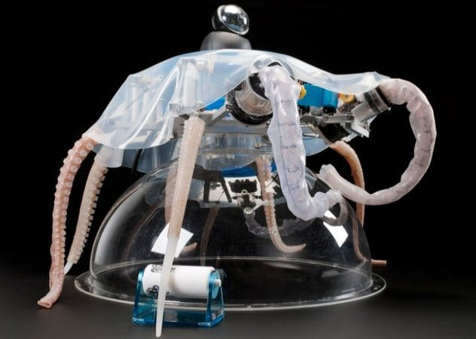
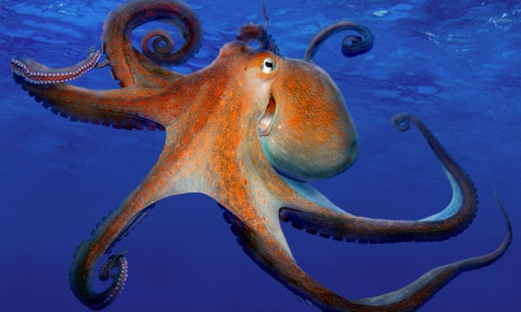
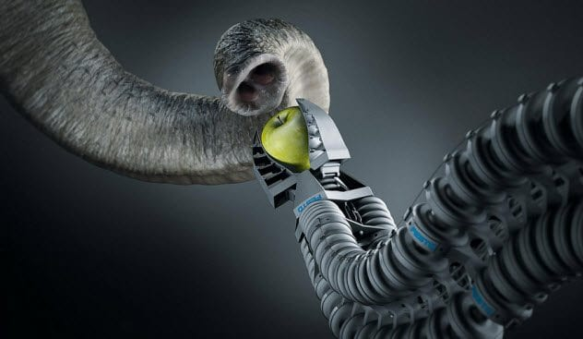
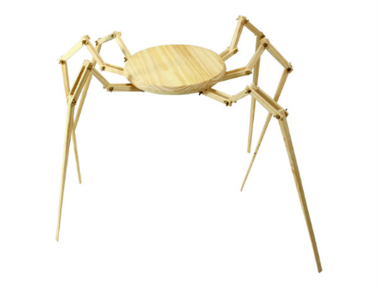
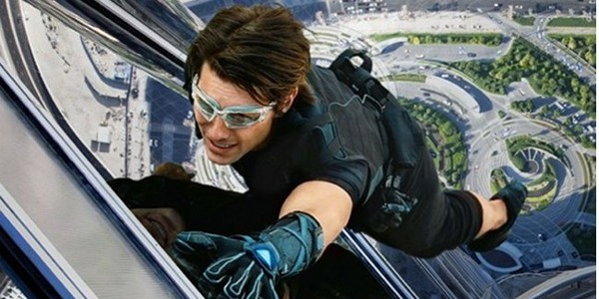
Inspiration from other Animals
Dr. Arzu GÜRSOY ERGEN
Science Faculty
Biology Department

Slide 2
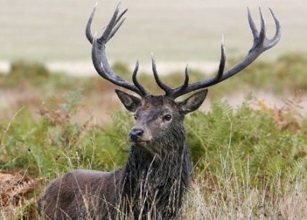
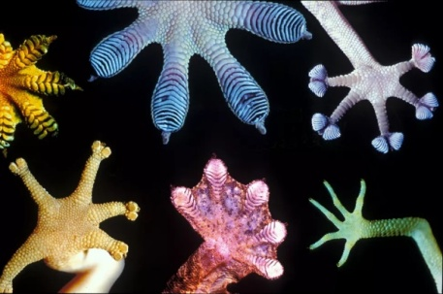
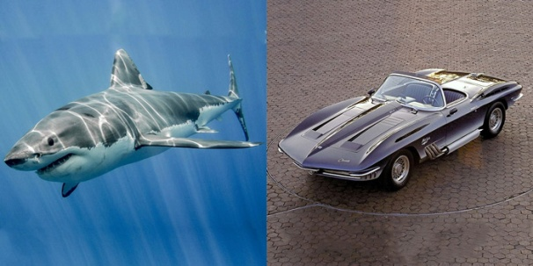
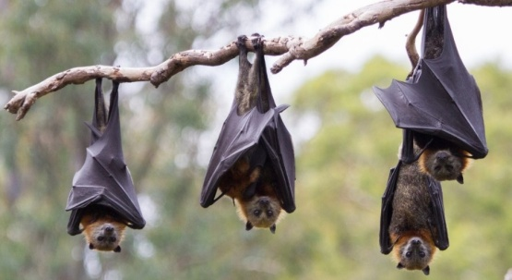
Gecko & its amazing climbing properties
A Robotic Arm Like an Elephant Trunk
Bats, echo waves & a walking cane for the blind
Sharks & swimsuits
Material based on sharkskin stops bacterial breakouts
Mercedes-Benz, the boxfish & the car
Dolphin inspired Tsunami warning system
Radar/Sonar System-Dolphins-Bats
Wale fin & green energy solution
The Road Shark = Corvett
Snowshoe = Hare
Mussels: Adhesives
Squishy Robots Octopus
Spiders webs
Cat eye = Car lights = Reflector

Slide 3
Squishy Robots Octopus
Who said that robots have to be hard and metallic?
A team of researchers from Italy discovered the advantages of an octopus’ squishy body. With the abilities to swim, hold objects, and crawl, the octopus robot uses a lot less computing power to function.
Instead of moving in mathematically predictable ways like hard-bodied machines, octopus robots shrink, undulate, and curl. They lack rigid limbs and fixed joints, which is a benefit.
Other robots modeled after solid skeletons require careful programming and other work to keep them from smacking into objects.
They also have a tendency to become erratic, even dangerous, around humans and new terrain.
Soft robots are much safer. They can twist themselves into new shapes and adjust well to their surroundings.
With such forms, it is possible for them to rescue trapped people, interact with us, and function with no previous programming.

Slide 4
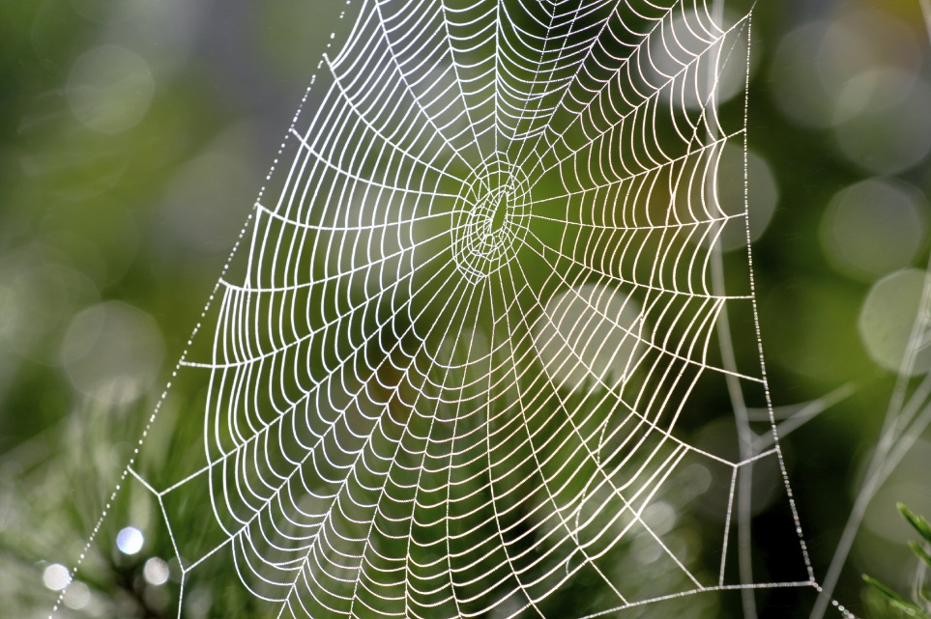
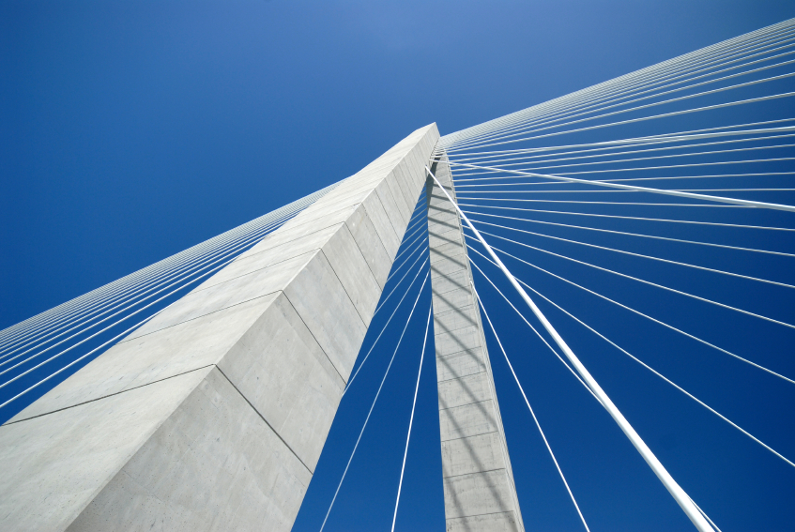
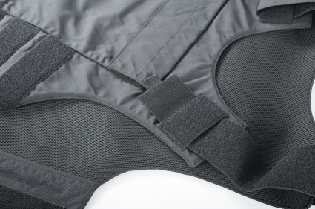
Spiders webs
Spiders webs are unique in that the individual threads are very thin, yet very very strong.
Spider silk is known to be one of the strongest materials in nature, being five times stronger than steel by weight
So strong infact that a large creature like a spider can walk across them without breaking them.
Spider webs are common on all continents and designers and engineers are been inspired by them to create… Bullet Proof Vests Suspension Bridges Parachute Lines
Products inspired by the spider web use the strong material structure (the vest) and the design of the web (the bridge) to create strength with very little material.

Slide 5
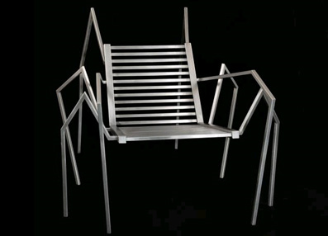
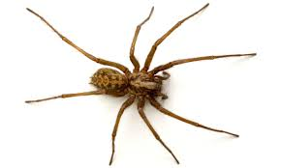
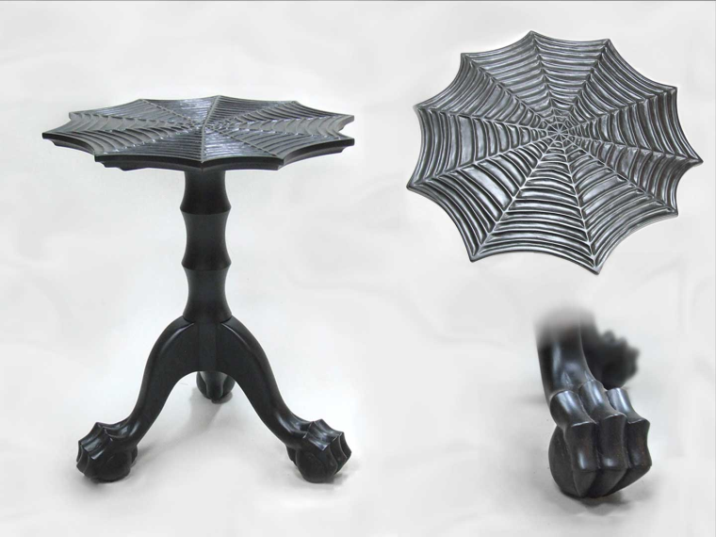
Design furniture inspired by a spider

Slide 6
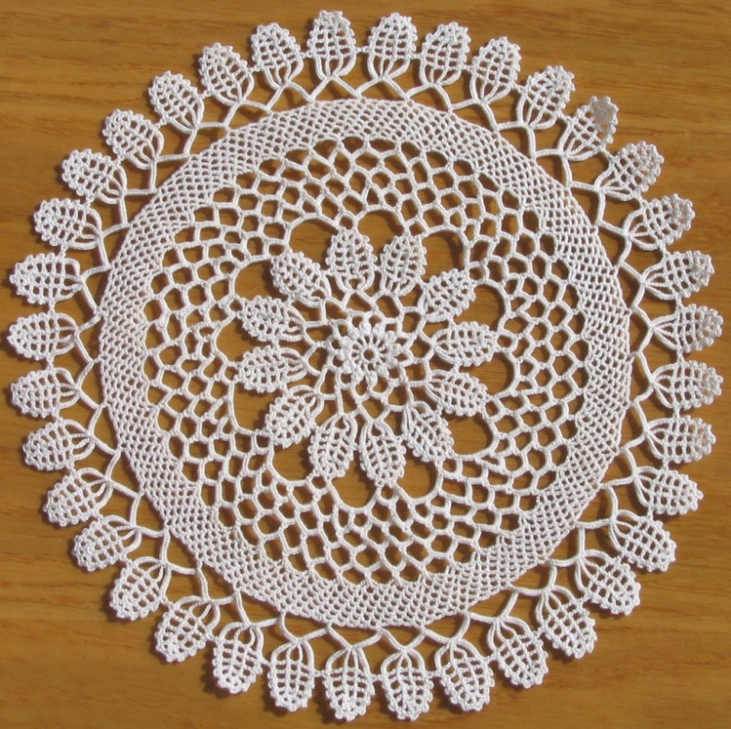
Spider web – Lace ☺

Slide 7
Biomimicry
Designer:
What is the product made from?
How has the product been ‘inspired by nature’?
Level 1
Level 2
Level 3
How is the product designed for the whole cycle (product in a system)?
Image/s

