Slide 1
Diplomatik Yabancı Dil V
Prof. Dr. Funda Keskin Ata
Arş. Gör. Tuğba Yürük

Slide 19
Kavramlar/ Concepts
Self-help
Anarchy
Balance of power
Security dilemma
National capability
Constrained choice
Bandwagoning
Miscalculation

Slide 22
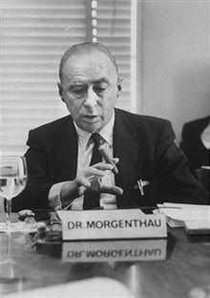

Slide 23
Robert Keohane, After Hegemony, Princeton University Press, (NJ, 1984) p. 244.

Slide 25
Kavramlar
Inalienable rights
Harmony of interests
Cooperation
Institutionalism
Interdependency
Democratic peace theory

